Slide 1

Exercise
Your
Imagination

Slide 2

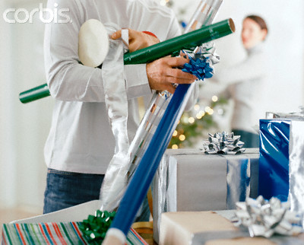

Scenario 1

Slide 3
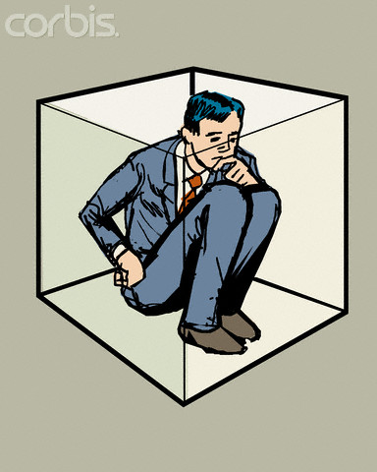
Caring
Notes:
I just want to show that a man is put in the box and then we put a label on it. The label should read “CARING PERSON”

Slide 4
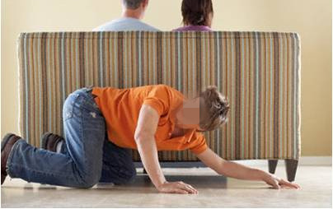
Scenario 2

Slide 5
Sneaky
Notes:
I just want to show that a man is put in the box and then we put a label on it. The label should read “CARING PERSON”

Slide 6
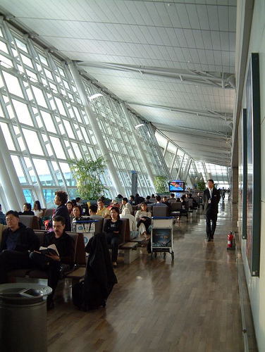
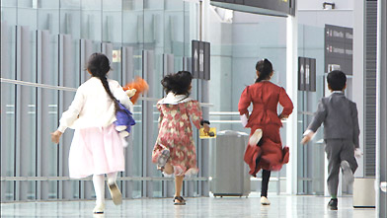
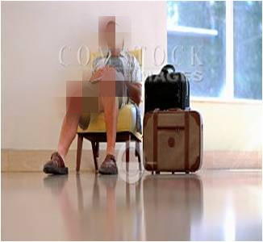
Scenario 3

Slide 7
Indifferent father & rowdy children
Notes:
I just want to show that a man is put in the box and then we put a label on it. The lable should read “CARING PERSON”

Slide 8
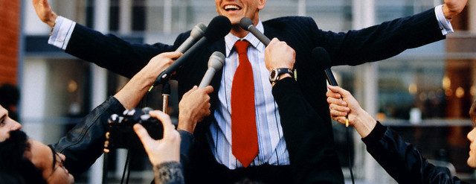
Scenario 4

Slide 9
Celebrity
Notes:
I just want to show that a man is put in the box and then we put a label on it. The lable should read “CARING PERSON”

Slide 10
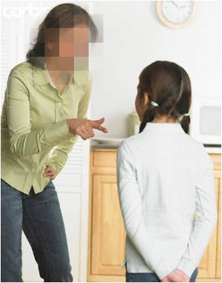
Scenario 5

Slide 11
Angry mother
Notes:
I just want to show that a man is put in the box and then we put a label on it. The lable should read “CARING PERSON”

Slide 12
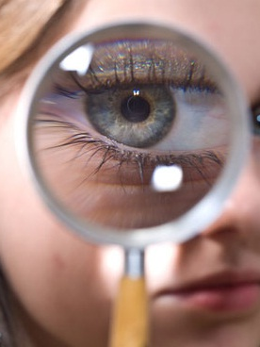
Lets evaluate our handiwork

Slide 13

Caring Person?
Notes:
I just want to show that a man is put in the box and then we put a label on it. The label should read “CARING PERSON”

Slide 14
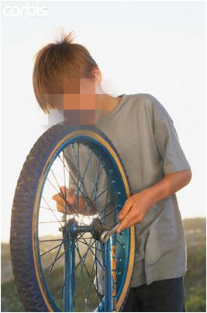
Sneaky?
Notes:
I just want to show that a man is put in the box and then we put a label on it. The label should read “CARING PERSON”

Slide 15
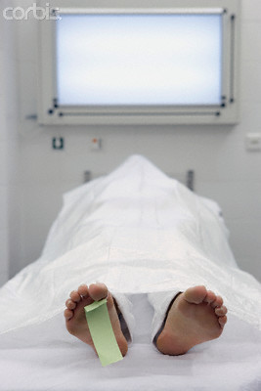
Indifferent father and rowdy children?

Slide 16
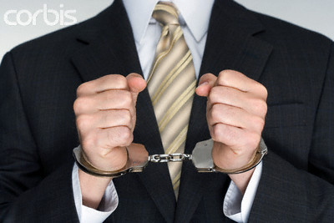
Celebrity?
Notes:
I just want to show that a man is put in the box and then we put a label on it. The label should read “CARING PERSON”

Slide 17
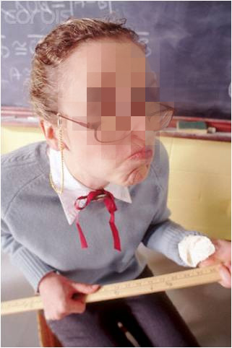
Angry mother?

Slide 18

Don’t put people in boxes
They are not objects
Notes:
We don’t know what happens in people’s hearts and minds, We don’t always have the entire context, the background. Therefore it is not our place to judge anyone. Allah is the only Judge.

Slide 19
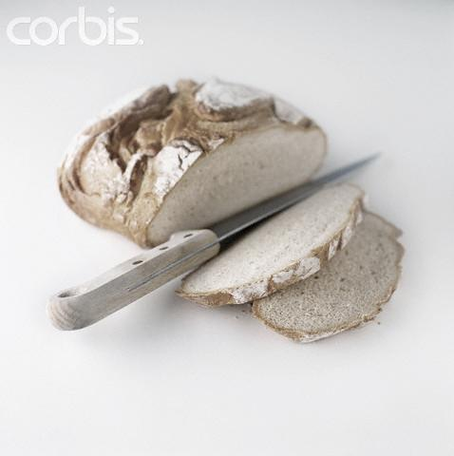
“No matter how thin a slice you cut, it will always have two sides.”

Slide 20

Make 70 excuses when a bad thought enters your mind about a Muslim brother.

Slide 21
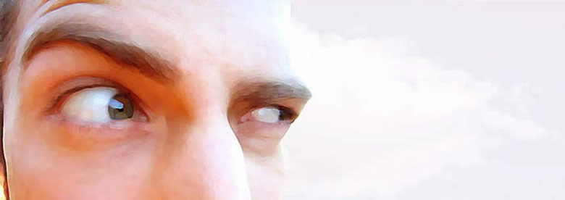
“O you who believe! Avoid much suspicions; indeed some suspicions are sins.” [Surah Al Hujrat 49: verse 12]

Slide 22

Lazy

Slide 23
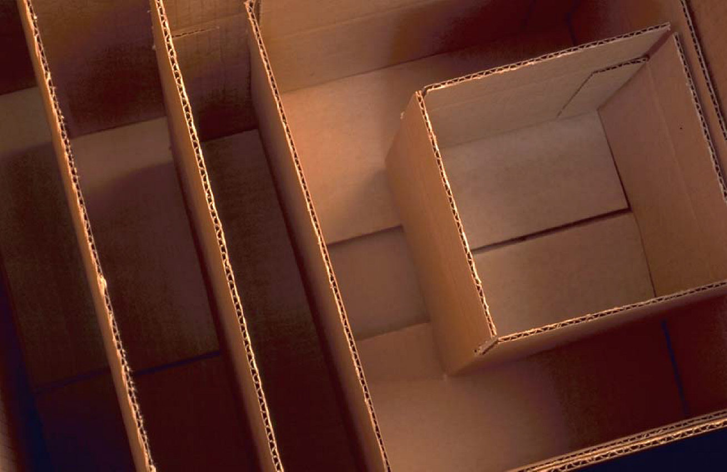
Feelings inside the box?
Depressed
Dejected
Claustrophobic
Scared
Hopeless
Uncomfortable

Slide 24
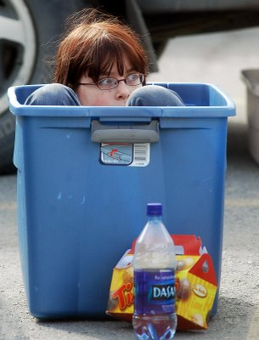
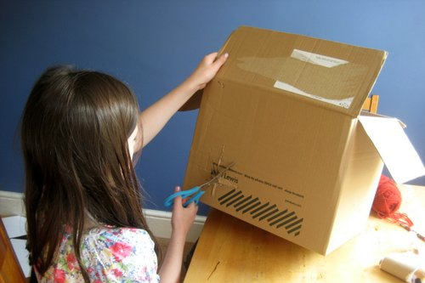
Two types of boxes
Created by self
Created by others

Slide 25
Created by others
Think objectively
Put your feelings aside
Analyze the label
Accept or reject
Forgive and forget
Move on with life

Slide 26
Created by Self
Difficult to identify
“ I can’t ……”
Accept that you have put yourself in the box
Know that Allah (swt) has made life as a challenge
Believe that you are the best creation of Allah (swt)
Believe that you can do better
Take small steps towards your goal
Give your best
Focus on your efforts and not on the result
Know that your efforts will be eventually rewarded
Make lots of duas & seek guidance & help from Allah (swt)
Notes:
Difficult to identify
“ I can’t ……”
Accept that you have put yourself in the box
Know that Allah (swt) has made life as a challenge
Believe that you are the best creation of Allah (swt)
Believe that you can do better
Take small steps towards your goal
Give your best
Focus on your efforts and not on the result
Know that your efforts will be eventually rewarded
Make lots of duas & seek guidance & help from Allah (swt)

Slide 27

Evaluate the label & make required changes
Angry

Slide 28
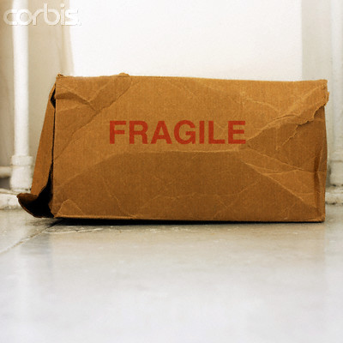
Realize that it is a very feeble box

Slide 29

You can break out of it

Slide 30
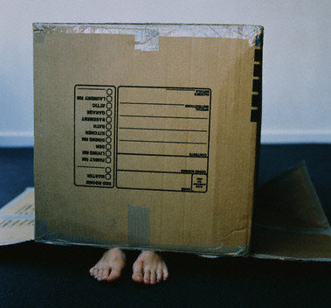
Don’t keep yourself in the box created by others or by your own self

Slide 31
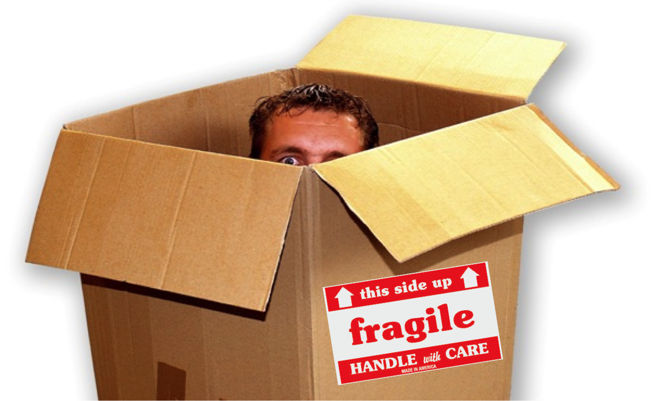
What is the harm in putting a bad label on someone?

Slide 32
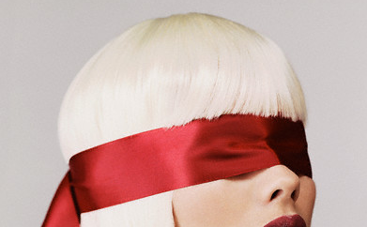
You are unable to see that person’s good points

Slide 33
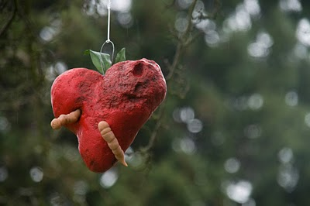
Allah (swt)doesn’t stay in hearts that have bad thoughts for others
Notes:
That is just something that we can’t afford! We’ll be too vulnerable without Allah’ protection.

Slide 34
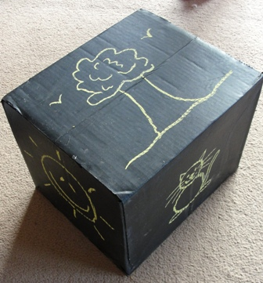
What is the harm in putting a good label on someone?
Friendly & Fun

Slide 35
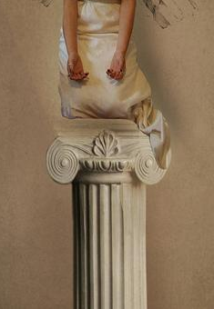
We put them on a pedestal

Slide 36
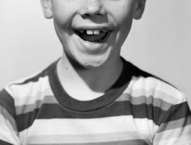
Our expectations become high

Slide 37
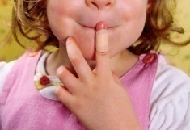
They can make mistakes

Slide 38
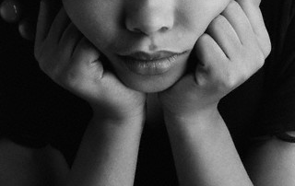
We get disappointed

Slide 39
Lessons
I can make mistakes
Others can make mistakes
Tolerance

Slide 40

Make excuses for others but NOT for yourself
Realize that it is not your right to make mistakes
You should do your utmost to avoid them

Slide 41

Think outside the box
Notes:
Don’t put others in the box and
don’t be in the box yourself
Look beyond the obvious
Don’t put others in the box and
don’t be in the box yourself
Look beyond the obvious

Slide 42
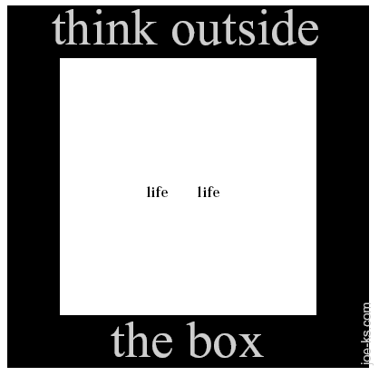
Notes:
Note to teacher: show slides 41 – 48 one by one and ask students to think outside the box and guess what is being said. Then show/explain the answer to them.
“Life is too short”

Slide 43
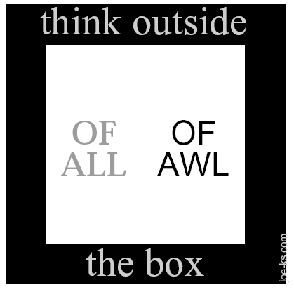
Notes:
“Pair of overalls”

Slide 44
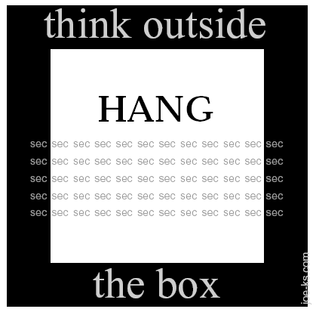
Notes:
“Hang on one minute.”

Slide 45
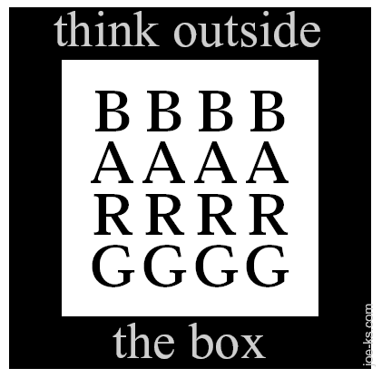
Notes:
“Up for grabs”

Slide 46
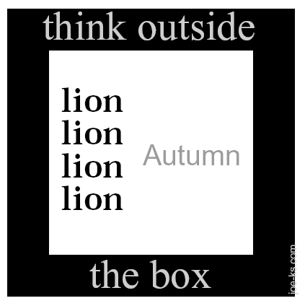
Notes:
“Pride goes before the fall.”

Slide 47
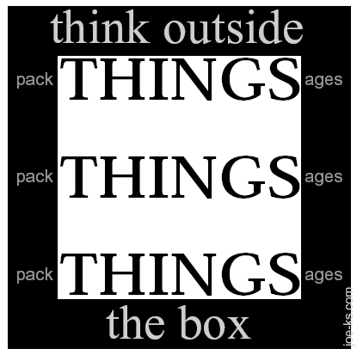
Notes:
“Great things come in small packages.”

Slide 48
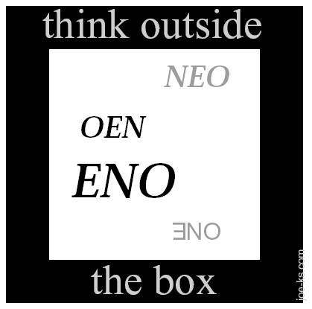
Notes:
“No one’s perfect.”

Slide 49
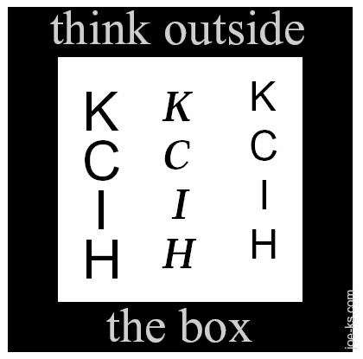
Notes:
“hiccups”

Slide 50

Operating Certainty
Everyone is sound and free of error

Slide 51
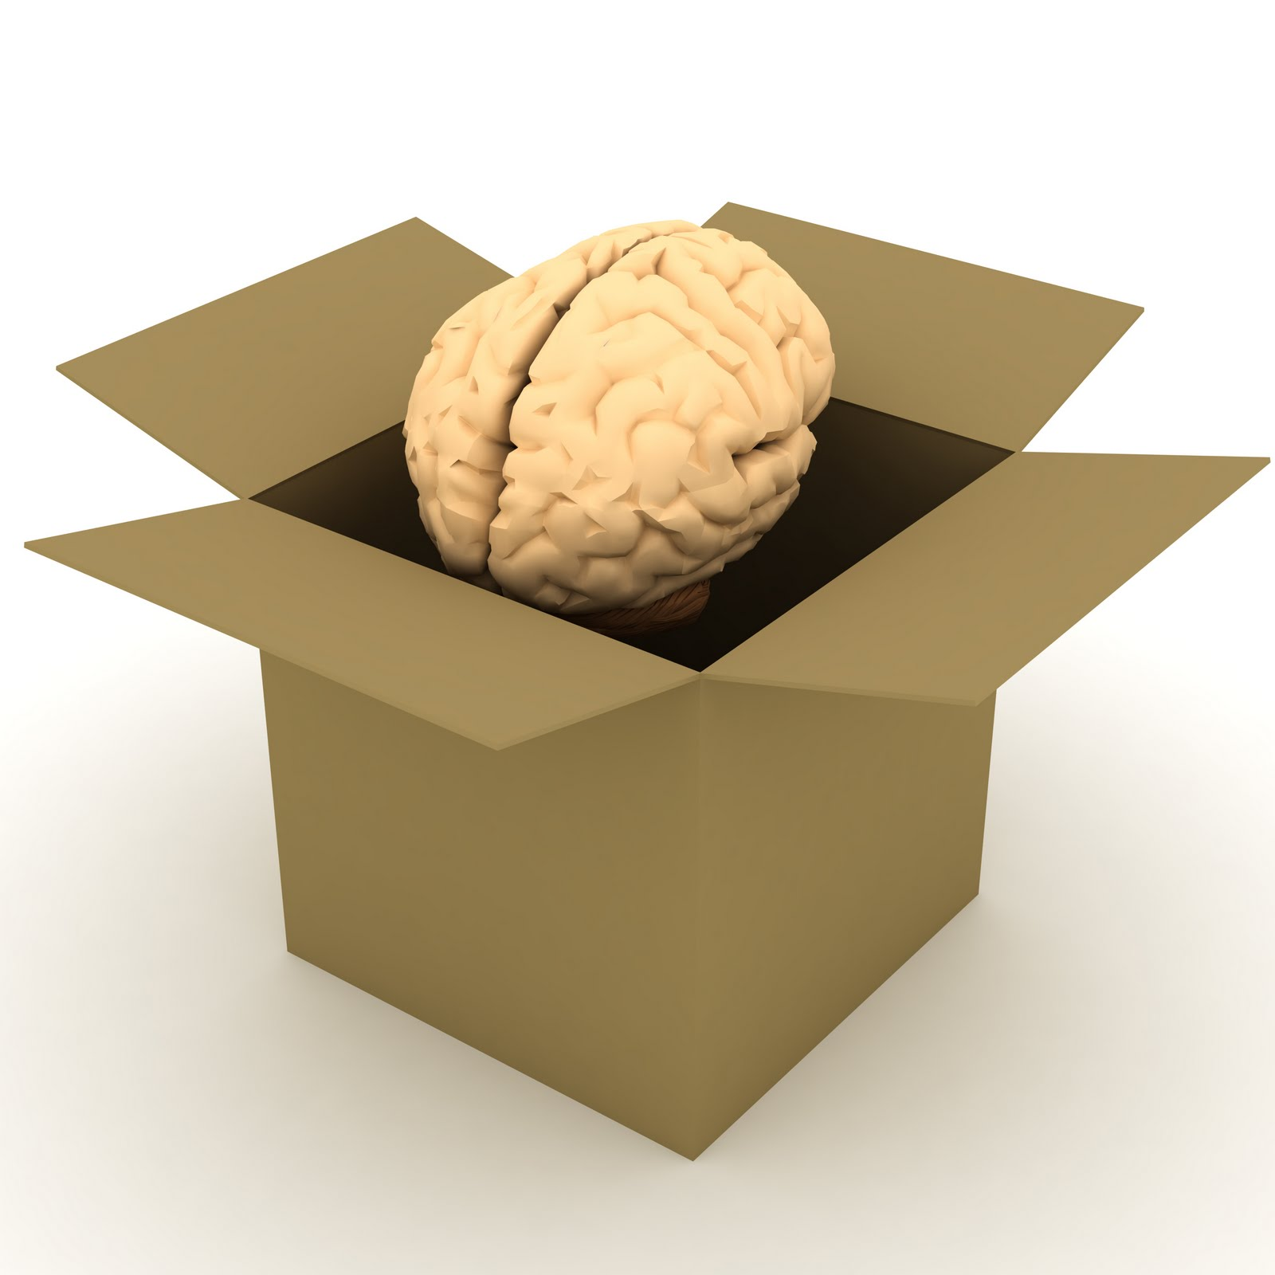
No assumptions!
No judgements!
No suspicions!

