Slide 1
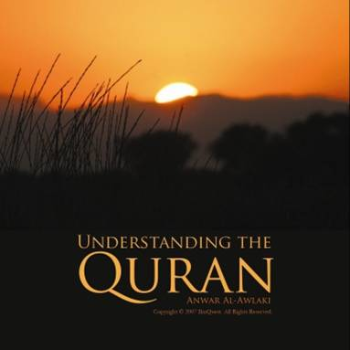
آیۃ الکرسی
اللّهُ لاَ إِلَـهَ إِلاَّ هُوَ الْحَيُّ الْقَيُّومُ لاَ تَأْخُذُهُ سِنَةٌ وَلاَ نَوْمٌ لَّهُ مَا فِي السَّمَاوَاتِ وَمَا فِي الأَرْضِ مَن ذَا الَّذِي يَشْفَعُ عِنْدَهُ إِلاَّ بِإِذْنِهِ يَعْلَمُ مَا بَيْنَ أَيْدِيهِمْ وَمَا خَلْفَهُمْ وَلاَ يُحِيطُونَ بِشَيْءٍ مِّنْ عِلْمِهِ إِلاَّ بِمَا شَاء وَسِعَ كُرْسِيُّهُ السَّمَاوَاتِ وَالأَرْضَ وَلاَ يَؤُودُهُ حِفْظُهُمَا وَهُوَ الْعَلِيُّ الْعَظِيمُ
Notes:
This ayat is read for protection from all types of evil in this world.

Slide 2
It was narrated that Abu Umamah said:
The Messenger of Allah (pbuh) said:
“Whoever recites Ayat Al-Kursi
Immediately after each prescribed Prayer, there will be nothing standing between him and his entering Paradise except death.”
(Reported by An-Nasa’i and Ibn Hibban.)
Notes:
When Allah T’ala will weigh our deeds on the day of judgment this ayat will be very heavy on the scale. (Nisa'i, Ibne Habban, Ibnelsani A'n Abi Amatah Albahili Radiallah Anhu)

Slide 3
It is reported by at-Tabarani that the Prophet (pbuh) said:
“The one who recites Ayat-al Kursi after the conclusion of an obligatory prayer, he is under the care of Allah until the next prayer commences.”

Slide 4
Jinns and Shayateen do not come close to the house in which Ayat- al-Kursi is recited. (Tirmidhi)

Slide 6
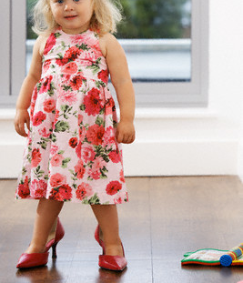
Lets play MOM !
Notes:
.

Slide 7
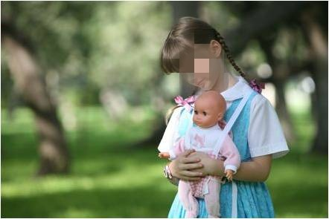
Imagine you have a cute little daughter
Notes:
and you being the mom have to give her complete protection

Slide 8
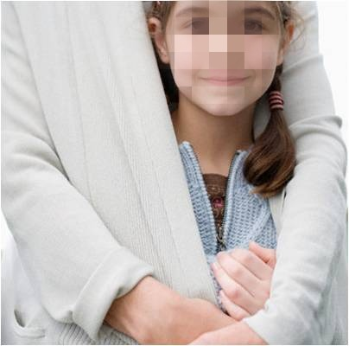
My weaknesses
Notes:
Now think hard : What kind of weaknesses do you have being a human which can effect your protection towards her I am a human so I can
Sleep
Get tired and neglect her
Die
Doze off
My lack of knowledge
Things out of your control
So we can’t really protect any one completely

Slide 9
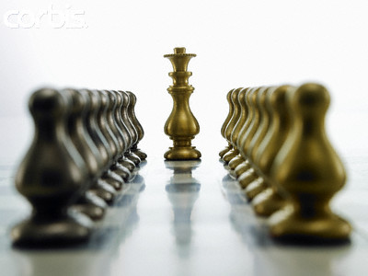
Ayat Al-Kursi is recited for complete protection

Slide 10
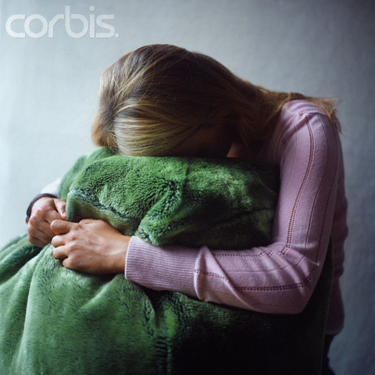
Why do things still go wrong?
Notes:
Its like a child saying, “ well I recited Ayat Al-Kursi and went to the doctor but he still gave me a shot which was extremely painful.”
What answer will you give him?
“ If Allah hadn’t decided to protect you, you probably would have not gone to the doctor or would have found the clinic closed.

Slide 11
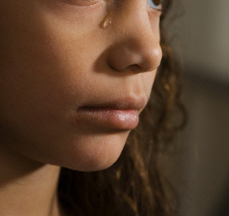
We don’t know what is good or bad for us , Allah (swt) does!

Slide 12
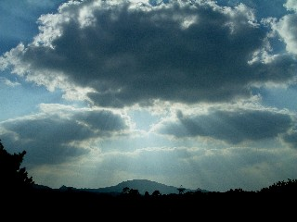
اللّهُ لاَ إِلَـهَ إِلاَّ هُوَ
Allah! There is no god but He
Notes:
There are two meanings to this line-
1.The literal meaning is very obvious that there aren’t two or more Gods basically negating the concept of polytheism the belief of mushrikeen that there is one god with a capital G and then there are other small gods who also have powers.
2.All the powers are only with Allah and therefore Allah’s rights must not be given to any thing else in this world.

Slide 13
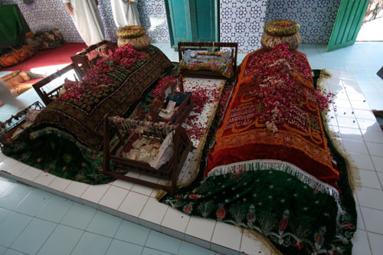
Who do we give Allah (swt)’s rights to?
Notes:
So who do you give Allah’s rights to ? By doing things you desire that
Allah doesn’t allow.
Your inner desires can be that god besides Allah.

Slide 14
To people we love
To our friends
To ourselves
To our desires
Notes:
And to people we love. By pleasing people at the cost of Allah’s disobedience
Lets say all your friend wants you to go or do something that is forbidden by Allah .
Now if you please your friend you are basically giving Allah’s right to your friend which is a type of shirk.

Slide 15
Allah’s
rights
People’s rights
Our own self
Notes:
A Momin gives top priority to Allah’s right ,then comes people’s right and in the last comes our own personal rights.

Slide 16
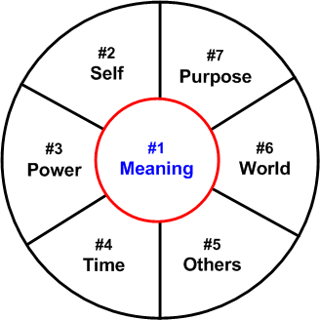
Allah
Notes:
For a momin all these things evolves around Allah’s consent.

Slide 17
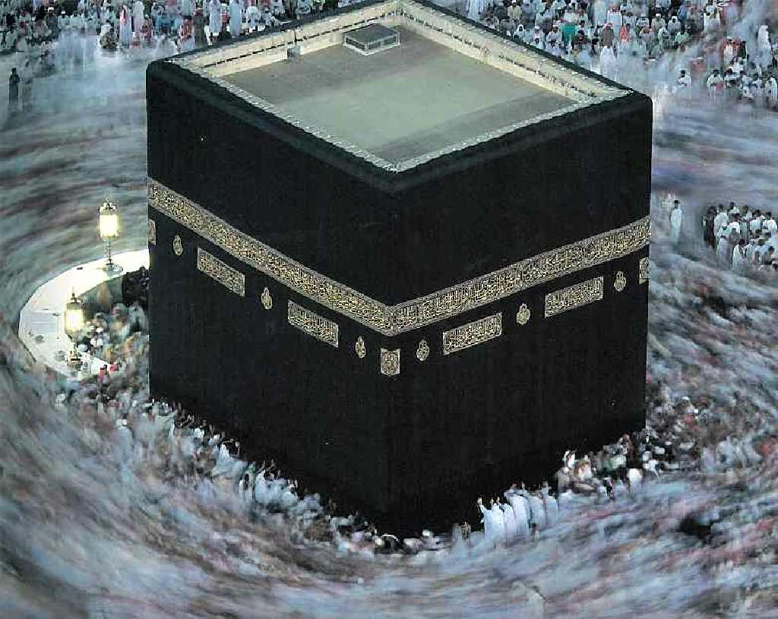
Notes:
Tawaaf is a symbol of the fact that the center of all our doings is Allah.

Slide 18
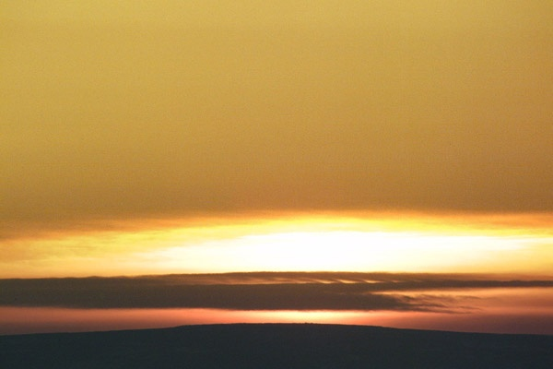
الْحَيُّ الْقَيُّومُ The Living, The All-Sustaining
Notes:
Again bring the mothers example in mind.
One of the weakness because of which she can’t protect us is that she can die.
But Allah……….explain

Slide 19
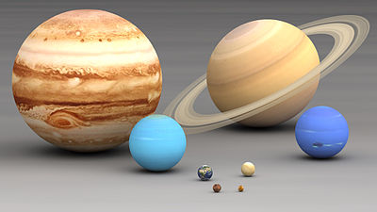
الْحَيُّ
No comparison between our living and His being Living
Notes:
The only thing common in ours and Allah’s life is the word life itself .
There is no comparison between the creator and His creation.
Lets see what all are the differences between our life and Allah’s.

Slide 20
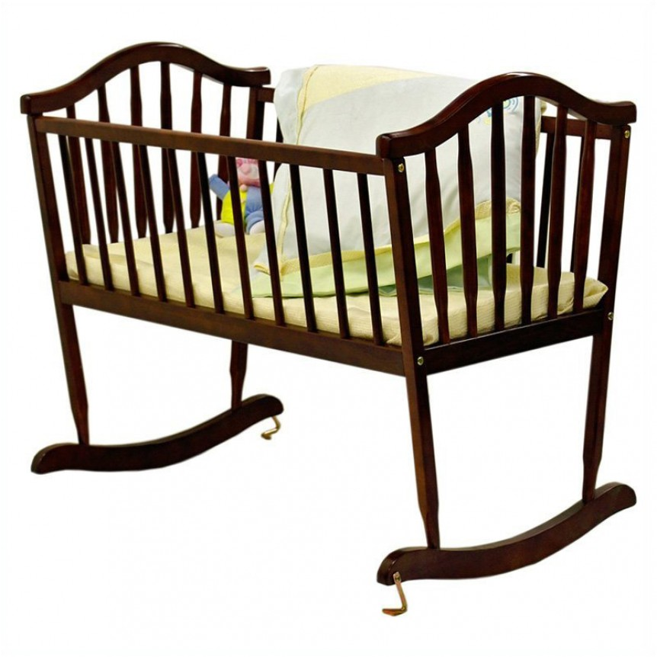
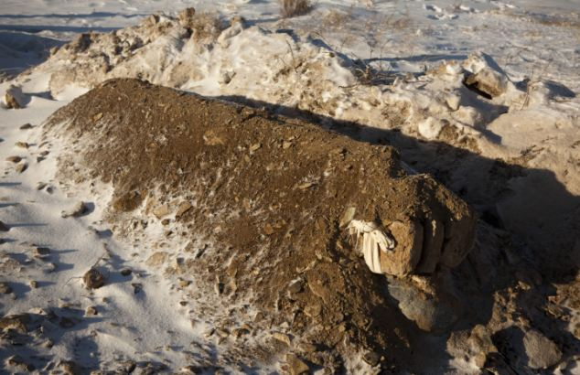
Our life is limited

Slide 21
Allah (swt)’s life is ever lasting

Slide 22
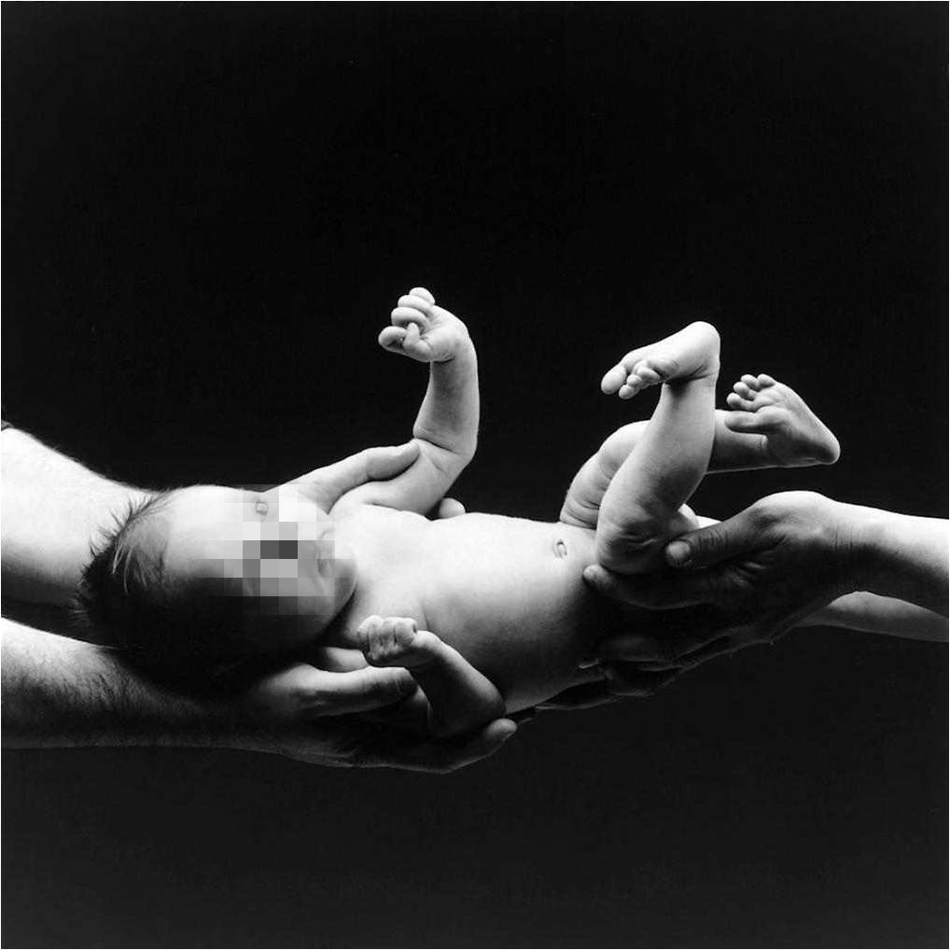
We are not born out of our own will

Slide 23
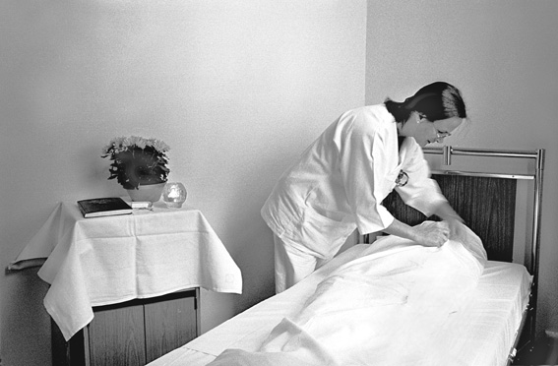
Nor do we die by choice

Slide 24
Allah (swt) was neither born nor will He die
Notes:
We might have difficulty in comprehending this concept as to how there was no beginning to Allah.

Slide 25
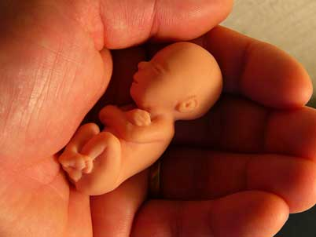
Our life is borrowed
Notes:
We are not born by our own choice neither do we die by our free will.
if I borrow a book from some one
Can I change the cover?
Write in it my remarks
Tear a few papers
Misplace it.

Slide 26
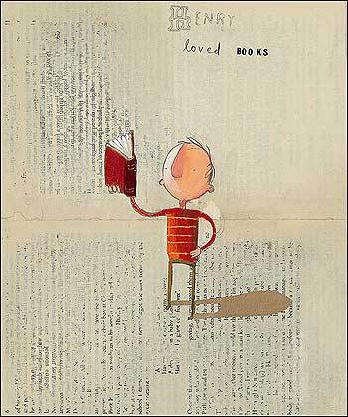
We must use it the way the lender wants us to
Notes:
I’ll be careful in using it.
Will use it the way she wants me to…….

Slide 27
And be prepared that she can take it back any time
Notes:
……So our life is Allah’ s
We have just borrowed it for a few days/years.
Are we prepared to give it back to him when He asks for it?

Slide 28
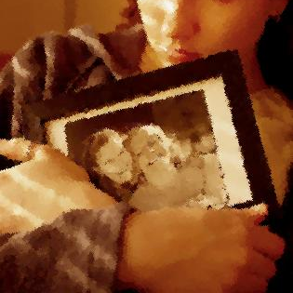
our loved ones die…
Notes:
With our own life we may still accept this concept but it is usually when our loved ones die that we say it is not fair.

Slide 29
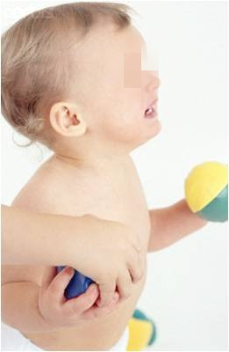
“No honey, it is not ours!”
Notes:
What do we tell our children when we go to someone's house and they play with their toys .
When leaving they don’t want to let go of the toy and we say…….
Like wise our lives
Our parents lives
Our loved ones lives are not ours.

Slide 30
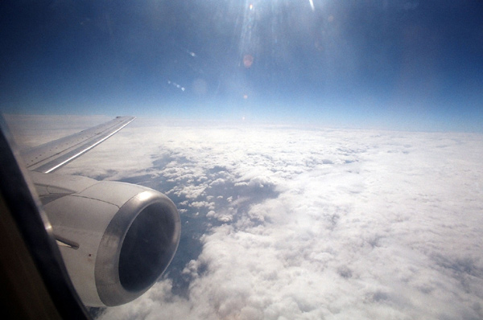
Allah (swt)’s life is His own
Notes:
On the other hand…

Slide 31
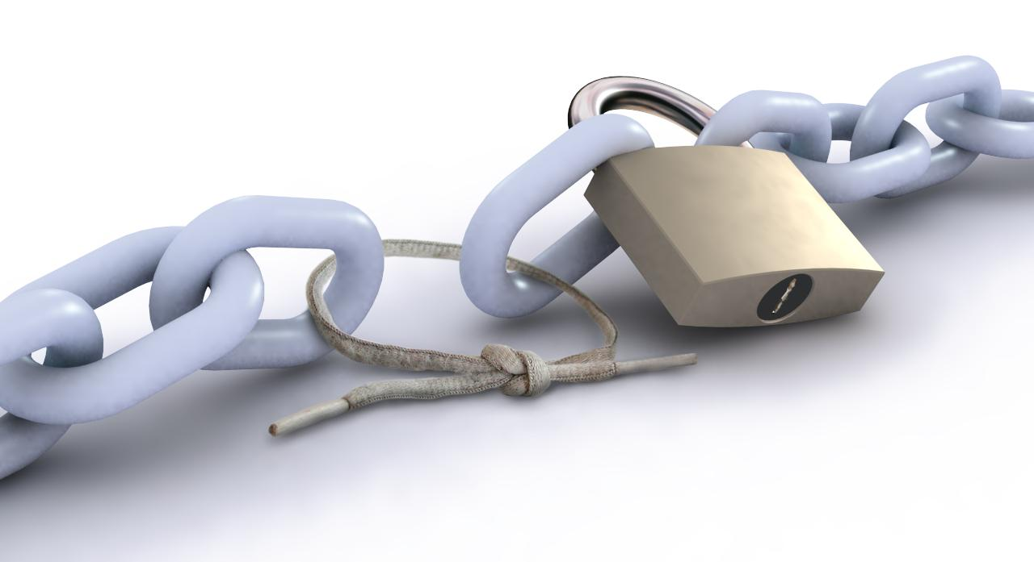
Our life is limited
and therefore weak
Notes:
Lets see another difference between our life and Allah’s life……
Our life can end at any time and without some basic things it can end immediately.
What are those things that make our life limited ?

Slide 32
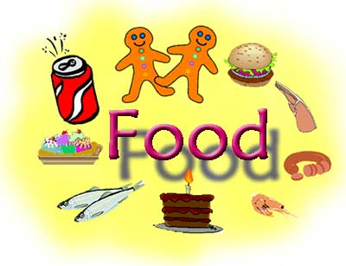
We are dependent on food to survive

Slide 33
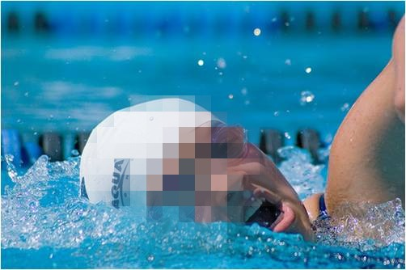
Air to breathe

Slide 34
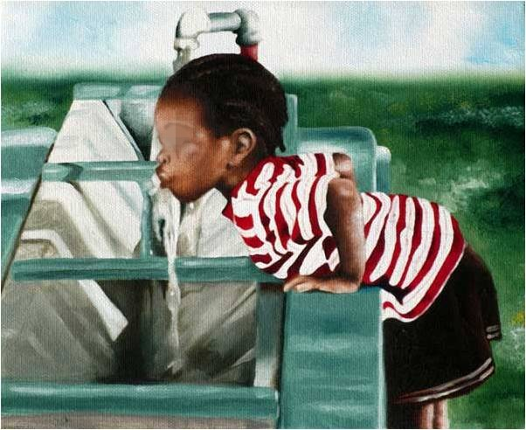
Water to drink

Slide 35
We are not self sufficient
Notes:
So our life is dependent on a lot of things without which we can’t live.

Slide 36
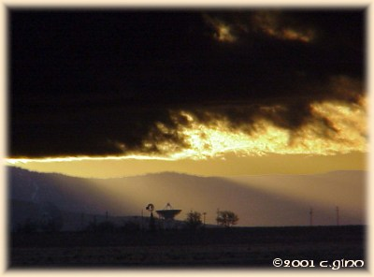
Allah (swt) doesn’t have these weaknesses
Notes:
Allah doesn’t need food, water or air to stay alive.
So although the word alive is used for Him and us both but his life is forever and our isn’t.

Slide 37
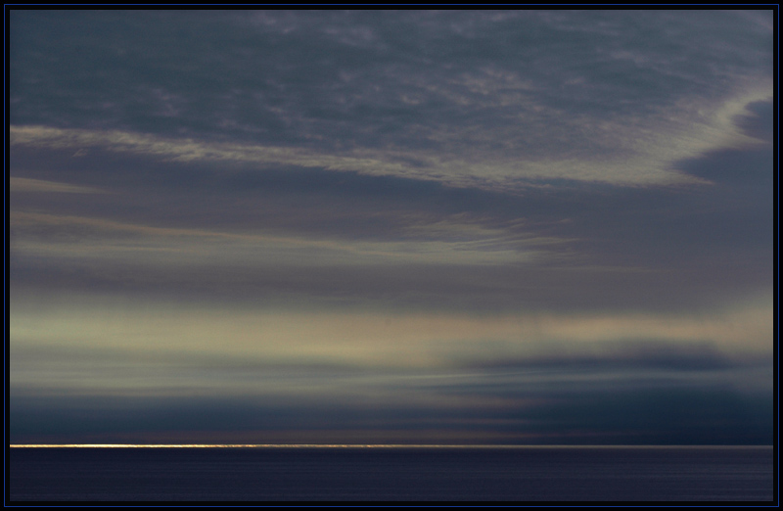
Allah (swt) was there when there was nothing
Notes:
Another difference…..
It is very difficult to imagine this and can become very confusing too,
e.g. one might think that how can there be something with no beginning because all the things we see in this world has a beginning.
Can you name any one thing that doesn’t have a beginning?

Slide 38
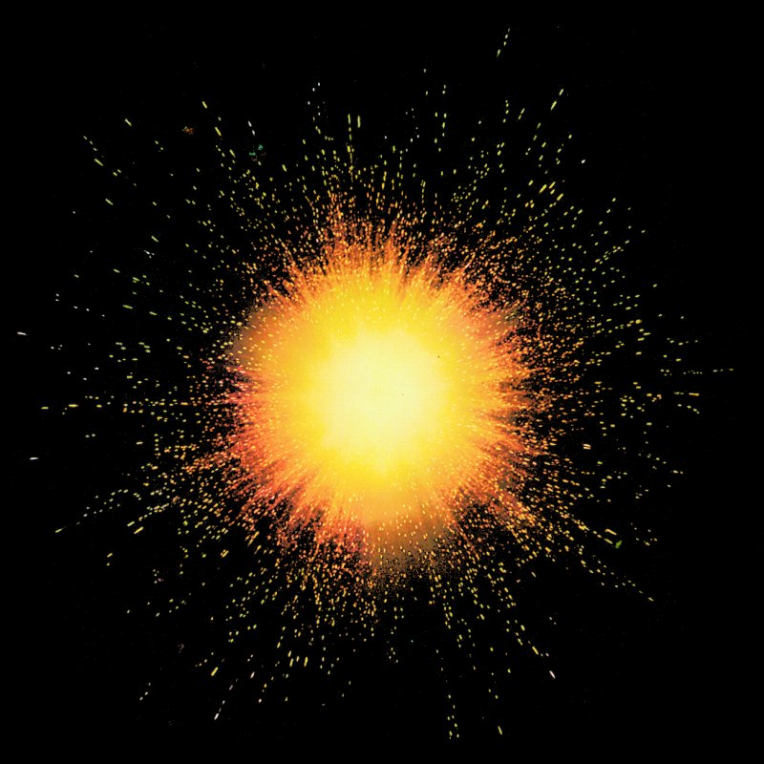
This world came into being with a big bang
Notes:
Even this world had a beginning …………………But Allah was present before that.

Slide 39
And He (swt) will be there when there will be nothing
Notes:
Again something that we cannot easily comprehend.
So we just blindly believe that Allah is there without using our imagination, he is ever living and ever lasting.

Slide 40
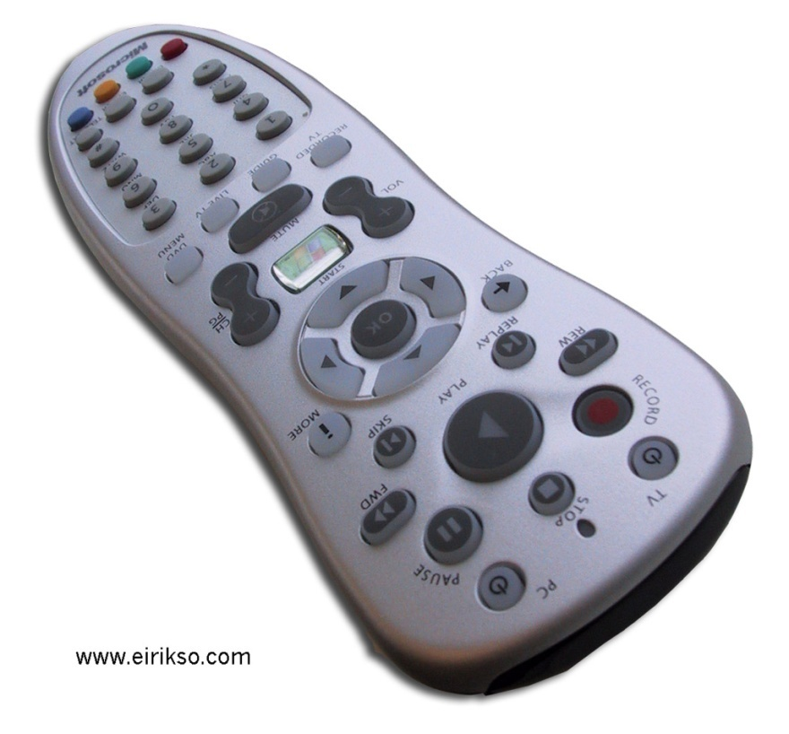
Al-Qayyum
Everything is in Allah (swt)’s
control.
Notes:
If we understand this and have a strong belief in this fact that Allah has control over everything, more than half our worries in this world will disappear.
Few things are obvious like death, accident.

Slide 41
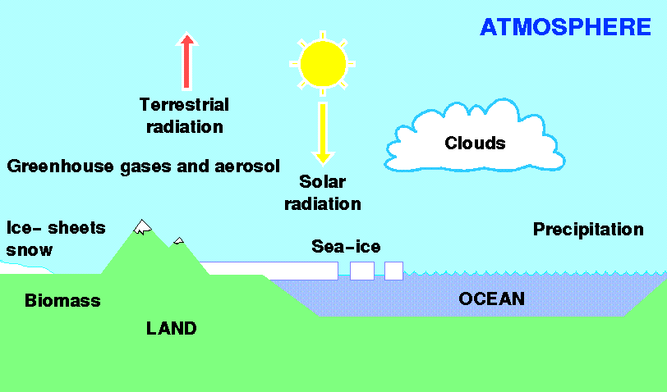
Physical laws are dependent on Allah (swt)
Notes:
But what we need to understand here is that all the laws in science, physics and chemistry are also made by Allah…..
So if you have dark thick clouds over your head, it is because of your knowledge of physic that you say it is going to rain.
But just as Allah has made a law he can break it too
But despite the dark clouds it will only rain if Allah so wishes.

Slide 42
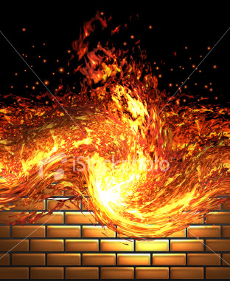
Fire can burn things only by the will of Allah (swt)
Notes:
That is the reason why Ibrahim (as) didn’t get burnt when he was thrown into fire.

Slide 43
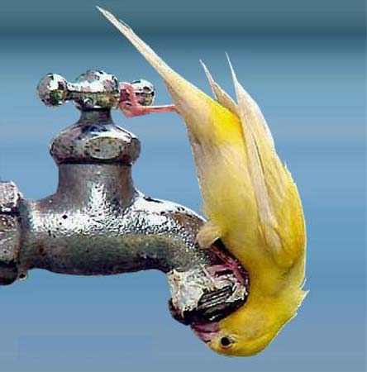
Water can quench thirst only by Allah (swt)’s will
Notes:
That is the reason why Aab-e- Zamzam quenched Bibi Hajira’s thirst.

Slide 44
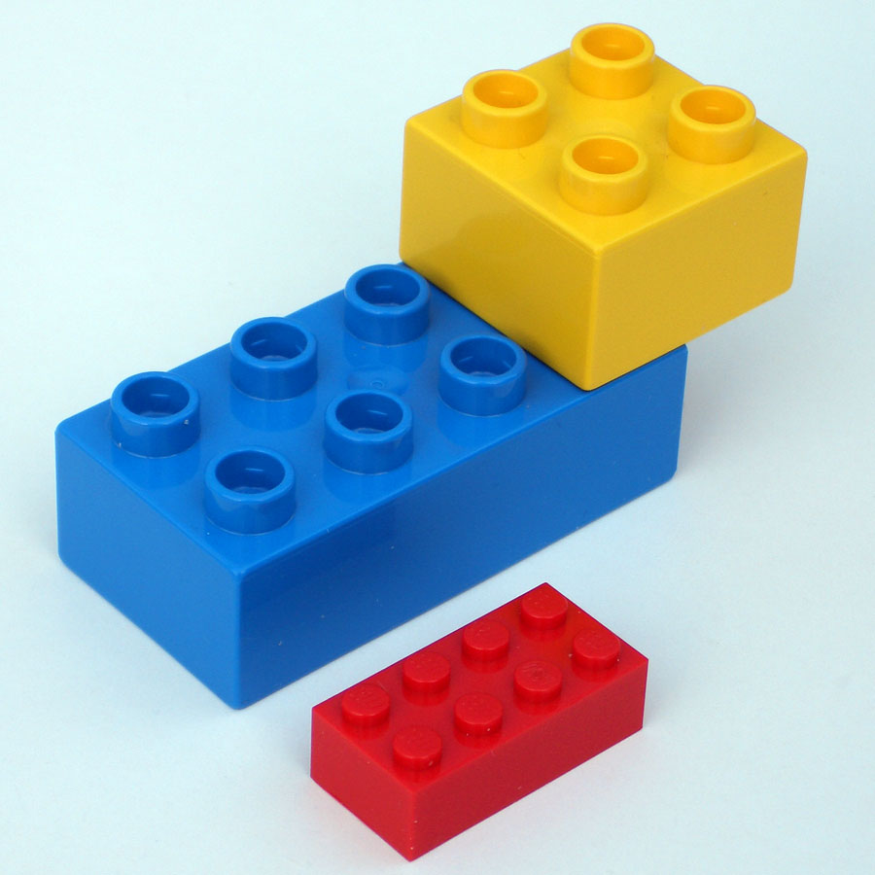
Allah can make and break His laws
Notes:
Just like we make and break Lego Allah can easily make or break his own laws.

Slide 45
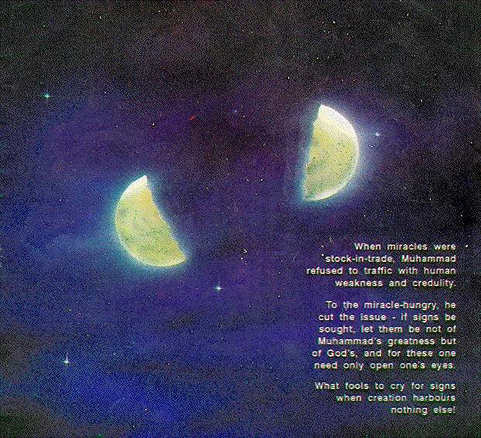
The miracles
of Allah (swt)
Notes:
That is the reason why miracles happen.
To show people that Allah is not dependent on the physical laws Allah sometimes break the laws that he has made for this earth.

