Slide 1
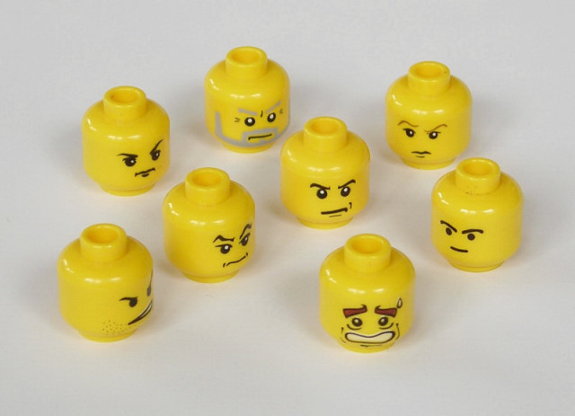
PEER PRESSURE

Slide 2
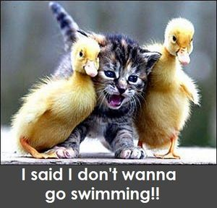
Pressure is the feeling that you are being pushed toward making a certain choice—good or bad

Slide 3
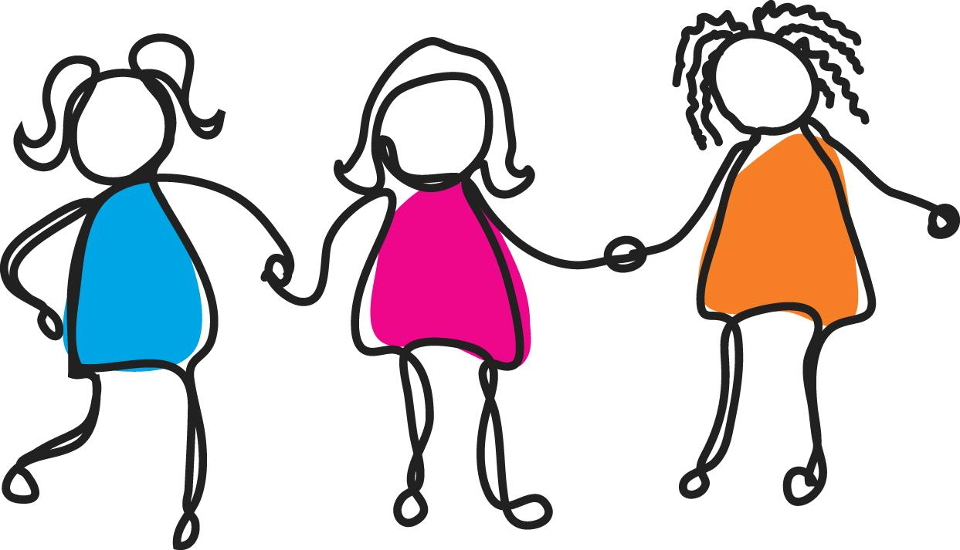
A peer is someone in your own age group.

Slide 4
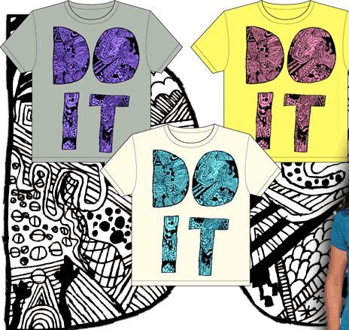
Peer pressure
the feeling that
someone your
own age is
pushing you
toward making
a certain choice,
good or bad

Slide 5
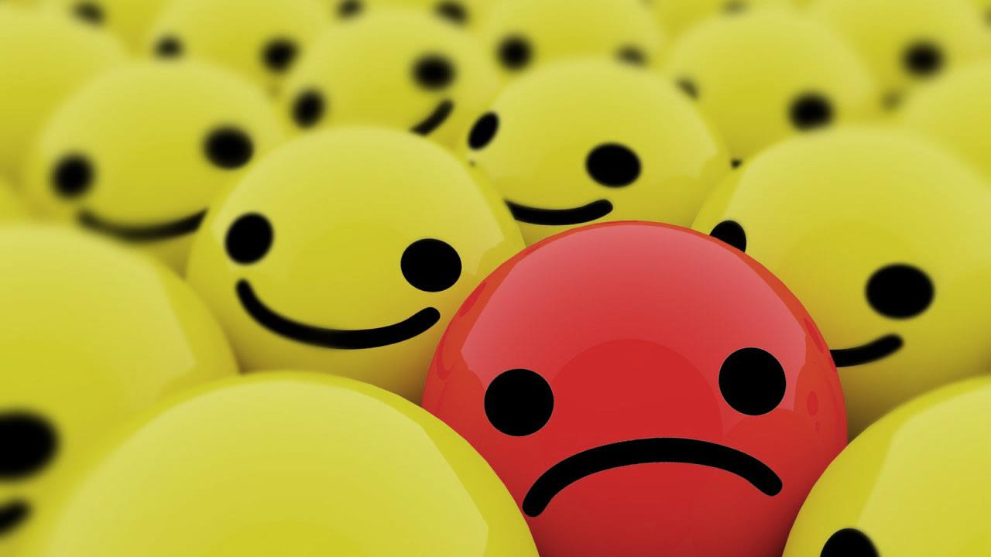
How did it feel to give into pressure?
sad
anxious
guilty
like a wimp or pushover
disappointed in yourself
Notes:
If you did something you wish you hadn’t, then most likely you didn’t feel too good about it.

Slide 6
Why we give in
afraid of being rejected by others
want to be liked and don’t want to lose a friend
want to appear grown up
don’t want to be made fun of
don’t want to hurt someone’s feelings
aren’t sure of what they really want
don’t know how to get out of the situation
Notes:
Everyone gives in to pressure at one time or another, but why do people sometimes do things that they really don’t want to do? Here are a few reasons. They…

Slide 8
Have your friends ever used these lines on you?
Did you give in, even though you didn’t want to?

Slide 9
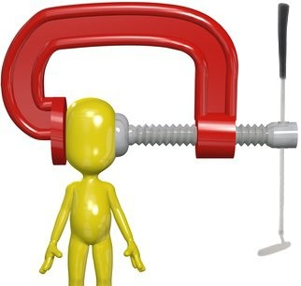
How people put pressure on peers

Slide 11
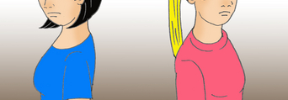
Rejection
Threatening to end a friendship
Who needs you as a friend any way?
Notes:
This pressure can be hard to resist because nobody wants to lose friends. Some examples of pressure by rejection are:

Slide 12
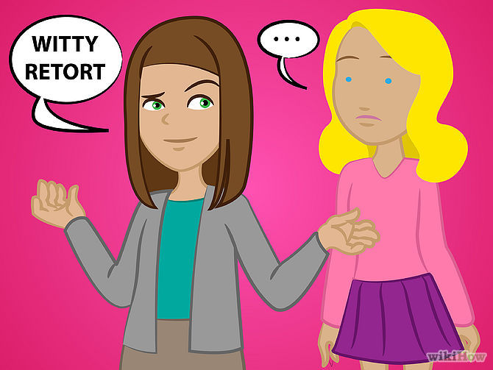
Put Downs
Insulting or calling a person names to make them feel bad
You're never any fun.
You're such a baby.
You're such a wimp.
You're so uncool.

Slide 13
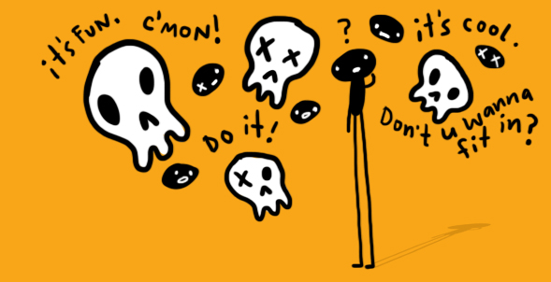
Reasoning
It won't hurt you
Your parents won’t find out
Notes:
Telling a person reasons why they should try something or why it would be OK if they did. (Nobody said these were good reasons.) Some examples of pressure by reasoning are:

Slide 14
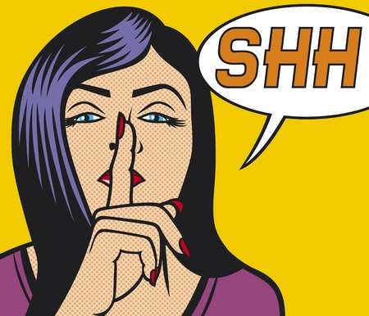
Unspoken
Pressure
Notes:
This is something you feel without anyone saying anything to you. You feel unspoken pressure if you want to do the same things others doing.

Slide 15
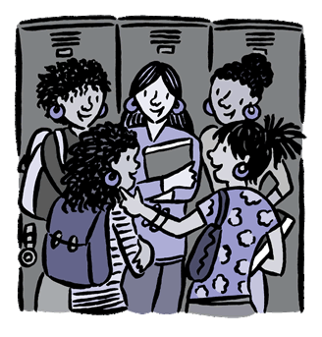
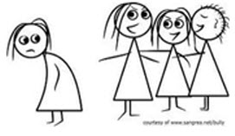
The Huddle
Notes:
A group of kids standing together in which everyone is talking and maybe looking at something you can't see, laughing and joking.

Slide 16
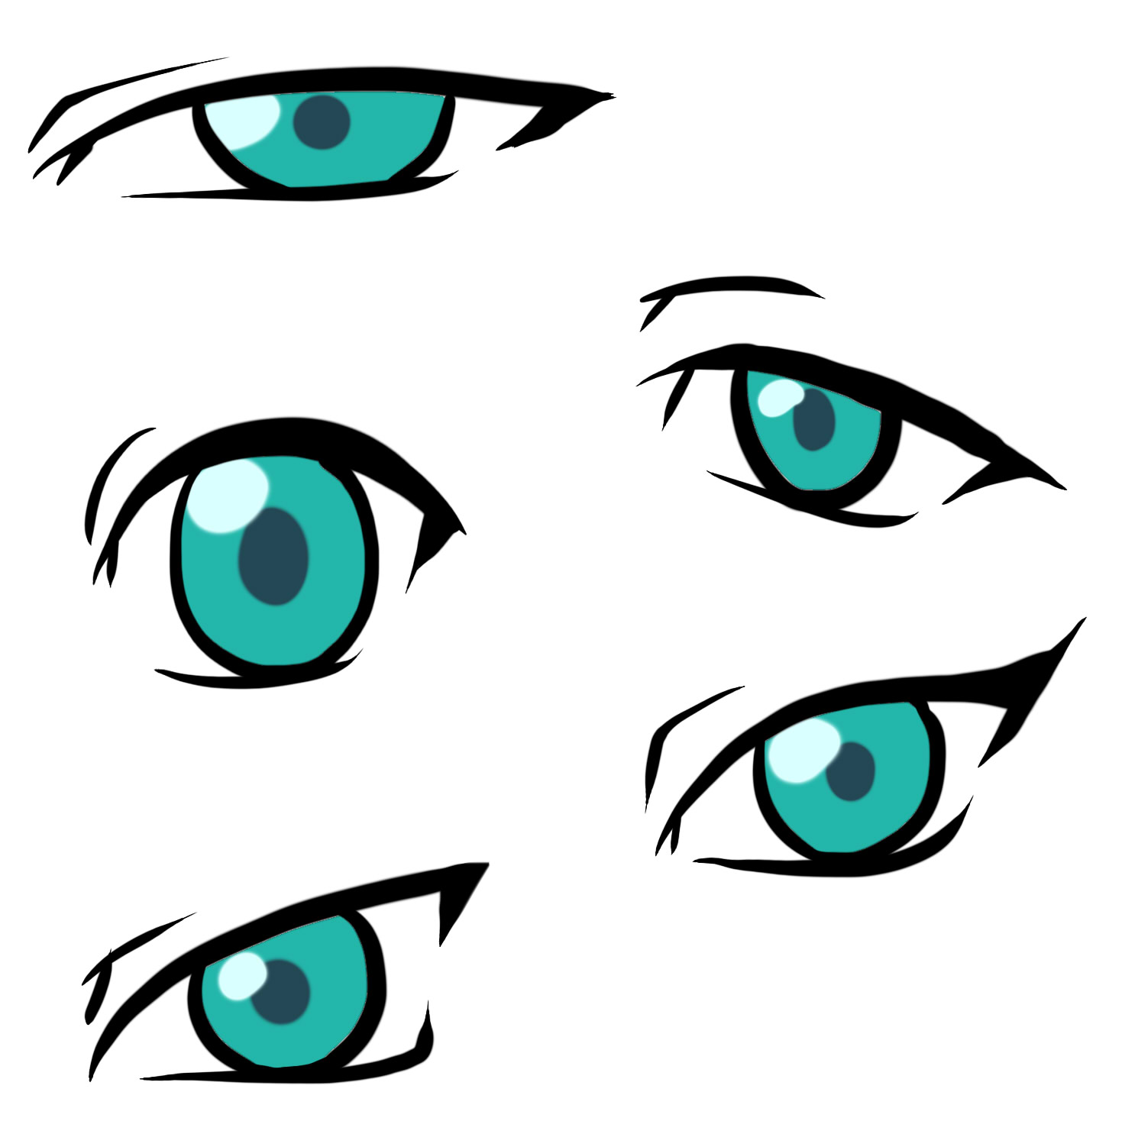
The Look
Notes:
: Kids who think they're cool give you a certain look that means we're cool and you're not.

Slide 17
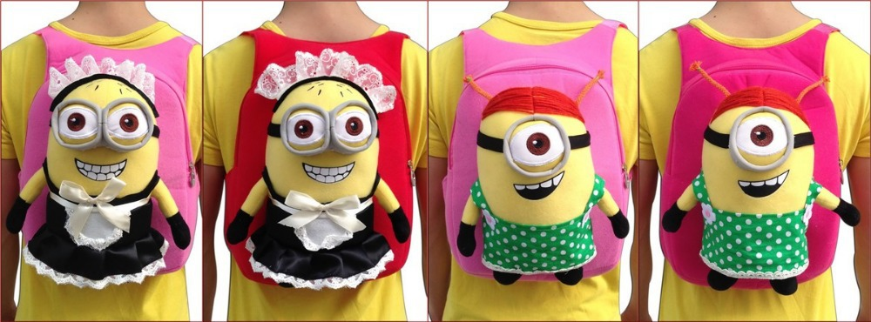
The Example
Notes:
: A group of popular kids decide to get the same backpack and you want one too

Slide 18
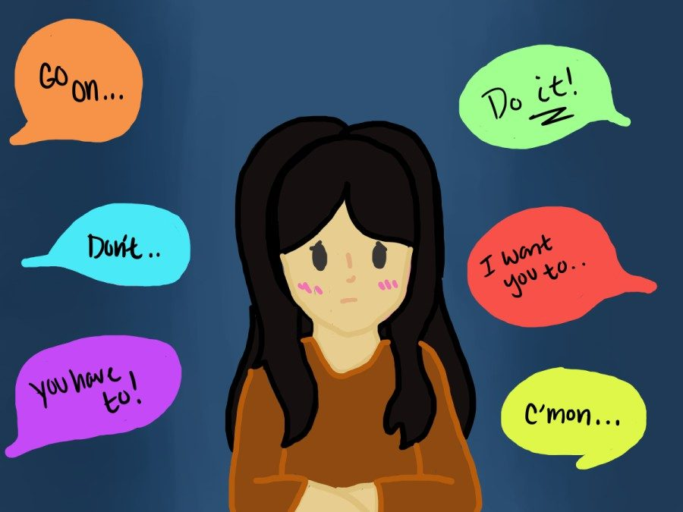
Why bother about negative Peer Pressure?

