Slide 1

Abundance

Slide 2

you are unique you play an important part in this universe

Slide 3

If life throws lemons at you,
make lemonade!

Slide 4


Every choice you make
leaves an impact

Slide 5

Discover your identity and goals amidst the worldly races

Slide 6

You all have an equal chance of emerging successful in Allah’s game of life

Slide 7



Allah Has Plentiful For You And Me So Don’t Fret

Slide 8

"Allah Ordered that the good and the bad deeds be written, and He then showed how If someone intends to do a good deed and he does not do it, then Allah will write for him a full good deed; and if he intends to do a good deed and actually did it, then Allah will write for him (its reward equal) from ten to seven hundred times to many more times. And If someone intends to do a bad deed and he does not do it, then Allah will write for him a full good deed (in his account) with Him, and if he intends to do a bad deed and actually did it, then Allah will write for him one bad deed.“ Bukhari and Muslim

Slide 9

Choose your competitions wisely

Slide 10

Giving opens the way for receiving

Slide 11

Observe and relish abundance around you

Slide 12
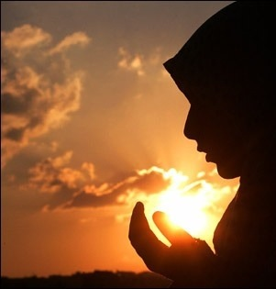
Seek Allah’s help

