Slide 1

THE INVITATION
Notes:
When it is time for salah, what is the first thing that happens?
Play the Adhan audio clip.

Slide 2
الله أكبر الله أكبر
Allah is the greatest Allah is the Greatest
أَشْهَدُ أَنْ لاَّ إِلـٰـهَ إِلاَّ الله
I bear witness that there is no god except Allah
أَشْهَدُ أَنَّ مُحَمَّدًا رَّسُولُ اللهِ
I bear witness that Muhammad (PBUH) is the messenger of Allah
حَيَّ عَلَى الصَّلَوٰةِ
Hurry to the prayer (Rise up for prayer)
حَيَّ عَلَى الْفَلاَحِ
Hurry to success (Rise up for Salvation)
اَلله ُ أَكْبَرُ اَلله ُ أَكْبَرُ
Allah is the greatest Allah is the Greatest
لاَ إِلـٰـه إِلاَّ الله
there is no god except Allah
Notes:
Read the complete Arabic and then the translation.

Slide 3
Additional for Fajr Prayers
الصَّلوةُ خَيْرٌ مِّنَ النَّوْمِ، الصَّلوةُ خَيْرٌ مِّنَ النَّوْمِ
Prayer is better than sleep,
Prayer is better than sleep

Slide 4
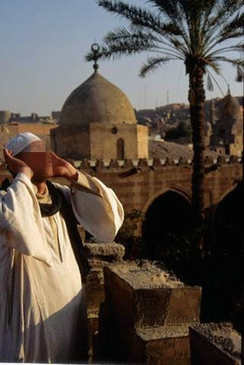
Adhan is an Islamic call to PRAYER
Notes:
Beautiful adhan affects, grabs your attention.

Slide 5
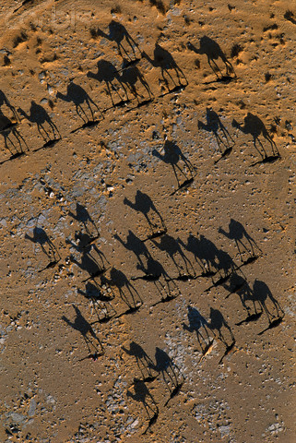
Story of Adhan
When the Muslims migrated from Makkah to Madinah they used to agree about a fixed time for the congregational prayer.
Notes:
They found it difficult to remember the time fixed for the prayer sometimes, especially when they were busy doing their work.

Slide 6
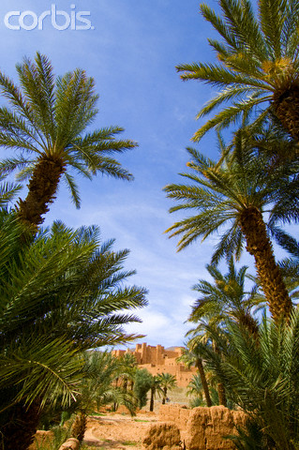
One day The Prophet (PBUH) and the Muslims discussed the matter of calling the people for prayer at the exact time.

Slide 7
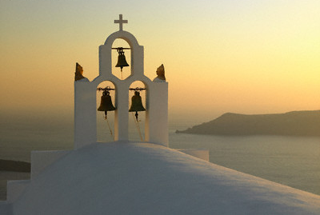
Notes:
Some of the believers suggested the use of something like the bell of the Christians,

Slide 8
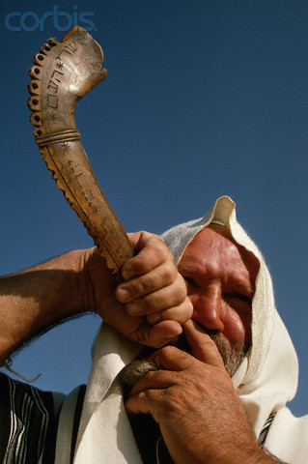
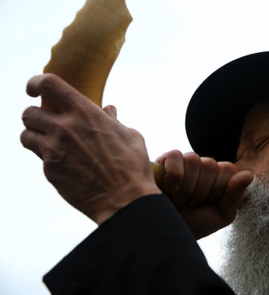
Notes:
Others suggested the use of a horn like that of the Jews.

Slide 9
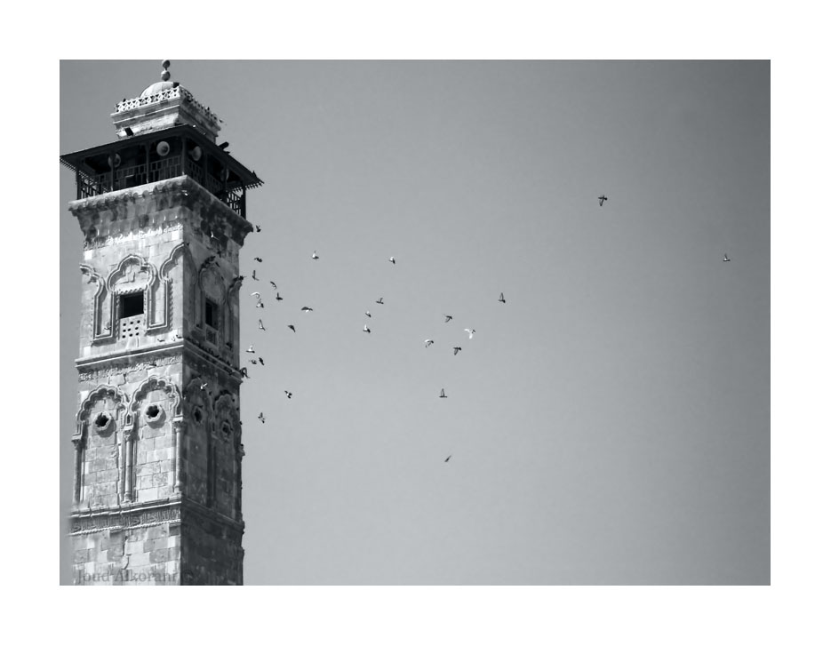
Abdullah bin Zaid bin Abd Rabbihi (RA) said, "I was sleeping when I saw a man carrying a naqoose (conch) in his hands, and I said, Servant of Allah will you sell this to me?' When he said what I would do with it? I replied, that we would use it to call the people to prayer. He said 'Shall I not guide you to something better than that?' I replied, 'Certainly', so he told me to say ……
Notes:
Reported 'Abdullah ibn (Zaid ibn) 'Abd Rabbih, "When the Prophet was suggested the use of a bell to call the people to prayer, he disliked it because it resembled the Christian practice. While I was sleeping, a man came to me carrying a bell. I said to him, 'O slave of Allah, will you sell me that bell?' Said he, 'What would you do with it?' I replied, 'I would call the people to prayer with it.' Said he, 'Shall I not guide you to something better than that?' I said, 'Certainly.' Said he, 'You should say, Allahu akbar, Allahu akbar, Allahu akbar, Allahu akbar. Ashhadu alla ilaha illal-lah, ashhadu alla ilaha illallah, Ashhadu anna Muhammad ar-Rasool-lal-lah, ashhadu anna Muhammadar-Rasool-lal-lah. Hayya 'alas-salah, hayyah 'alassalah. Hayya 'alal-falah, hayya 'alal-falah. Allahu akbar, Allahu akbar. La ilaha illal-lah.' Then he went a short distance away and said, 'When you stand for the prayer, say, 'Allahu akbar, Allahu akbar. Ashhadu alla ilaha illal-lah, Ashhadu anna Muhammad ar-Rasool-lal-lah Hayya 'alas-salah, hayya 'alal-falah. Qad qaamatis-salah, qad qaamatis-salah. Allahu akbar, Allahu akbar. La ilaha illal-lah.‘ When the morning came, I went to the Messenger of Allah to tell him what I had seen. He said, 'Your dream is true, Allah willing. Go to Bilal, tell him what you have seen, and tell him to make the call to prayer, for he has the best voice among you.' I went to Bilal and told him what to do, and he made the call to prayer. ‘ Omar was in his house when he heard it. He came out with his cloak, saying 'By the One who has raised you with the truth, I saw similar to what he saw.' The Prophet, upon whom be peace, said, 'To Allah is the praise." (Ahmad, Abu Dawud, Ibn Majah, Ibn Khuzaimah, Tirmidhi)

Slide 10
The Prophet (PBUH) asked Bilal (RA) to get up and make the call to prayer
{Ahmad, Ibn Majah, Tirmidhi}
Notes:
Adhan is given only by men. This is not a gender bias. Allah(SWT) has given different roles to men and women. They complement each other.

Slide 11
Special honour for Calling to Prayer
  The one who says Azaan for reward
  is like that martyr who is drenched in
  blood and when he will die, insects
  will not come in to his
  body.(Tabrani)
  If people knew how much reward
  there was in Azaan then swords
  would be used amongst them [to say
  it]. (Musnad-e-Ahmad)
Notes:
Importance of adhan … Those who call the adhan will have an honorable and great status on the Day of Judgement.

Slide 12
Call Adhan Even During Travel!
  Maalik bin Huwairith (RA) said, “I
  came to the Prophet (PBUH) with
  my cousin. The Prophet said:
  ‘When you travel, call Adhan and
  Iqamah for Salah…’”
  (Bukhari)
Notes:
Iqamah is a shorter “call to prayer” that is made immediately prior to each of the five daily Islamic prayers, to let people know that the prayer is about to begin.

Slide 13
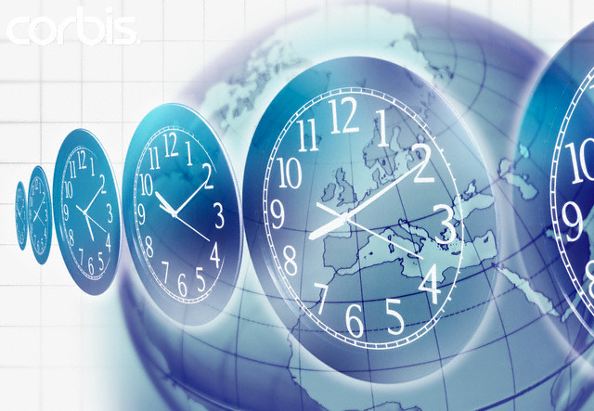
Today, Adhan resounds
across the world
round the clock!

Slide 14

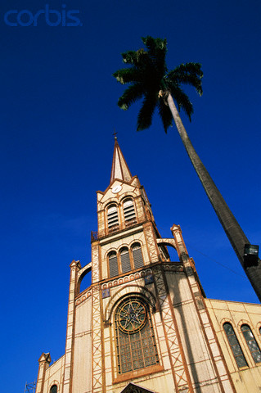
Notes:
You hear gongs in the churches

Slide 15
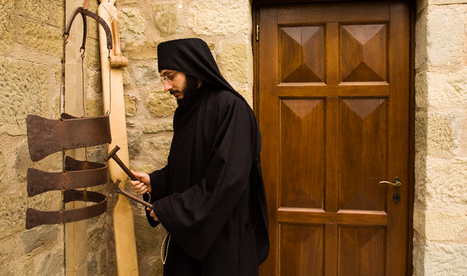
Notes:
This hammering at a Synagogue. This is an orthodox Jew. See how he is all covered up.

Slide 16
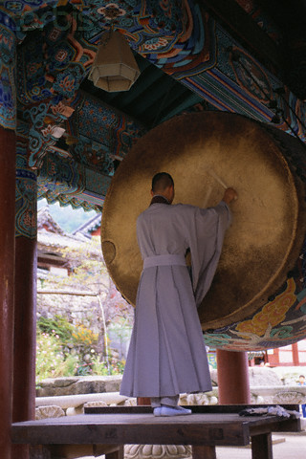
Notes:
Beating of the drum in Buddhists.

Slide 17
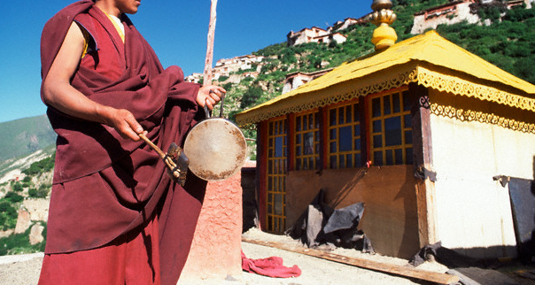
Monastery in Tibet

Slide 18
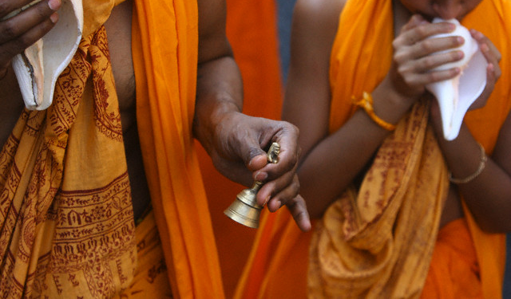
Notes:
These are Hindus ringing bells.

Slide 19
International
ANTHEM
Of Muslims
Notes:
Identity of Muslims.

Slide 20

Notes:
We are invited by Allah(SWT)

Slide 21
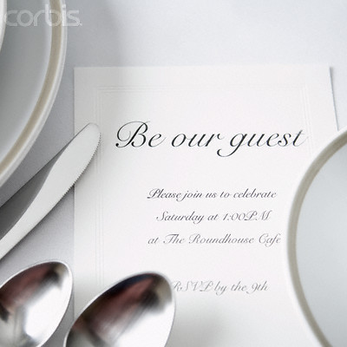
Notes:
He honours us with an invitation 5 times daily

Slide 22

Notes:
and the best part about this party is, it is an open invitation.

Slide 23

Invitations as we know them
Notes:
We get all sorts of invitations.

Slide 24
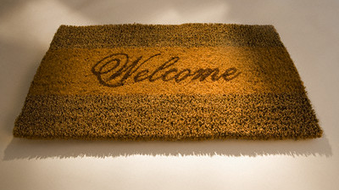

Slide 25
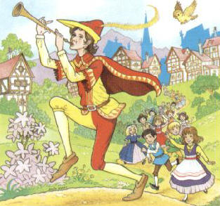
Notes:
Pied Piper also gave an invitation. The kids loved it and followed him blindly.

Slide 26
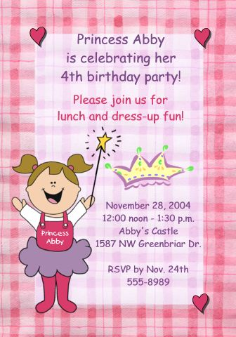

Notes:
Young girls like to have such sort of parties.

Slide 27


Notes:
Invitation cards can be of all shapes and sizes.

Slide 28


Notes:
It can be a graduation party, or a fancy dress

Slide 29

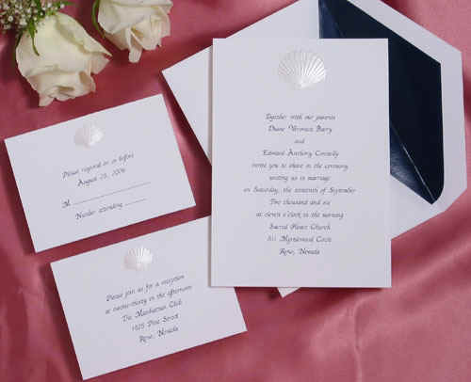
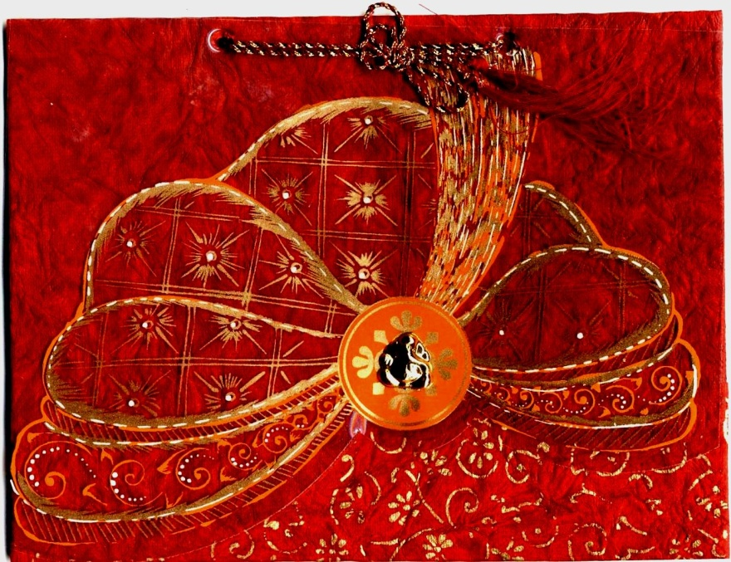
Notes:
Wedding cards are different for each and every function.

Slide 30
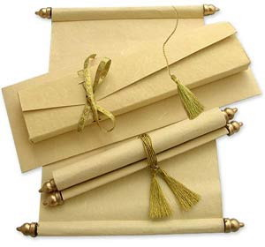
Notes:
Some people really go out of their way to make invitation cards.

Slide 31
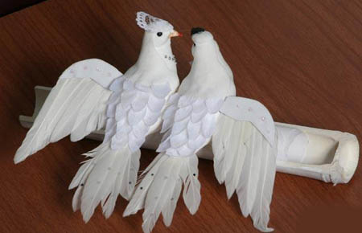


Notes:
They want their invitation to be different from all the others.

Slide 32
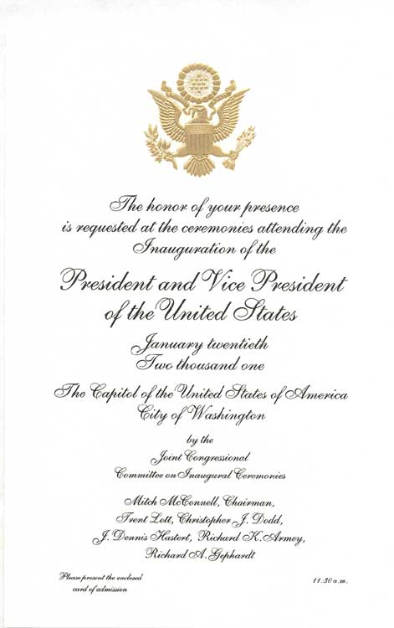
Notes:
Can be an invitation from a dignitary.

Slide 33

Notes:
Or with celebrities .

Slide 34
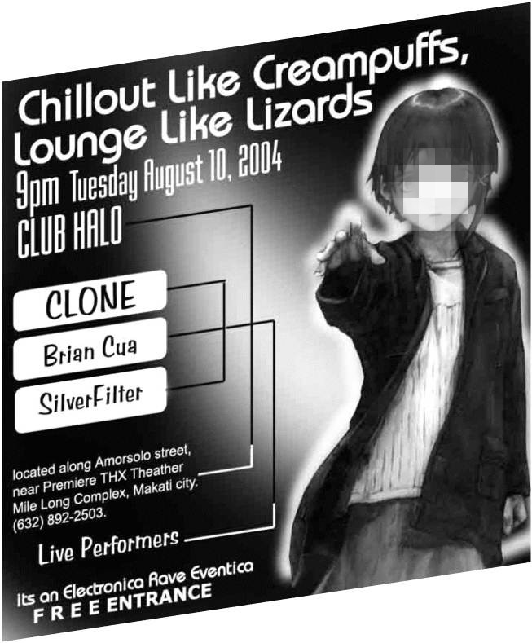


Slide 35


Slide 36

Comparison with Allah’s invitation
Notes:
Let’s compare the invitations we get with Allah’s invitation.

Slide 37
A “Wholesome” party offers
Notes:
By “wholesome” here we mean a halal party where it is fine for us to go and have fun like alhamdolillah our Perceptions party.

Slide 38


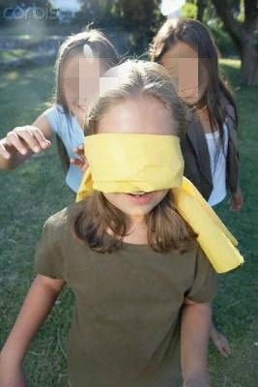
Notes:
Games, balloons

Slide 39




Notes:
Great conversation with our friends

Slide 40

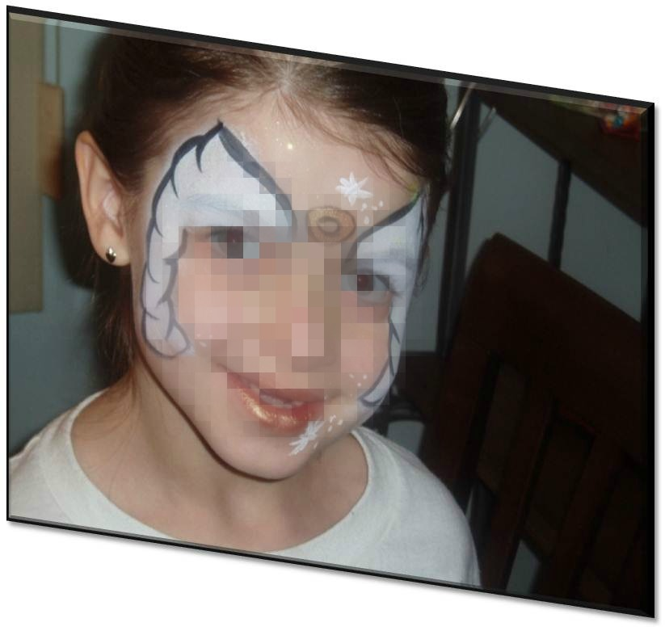
Notes:
Face painting

Slide 41
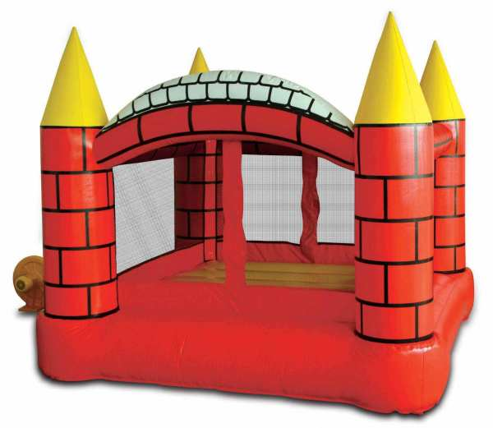


Notes:
Bouncing castles and slides

Slide 42
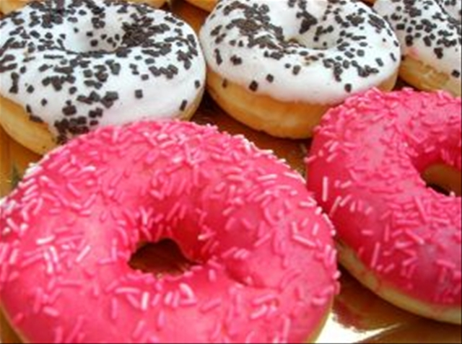

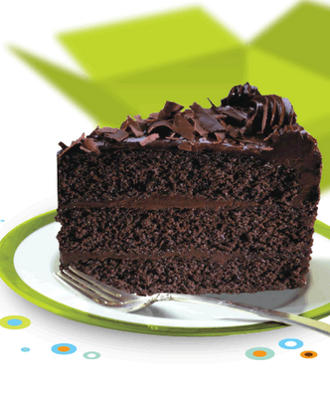

Notes:
How can we talk about a “wholesome” party and not talk about yummy food?

Slide 43
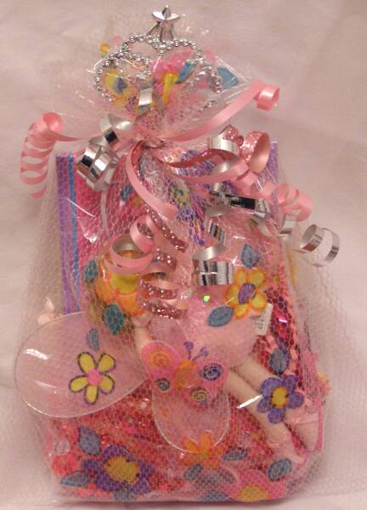

Notes:
And then we sometimes get goody bags.

Slide 44

Gratification of the senses

Slide 45

THAT IS OK!
Notes:
Alhamdolillah, it is good to have fun.

Slide 46
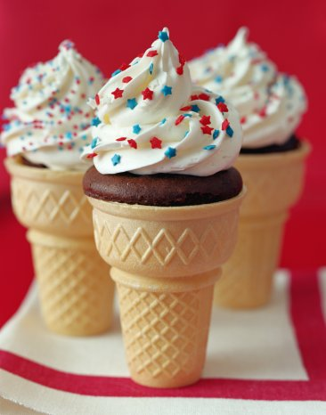
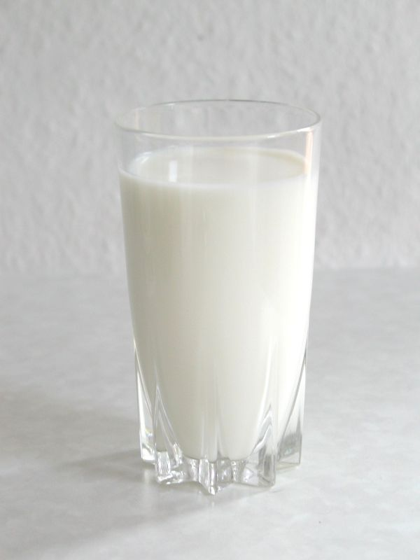
Allah takes care of our NEEDS
As well as our WANTS
Notes:
He just didn’t milk for us, He also made delicious ice cream for us to enjoy.

Slide 47
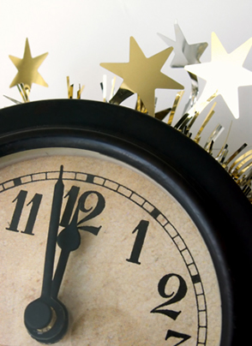

Notes:
But how long does all that last?

Slide 48
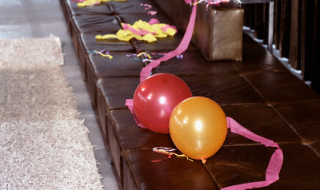
Notes:
The balloons burst, the ribbons come down….

Slide 49

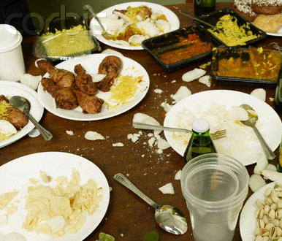
Notes:
Dirty plates and leftover food is all that is left.

Slide 50

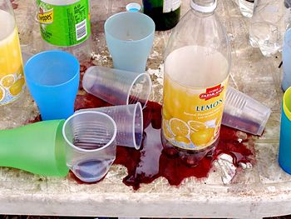

Slide 51
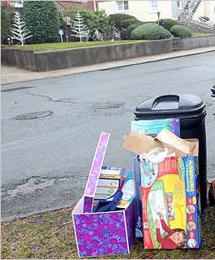
Notes:
All the garbage is disposed off.

Slide 52
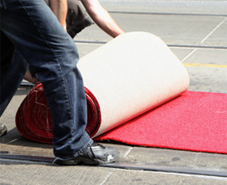
Notes:
The red carpet is rolled up.

Slide 53
Gratification of the senses
TEMPORARY
CHILL
&
THRILLS
Notes:
It all ends very soon.

Slide 54
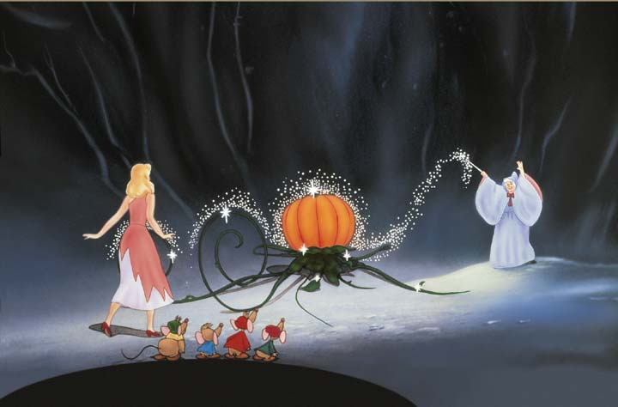
Notes:
The carriage turns in to a pumpkin.

Slide 55


Slide 56

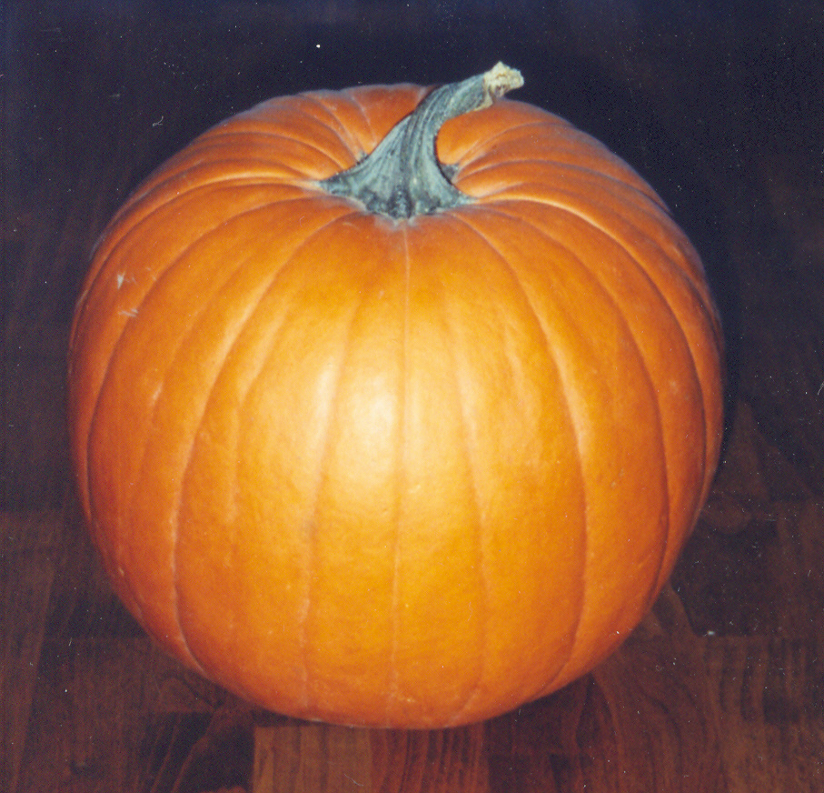
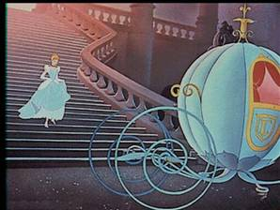
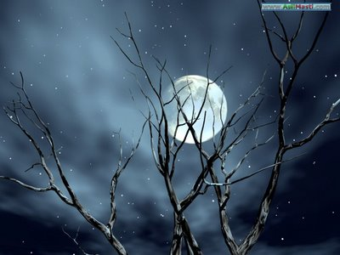
Notes:
The pretty clothes turn in to rags.

Slide 57
الله أكبر الله أكبر
Allah is the greatest Allah is the Greatest
أَشْهَدُ أَنْ لاَّ إِلـٰـهَ إِلاَّ الله
I bear witness that there is no god except Allah
أَشْهَدُ أَنَّ مُحَمَّدًا رَّسُولُ اللهِ
I bear witness that Muhammad (PBUH) is the messenger of Allah
حَيَّ عَلَى الصَّلَوٰةِ
Hurry to the prayer (Rise up for prayer)
حَيَّ عَلَى الْفَلاَحِ
Hurry to success (Rise up for Salvation)
اَلله ُ أَكْبَرُ اَلله ُ أَكْبَرُ
Allah is the greatest Allah is the Greatest
لاَ إِلـٰـه إِلاَّ الله
there is no god except Allah
Notes:
And what do we hear in the adhan?

Slide 58

الْفَلاَحِ
Comprehensive success

Slide 59
Importance of Adhan
It is the first step towards the first act of worship
If we take the first step properly, it will have direct effect on the performance of the first act of worship: Salah!

Slide 60

الصَّلَوٰةِ
Adhan
Notes:
Adhan takes you towards Salah

Slide 61
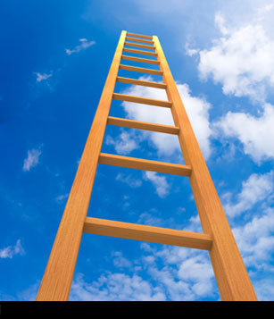
الْفَلاَحِ
الصَّلَوٰةِ
Notes:
which takes you towards Al Falah, comprehensive success.

Slide 62

Non-stop Party Time
Notes:
Where the party never ends.

Slide 63
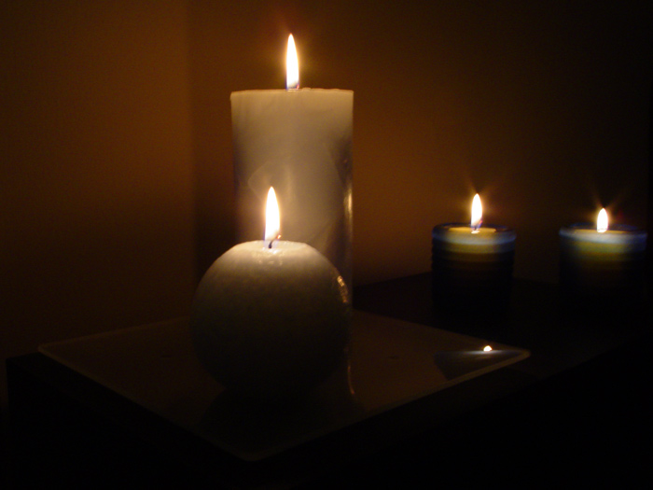
It sets the “mood” for Salah

Slide 64
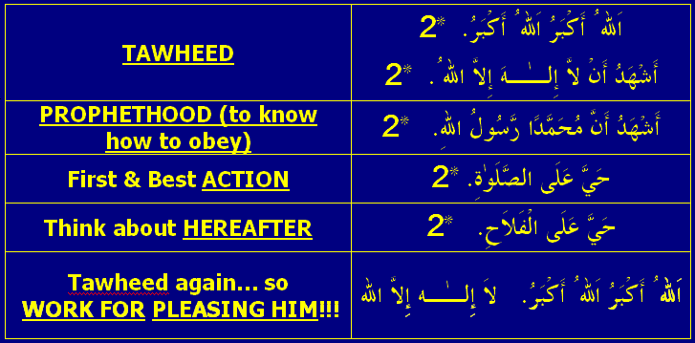
Fundamentals of Islam are conveyed in Adhan

Slide 65

Words of Adhan were probably the first words you heard
Notes:
It is reported that Abu Rafi` (a Companion) said, "I saw the Messenger of Allah (may Allah bless him and his household and grant them peace) give adhan in the ear of al-Hasan, the son of `Ali, when Fatimah gave birth to him."
(Tirmidhi, Abu Dawud, Ahmad, al-Hakim and al-Bayhaqi)

Slide 66

Adhan is a SATAN repellent

Slide 67
  Jabir (RA) reported:
  he heard the Prophet (PBUH)saying;
  Indeed when Shaytan hears the call for prayer, he goes away till Rawhaa
  (Muslim)
Notes:
Rawhaa – place 60 km from Madinah

Slide 68


We
respond to an invitation
Notes:
Unfortunately, we don’t have this custom even though RSVP is written on invitations but we generally do not confirm or decline. But this is a basic etiquette because people make arrangements accordingly.
RSVP : Responde sil vous plait

Slide 69
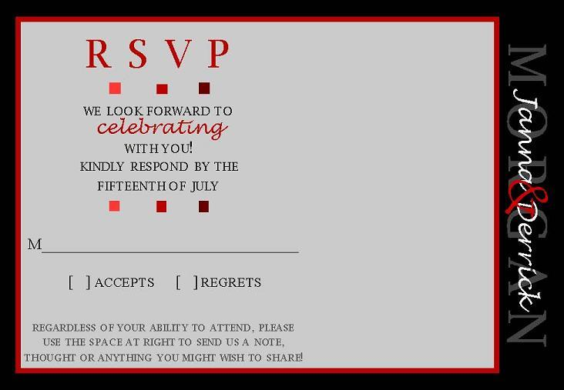
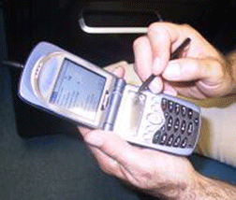
Thank you for the invitation
Notes:
You can do that by calling or by sending an sms, email.

Slide 70
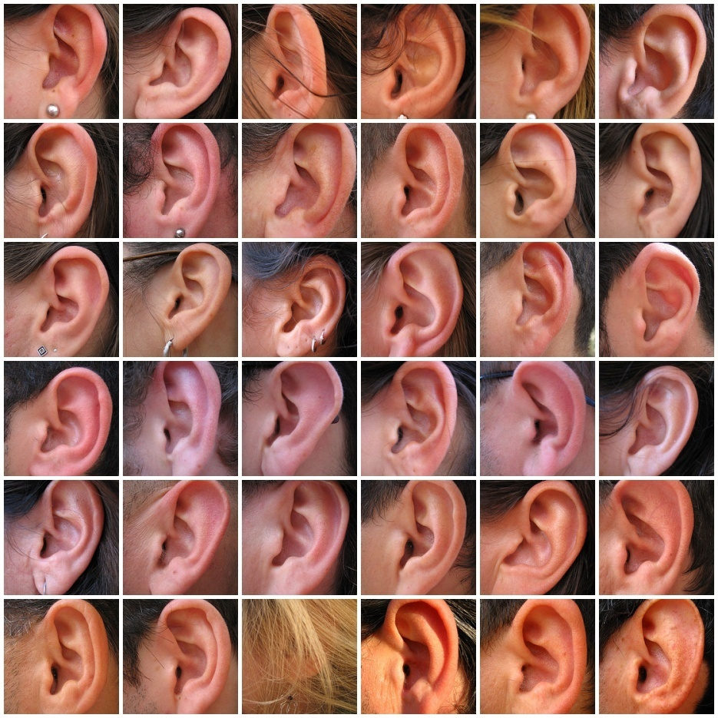
4 things to do
During & after hearing Adhan!
Notes:
Our response to adhan

Slide 71
1. Repeat words of Adhan
  Abu Sa`id Al-Khudri (RA) reported: The Messenger of Allah (PBUH) said:
  When you hear the Mu'adhdhin (pronouncing the call to Salah), repeat after him what he says.
  {Bukhari and Muslim}

Slide 72
  In response to حَيَّ عَلَى الصَّلوة and حَيَّ عَلَى الفلاح
لاَ حَوْلَ وَلاَ قُوَّةَ إِلاَّ بِاللهِ
  There is no strength (to avoid sins; to leave everything else for Salah) and no power (to do good; to come to Salah) except with (the help of) Allah.

Slide 73
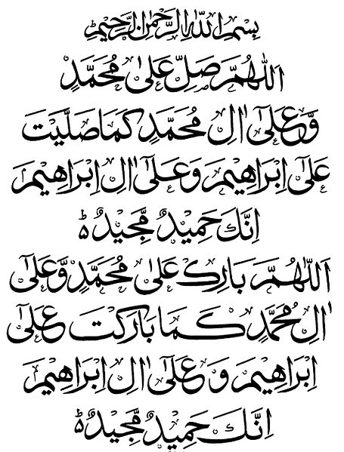
2. Send Durood on The Prophet (PBUH)
O God! Send blessings upon Muhammad and upon the House of Muhammad as You sent blessings upon Abraham and upon the House of Abraham; indeed, You are praiseworthy and glorious. O God! Bless Muhammad and the House of Muhammad as You blessed Abraham and the House of Abraham; indeed, You are praiseworthy and glorious.

Slide 74
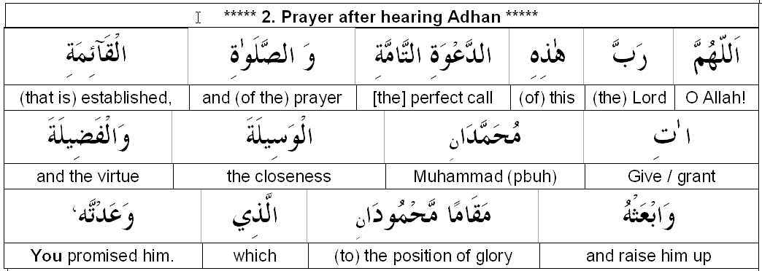
3. Make this dua for
The Prophet (PBUH)
{Bukhari}

Slide 75
OR …
انّک لا تخلف المیعاد
Verily, You do not neglect promises
{Al Baihiqi}

Slide 76
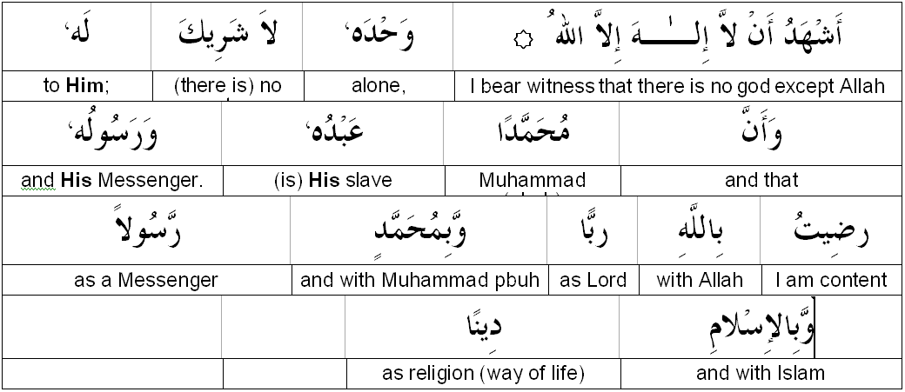
We can add this dua
{Mishkat}

Slide 77
  `Abdullah bin `Amr bin Al-`As (RA) reported:
  I heard the Messenger of Allah (PBUH) saying, "When you hear the Adhan, repeat what the Mu'adhdhin says. Then ask Allah to exalt my mention because everyone who does so will receive in return ten rewards from Allah. Then beseech Allah to grant me Al-Wasilah, which is a high rank in Jannah, fitting for only one of Allah's slaves; and I hope that I will be that man. If any one asks Al-Wasilah for me, it becomes incumbent upon me to intercede for him.''
  [Muslim]

Slide 78
4. Make any dua
Anas (RA) reported:
The Messenger of Allah (PBUH) said:
The supplication made between the Adhan and the Iqamah is never rejected.’
[Abu Dawud and Tirmidhi]

Slide 79
Send Durood again

Slide 80

focus
for
SALAH

