Slide 1

DANGEROUS
ROAD BLOCKS
(part 2)

Slide 2
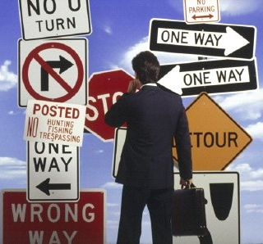
How to remove these road blocks and get going
Notes:
When ever you find a task difficult because of any road block in your life what do you do?
There are few steps which will help you to do what u want to do in your life.

Slide 3
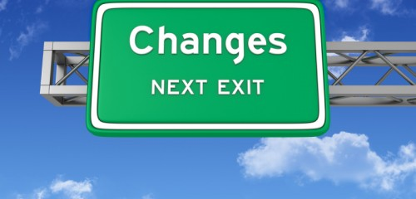
The Key # 1
Count the cost and the benefits

Slide 4
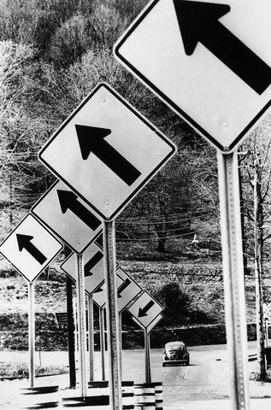
We don’t do it
Notes:
Biggest problem in what we want to do is that ….

Slide 5
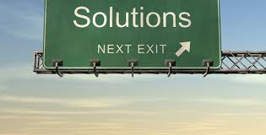
Before beginning count the cost
HOW?
Notes:
If we want to get good grades this year
First step is to think what all do I need to give up to achieve this, What all will it require from u?
Because nothing is free in this life
….More time practicing math
Talking less on the phone
Getting up early
Sleeping early too
Reduce TV watching
Praying to Allah

Slide 6



Count the benefits
Notes:
Feeling of accomplishment
Happy parents
Relaxed environment at home
Siblings and friends looking up to you
parents
Respect
Confidence

Slide 7
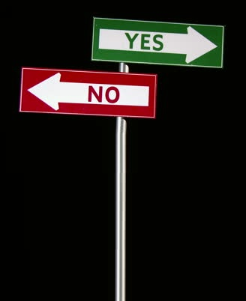
Now ask yourself
Am I willing to make the sacrifices?
Notes:
If not ….

Slide 8

Then please don’t do it !
Notes:
Its not a good idea to make commitment to yourself that you know you r going to break.
If yes , go ahead and do it.

Slide 9
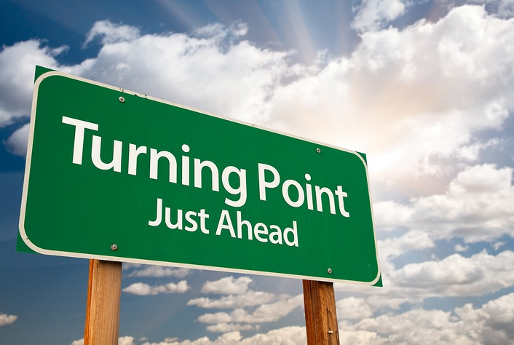
Lets count our costs for Jannah
Notes:
Another example
There is one thing we all would want for ourselves and that is jannah….what will you have to give up for attaining jannah??

Slide 10


Notes:
Now lets count the cost and the benefits
Now ask yourself
Am I willing to make the sacrifices?
If not. Then please don’t bother abt it and keep enjoying this life !

Slide 11


JUST DO IT!
Notes:
If yes,
We will have to overcome all the road blocks
And just get going….

Slide 12


What is the difference between
I
Will
I’ll
Notes:
…..You make excuse in this

Slide 13
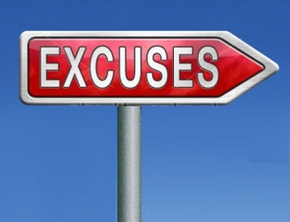
“I’ll try to return it?”
‘I’ll try not to cheat on you?’
Notes:
Would u lend money to someone who would say ….
Would u marry a guy who would say
Get the point?
So if u think or say that u will try to change your lifestyle to please allah what type of commitment r you giving?

Slide 14

Master
& his servant
Story
Notes:
master: Go and deliver this letter to my friend
servant: I'll do my best master
Master: no I don’t want u to do your best , I want u to deliver this letter.
Servant: I’ll do it or I’ll die master.
master: you misunderstood me. I don’t want you to die . I want u to deliver this letter.
Finally the servant caught on and said , ‘ I’ll do it master

Slide 15
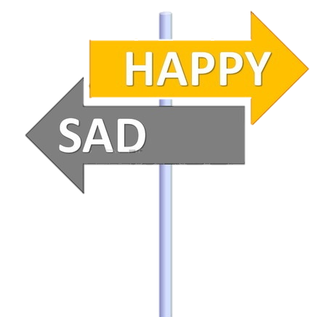
Key no.2
Use momentous moments
Notes:
1st was Count the cost and benefits
Certain moments in life are very powerful.
Death of a close one
A new school
Ramazan
A second chance
A loss
A moment in this class
A new day

Slide 16

Notes:
The key is to harness these moments to achieve your goals
Bc this mood to do it will not last too long in your life.
And then stick with it even when u don’t feel like doing it…..

Slide 17


Key no.3
“Roping up”
Notes:
1st cost benefits
2nd momentous moments
We can rope up together to aid each other in climbing

Slide 18

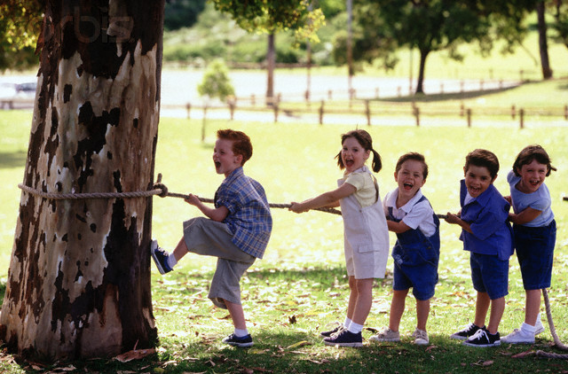
Notes:
You can accomplish the impossible by borrowing strength from others

Slide 19
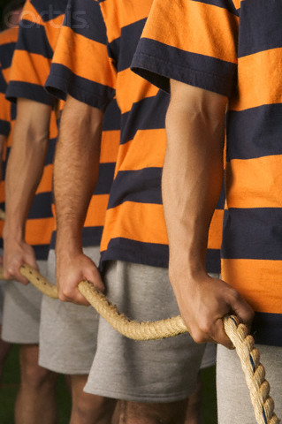
How to rope up ?
Notes:
….Find a friend with the same goal
The two of u can become each others cheer leader
Get your parents involved or your siblings.

Slide 20
You can rope up with your
Parents
Aunts & Uncles
Friends
Siblings
Teacher
Notes:
Or perhaps all of you can rope up together

Slide 21
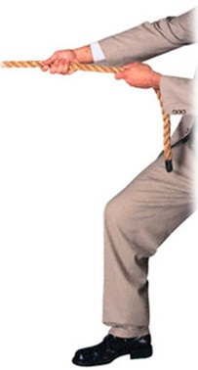
What is better?
Or

Slide 22
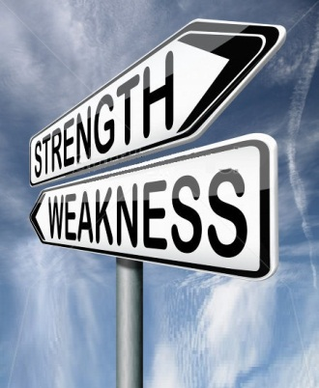
Key no .4
“Turn your weakness into strength”
Notes:
1st cost benefits
2nd momentous moments
3rd roping up

Slide 23
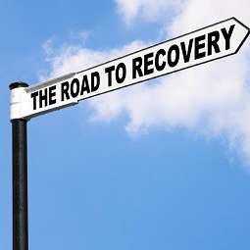
Notes:
If u R not gifted with the beauty, wealth and brains that you desire
The uphill battle always produce qualities and strengths one can’t develop any other way

Slide 24


Timber
Ahead
Notes:
Good timber does not grow with ease,
the stronger wind, the stronger trees

Slide 25
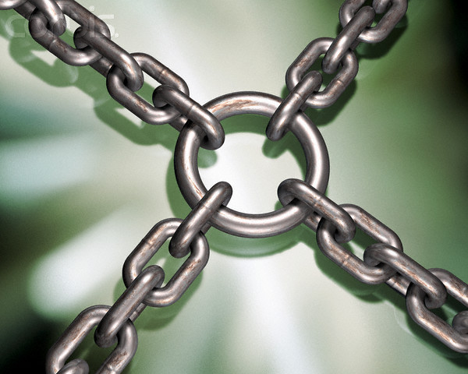
Notes:
This is how weakness becomes your strength
1st cost benefits
2nd momentous moments
3rd roping up
4th turn your weakness into strength

Slide 26

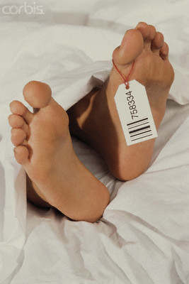
Notes:
Each one of us in this room will stop breathing one day
We all will turn cold ,
die and be fertilizer for daffodils

Slide 27
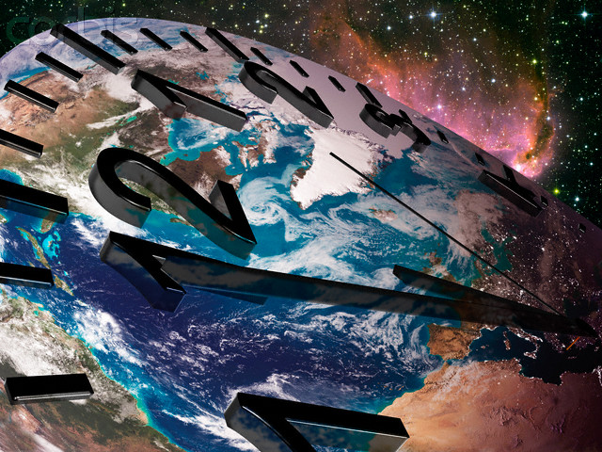
Notes:
Time is clicking and we cant slow it down
Lets not be late in making the best of what we are capable of
We are very lucky that our destiny in the hereafter is yet to be determined

Slide 28
For every closed door, there is always another which is open—but only to those who have the eyes to see it, and the courage to march through it.

Slide 29

Think !

