Slide 1

DANGEROUS
ROAD BLOCKS
(part 1)
Notes:
Does this sound familiar?
When was the last time u said this
Lets list down the things on which u said this

Slide 2

Notes:
Lets say the road leading to your school was closed and had this sign on it
What did u do then ?
reading this sign one takes anther road to school
But it surely doesn’t mean that now since the actual road is closed therefore one cant go to school

Slide 3
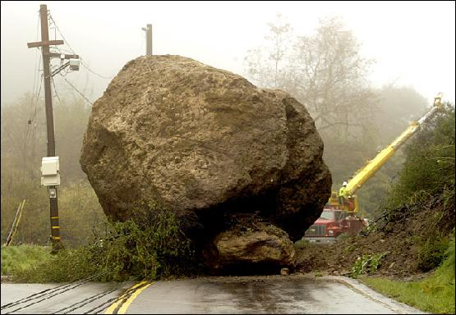

ROADBLOCK
CAN YOU
BREAK THROUGH?
Notes:
Like wise in our lives sometimes we cant go further and do stuff that we should be doing because of some reason.
But this must not stop us.
there can be some road blocks we need to watch out for some dangerous roadblocks might be not removable.

Slide 4

Major roadblocks of my life
Negative labels
“Its all over” syndrome
Climbing the wrong wall
Notes:
There are millions of unique individuals in this world

Slide 5

# 1: Negative Labels
Notes:
There are millions of unique individuals in this world

Slide 6

Notes:
Things in a store are shelved according to its size and shape
But we humans cannot be neatly shelved into a category
Why ?
Because we all are very unique and we cannot be labeled like things at shop.
We have different temperaments and no two people are a like.
Even when u say that she is like so and so, it means that few of her qualities are like so and so.
Even when u say someone is exactly like someone we just say it and its not true.

Slide 7

LAZY
DORK
STUPID
Notes:
Putting False label means calling someone what she isn’t really.
Like she is so proud
She is so lazy
You can still live with a false label stuck to you by others
But believing the label yourself is a dangerous road block

Slide 8

You are what you believe in

Slide 9

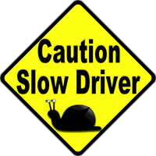
You act out a label if you believe it!
Notes:
…… If you are being labeled as stupid you will start acting stupid if you believe it.

Slide 10

Some common labels
You are the laziest kid I know.
You guys from so & so school always get crappy grades.
She sucks at math.
Why can’t you be like your sister?
You are unpopular because you are religious.
Why do you always get into trouble?
She is the black sheep of the family.
Notes:
So what do you do if people stick a false label on you?
Don’t believe in it.

Slide 11

#2:“It’s all over” syndrome
Notes:
The second thing that acts as a road block in our life , that stops us to do what we should is to feel hopeless.
Does it ever happen to u that u make a mistake or three
and you get the feeling that u have blown it,
who cares what happens now?

Slide 12

It is NEVER over…
Notes:
U might lose it and u might do a bunch of things that u might not feel proud of
If you make mistakes …..
It is normal
We all do

Slide 13

What to do next ?
Notes:
GET YOUR HEAD SCREWED ON STRAIGHT
AS QUICKLY AS U CAN
AND U’LL BE FINE
DO TAUBAH
HOW DO YOU DO TAUBAH

Slide 14

DO TAUBAH
Feeling genuinely sorry and ashamed over it.
Resolve sincerely not to do so again.
Seek the forgiveness of Allah with all your heart.
Notes:
Tauba means that if a person many slip into folly and be guilty of a sin he should feel genuinely sorry and ashamed over it,
and resolve sincerely not to do so again,
and seek the forgiveness of God with all his heart.
It is essential to know that Tauba is not vocal apology.
It is not at all a matter of uttering so many words of repentance.
The sorrow must be sincere,
the shame must be felt in the heart
and the resolution not to repeat the folly and be guilty of the sin again must be totally genuine.

Slide 15
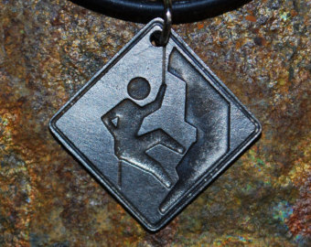
#3: Climbing the wrong wall
Climbing a wall you have
to be good at two things:
Climbing efficiently
Climbing the right wall
Notes:
The third road block is…..
Sometimes we make the effort but not the right one.
e.g.
Going on tuitions when u need to concentrate in the class
Baking cakes for your mother to please when all she needs is obedience
Giving gifts to friends where she needs to be heard out
Desiring joy in life through expensive vacations

Slide 16
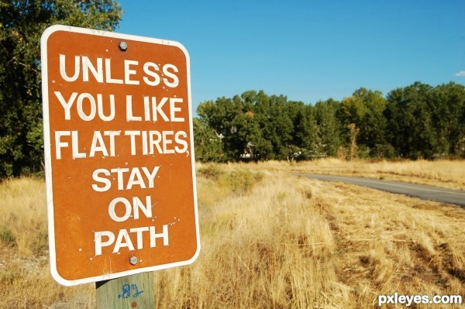
Notes:
1. Sometimes we work so hard towards climbing a wall that we forget to check if it is leaning against the right wall
2. It doesn’t matter how good u are doing if you are headed in the wrong direction.
Example. Parents,studies,namaz.

Slide 17

Stop and ask yourself
Notes:
How can u tell if u are struggling in the right direction??
Am I really in the right direction ?
Will this take me to my desired end result?
Be brutally honest as you pause now
And Listen to your inner voices

Slide 18

Notes:
There is an easier way for us muslims
Quran and sunnah

