Slide 1
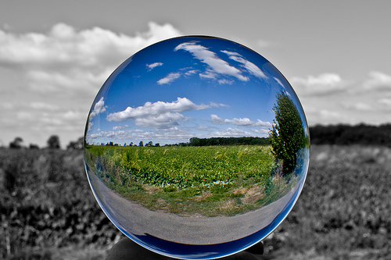
Reality or Illusion?
Make a choice

Slide 2
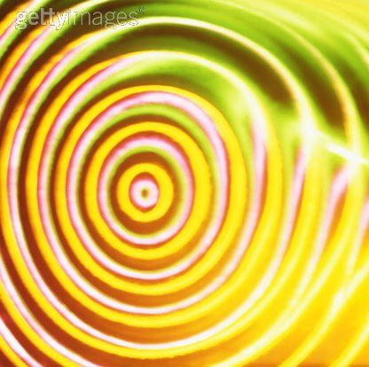
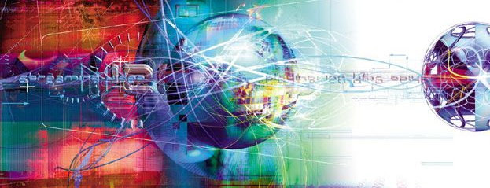
We live in a world of Information

Slide 3
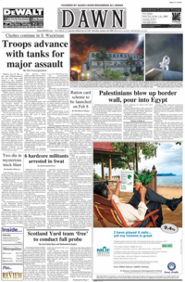
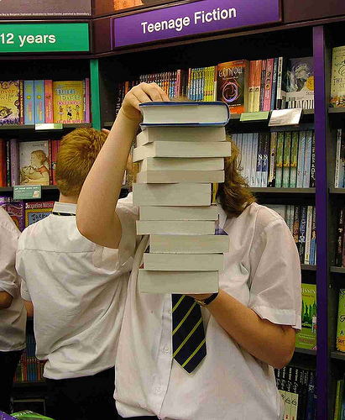
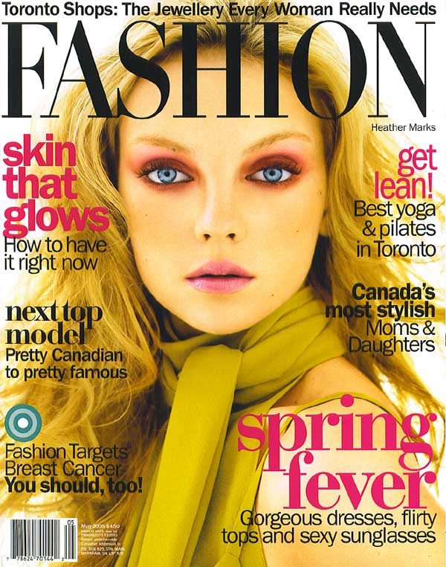
Books, Newspapers, Magazines

Slide 4
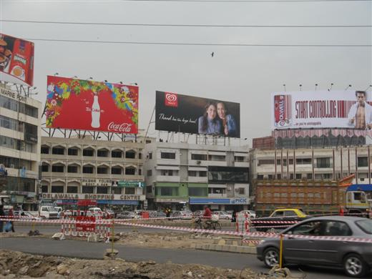
BILLBOARDS – In Your Face

Slide 5


Slide 6
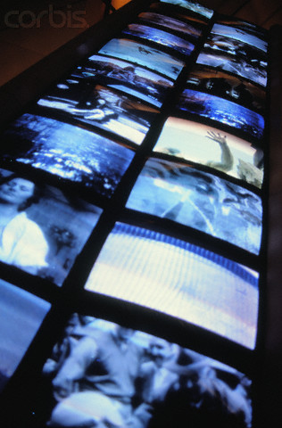
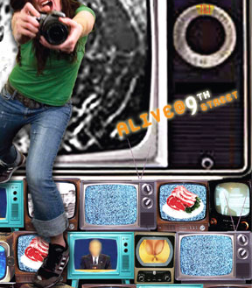
Invasion of Television

Slide 7


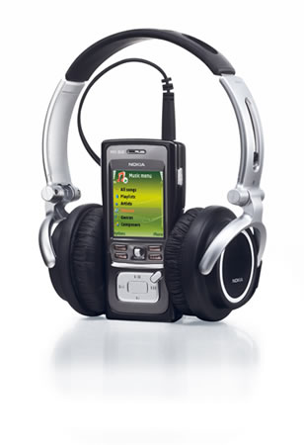
Information at our fingertips

Slide 8
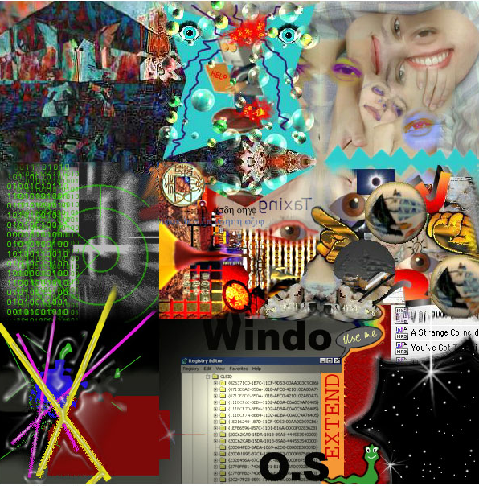
All this information is enough to make our heads go spin spin spin …..

Slide 9

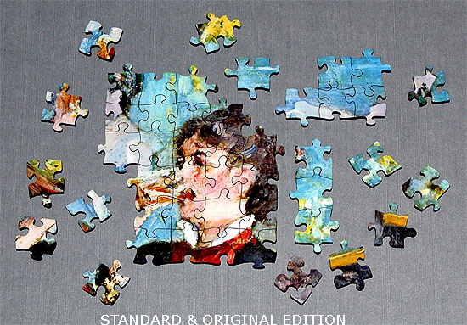
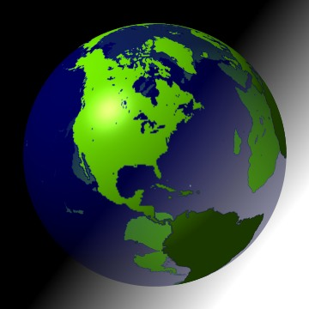
This information is the basis of our formation of a picture of the world around us as well as of ourselves.

Slide 10

That is what we call
REALITY

Slide 11
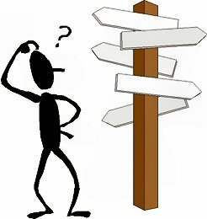
But we see there is a lot of confusion and misunderstanding about reality … lets see some examples

Slide 12
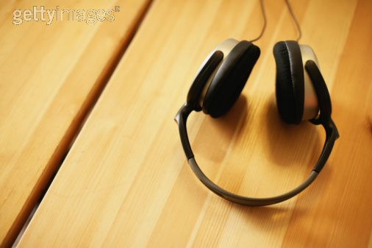
What we hear can be misleading

Slide 13
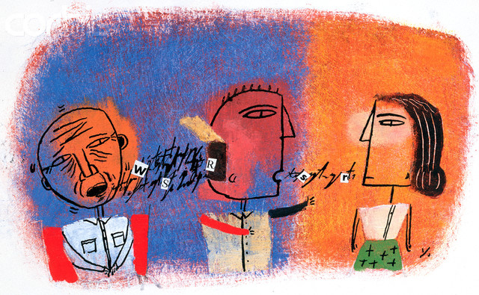
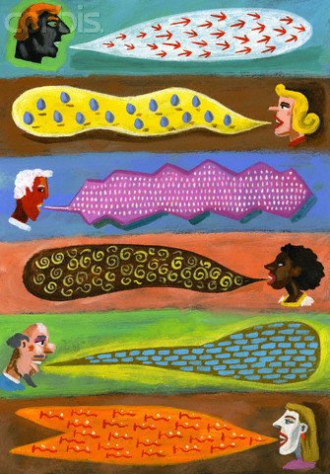
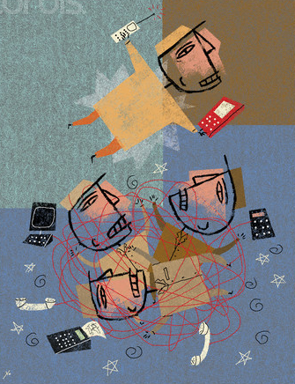

Slide 14
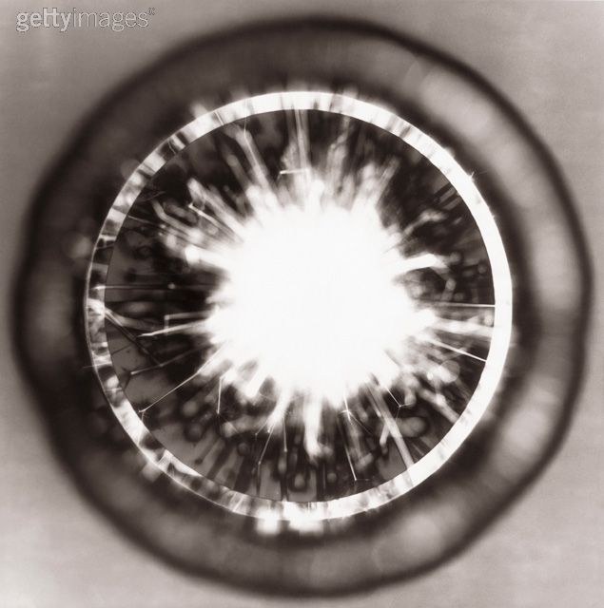
What we see can be deceiving

Slide 15
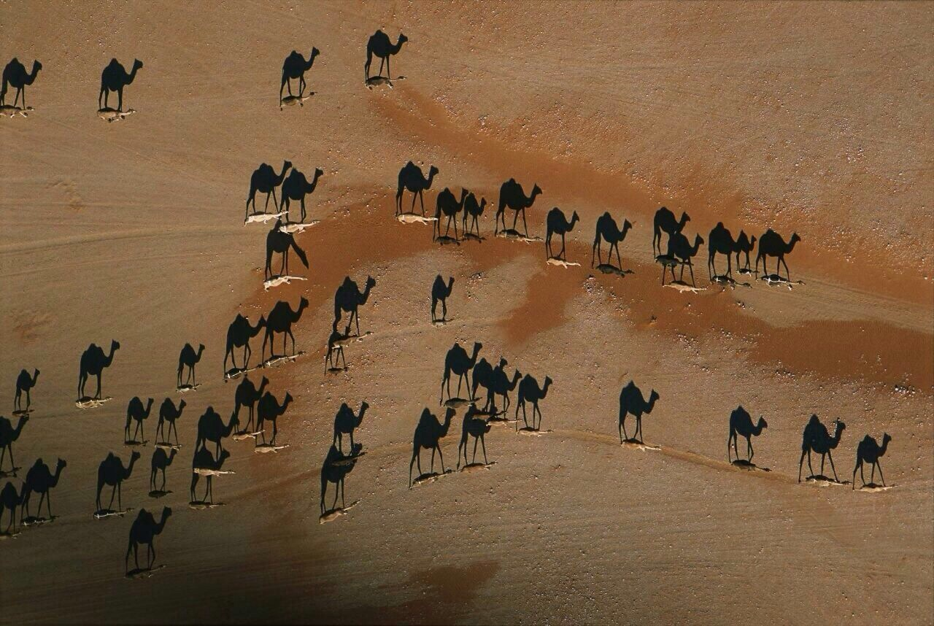

Slide 16



Slide 17
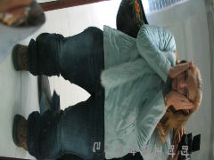
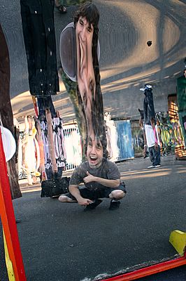

Slide 18
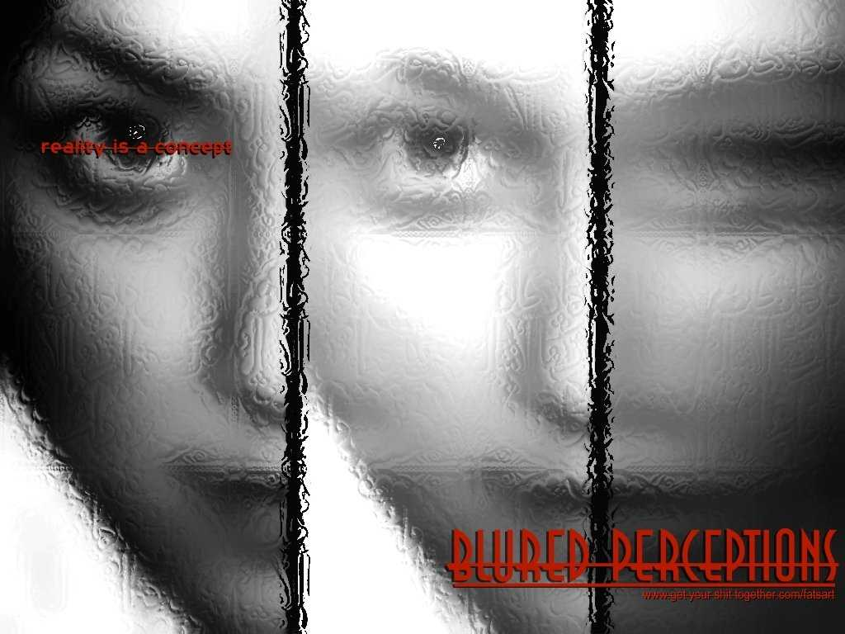

Slide 19
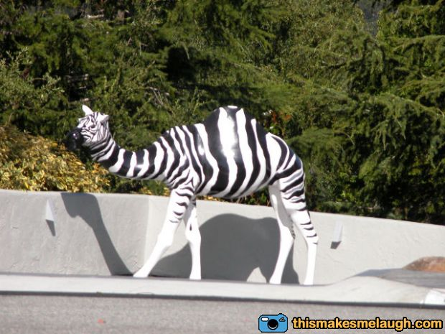

Slide 20
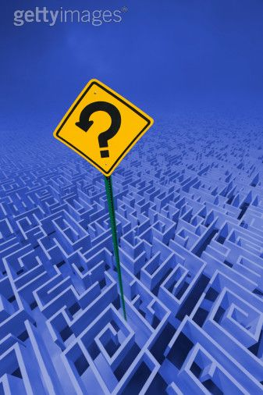
What we feel can be confusing

Slide 21
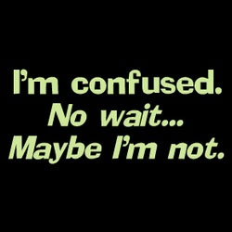


Slide 22

Seen
Unseen

Slide 23
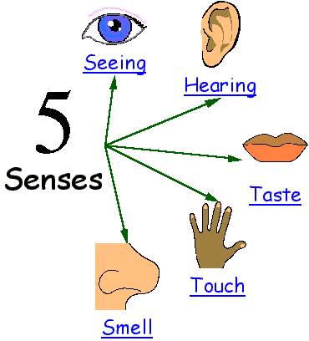
Primary
Receivers
of
Seen
reality

Slide 24
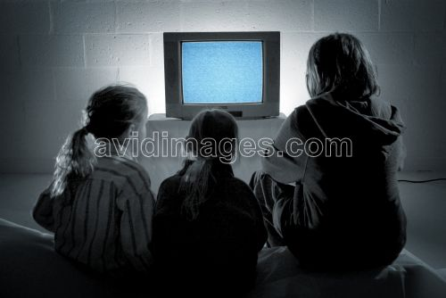
When we rely only on
“seen” reality

Slide 25

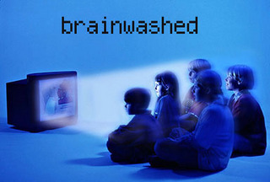
This is what happens …

Slide 26

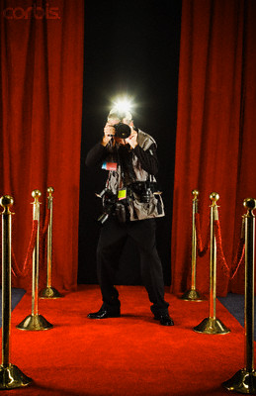
we start thinking - all the world is a stage …
Lights, Camera, Action ….

Slide 27
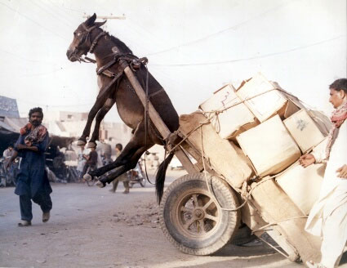
We become like this donkey – over loaded and over whelmed with “information”

Slide 28
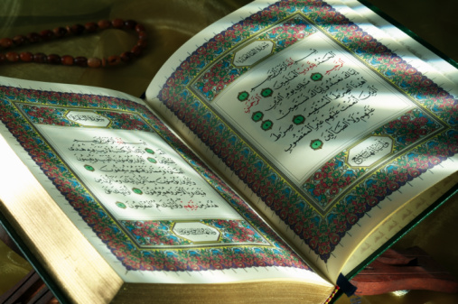
Only Source of “Unseen Reality”
The Quran

Slide 29

Hadith of The Prophet (PBUH)
Which is understood
with the lens of
Quran
Quran
A
H
A
D
I
T
H

Slide 30
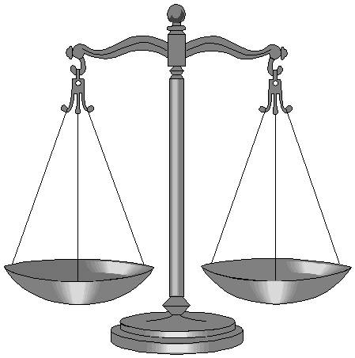
To keep a balance in our lives and to see the complete picture of REALITY we must know about the things we cannot see i.e the unseen reality
Seen
Unseen

Slide 31
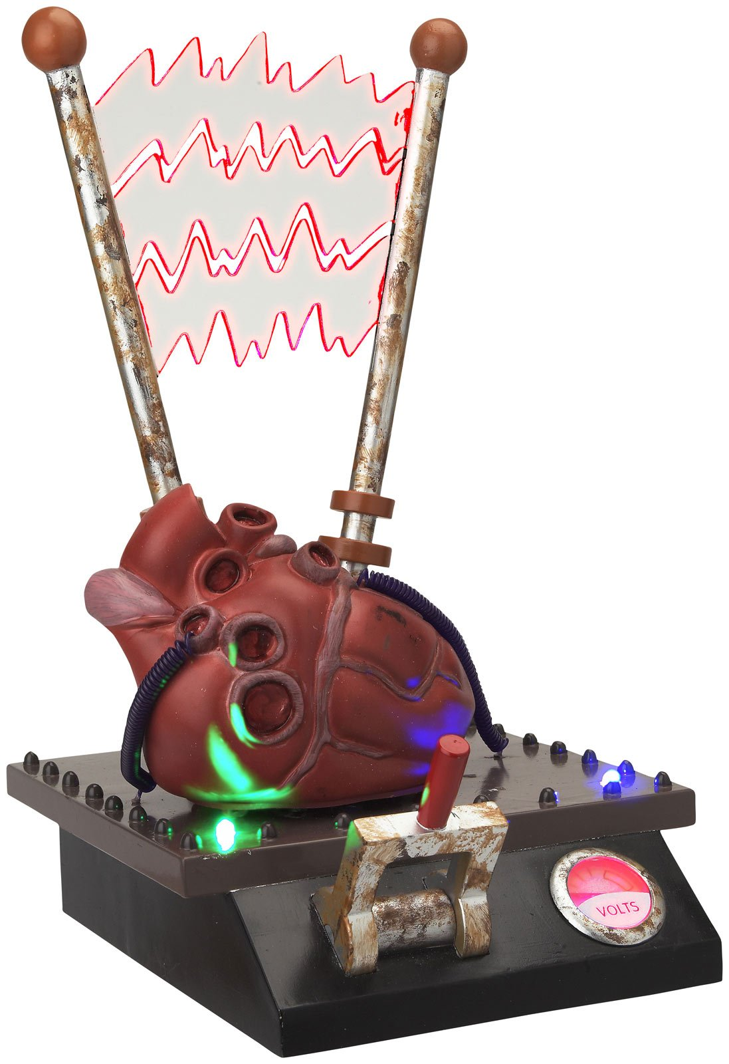
Sole receiver
Of
Unseen Reality
HEART

Slide 32
Surah Al Araaf: Verse 179
… لَهُمْ قُلُوبٌ لاَّ يَفْقَهُونَ بِهَا وَلَهُمْ أَعْيُنٌ لاَّ يُبْصِرُونَ بِهَا وَلَهُمْ آذَانٌ لاَّ يَسْمَعُونَ بِهَا أُوْلَـئِكَ كَالأَنْعَامِ بَلْ هُمْ أَضَلُّ أُوْلَـئِكَ هُمُ الْغَافِلُونَ
…They have hearts wherewith they understand not, and they have eyes wherewith they see not, and they have ears wherewith they hear not. They are like cattle, even more astray; those they are the heedless ones.

Slide 33
Surah Al Hajj: Verse 46
أَفَلَمْ يَسِيرُوا فِي الْأَرْضِ فَتَكُونَ لَهُمْ قُلُوبٌ يَعْقِلُونَ بِهَا أَوْ آذَانٌ يَسْمَعُونَ بِهَا فَإِنَّهَا لَا تَعْمَى الْأَبْصَارُ وَلَكِن تَعْمَى الْقُلُوبُ الَّتِي فِي الصُّدُور
Have they not travelled through the land, and have they hearts wherewith to understand and ears wherewith to hear? Verily, it is not the eyes that grow blind, but it is the hearts which are in the breasts that grow blind.

Slide 34
Prophet (PBUH) said:
"Truly, what is lawful is evident, and what is unlawful is evident, and in between the two are matters which are doubtful which many people do not know. He who guards against doubtful things keeps his religion and honour blameless, and he who indulges in doubtful things indulges in fact in unlawful things, just as a shepherd who pastures his flock round a preserve will soon pasture them in it. Beware, every king has a preserve, and the things Allah has declared unlawful are His preserves. Beware, in the body there is a flesh; if it is sound, the whole body is sound, and if it is corrupt, the whole body is corrupt, and behold, it is the heart.“ {Bukari & Muslim}

Slide 35
The Prophet (PBUH) said:
Indeed Allah does not look at your faces or your wealth. Instead, He looks at your hearts and your deeds.
{Muslim}

Slide 36

The heart is the centre of our emotions is universally accepted

Slide 37
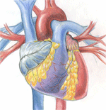

Slide 38
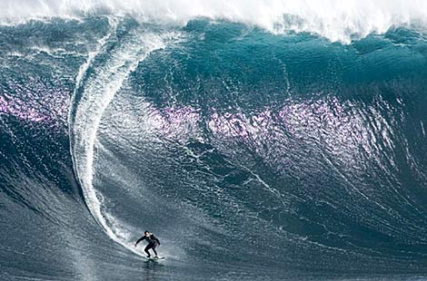
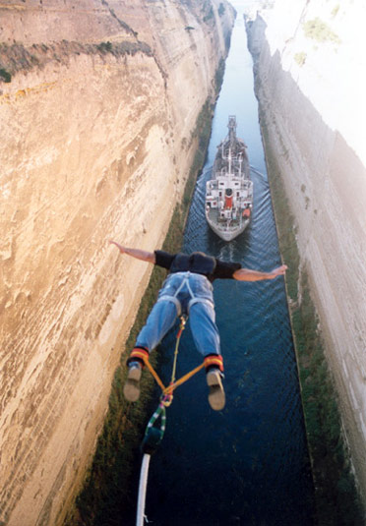
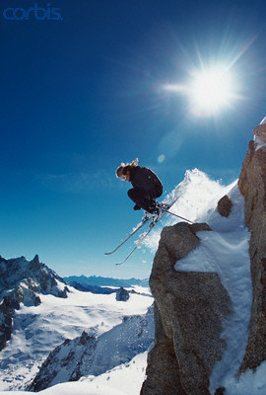
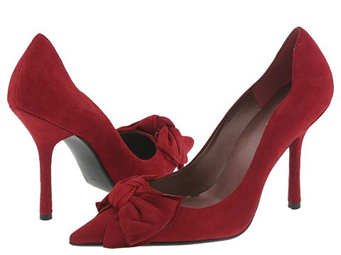
When we want … we can do just about anything …. Even wear high heels!

Slide 39
When our heart is not involved – ZILCH happens

Slide 40
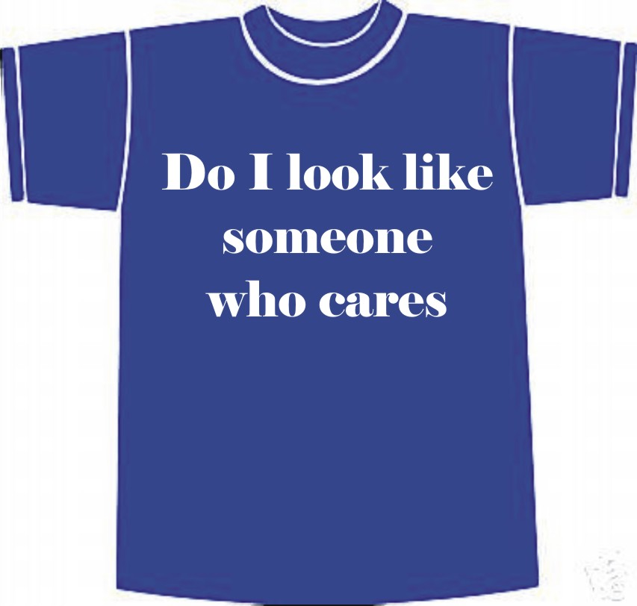
Reality or Illusion
You may be wondering so who cares? Why is there a need to know REAL reality. Why not keep living in la la land … it is convenient and fun!

Slide 41
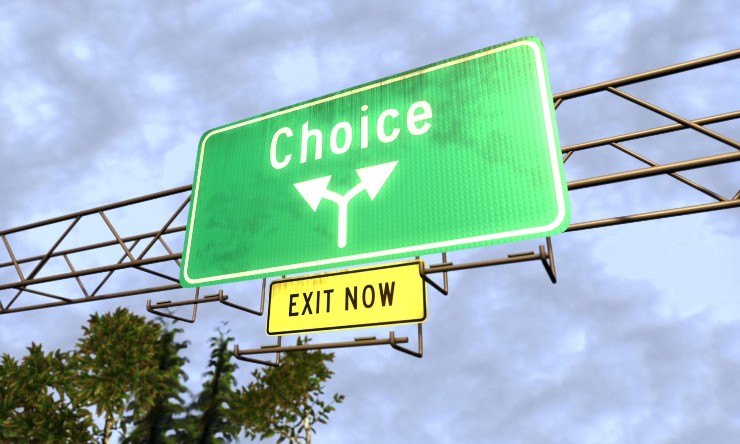
The reason we must care and try to understand is that our life is a series of choices

Slide 42
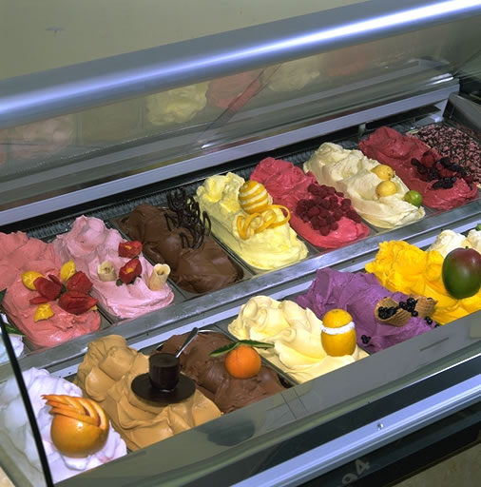
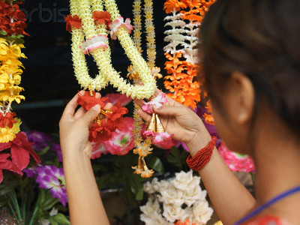
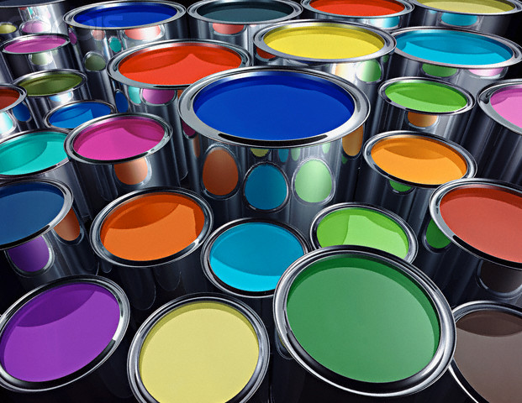

Slide 43
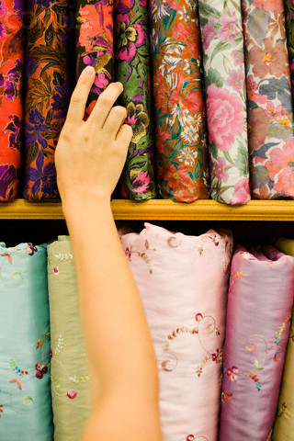
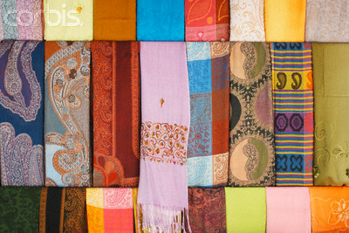
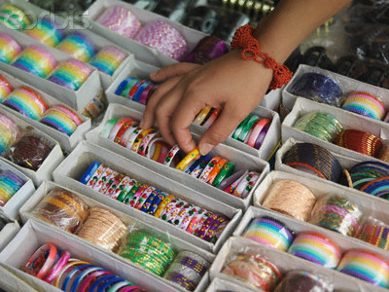

Slide 44
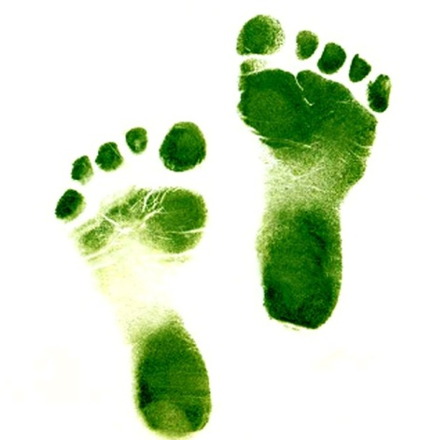
Every choice we make takes us closer to our destination

Slide 45
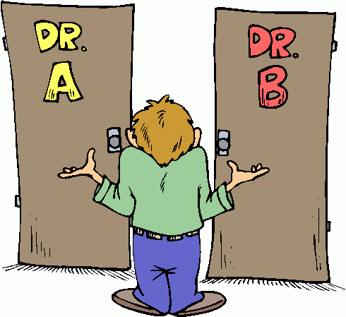
And in the end
There are only two places to go
H
E
L
L
H
E
A
V
E
N

Slide 46

WISELY

Slide 47
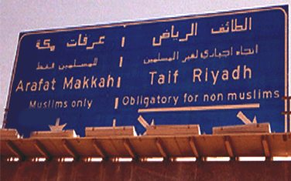
Make an
Informed & Educated Choice

Slide 48

ROAD TO HEAVEN
For MUSLIMS only

Slide 49

یا مقلب القلوب ثبّت قلبی علی دینک
O’ Turner of Hearts! Make my heart steadfast on Your Deen
{Tirmidhi}

Slide 50

اللّھمّ انّی اسئلک حبّک و حبّ من یّحبّک والعمل الذی یبلّغنی حبّک
O’ Allah! I beg You for Your love and the love of the person who loves You and of that deed which would make me worthy of Your love
{Tirmidhi}

