Slide 1
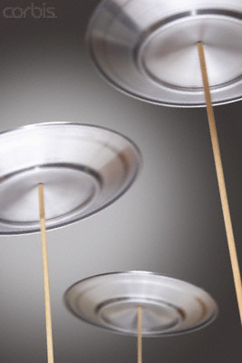
B
A
L
A
NCING ACT
Notes:
Let’s try to find out what this is all about.

Slide 2
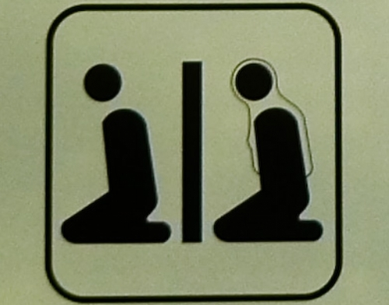
Salah is a STRUCTURED worship
Notes:
You have to follow a prescribed way of doing your salah which we know from the sunnah. We can’t make up things or do what we like.

Slide 3
Difference between Dua &Salah
DUA
SALAH
Informal & formal
Not structured
Can use any words
Can use any language
At any time
Optional
Formal
Structured
Must use certain words
Must be done in Arabic
At specific times
Obligatory
Notes:
Remember we discussed this in the first class.

Slide 4
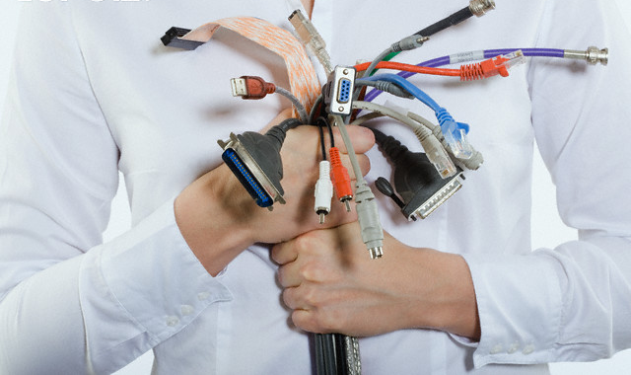
Notes:
Look at the example of hooking up a computer. So many plugs, some look alike, some different. Different colours, different shapes. Confusing for a lot of people.

Slide 5
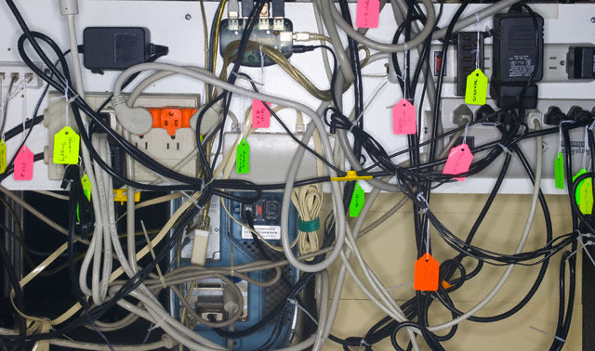
Notes:
All the cables have to go in specific places, otherwise things won’t run and there must be electrical supply only then will the connection be made.
Without an electrical connection, all these gadgets are useless. Can’t perform any function.

Slide 6
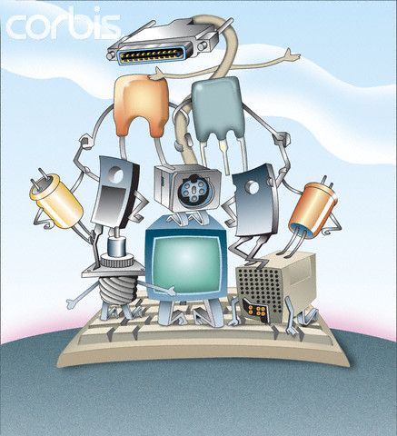
A structure is made up of parts
Notes:
Each part has its own function. All the parts are inter related and help each other in achieving the final goal.

Slide 7

The essence of Salah comprises three basic parts. It is composed of:
a) Feeling of respect, reverence and awe in the heart totally
b) Remembrance of Allah by tongue (word)
c) Showing bodily (physical) respect and reverence to Allah at the utmost degree.
Notes:
First step is a feeling in the heart. Usually we get so involved in the physical movements that we miss out the other aspects.

Slide 8
Heart
Body
Mind
Notes:
Feeling in the heart, remembrance through the tongue (involves the mind), physical respect through the body.

Slide 9

THE CHALLENGE
B
A
L
A
N
C
E
F
I
N
D
I
N
G
Notes:
Finding a balance between the heart, mind and body.
When you close your eyes and envision balance, what do you see? Whatever mental image comes to mind, underneath that image is the feeling of contentment and peace that cannot be shaken. We might find ourselves at the center of a whirlwind of activity, but, when we are in a state of balance, our minds and bodies are steady, ready to take on any challenge and move in a positive direction.

Slide 10
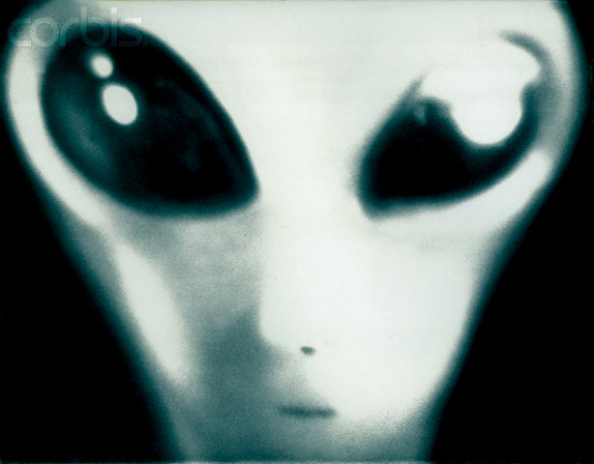
Balancing is not Alien to us
Notes:
Nothing new.

Slide 11

We face physical “balancing” challenges in different ways
Notes:
Right from our childhood. When we learn how to walk, it is all about balancing. Climbing stairs is one serious business for toddlers.

Slide 12
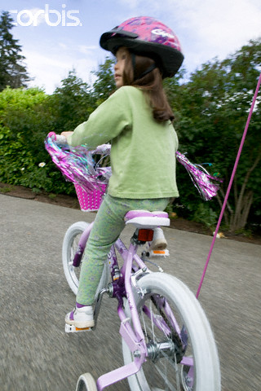

Notes:
Learning how to ride a bicycle is a balancing act. You generally start on a tricycle. Then when you get on a bicycle, two small wheels are attached additionally, to keep you balanced. Once you get used to the bike, then the small wheels are removed and you are on your own.

Slide 13

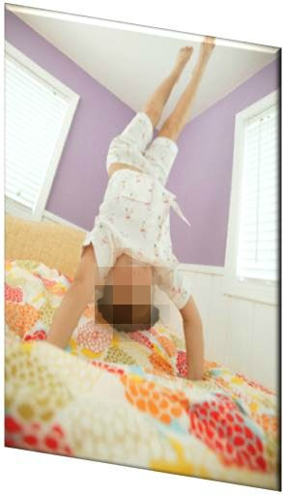
Notes:
Balancing on narrow foot paths. Or standing upside down. That requires good balancing techniques.

Slide 14
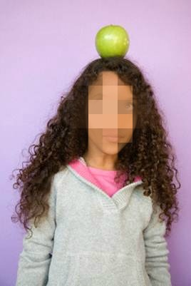
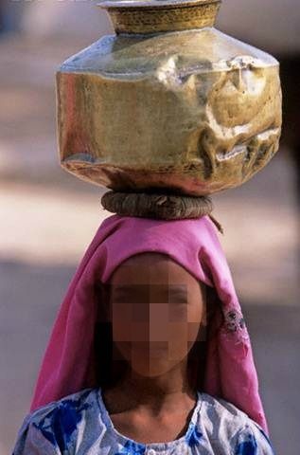
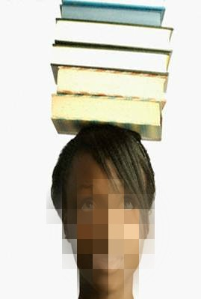
Notes:
Balancing anything on your head. Sometimes it is part of a game in sports.
Also people do that to correct their posture. If you have a habit of curving your back or slouching, then you should try this.
Rural women balance things on their heads with perfection.

Slide 15
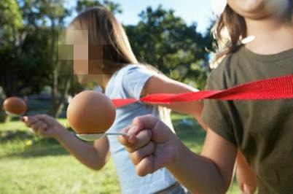

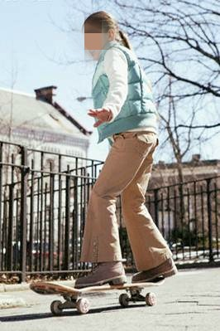
Notes:
Have you ever taken part in a spoon race? You have to balance something on a spoon and walk with it to the finishing line.
Balancing a ball on your fingertip, that seems tough.
Skating or being on a skateboard, that requires a lot of balance.

Slide 16
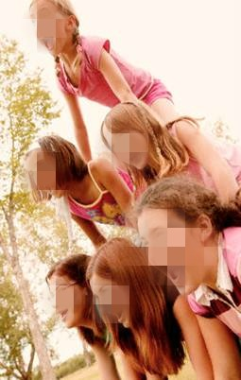
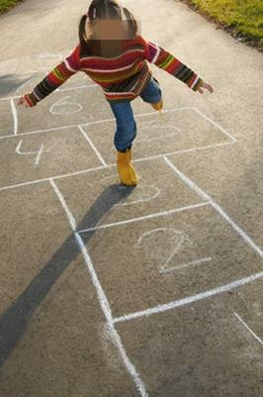
Notes:
Hopping on one foot or climbing on each other’s shoulders. That’s balancing.

Slide 17
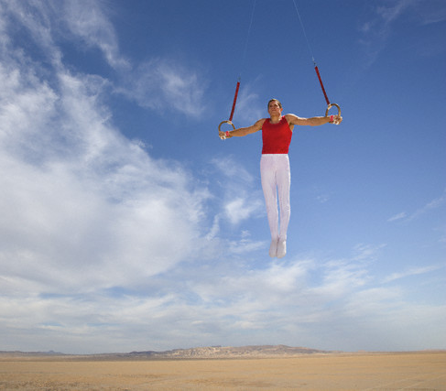
Notes:
This sure is tough. Balancing all your weight on your arms.

Slide 18
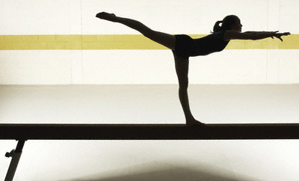
Notes:
Gymnastics is the whole art of balancing.

Slide 19
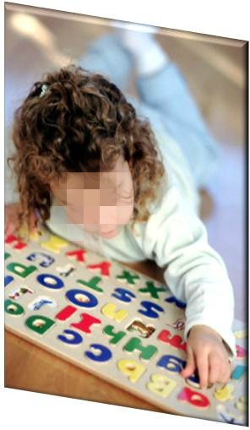

Mental “Balancing” Challenges
Notes:
Completing a puzzle is serious business!
You have to balance all the pieces so that they fit in properly.

Slide 20
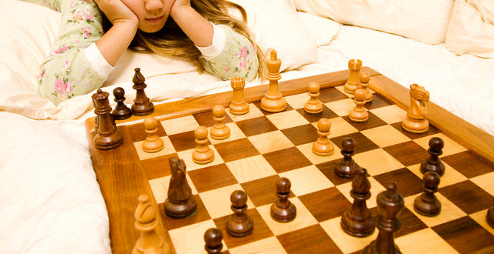
Notes:
Chess is a mental game. Balance your moves so that you can give check mate.

Slide 21

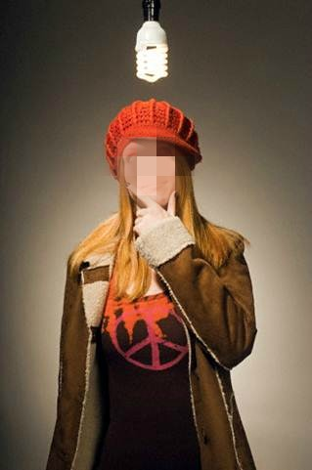
Notes:
As we grow up, our studies require balancing power.

Slide 22
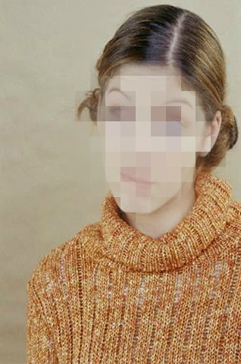
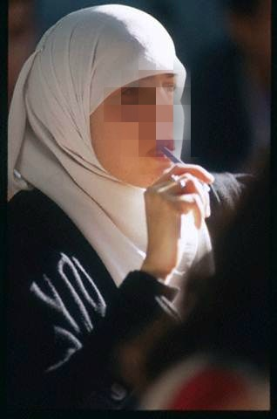
Notes:
Studies are a mental challenge.
You also have to balance your studies and all your other activities.

Slide 23

Notes:
Studying, using the computer, being on the phone. Balancing all these activities.

Slide 24

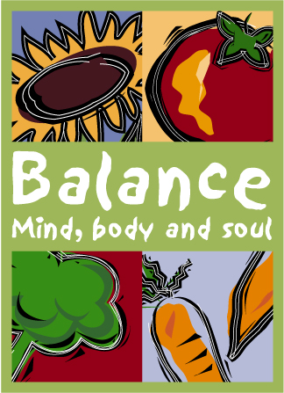
Non Muslims know the power of “BALANCE”
Notes:
Lots of books have been written on this subject.

Slide 25
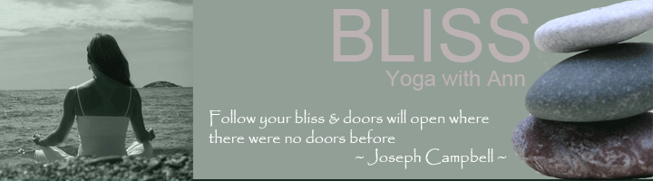
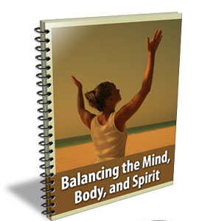
Notes:
Yoga is something very popular.

Slide 26
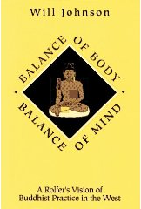
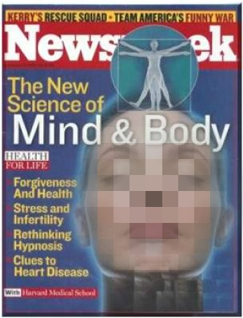

Notes:
You will find articles in magazines on this topic.

Slide 27
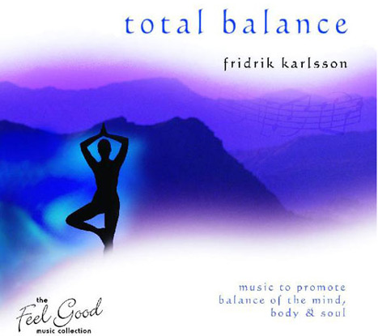
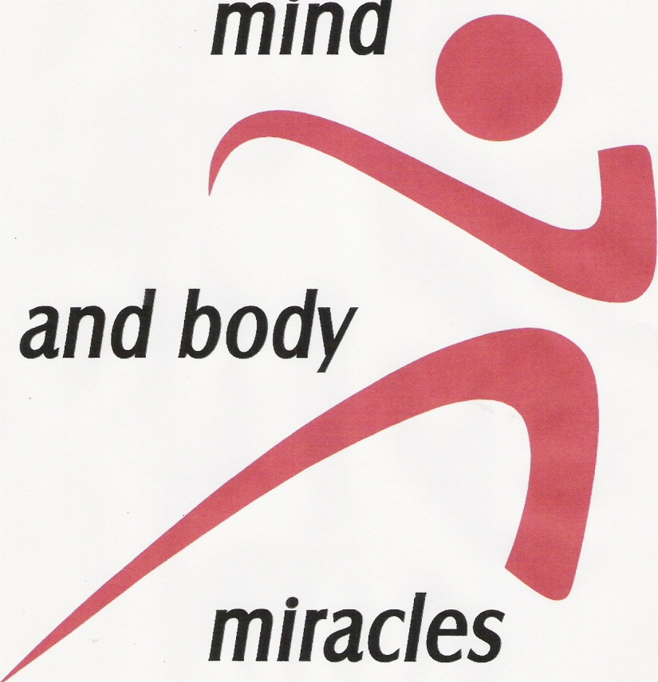
Notes:
You strike a balance between your mind and body.

Slide 28




Notes:
There are various products that assist and enhance our balance -

Slide 29
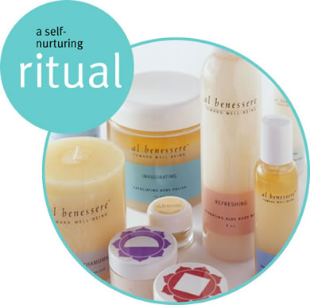

Notes:
All sorts of oils, lotions, creams etc.

Slide 30

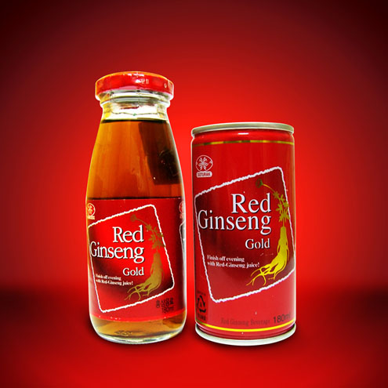


Notes:
There are some edible items also. Herbal teas and other drinks.

Slide 31
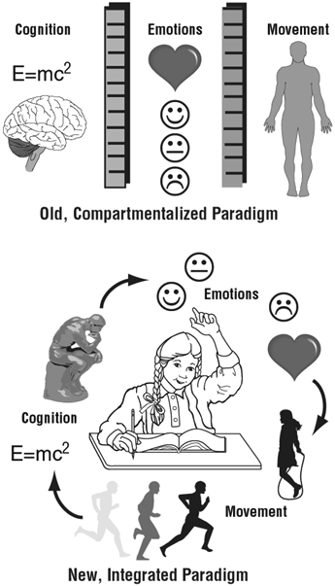
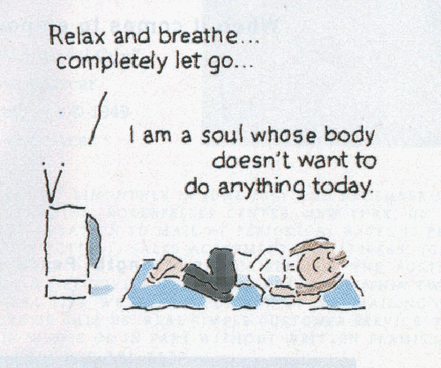
Notes:
I love this caption. I am a soul…..

Slide 32
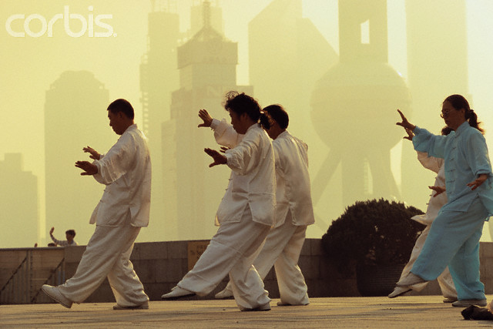
Notes:
Different religions also encourage physical balancing techniques.

Slide 33
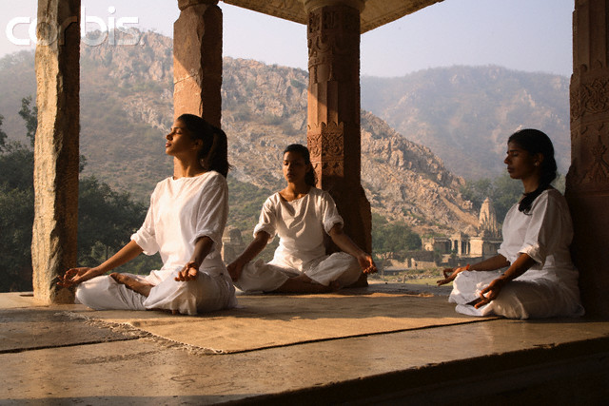
Notes:
Again yoga relaxes your muscles and your mind.

Slide 34
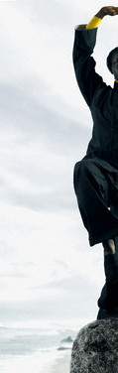

Slide 35
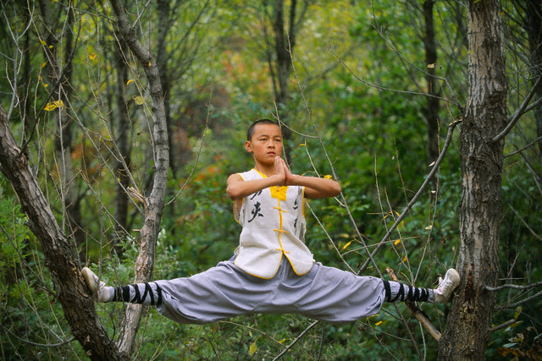
Notes:
This is tough.

Slide 36

Notes:
Buddhists really practice such things. They do this for hours to achieve a perfect balance.

Slide 37
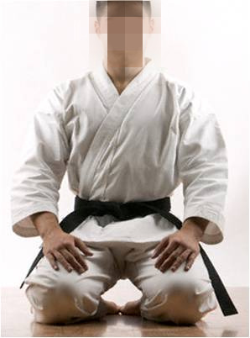
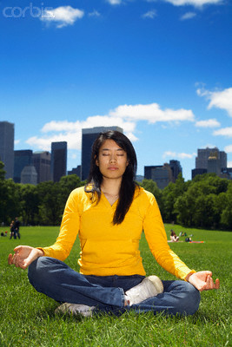
Notes:
Don’t these positions of balance look familiar? In our daily salah, we do similar physical movements.

Slide 38
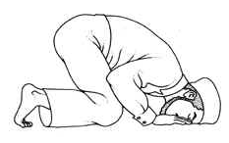
Lets focus on one particular position

Slide 39
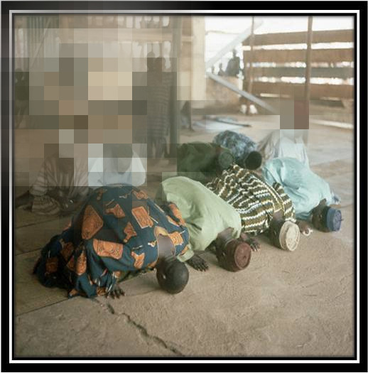

Slide 40
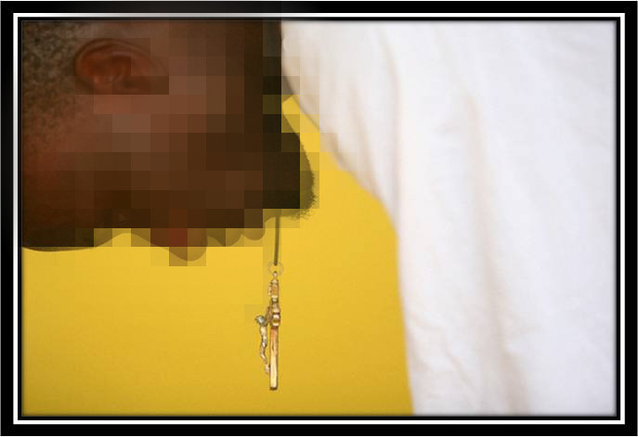
Notes:
He’s a Christian.

Slide 41
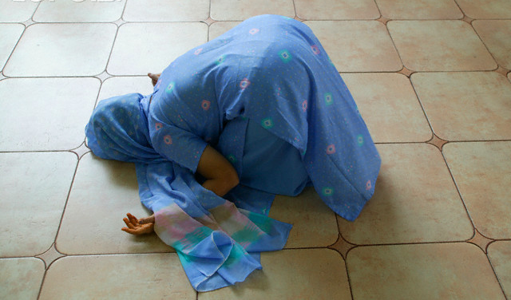
Notes:
Parsi

Slide 42
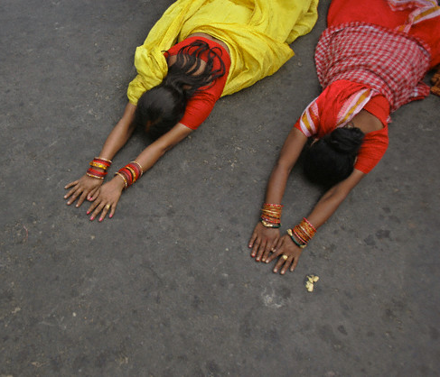
Notes:
Hindus

Slide 43
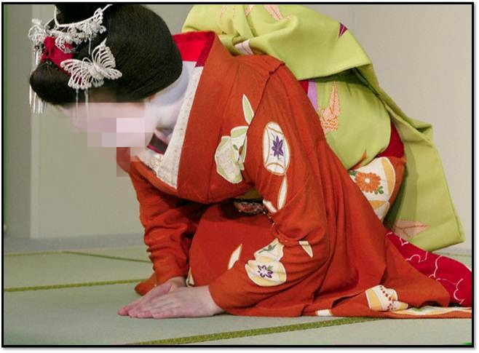
Notes:
Shintoism. A religion popular in Japan.
Shinto is a religious form of Japanese patriotism. The mythology of Shintoism teaches that Japan and the Japanese people were brought into being by special divine creation and that their emperors were literally descendants of the Sun Goddess
Shintoism has no rules for morality. It is because the Japanese were truly moral in their practice that they require no theory of morals."

Slide 44
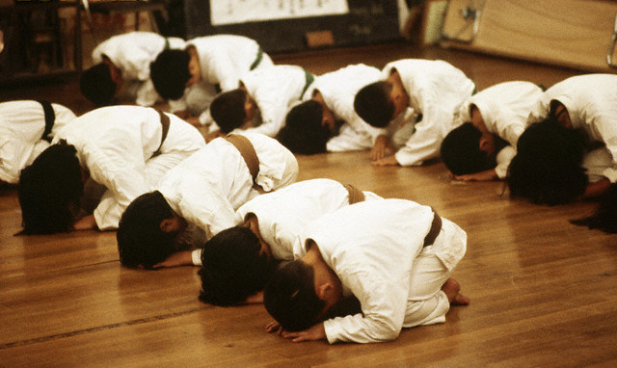
Notes:
They are all doing sajdah.

Slide 45
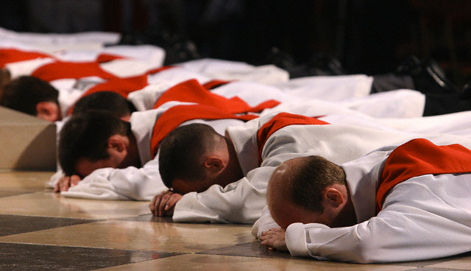
Notes:
Christian priests.

Slide 46
Physical Benefits of Prostrations
Prostrations strongly influence the balance and harmony in our body. Blocks in its energy channels gradually dissolve. This helps us avoid diseases, lack of energy, and other problems. Our mind becomes clearer. Our ability to understand increases.
www.purifyminds.com/prostrations

Slide 47
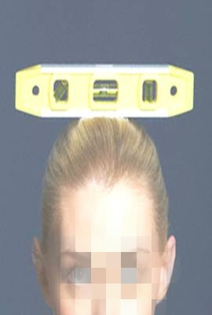
Harmonious functioning of body and mind at the correct level and in the most balanced way is achieved only through prayer

Slide 48

Are you convinced of the Balancing power of Salah?

Slide 49

WHY

Slide 50
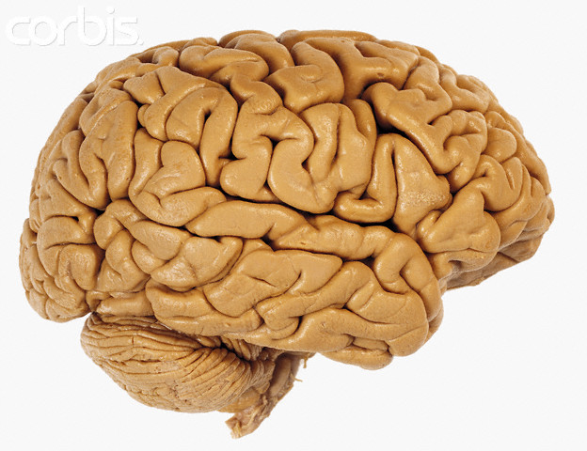
Because your brain bought it!

Slide 51
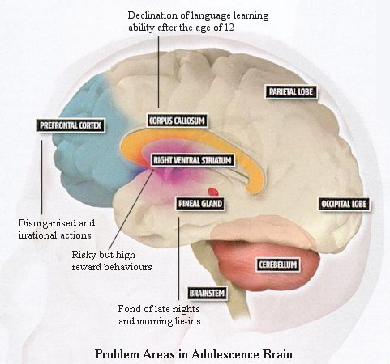
Notes:
We saw reasons for doing sajdah, saw other religions doing the same.

Slide 52
Conditions for Salah
Faith – be a Muslim
Must Be Sane and Have Reached Puberty
Have Wudhu
Purity of Body, Clothes and Place
Proper covering
Face Qibla
Have intention
On time
Notes:
Point # 2 is when salah becomes obligatory

Slide 53
First Condition for Salah
FAITH
IMAAN

Slide 54
…لَئِنْ أَشْرَكْتَ لَيَحْبَطَنَّ عَمَلُكَ وَلَتَكُونَنَّ مِنَ الْخَاسِرِينَ
….If you join others in worship with Allâh, (then) surely, (all) your deeds will be in vain, and you will certainly be among the losers
(Surah Az -Zumar , 39: Verse 65)

Slide 55
يَا أَيُّهَا الَّذِينَ آمَنُوا أَطِيعُوا اللَّهَ وَأَطِيعُوا الرَّسُولَ وَلَا تُبْطِلُوا أَعْمَالَكُمْ
O you who believe! Obey Allah, and obey the Messenger (Muhammad PBUH) and render not vain your deeds.
  (Surah Muhammad, 47: Verse 33)

Slide 56

Notes:
How do we find out how to pray?

Slide 57

Notes:
Who do we look up to?

Slide 58
The Prophet (PBUH) said:
Perform salah like you see me performing it
{Bukhari}
Notes:
He is our role model in everything including how we perform salah.

Slide 59
The Prophet (PBUH) said:
“The evilest thief is he who steals from his Salah." They asked, "O Messenger of Allah, how does he steal from his Salah?” He (PBUH) said, "He does not perfect it’s ruku’ and Sujood.”
Notes:
The reason we bow a certain way and prostrate just so is because the Prophet (PBUH showed us to do so – we follow his example. The physical benefits we get are the fringe benefits – NOT – the primary reason.

Slide 60

Follow the Leader
Notes:
We don’t make things up. We follow the leader, Rasool Allah(PBUH).

Slide 61

Notes:
Follow his footsteps.

Slide 62

Notes:
The danger of NOT following the “sunnah” is akin to being blind and groping about for direction

Slide 63

Notes:
Our entire concept of worship becomes chaotic without the guidance of “sunnah”

Slide 64

Notes:
We may think that we can connect with Allah by means other than salah and we are likely to start practicing that which has no basis in our religion, no concrete proof. Islamic practice is based on solid concrete evidence.

Slide 65

Notes:
We may end up getting involved in such acts.

Slide 66

Notes:
Or this. Causing physical pain to yourself in the name of religion.

Slide 67

Notes:
Doing shirk. Going to mazaars.

Slide 68

Notes:
And nauzobillah, making dua there. To a dead person who can’t do anything for himself. Let alone do anything for us. He is helpless. Once you die, you can’t even close your own eyes, take a bath yourself. Other people do that. You are totally dependent on others.

Slide 69


Notes:
Praying on graves

Slide 70

Notes:
Dancing and doing dhamaal. Then “haal” aa jata jay”. This is not the sunnah.
Can you imagine Rasool Allah(PBUH) or his companions doing anything of this sort?
Nauzobillah.

Slide 71

Notes:
You get off the sunnah path and you lose your way.
A few years ago you must have heard of a woman leading a prayer of men and women in the US. This is not permissible at all. Women can lead only women and they stand in the middle of the first row. Not in front like the imam does.

Slide 72


Slide 73


Notes:
Then you see something like this.
Praying in clothes which do not cover your satar for salah.
Also men and women cannot pray next to each other. The prayer is not valid. Women have to stay behind men.

Slide 74

No need to reinvent the wheel
Notes:
There is no need to do that.

Slide 75

Our “Balance” lies in the Sunnah of our Prophet (PBUH)

Slide 76
قُلْ إِنَّ صَلاَتِي وَنُسُكِي وَمَحْيَايَ وَمَمَاتِي لِلّهِ رَبِّ الْعَالَمِينَ
Say: "Truly, my prayer and my sacrifice, and my life and my death, are (all) for Allah, the Cherisher of the Worlds“
( Surah Al-An’am, 6: Verse 162)

