Slide 1

SEEKER OF KNOWLEDGE
علم طالب

Slide 2
أَمَّنْ هُوَ قَانِتٌ آنَاء اللَّيْلِ سَاجِدًا وَقَائِمًا يَحْذَرُ الْآخِرَةَ وَيَرْجُو رَحْمَةَ رَبِّهِ قُلْ هَلْ يَسْتَوِي الَّذِينَ يَعْلَمُونَ وَالَّذِينَ لَا يَعْلَمُونَ إِنَّمَا يَتَذَكَّرُ أُوْلُوا الْأَلْبَابِ
“…Say: Are those who are knowledgeable equal to those who are not knowledgeable?...”
(Surah Az Zumer,39:Verse 9)

Slide 3
It was narrated that Qays ibn Katheer said: “A man came from Madeenah to Abu’l-Darda’ in Damascus and he said, ‘What brought you here, my brother?’ He said, ‘A hadith which I have heard that you narrate from the Messenger of Allah (PBUH).’ He said, ‘Have you come for any other reason?’ He said, ‘No.’ He said, ‘Have you come for trade?’ He said, ‘No. I have only come to seek this hadith.’ Abu’l Darda said, ‘I heard the Messenger of Allah (PBUH) say, “Whoever follows a path to seek knowledge, Allah will make easy for him the path to Paradise. The angels beat their wings in approval of the seeker of knowledge, and those who are in the heavens and on earth pray for forgiveness for the scholar, even the fish in the water. The superiority of the scholar over the worshipper is like the superiority of the moon over all other heavenly bodies. The scholars are the heirs of the Prophets, for the Prophets did not leave behind dinars or dirhams, rather they left behind knowledge, so whoever gains knowledge has gained great good fortune.’”
(narrated by al-Tirmidhi)

Slide 4
The Prophet (pbuh) said:
“This world is cursed, as is everything in it, except for remembrance of Allah (dhikr) and what he likes (righteous deeds etc), and a scholar or a student.”
Narrated by al-Tirmidhi (2322)

Slide 5

Types of Seekers of Knowledge

Slide 6
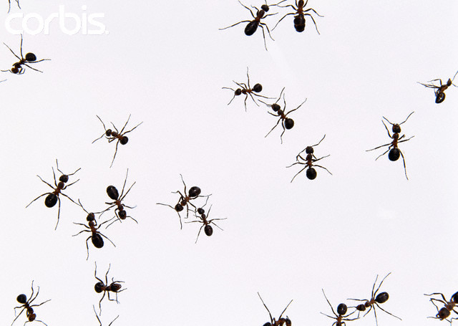
Ant
collects data without ever giving a unifying structure to them

Slide 7

Spider
spins
out
ideas
in
solitude

Slide 8
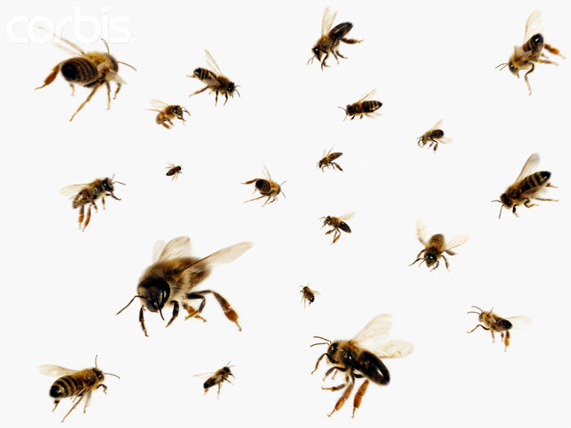
Bee
spins ideas but not only it's own, rather societal and community aspect with sharing and evaluating all the data

Slide 9
Etiquettes of Seeking Knowledge
Relationship with …
Allah
purity of intention
humility
Teachers
respect
humility
Classmates
respect
desiring same success for them
overlooking faults
humility
sharing

Slide 10
قَالُواْ سُبْحَانَكَ لاَ عِلْمَ لَنَا إِلاَّ مَا عَلَّمْتَنَا
إِنَّكَ أَنتَ الْعَلِيمُ الْحَكِيمُ
(Surah Al Baqarah, 2: Verse 32)

Slide 11
وَمِنَ النَّاسِ وَالدَّوَابِّ وَالْأَنْعَامِ مُخْتَلِفٌ أَلْوَانُهُ كَذَلِكَ إِنَّمَا يَخْشَى اللَّهَ مِنْ عِبَادِهِ الْعُلَمَاء إِنَّ اللَّهَ عَزِيزٌ غَفُورٌ
And so amongst men and crawling creatures and cattle, are they of various colours. Those truly fear Allah, among His Servants, who have knowledge: for Allah is Exalted in Might, Oft-Forgiving.
(Surah al Fatir, 35: Verse 28)

Slide 12
`Ubâdah b. al-Sâmit relates that Allah’s Messenger (pbuh) said:
“Whoever fails to show honor to our elders, mercy to our children, and due respect to our scholars is not one of us.”
[Musnad Ahmad (21693)]

Slide 13

Qualities desired in
a Seeker of Knowledge

Slide 14

PATIENCE
Notes:
Story of Musa (as) & Khizr

Slide 15

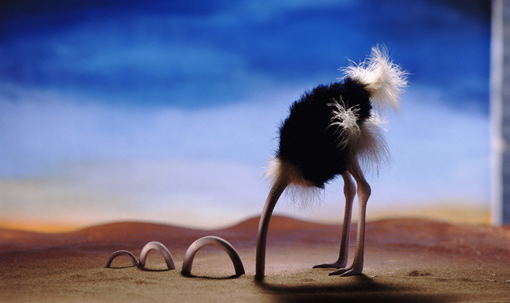
Listen Attentively

Slide 16


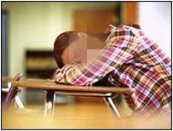


Slide 17
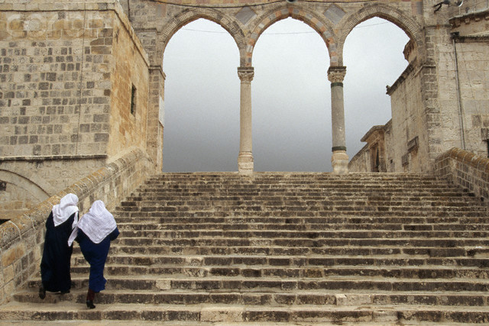
PERSEVERANCE

Slide 18
It was narrated from Abu Sa’eed al-Khudri (RA) that the Prophet (PBUH) said:
“The believer will never have enough of listening to good things (seeking knowledge) until he reaches Paradise.”
Narrated by al-Tirmidhi (2686)

Slide 19
PRACTICE WHAT YOU KNOW
“The likeness of those who were entrusted with the (obligation of the) Torah (i.e. to obey its commandments and to practice its laws), but who subsequently failed in those, is as the likeness of a donkey which carries huge burdens of books (but understands nothing from them). How bad is the example of people who deny the signs of Allah. And Allah guides not the people who are Zalimoon (polytheists, wrongdoers, disbelievers).”
(Surah Al-Jumu’ah 62: Verse 5)

Slide 20
Remember the 4 P’s
Patience
Perseverance
Practice
Purpose

Slide 21
Beware of the 2 Meems
Ignorance
مستحیون
متکبّرون
Those who
are shy
Those who
are proud

Slide 22
Hurdles on path of knowledge
Two م’ s can never learn:
مستحیون (those who are shy)
متکبّرون (those who are proud)

Slide 23
Be aware that Allah is watching you
Make the best use of time
Focus
Study
Choose the right companions
Have good manners

Slide 24
lbn Qayyim Al-Jawziyyah said: There are six stages to knowledge:
Asking questions in a good manner.
Remaining quiet and listening attentively.
Understanding well.
Memorizing.
Teaching.
Acting upon the knowledge and keeping to its limits.

Slide 25

“Allahhuma inni asaluka ‘ilman nafian wa ‘ammalan mutaqabbalan wa rizqan tayyibah.”
O Allah! I beg you for knowledge that is beneficial, for deeds that are accepted and for sustenance that is pure [Mishkat]

