Slide 1
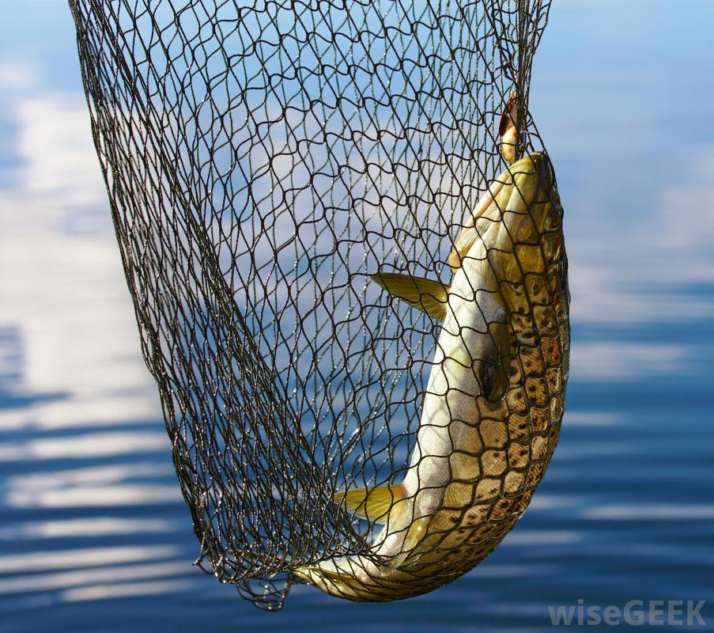
The Saturday People

Slide 2
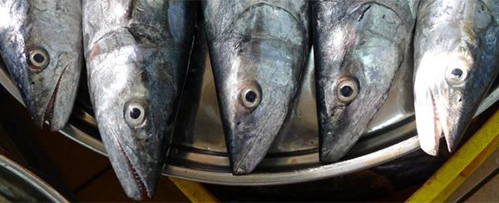
It was reported that Allah (swt) ordered Jibril (as) to destroy a village that had become extremely corrupt, but Jibril (as) asked Allah (swt), “O Allah, in this village is your servant that constantly prays to You”, Allah (swt) replied, “Start with him! For his face never changed with disapproval to what had been going on.” Because he didn’t speak up, because he thought it was enough for him to be good, he too was punished with the sinners.

Slide 3
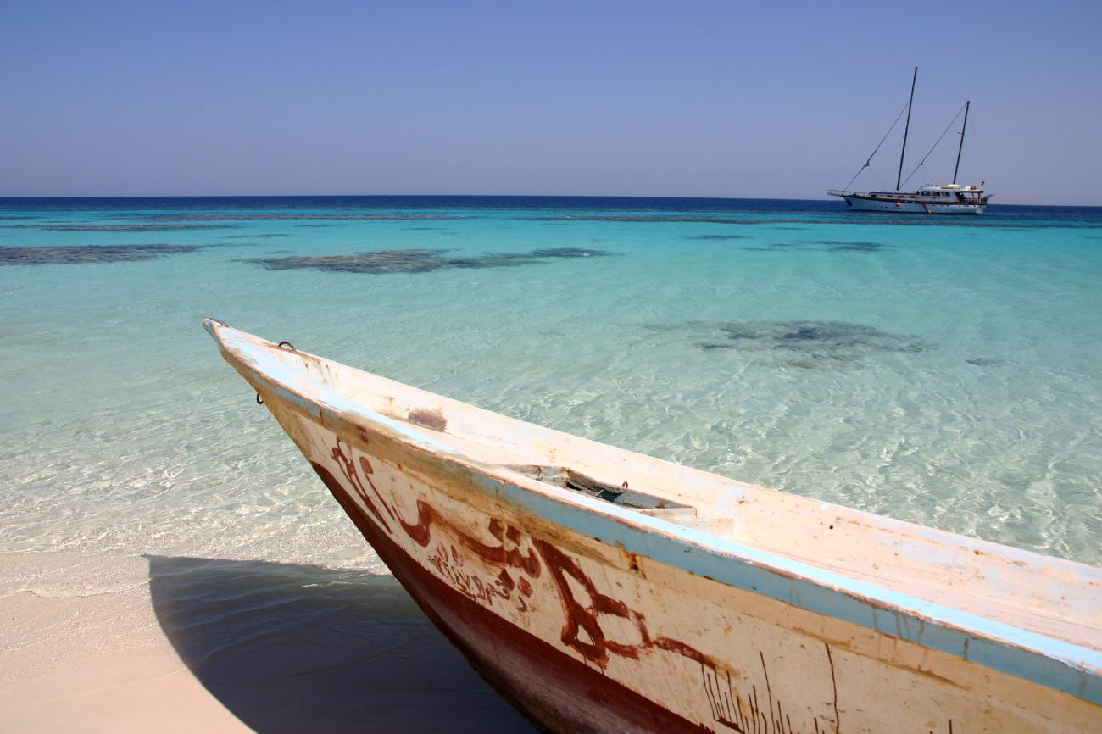
Abu Sa'id al-Khudri said, "I heard the Messenger of Allah, may Allah bless him and grant him peace, say, 'Whoever of you sees something wrong should change it with his hand; if he cannot, then with his tongue; if he cannot, then with his heart, and that is the weakest form of faith.'" [Muslim]

Slide 4
And ask them about the town that was by the sea;

Slide 5
when they transgressed in the matter of the Sabbath:

Slide 6
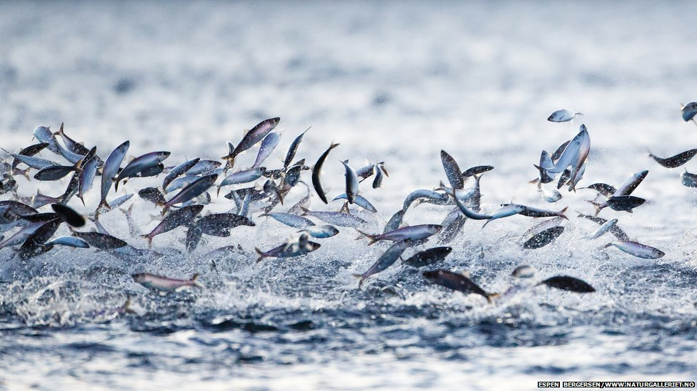
when their fish came to them openly on the Sabbath day, and did not come to them on the day they had no Sabbath.

Slide 7
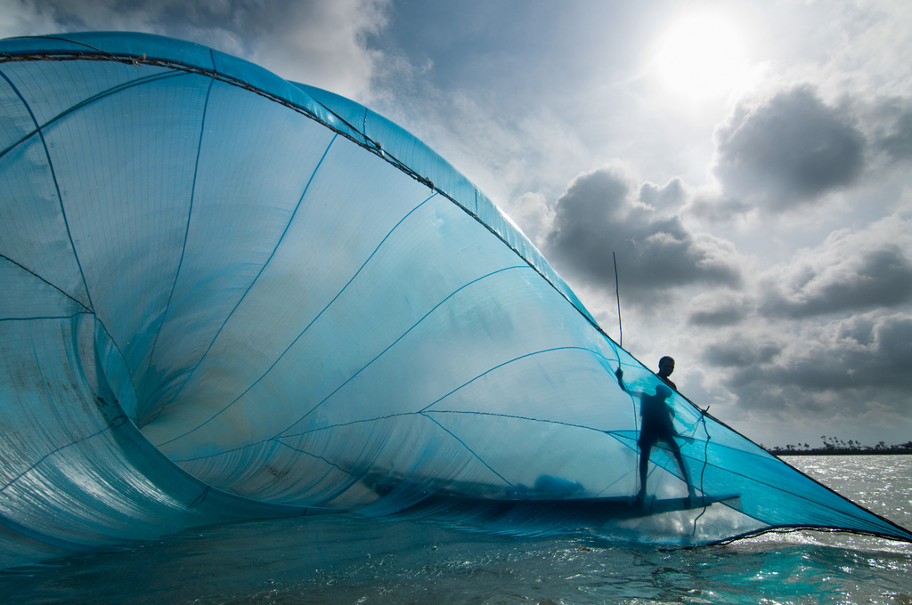
Thus We made a trial of them

Slide 8
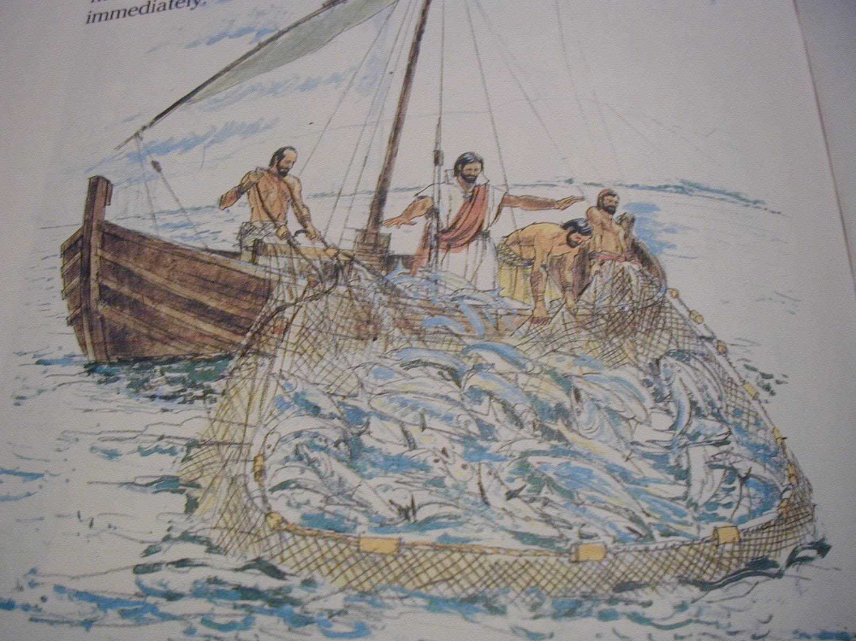
for they used to rebel against Allah’s Command.
(Surah Al A’raf 7: Verse 163)

Slide 9

“And when a community among them said: ‘Why do you preach to a people whom Allah is about to destroy or to punish with a severe torment?”

Slide 10
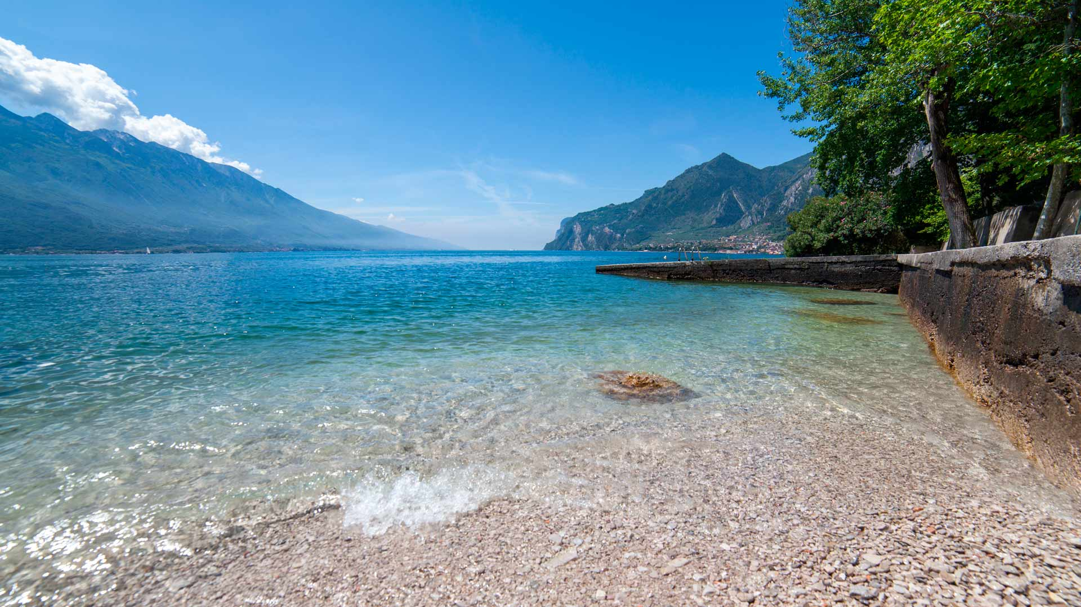
(The preachers) said: ‘In order to be
free from guilt before your Lord (Allah),
and perhaps they may fear Allah.’”
(Surah Al A’raf 7: verse 164)

Slide 11
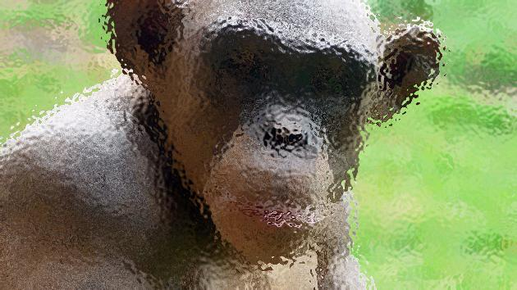
فَلَمَّا عَتَوْاْ عَن مَّا نُهُواْ عَنْهُ قُلْنَا لَهُمْ كُونُواْ قِرَدَةً خَاسِئِينَ
So when they exceeded the limits of what they were prohibited, We said to them, “ Be you monkeys, despised and rejected.”
(Surah Al A’raf 7: verse 166)

Slide 12
Group one:
They transgressed, they devised a scheme to disobey Allah (swt)’s commandment
Group two:
tried to warn group one of the horrific consequences of their actions. They commanded the good & forbade the wrong & evil.
Group three:
They felt that they had no responsibility for what was taking place so they went around minding their own business

Slide 13

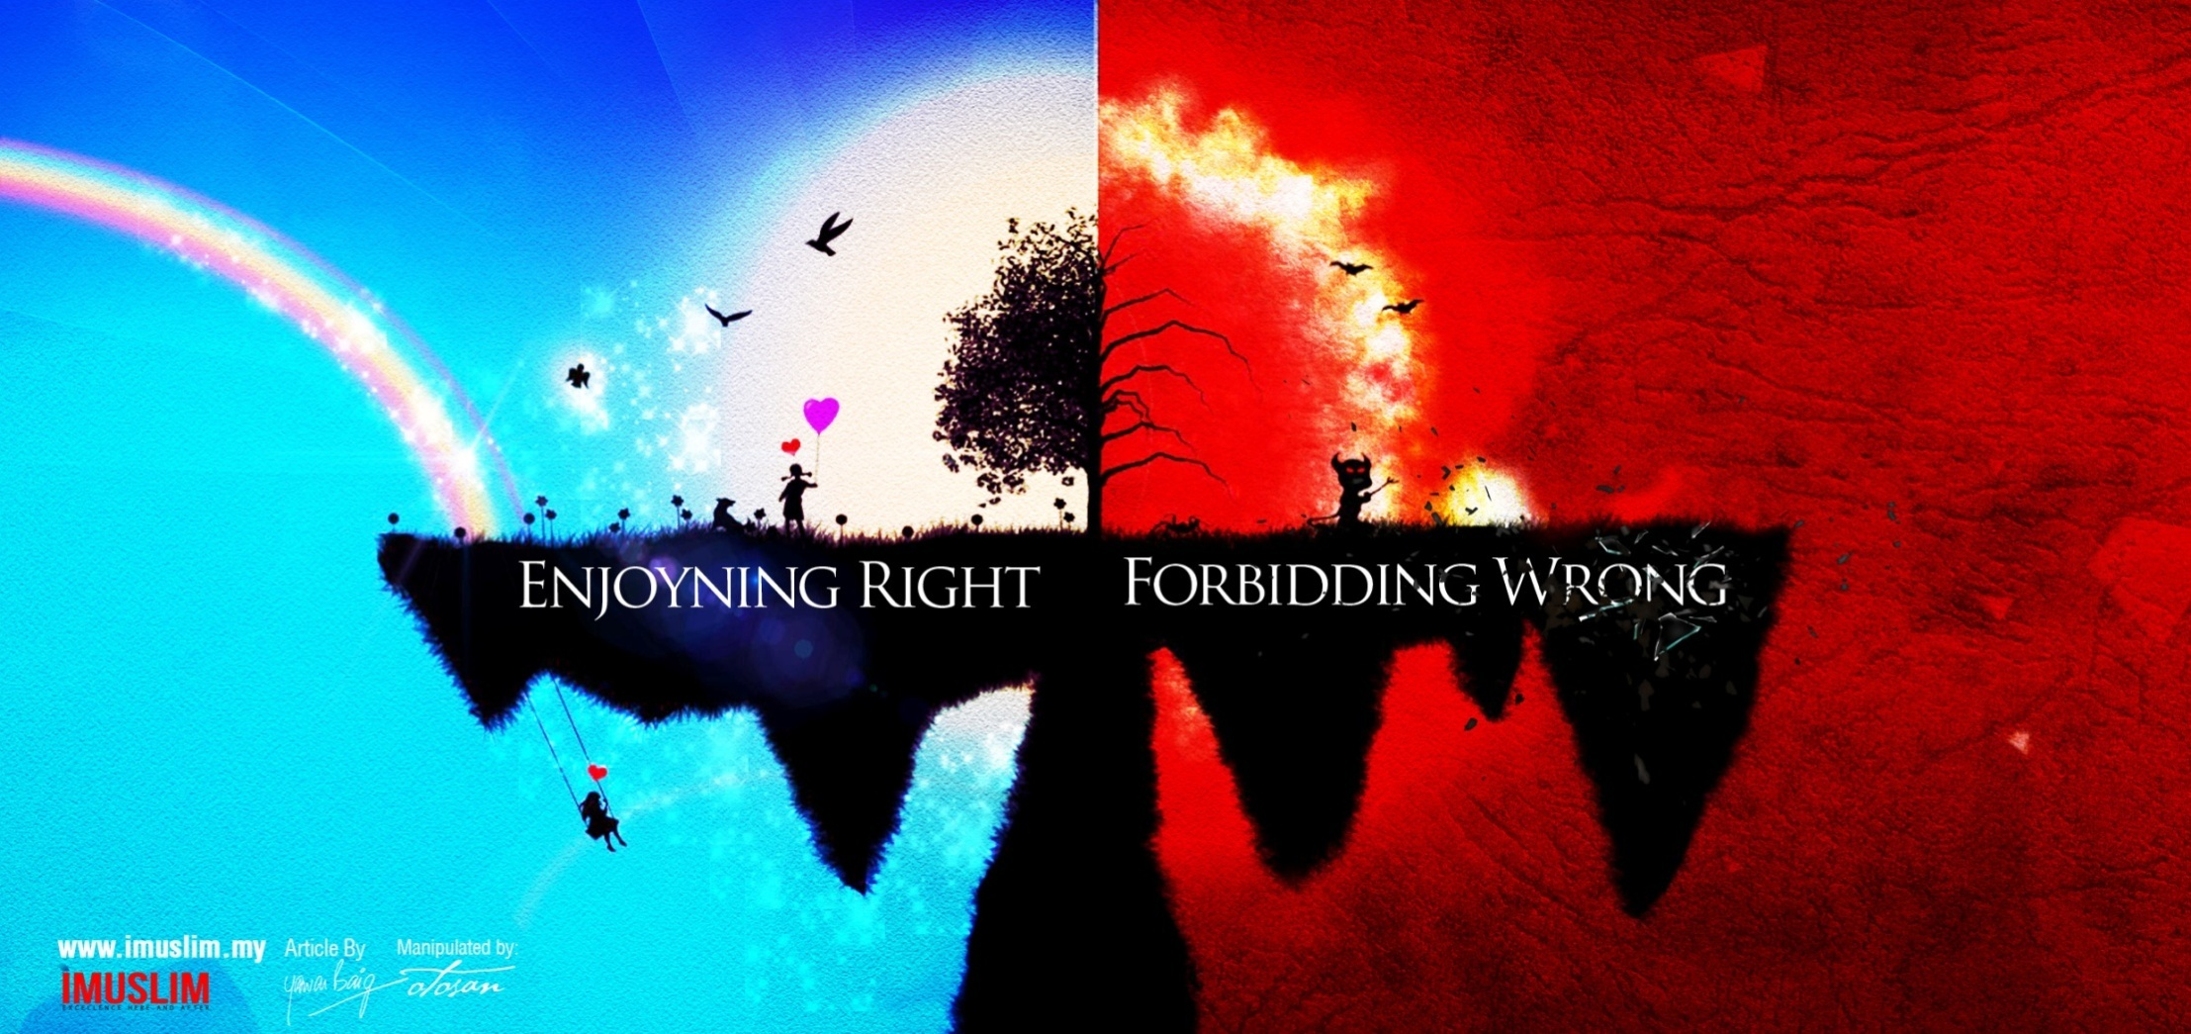

Slide 14
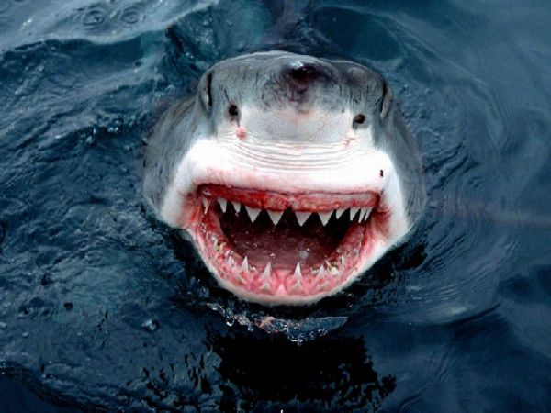
“If a sin is committed in private, it only harms the one that does it,
but if it is committed in public and no one objects and changes it, it will harm everyone!” Umar ibn Al-Khattab (ra)

Slide 15
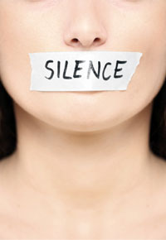
All that is required for the triumph of evil is for good men to remain silent.
Edmund Burke

Slide 16
3 Levels of Faith
Stop it with your hand
Stop it with your tongue
Feel bad in your heart
Notes:
#vulgar ads/ billboards
# no prayer areas in malls or horrible state of those areas eg dolmen mall
# drinking, dating, dirty jokes/movies/ magazines, gossiping, back biting

Slide 17
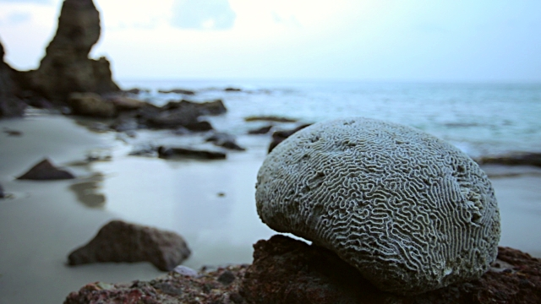
Use the tool of wisdom

Slide 18

An-Nu'man ibn Bashir reported that the Prophet (pbuh) said, "The metaphor of someone who stops at the limits of Allah and someone who transgresses them is that of some people who draw lots on a boat.

Slide 19
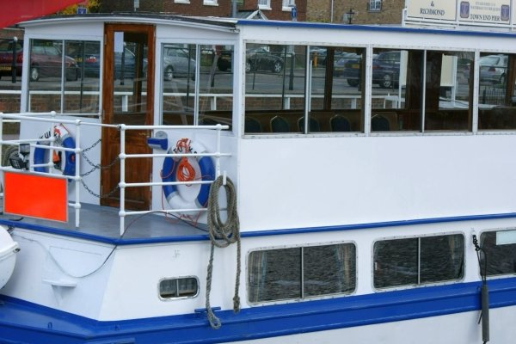
Some of them get the upper deck & some of them the lower. When those in the lower deck want to get water,
they have to pass by those above them.

Slide 20
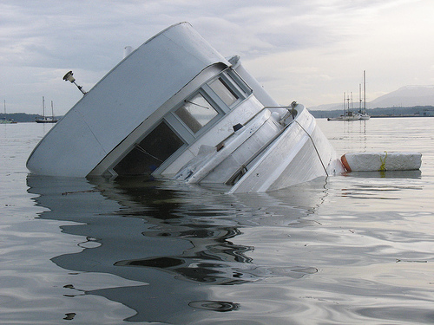
Then they say, 'If we were to make a hole in our deck, we would not have to bother those above us.' If they were to let them do what they wanted, all of them would perish.

Slide 21
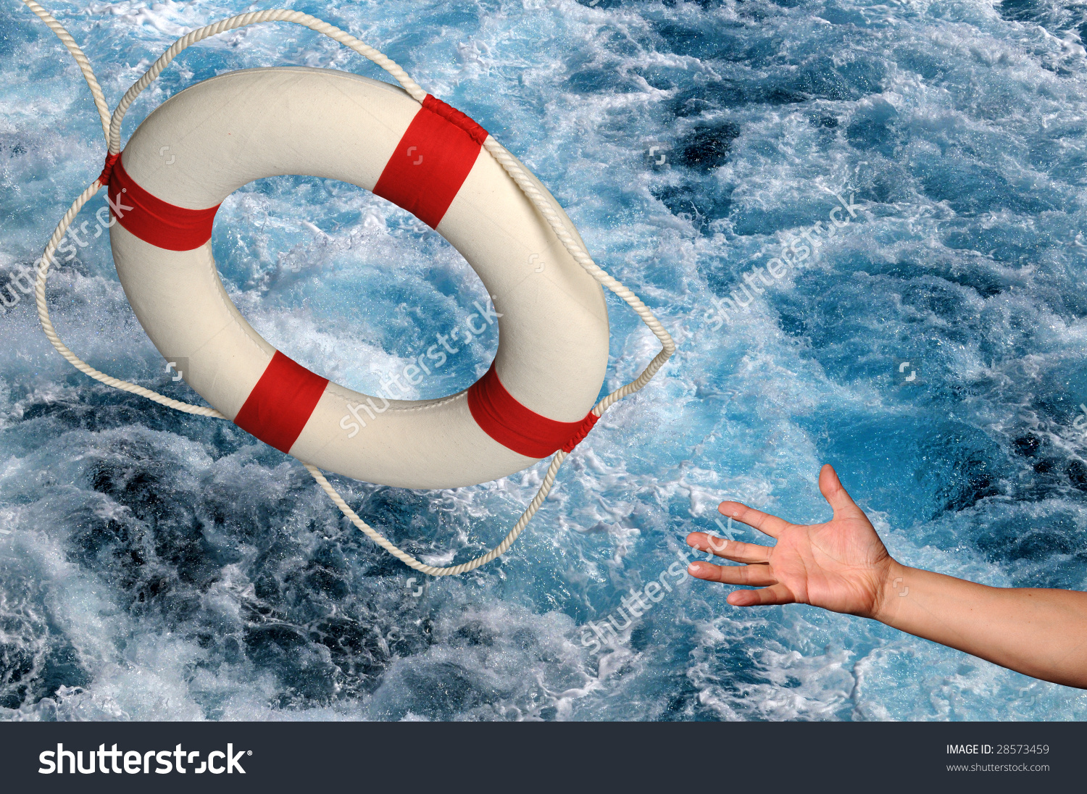
If they seize hold of their hands and stop them, they will be saved and all of them will be saved." [Bukhari]

Slide 22
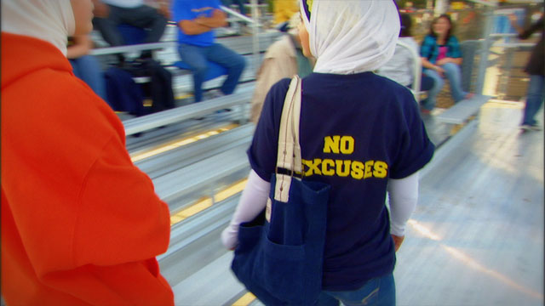
Be proud, confident and courageous Muslims

Slide 23
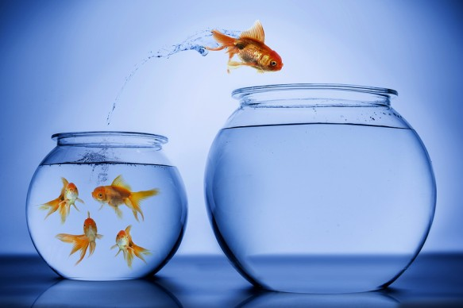
Be a role model

Slide 24
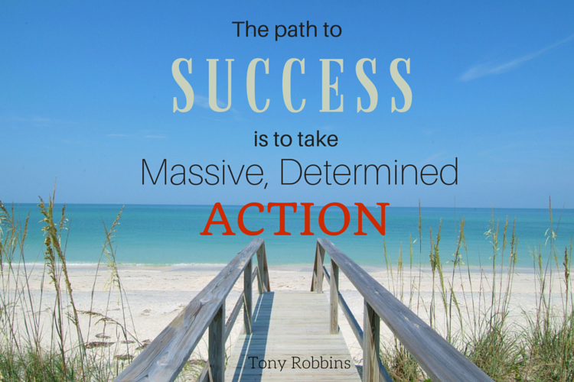

Slide 25
