Slide 1

Just because you can, doesn’t mean you should!

Slide 2

Inspiring?

Slide 3
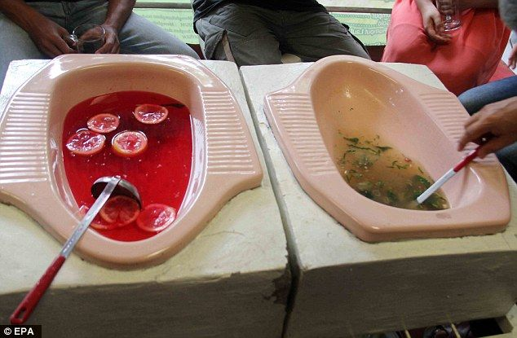
Appetizing?

Slide 4

Binge-watching?

Slide 5

Me at 2:30 in the afternoon:
Morning already??

Slide 6
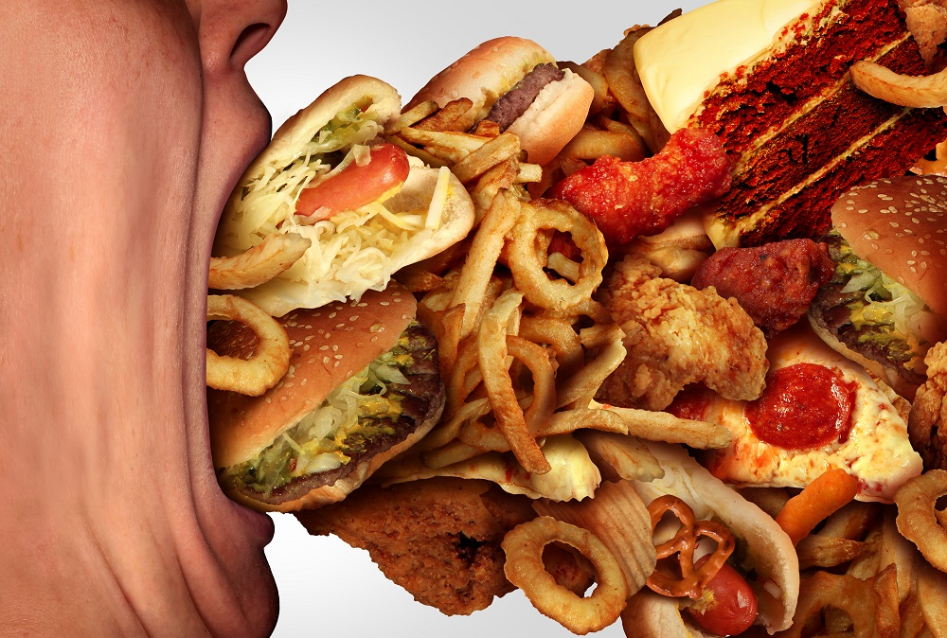
Binge eating?

Slide 7
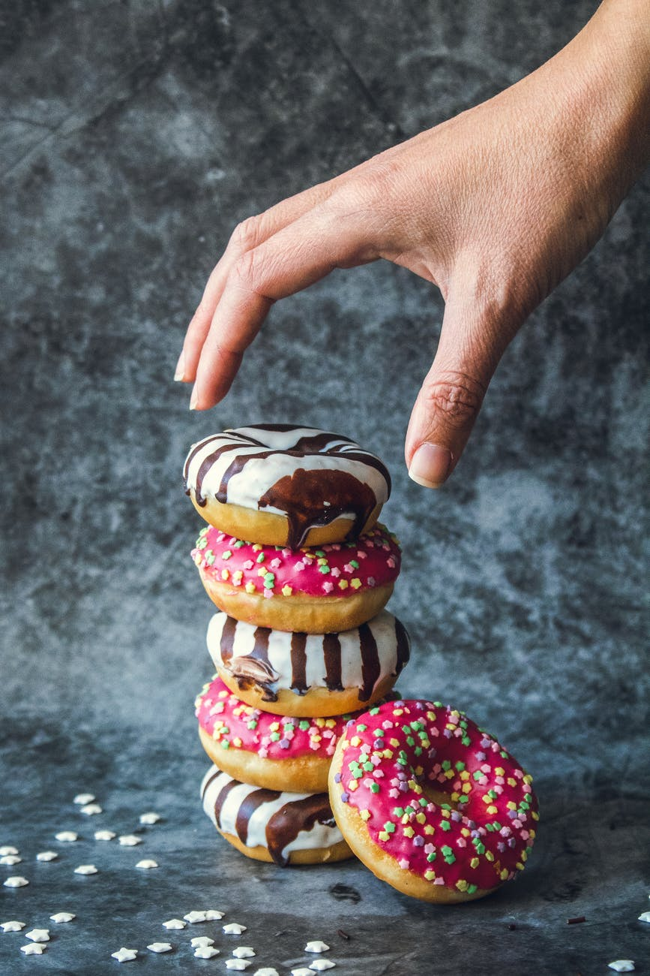
mmm…feels good!

Slide 8
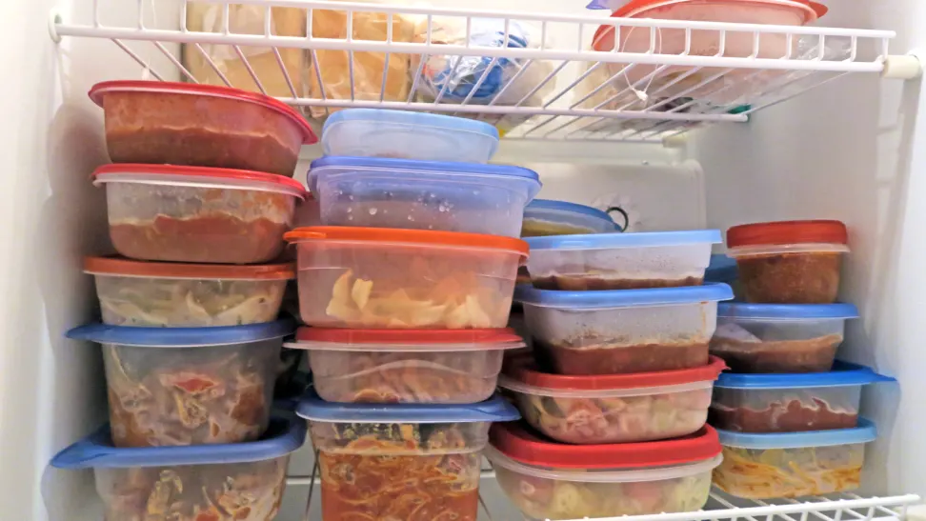
Food food everywhere!

Slide 9

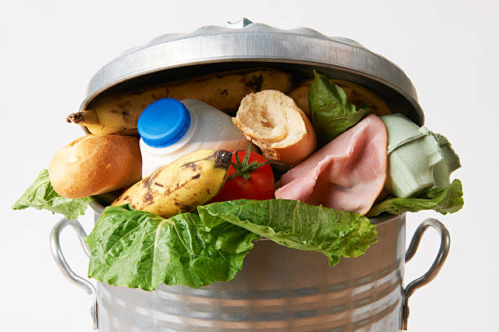
Want not?
Waste not!

Slide 10
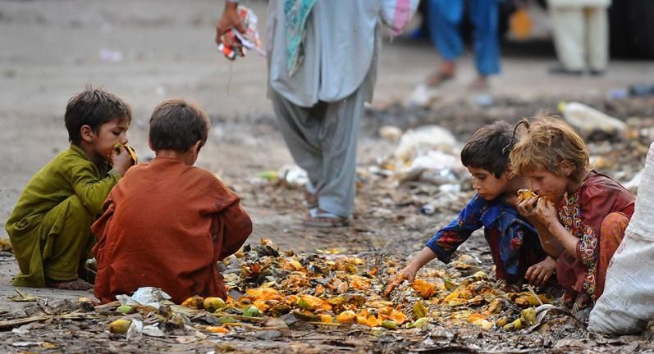
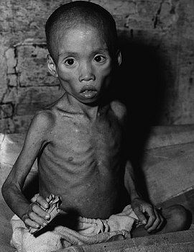
In a world where there is enough food to feed everyone…
1 in 9 people go to bed on an empty stomach!

Slide 11

ثُمَّ لَتُسْأَلُنَّ يَوْمَئِذٍ عَنِ النَّعِيمِ
Then you will be asked about all the pleasures (you enjoyed in the world).
Surah Takathur, Verse 8

Slide 12


Slide 13

The best way to balance life is setting your boundaries and learning to say enough

Slide 14
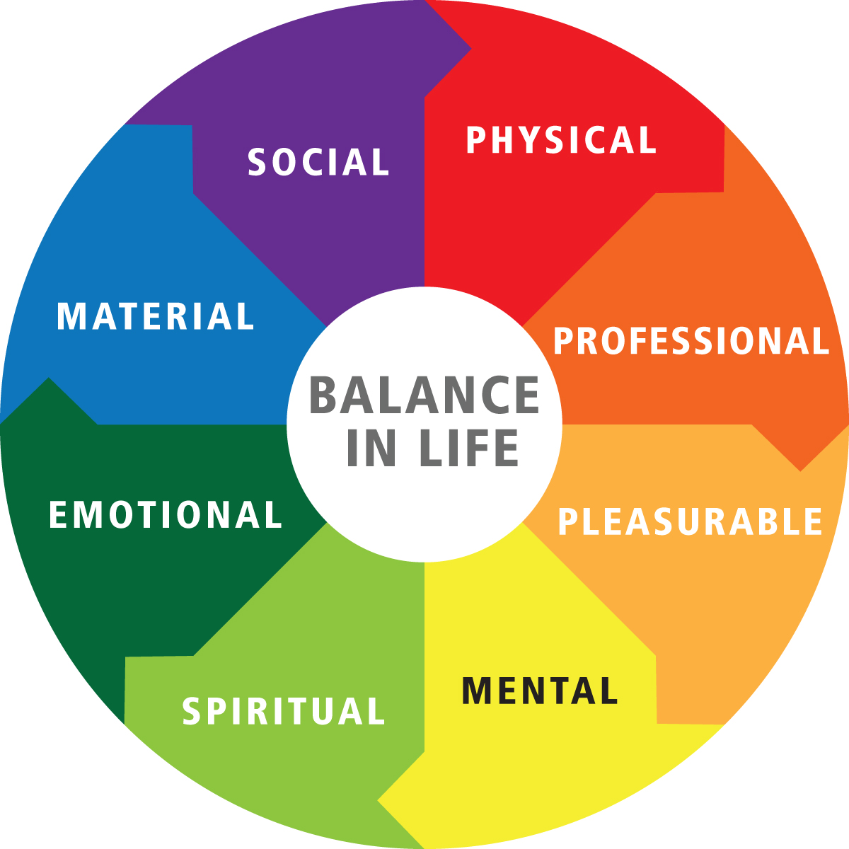
Thumb rule

Slide 15

Now is the time!

Slide 16


Slide 17
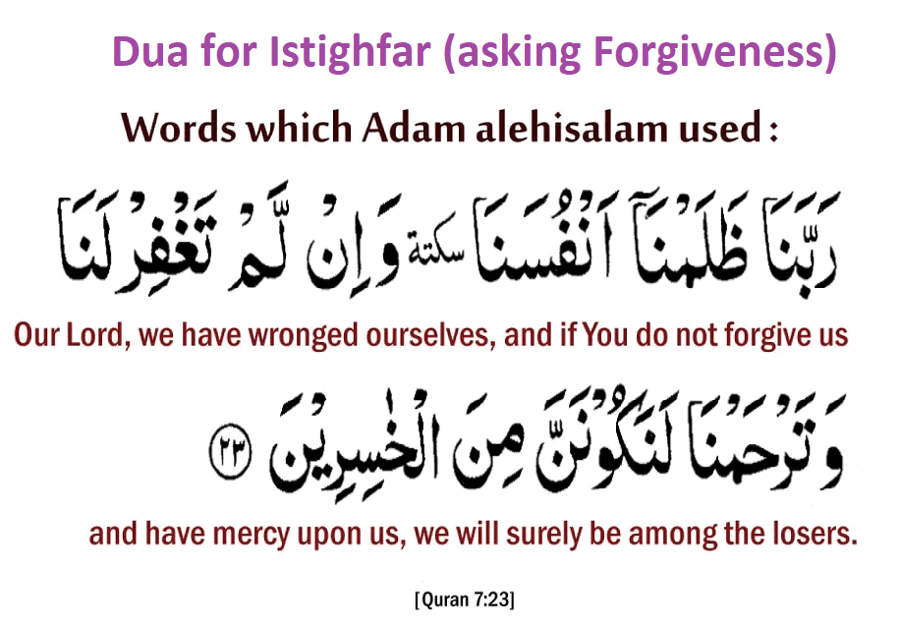
Because we can repent and change, so we shall!
.

