Slide 1
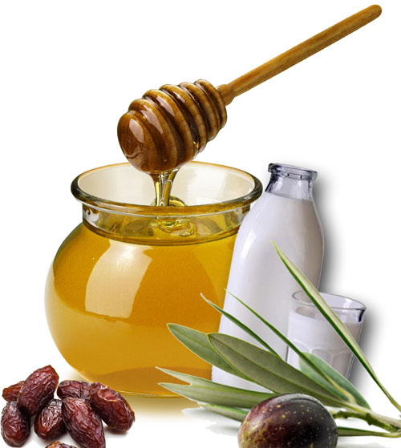
SHIFA FROM SUNNAH part 2

Slide 2
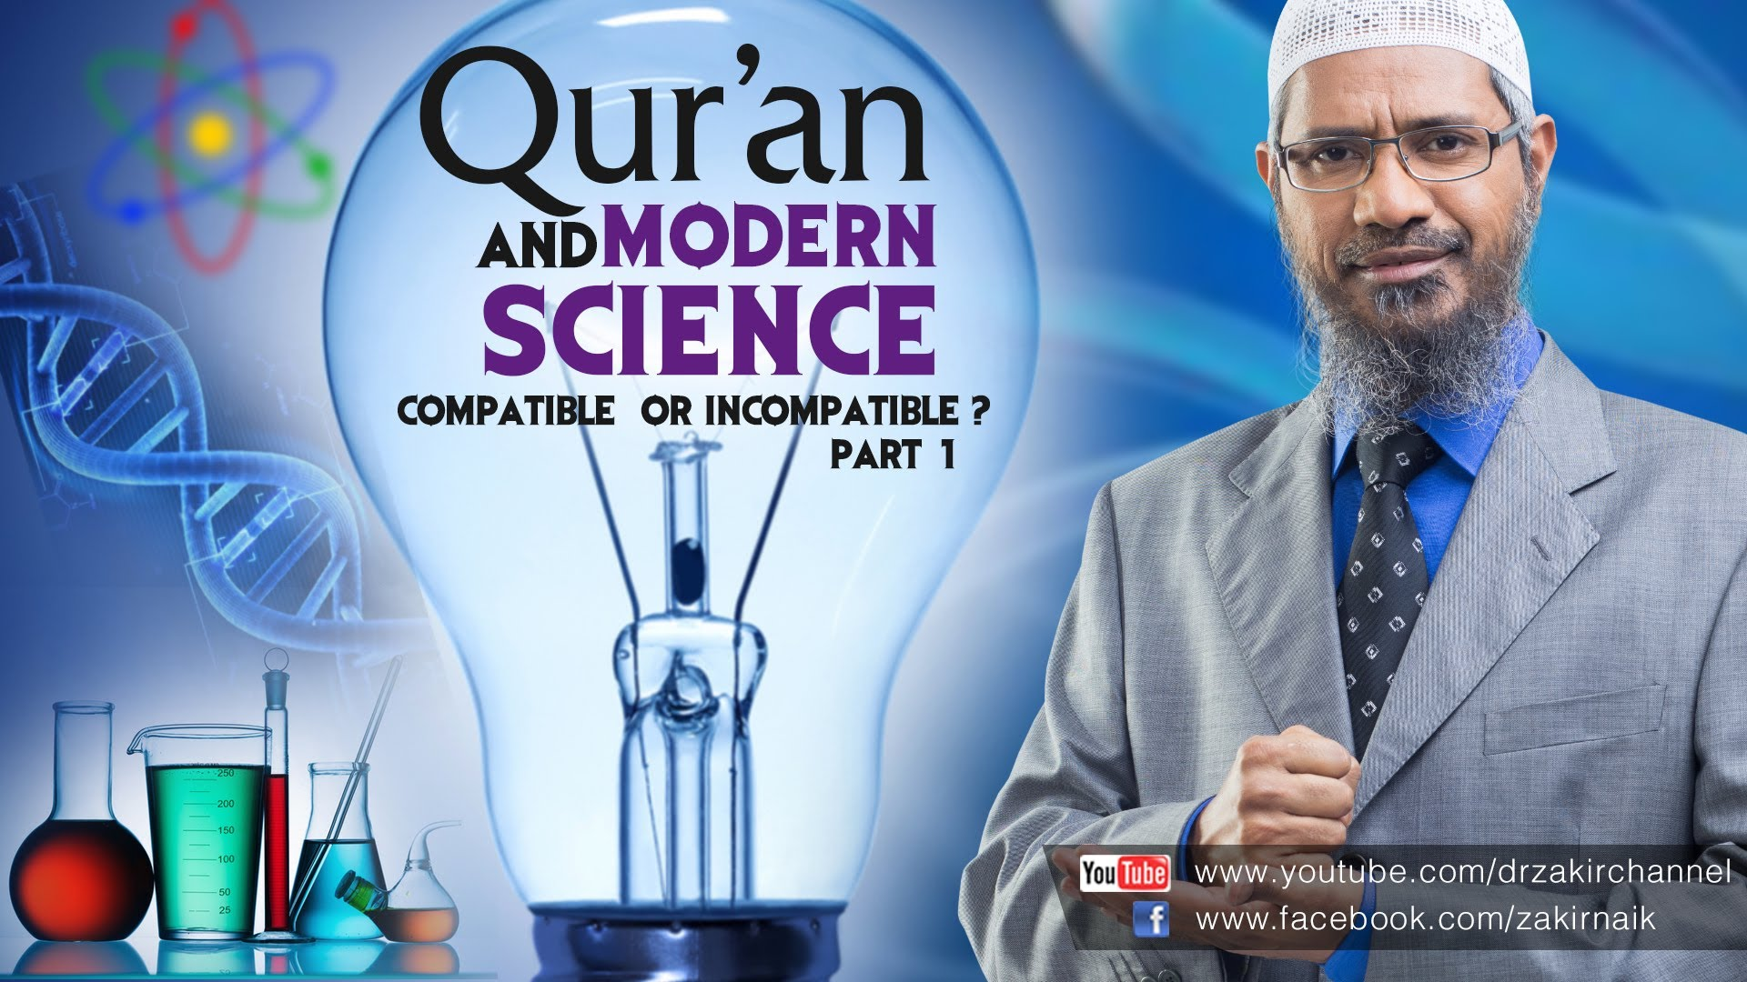
GO HAND IN HAND

Slide 3
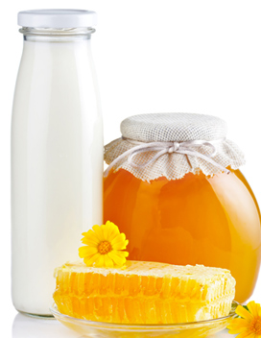
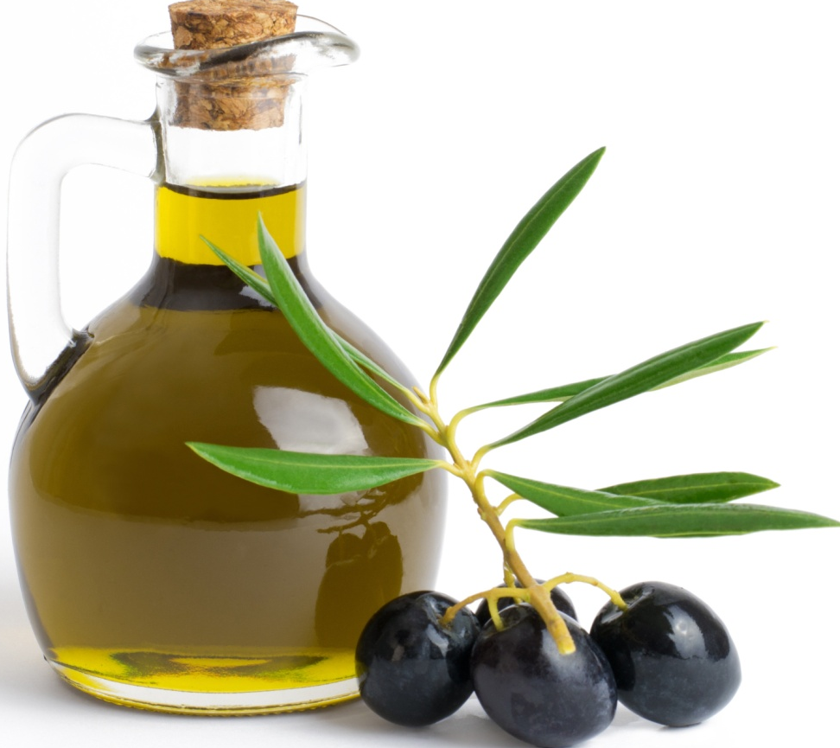
Allah (swt) says in the Quran:
"And We sent down of the Quran that which is a healing and a mercy to those who believe "
[Surah Al-Isra’ 17: Verse 82]

Slide 4

Ruqya
How
To recite Quran
Spit on hand and wipe over body
Why
to seek cure
Against
Illness
Magic
To recite duas from Sunnah
Evil eye
Poisonous sting

Slide 5
Allowed
Shariah compliant
Plural– Ruqa
Short form - Ruqya

Slide 6
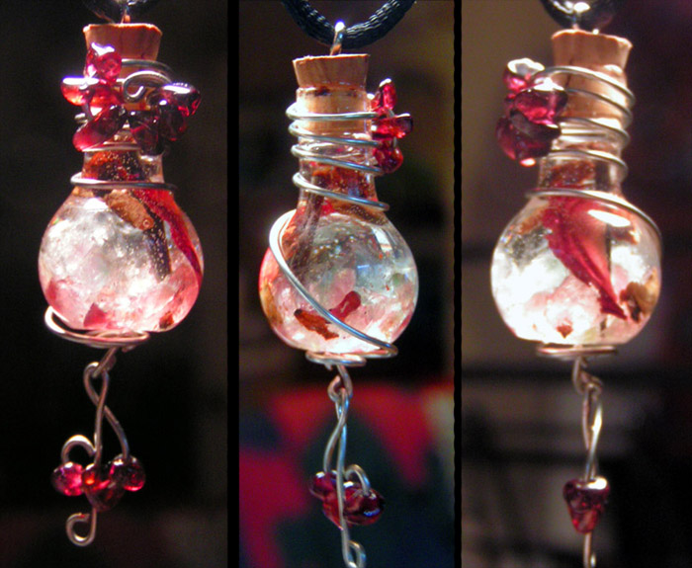
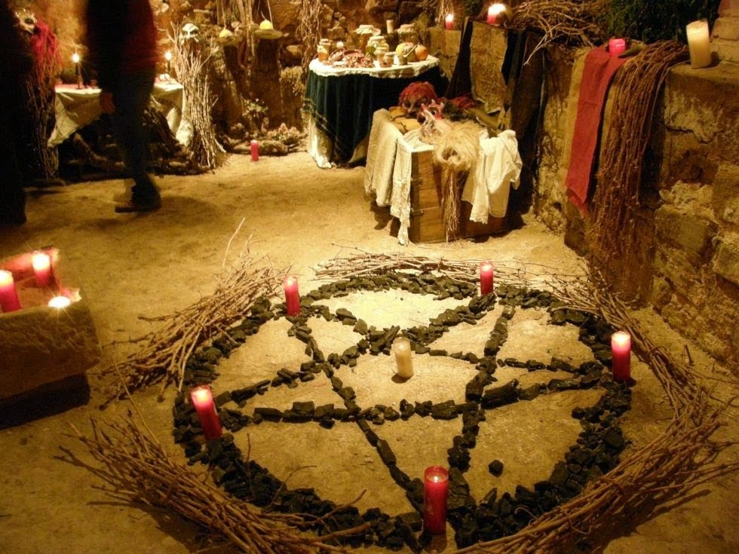
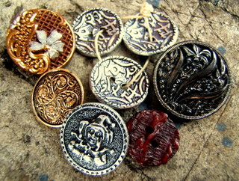
Before Islam

Slide 7

After Islam
Awf Bin Malik (ra) narrated that he said to the Prophet (pbuh):
"O Allah's Messenger (pbuh)! We used to apply ruqa during jahiliyyah. What do you think of that?" He (pbuh) replied: ‘Present your ruqa to me. There is nothing wrong with them as long as they do not involve shirk.’
[Muslim]

Slide 8
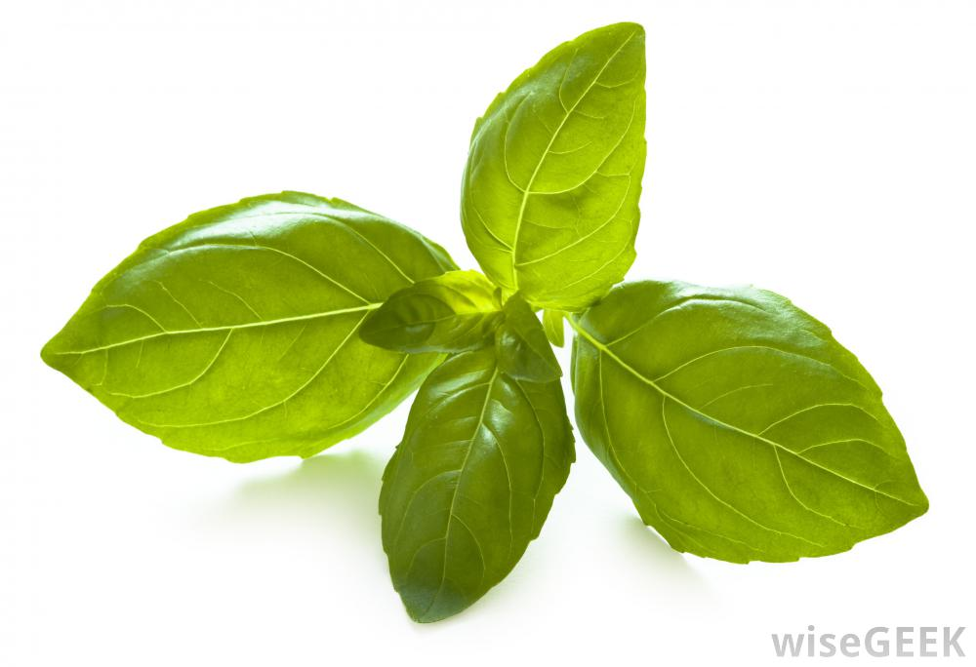
Passage or surah from Quran and du’as from Sunnah
Clear words preferably in Arabic language
Unwavering and sole reliance on Allah for cure
Place and person must be clean and pure

Slide 9

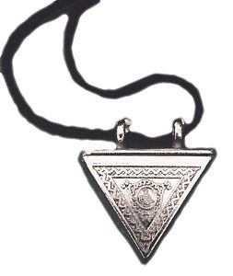


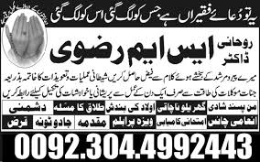
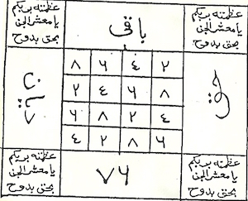
Stay clear of this mumbo jumbo

Slide 10
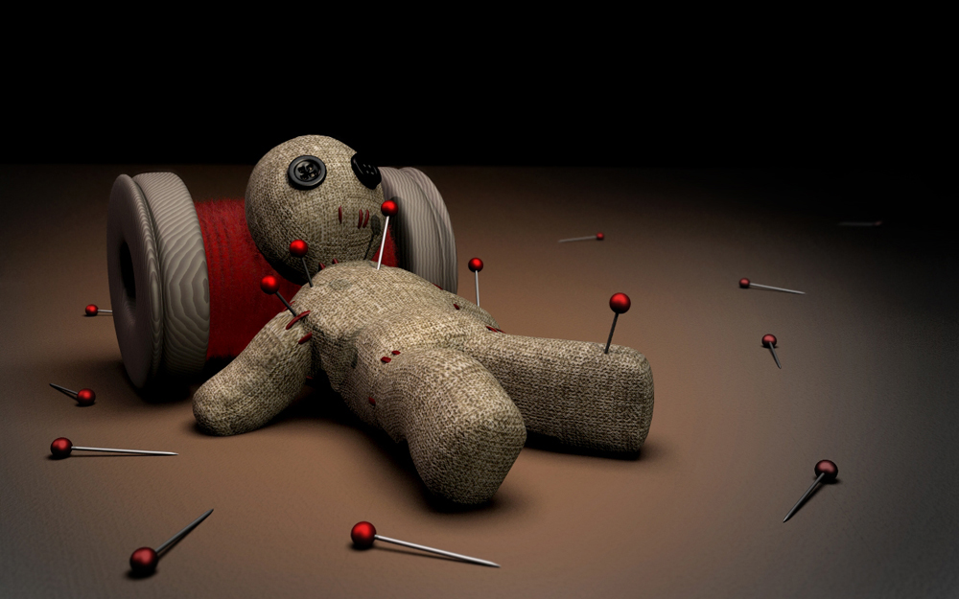
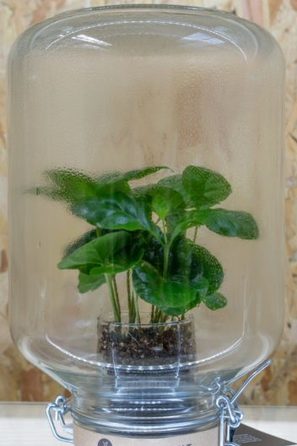
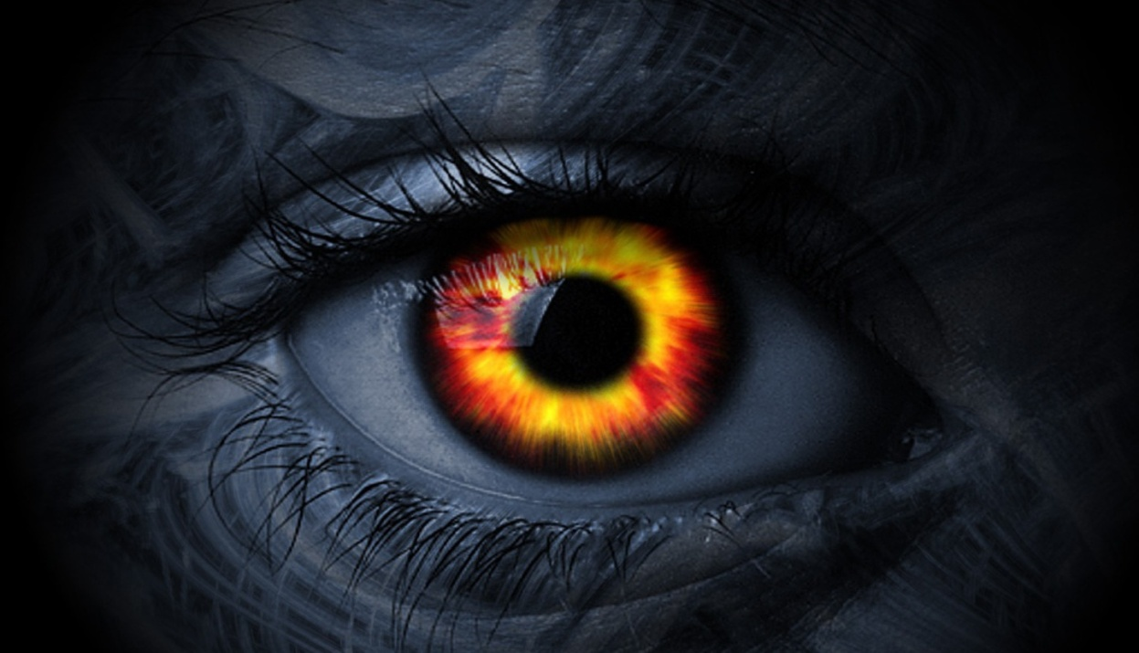
Ruqya serves as a protection

Slide 11
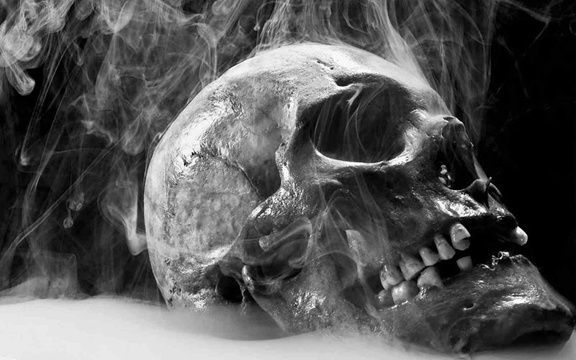
Magic is a test of iman for both the one who practices as well as the victim

Slide 12
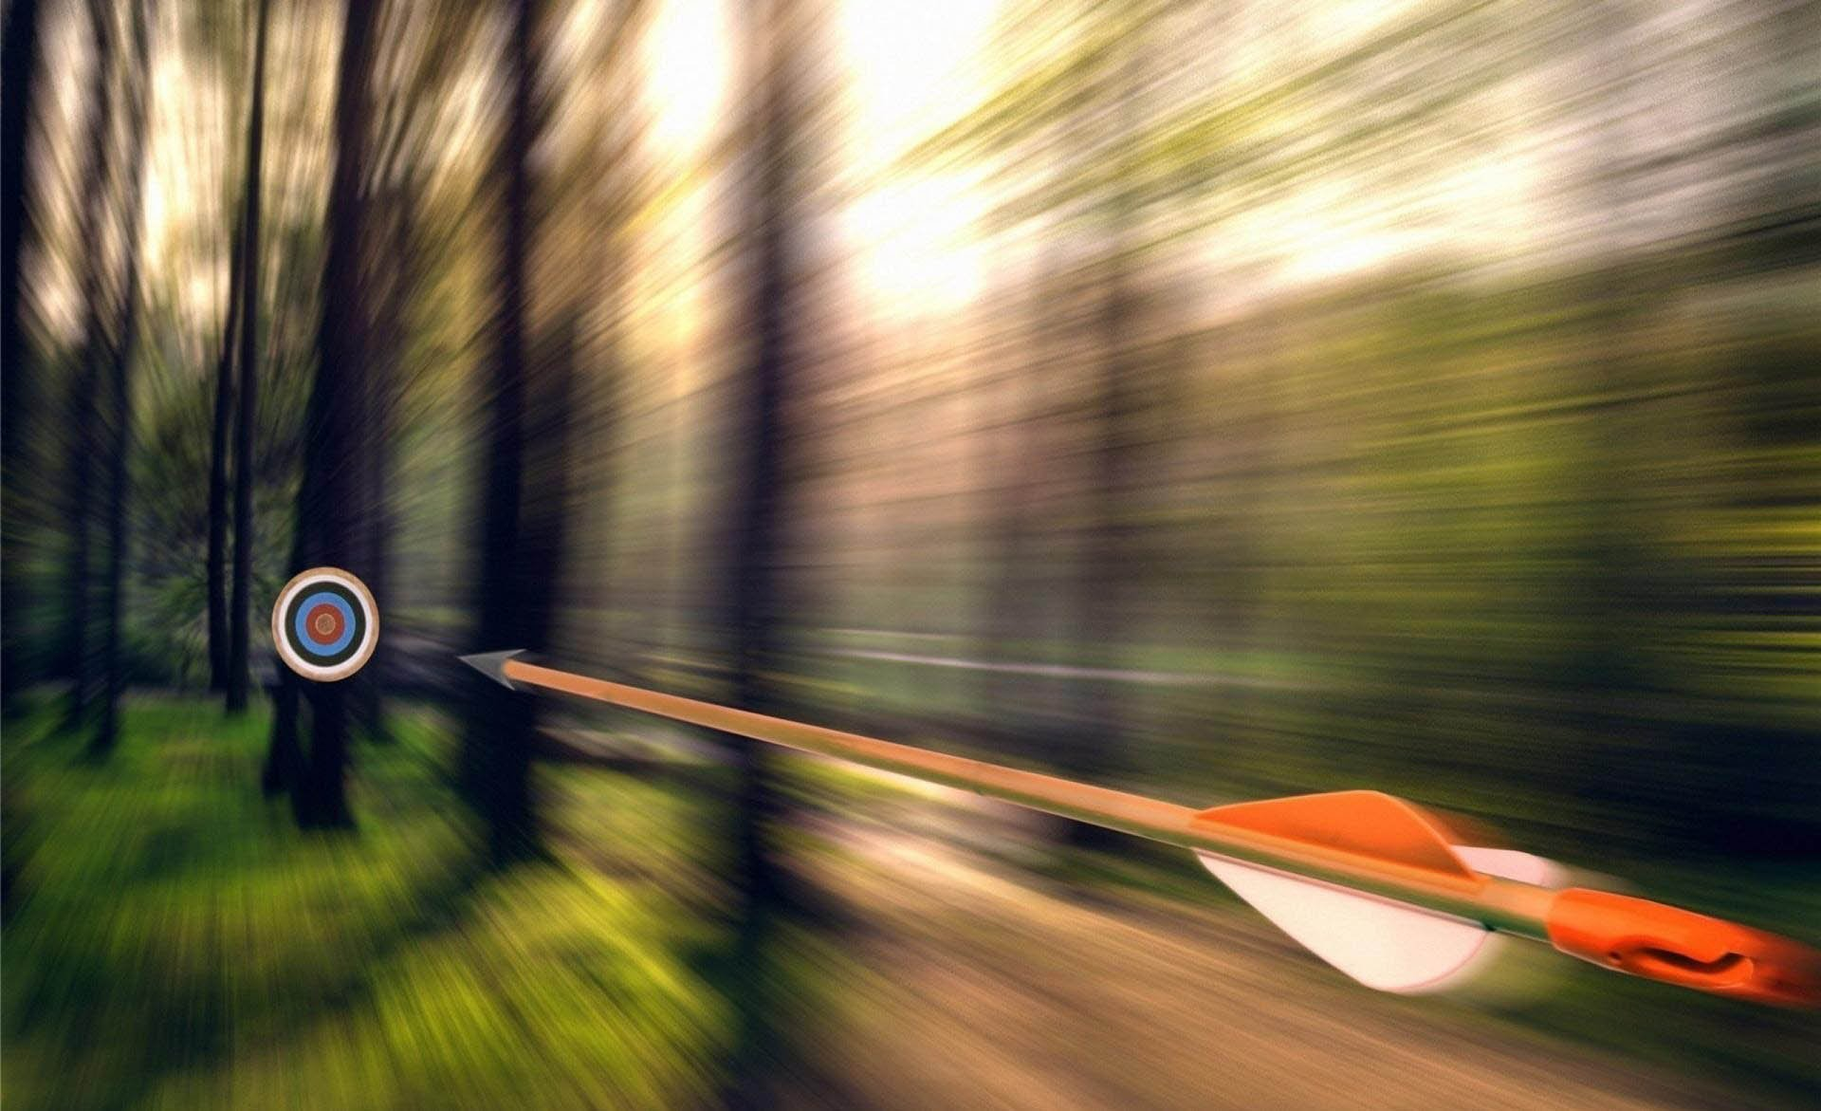
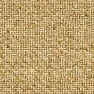
The evil eye is like an arrow from the soul of the envier towards the one who is envied.
Sometimes it hits him; sometimes it misses.
If the target is exposed and unprotected, it will affect him, but if the target is cautious and armed, the arrow will have no effect and may even come back on the one who launched it

Slide 13
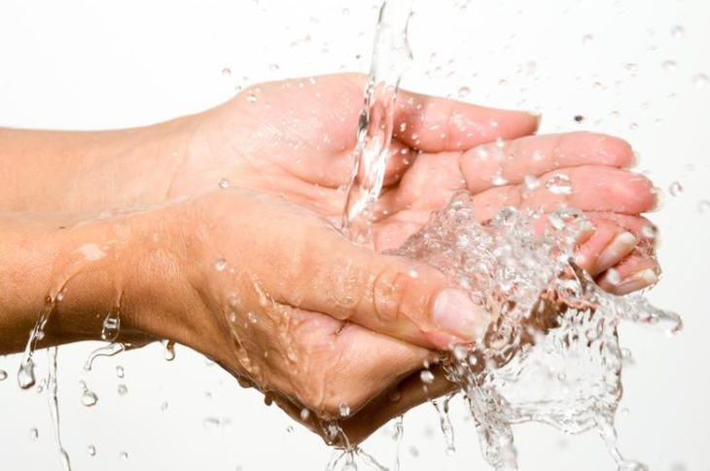
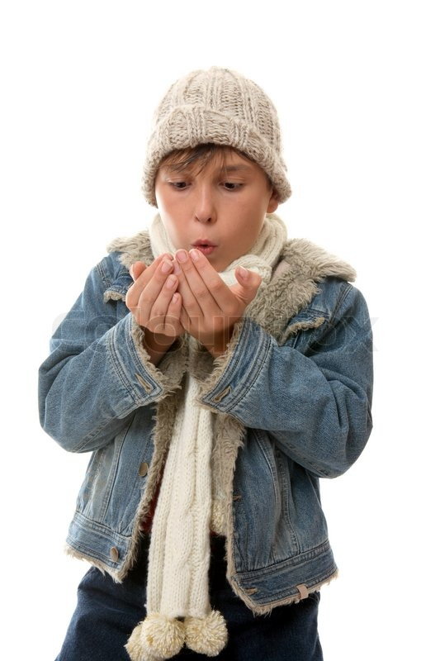
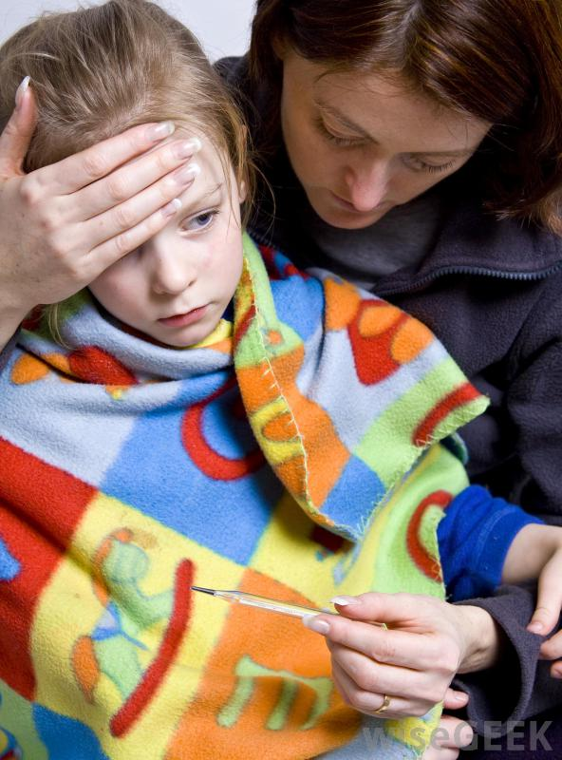
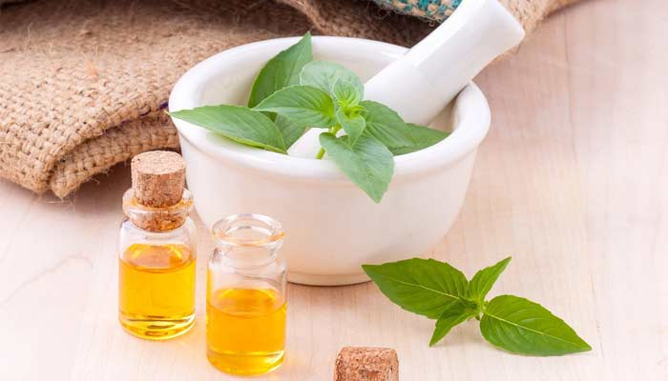

Slide 14

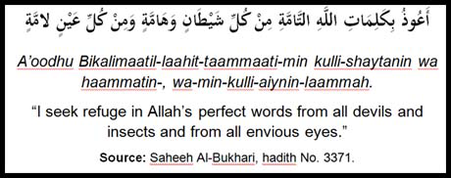
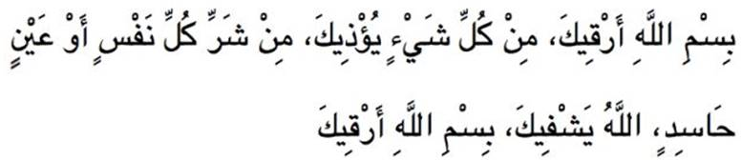
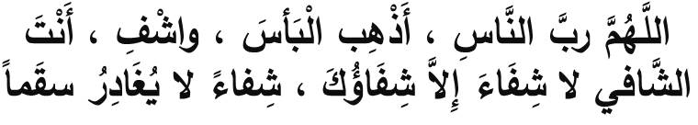

Slide 15

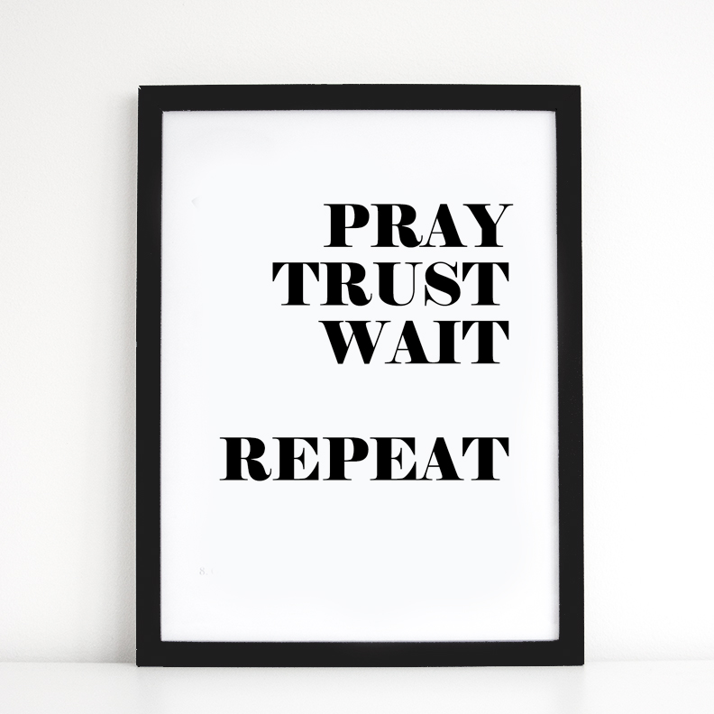

Slide 16
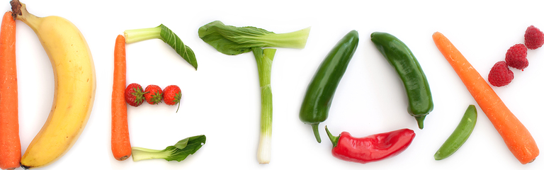
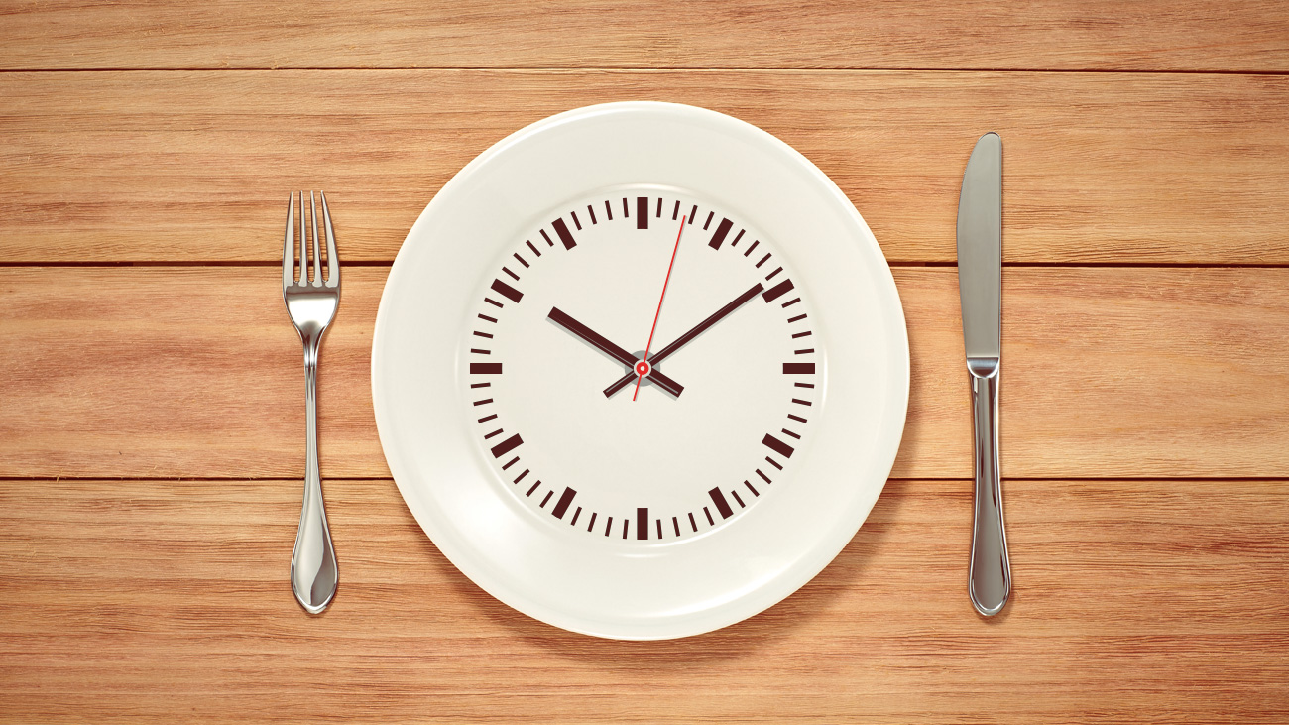
Hot trend in diet

Slide 17

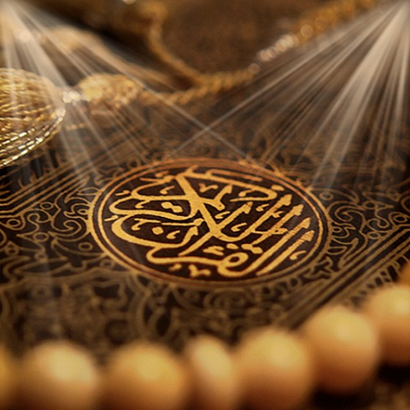
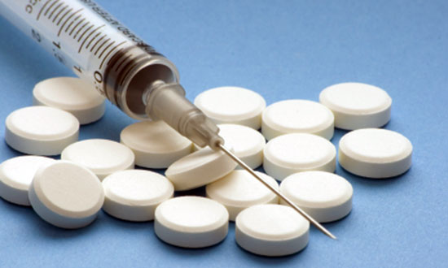

Slide 18
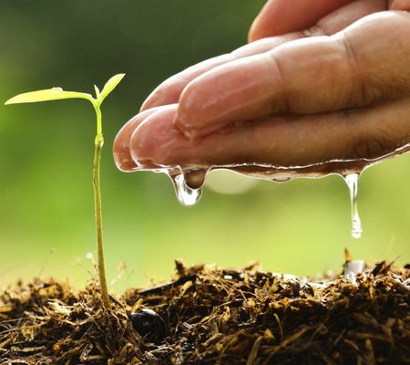
“Whoever revives an aspect of my Sunnah that is forgotten after my death, he will have a reward equivalent to that of the people who follow him, without it detracting in the least from their reward.” [Tirmidhi]

