Slide 1
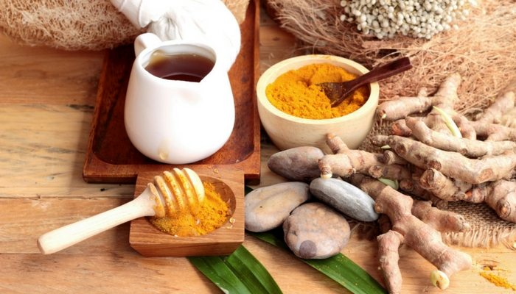
SHIFA FROM SUNNAH PART 1

Slide 2
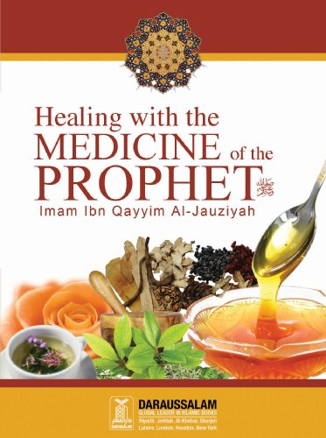
Was Muhammad (pbuh)
a physician?

Slide 3
Mode of practice in Islamic Medicine
Nutritional assessment
Physiotherapy
Drugs

Slide 4
وَنُنَزِّلُ مِنَ الْقُرْآنِ مَا هُوَ شِفَاء وَرَحْمَةٌ لِّلْمُؤْمِنِينَ وَلاَ يَزِيدُ الظَّالِمِينَ إَلاَّ خَسَارًا
“And We sent down from the Quran that which is a healing and a mercy to those who believe…”
[17:82]

Slide 5

Narrated Abu Huraira (raa):
The Prophet (pbuh) said, "There is no disease that Allah (swt) has created, except that He also has created its treatment”.
[Muslim & Ahmad]

Slide 6
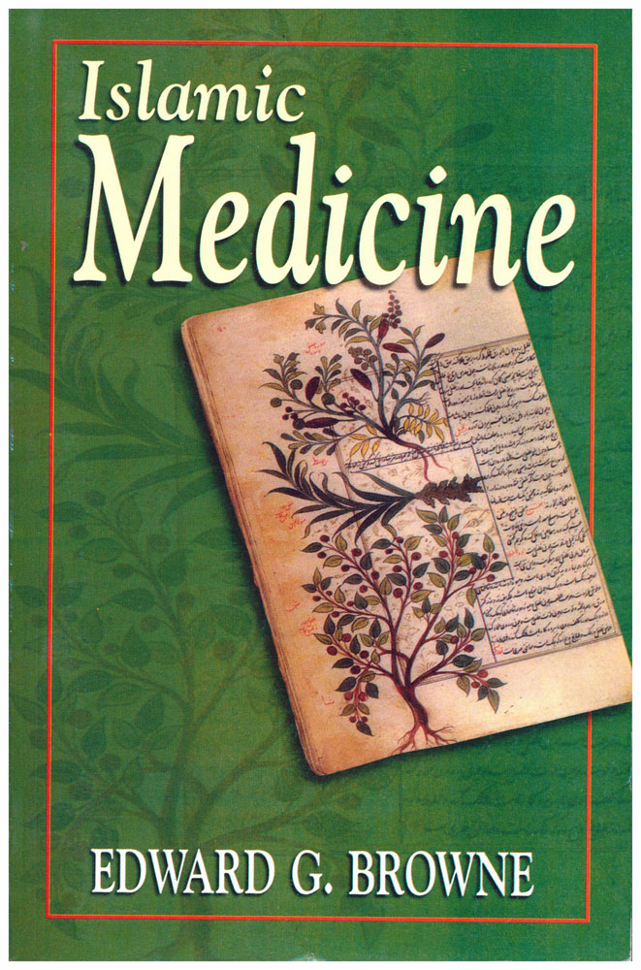
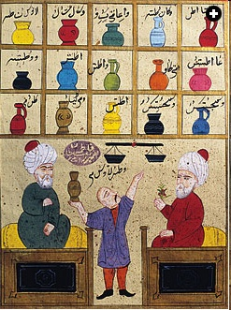
From an Ottoman manuscript, two doctors telling the pharmacist how to make different medicines

Slide 7
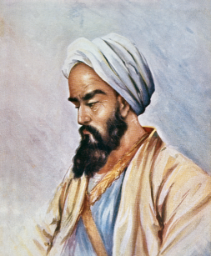
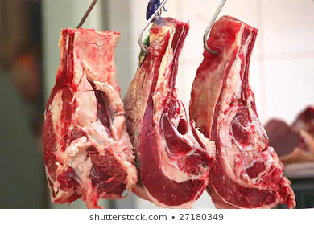
Ar Razi:
“The Meat Guy”

Slide 8
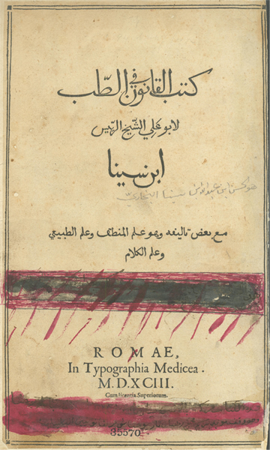
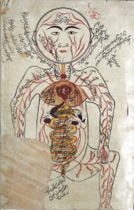
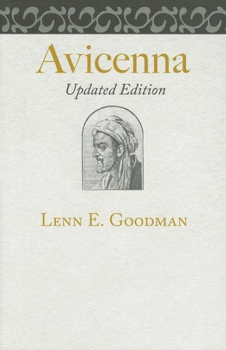
Ibn Sina
“Avicenna”

Slide 9
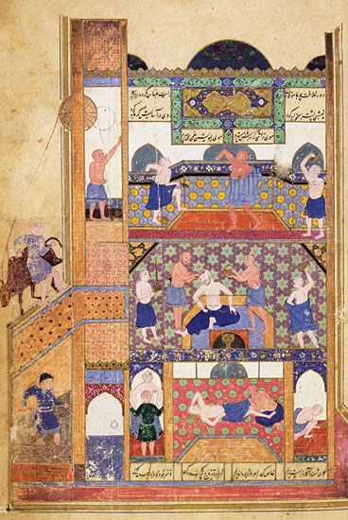
First hospital in
Baghdad

Slide 10

Muslims introduced the concept of gardens

Slide 11
Holistic therapy looks at human beings as combination of 5 bodies
emotional
spiritual
physical
biochemical
intellectual

Slide 12
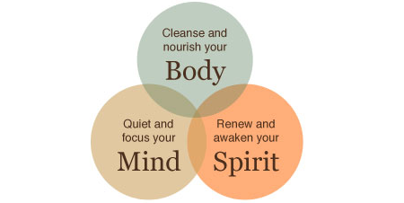

Slide 13
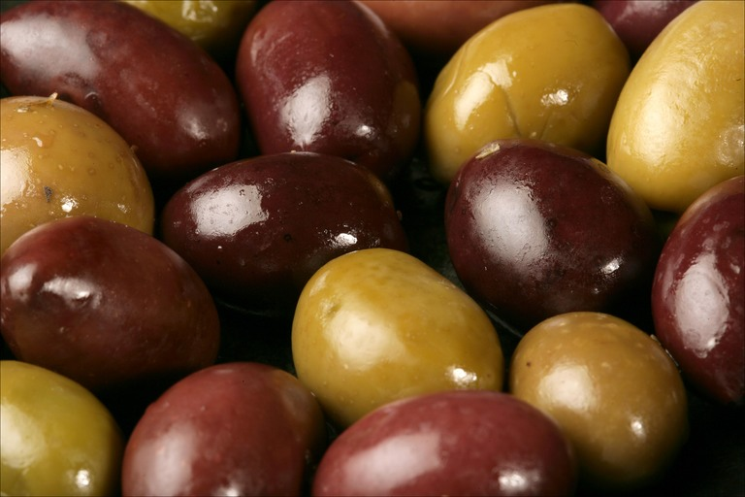
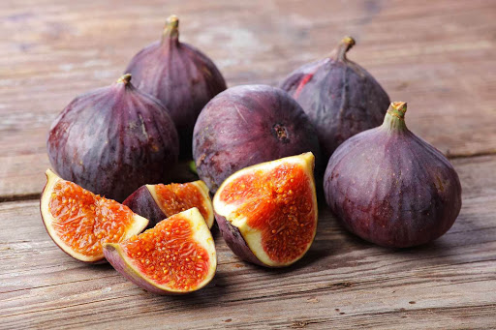
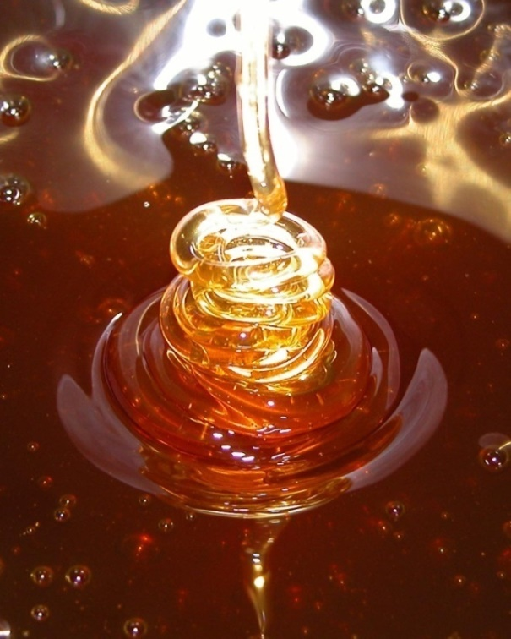
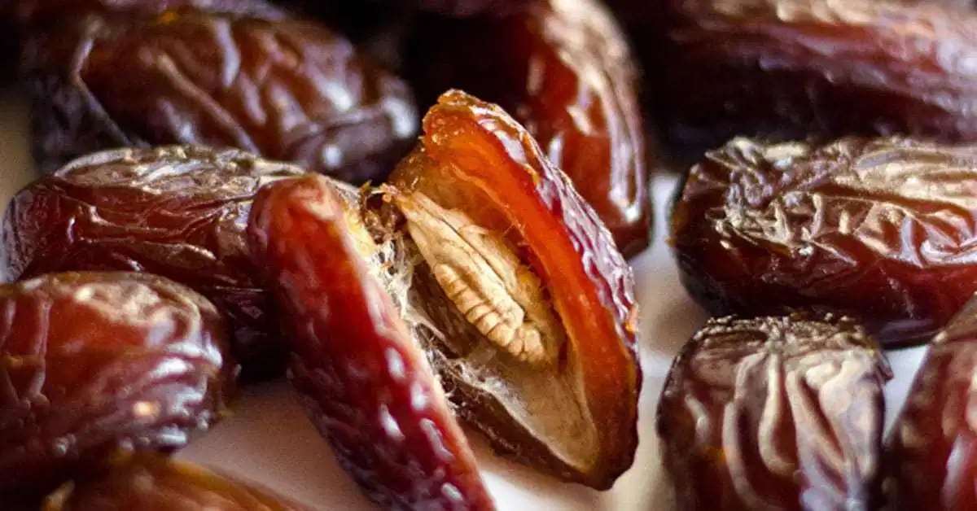
Islamic Shifa!

Slide 14
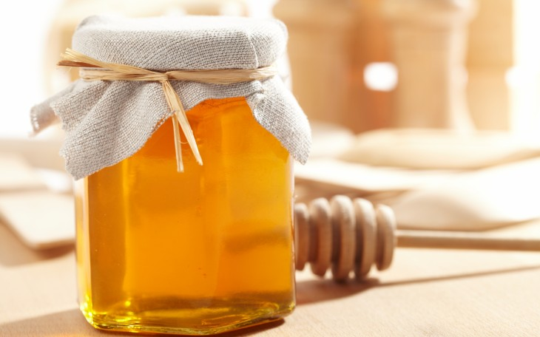
The Prophet (pbuh) said:
“Honey is a remedy for every illness and the Quran is a remedy for all illnesses of the mind, therefore I recommend to you both remedies, the quran and honey.”
[Bukhari]

Slide 15
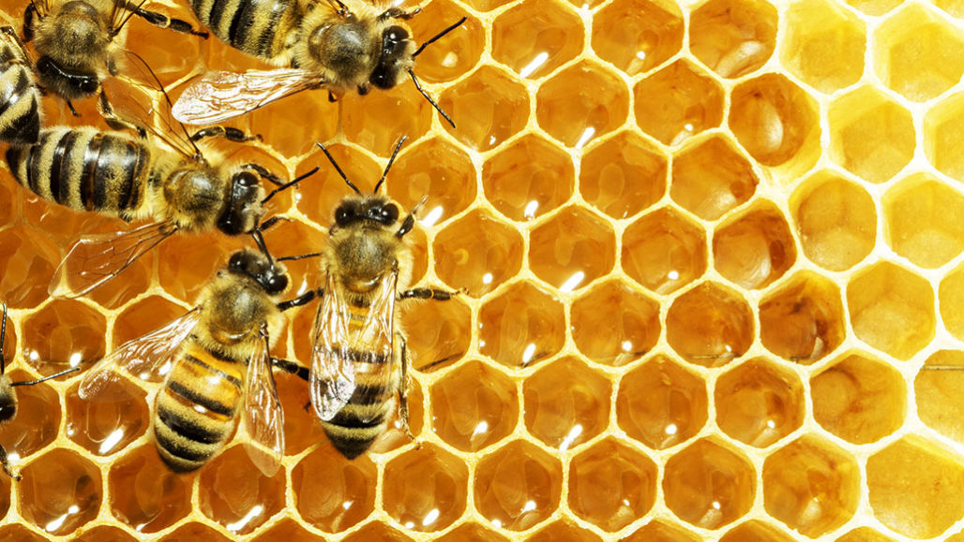
“There comes forth from their bellies, a drink of varying colour wherein is healing for men. Verily, in this is indeed a sign for people who think.”
[16:69]
Notes:
Prophet (saw) strongly recommended the use of honey as a cure for illnesses.

Slide 16

Water
The Prophet (pbuh)said:
‘Fever is from the heat of Hell, so put it out (cool it) with water.’
[Bukhari]
Notes:
Narrated Fatima bint Al-Mundhir: Whenever a lady suffering from fever was brought to Asma' bint Abu Bakr, she used to invoke Allah for her and then sprinkle some water on her body, at the chest and say, "Allah's Apostle used to order us to abate fever with water." Volume:7 Book :71 (Medicine)Number :620

Slide 17
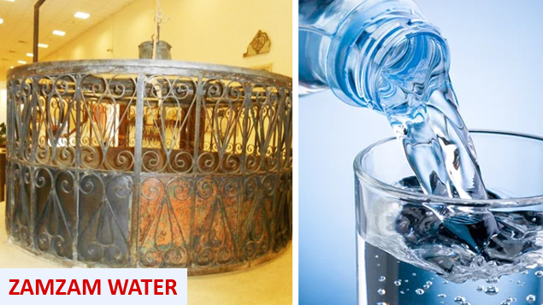
Prophet (pbuh) said:
“The water of Zam-Zam is for whatever it is drunk for.”
[Ibn Majah]
Notes:
Therefore, ask for whatever you want and
Pray TILL YOU DROP!

Slide 18

Keep yourself Hydrated
Drink 6- 8 glasses of water everyday

Slide 19
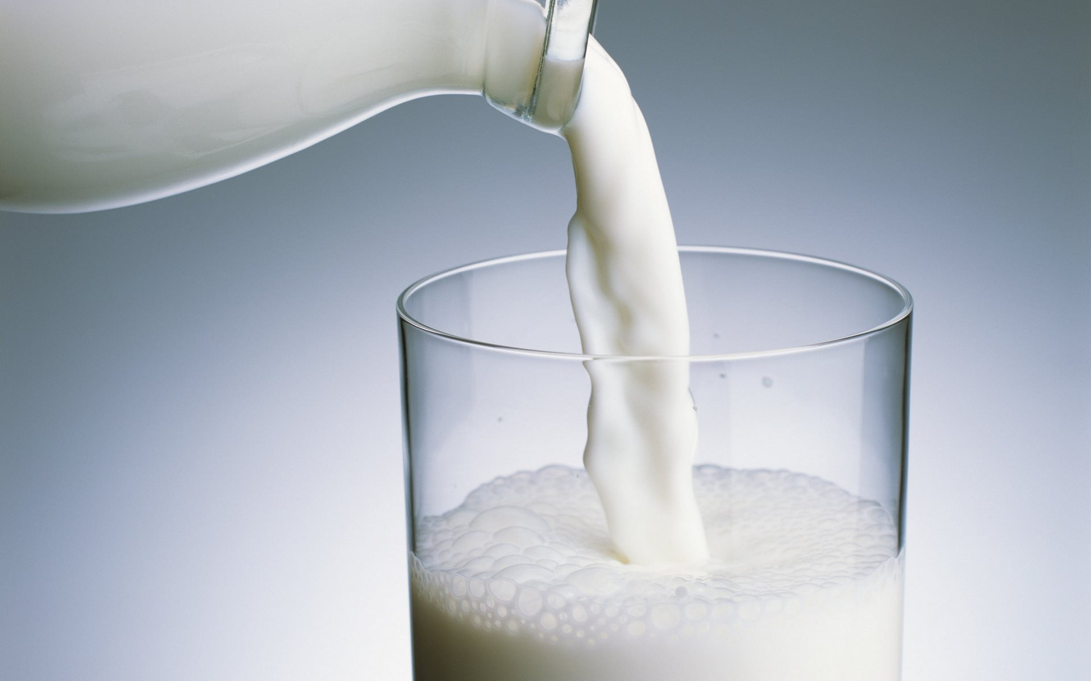
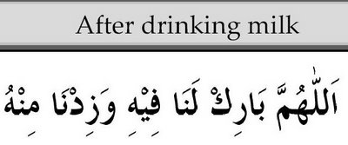
Milk!
“O Allah! Bless it for us and grant us more of it”
[Tirmidhi, Abu Dawood]

Slide 20
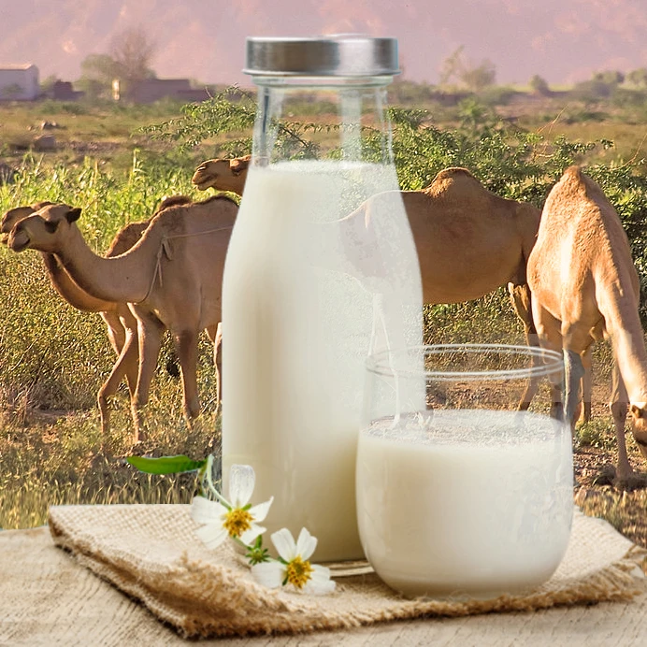
Camel
milk
The next big thing?

Slide 21
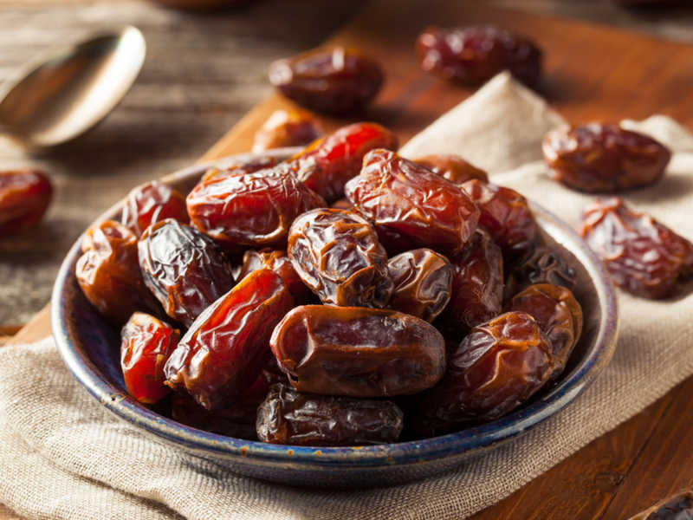
DATES

Slide 22
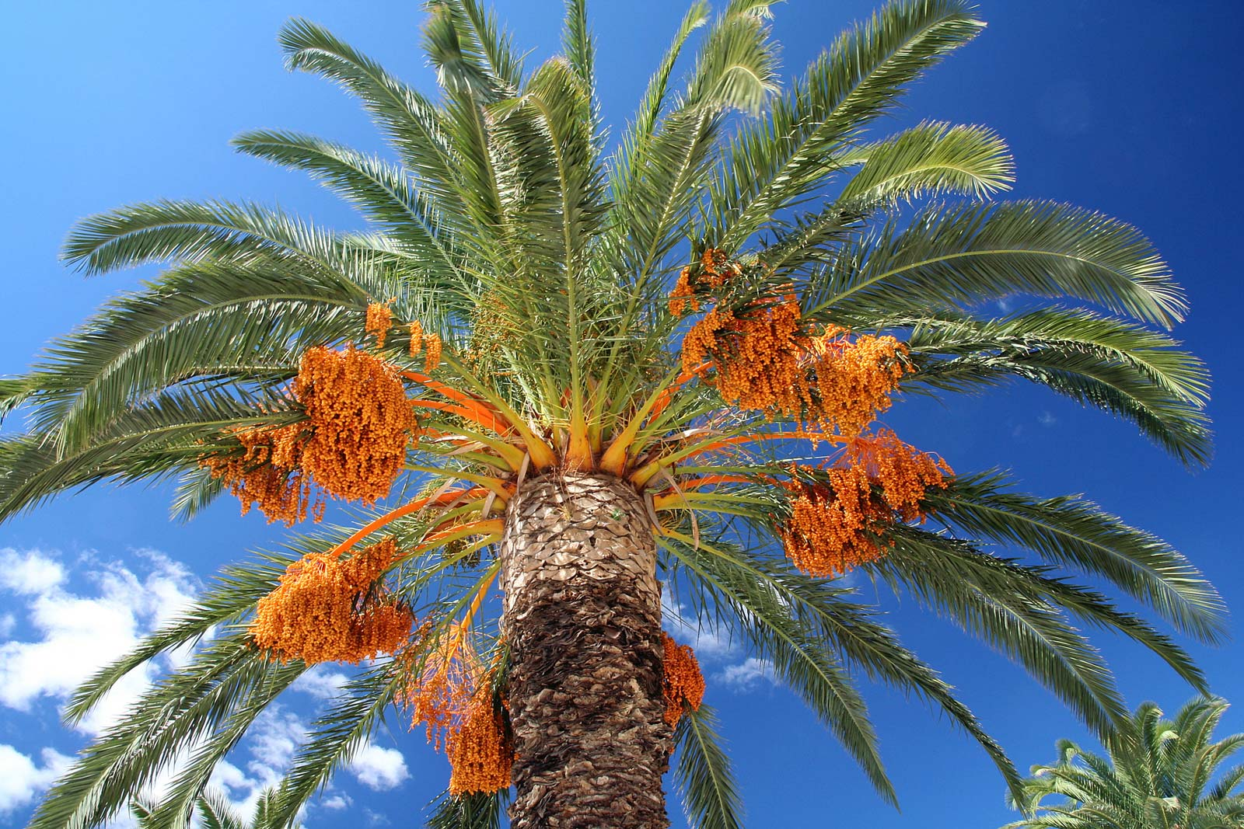
Candy That Grows On Trees!

Slide 23
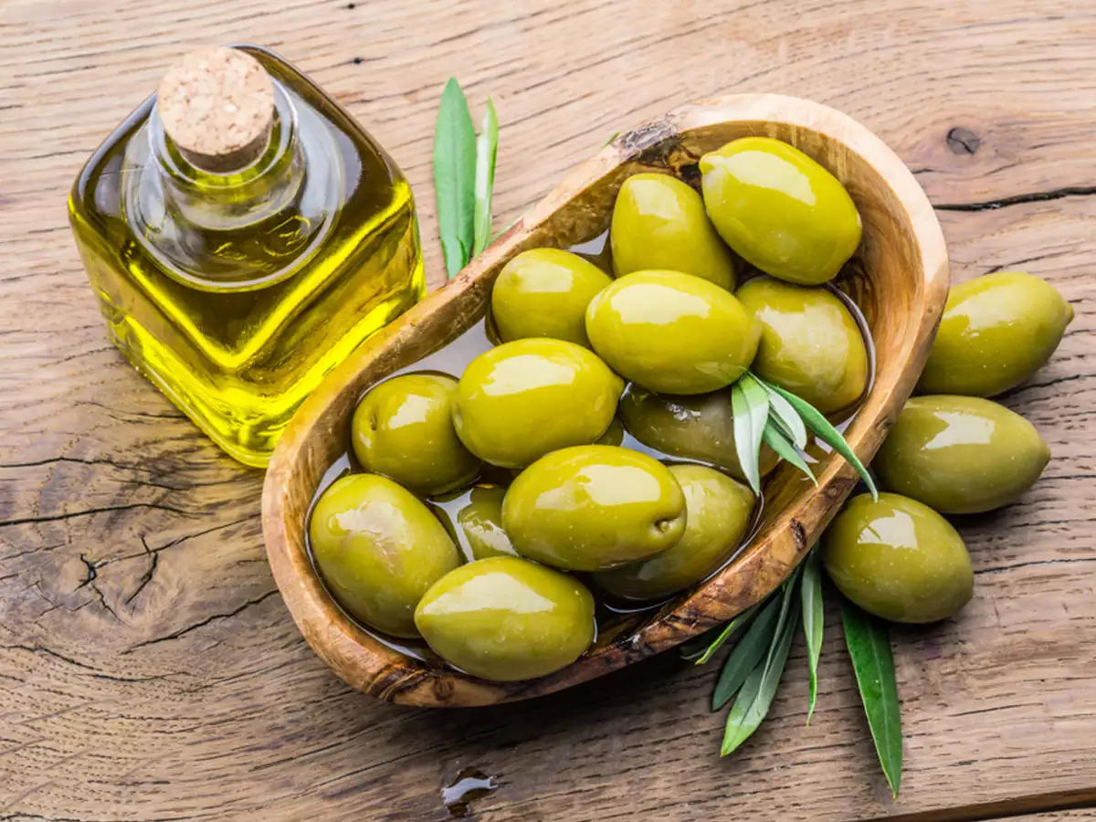
Olives

Slide 24
Shoo that Flu AWAY!
The Prophet (pbuh) said,
"Eat the olive oil and massage it over your bodies since it is a blessed tree.“
  [Ahmad]

Slide 25
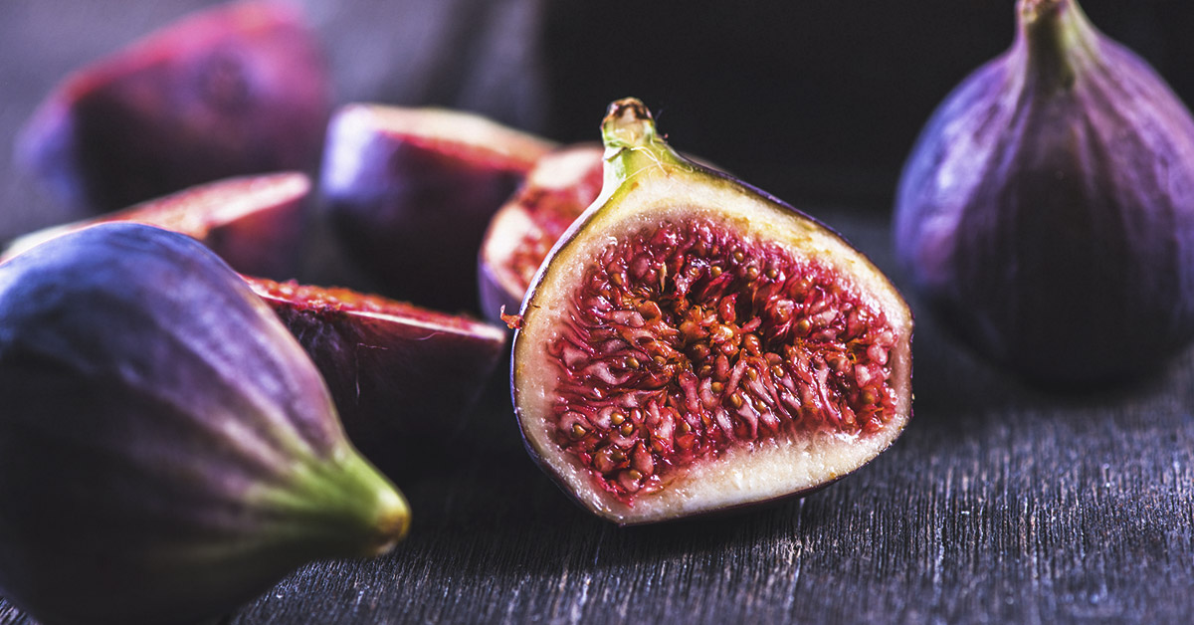
Figs

Slide 26
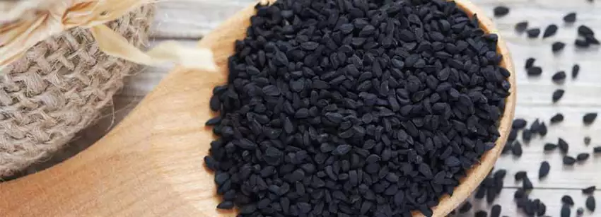
Abu Hurairah (ra) related that the Prophet (pbuh) said:
"Use the black seed, because it contains a cure for every type of ailment, except death." [Tirmidhi]

Slide 27
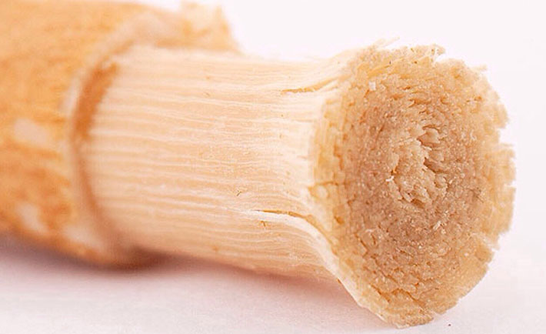
MISWAK

Slide 28
Abu Hurairah (RA) reported: The Prophet (pbuh) said:
"Had I not thought it difficult for my ummah, I would have commanded them to use the miswak (tooth-stick) before every salah.''
[Bukhari and Muslim]

