Slide 1

Part 2

Slide 2

RECAP:
-Mothers and daughters both are emotionally sensitive in some matters

Slide 3
    وَبِالْوَالِدَيْنِ إِحْسَانًا
And with the parents do
utmost good

Slide 4

What are some sensitive areas we can improve to understand each other better?

Slide 5

What drives them up the wall?

Slide 6

What is their soft spot?
Is it that cup of chai?

Slide 7
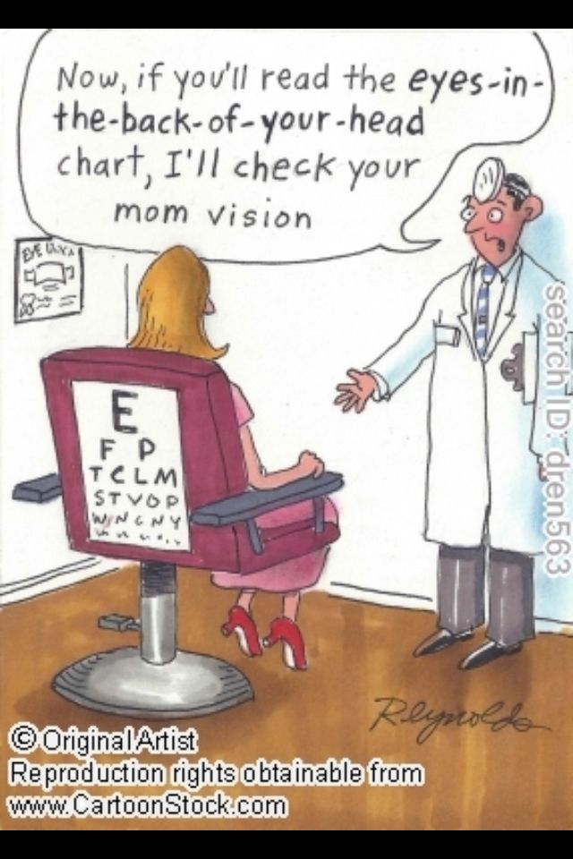
    Parents will always sniff out what wrong you’ve done
    Come clean, or you may lose their trust!

Slide 8

    Trust is incredibly delicate, and takes a lot of time and effort to build

Slide 9

Start with making YOUR attitude positive
Notes:
One person speaks at a time.
Respectful
We will make a sincere commitment to listen to one another, to try to understand the other person's point of view before responding.
We agree to try our hardest and trust that others are doing the same within the group.
We will not carry any grudges against anyone when we leave this place.
We agree to attack the issues, not the people with whom we disagree

Slide 10


Its easy to complain and crib, but have YOU made the effort?

Slide 11

Grab every chance to refuel your relationship!

Slide 12

The Messenger of Allah ((pbuh) said:
“The pious offspring who casts a single look of affection at his parents receives a reward from Allah equal to the reward of an accepted Hajj.” The people enquired: “O Prophet of Allah (pbuh), if someone casts a hundred such glances of love and affection at his parents, what then?” The Messenger of Allah (pbuh) said: “Yes, indeed, even if one does so a hundred times a day, he will get a hundred-fold reward. Allah is far greater than you imagine and is completely free from petty narrow mindedness.”
[Sahih Muslim]

Slide 13

Take the initiative of talking to them about your life before they feel the need to interrogate

Slide 14

Consult them in important decision making
Don’t be afraid of their input

Slide 15

SMALLEST WORDS tend to have the BIGGEST IMPACT

Slide 16

Go on…try it!

Slide 17
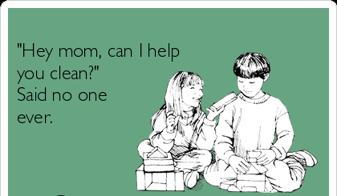
Surprise them for a change!

Slide 18


Slide 19

Arguing always backfires
It’s like giving them more reasons to be stricter

Slide 20

Try to defuse the situation

Slide 21
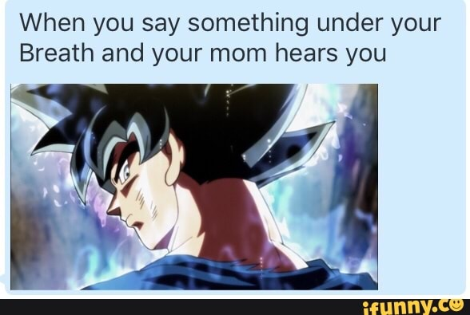
They can always here you, so don’t mutter under your breath!
Notes:
No magic wand

Slide 22

You may just forget about it, but your mother will continue to hurt silently
Do you want to cause this pain?
Notes:
No magic wand

