Slide 1
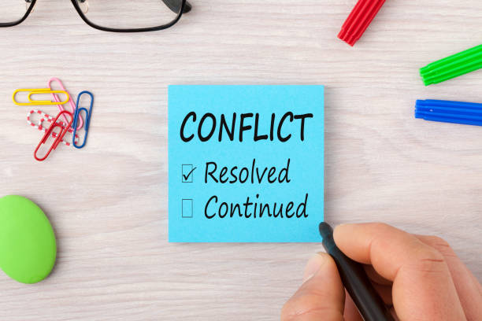
Part 3

Slide 2
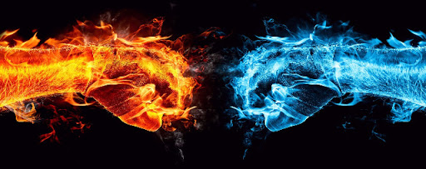
RECAP:
- Insight into each others minds & feelings
- Rethink your relationship
- Develop & strengthen an understanding

Slide 3
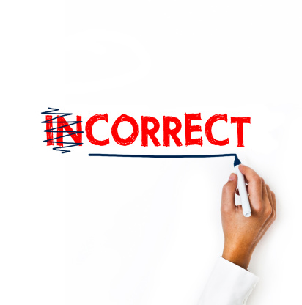
Parents are our #1 influence!
We love them!
We DO wish to get along with them!
We wish they spend more time with us

Slide 4

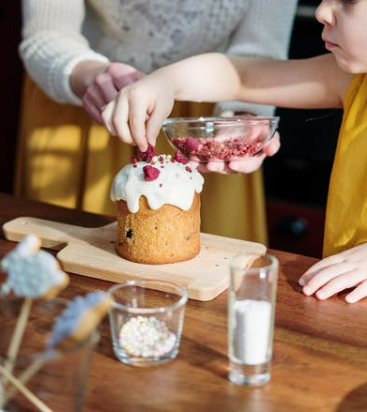

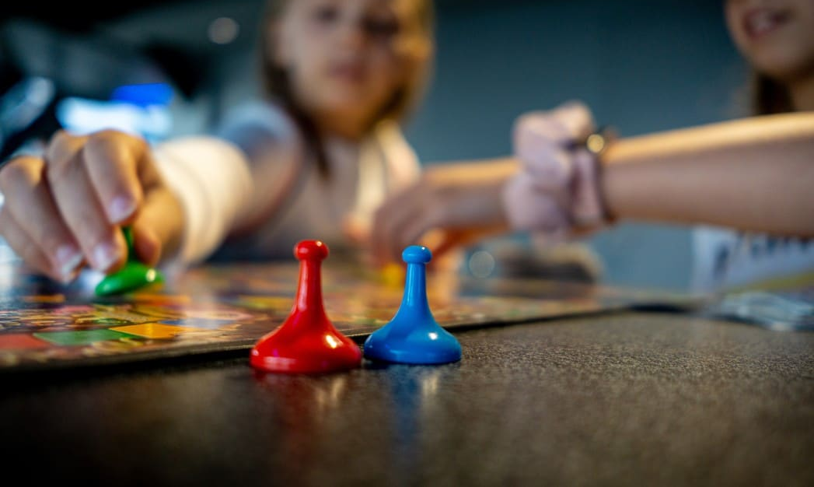
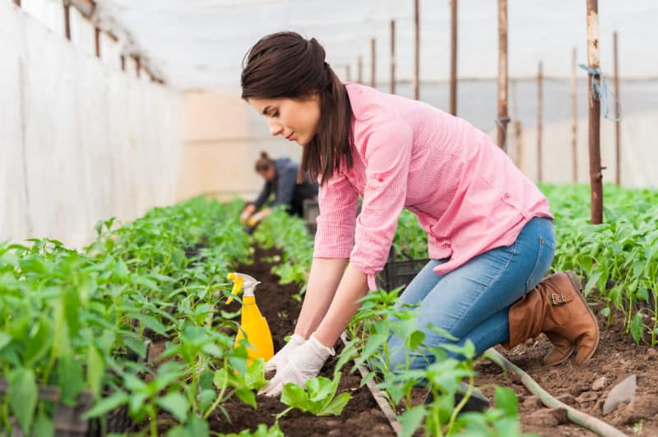

Slide 5

The first step takes…
HONESTY & GUTS!

Slide 6


Slide 7

Defensive Mode
Tranquility
Respect & Rightful Obedience
Barakah

Slide 8

Story of the boy and the apple tree

Slide 9

Moral of the story
Like trees, parents too are givers

Slide 10
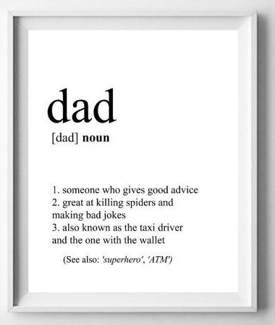


Slide 11
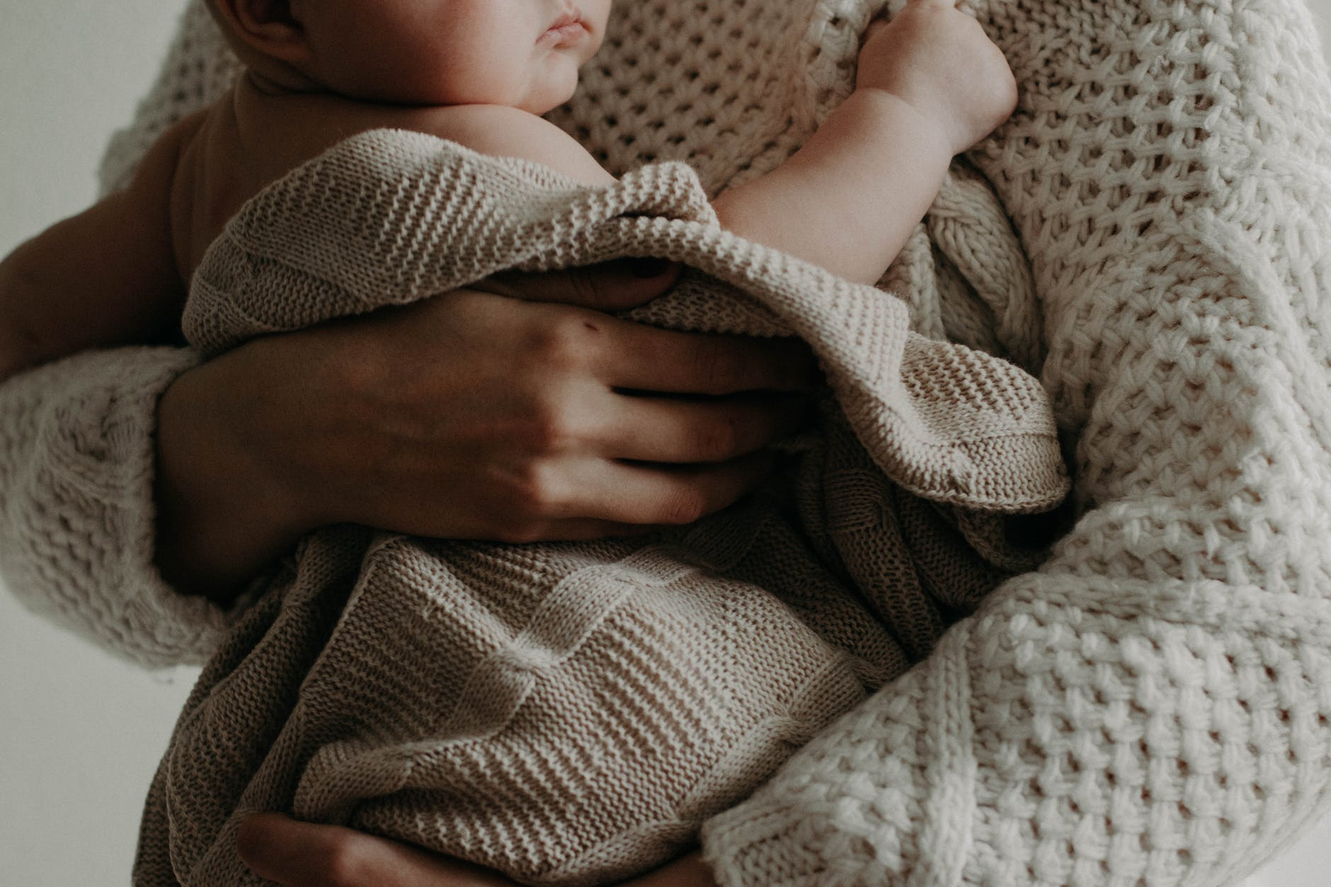
Moral of the story
We need them when we
are young

Slide 12

Moral of the story
As we grow older, they are still the first ones we turn to for help!

Slide 13

Resolving conflicts is the responsibilty of both parties!

Slide 14
‘Aa’ishah (RA) said: A woman came to me with two daughters and asked me for food, and I could not find anything except one date which I gave to her. She shared it between her two daughters, then she got up and went out. The Prophet (SAW) came in and I told him what had happened. He said:
“Whoever is in charge of any of these girls and treats them well, they will be a shield for him against the Fire.”
Bukhari & Muslim

Slide 15
Parent’s duty towards their children:
- teach children Islam
- teach worldly matters
- teach good manners
- teach acts of worship

Slide 16

“(Remember) when Luqmaan said to his son, while he was advising him, “My dear son, do not ascribe partners to Allah. Indeed, ascribing partners to Allah (shirk) is a grave transgression”
31:13

Slide 17
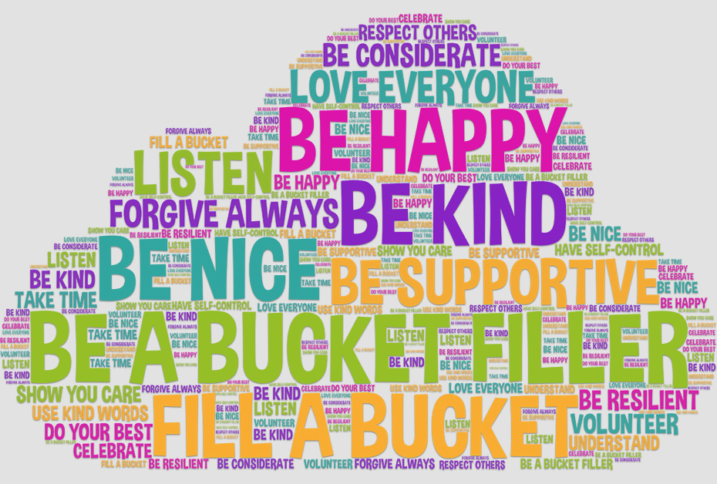
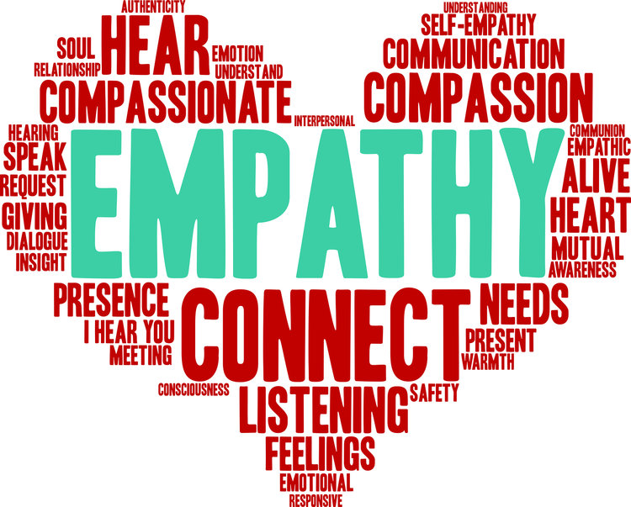

Slide 18

Islam also teaches parents to be fair to all their children

Slide 19

Give gifts equally
Show no preference
Treat them equally in all matters

Slide 20

“O you who believe, save yourselves and your families from a fire, the fuel of which is human beings and stones, appointed on which are angels, stern and severe, who do not disobey Allah in what He orders them, and do whatever they are to do”
66:6

Slide 21

Parents are also supposed to spend on their kids
In the form of money and time

Slide 22
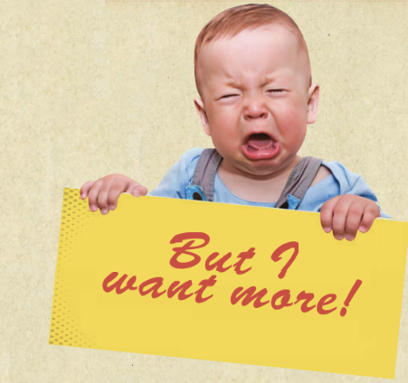
That doesn’t mean that children can stand in front of their parents with a long list of unreasonable demands!

Slide 23
Appreciate and understand that your parents have to act as your parents
- it’s the obligation Allah has placed on them to raise you as good Muslims
-they literally have to be answerable to Allah for it!
Notes:
No magic wand

Slide 24
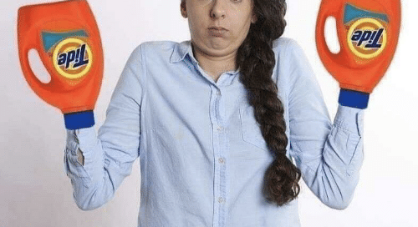
Sometimes it may feel like they’re on your case; but in reality
Their hands are tied!
Notes:
No magic wand

Slide 25
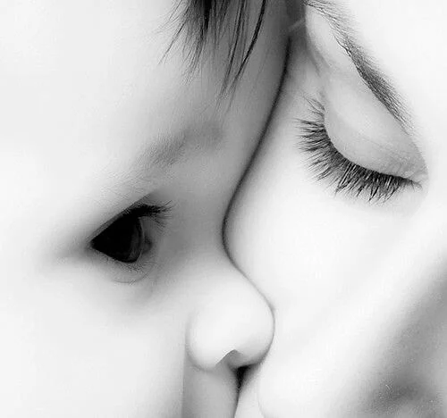
THIS RELATIONSHIP IS WORTH CULTIVATING

