Slide 1
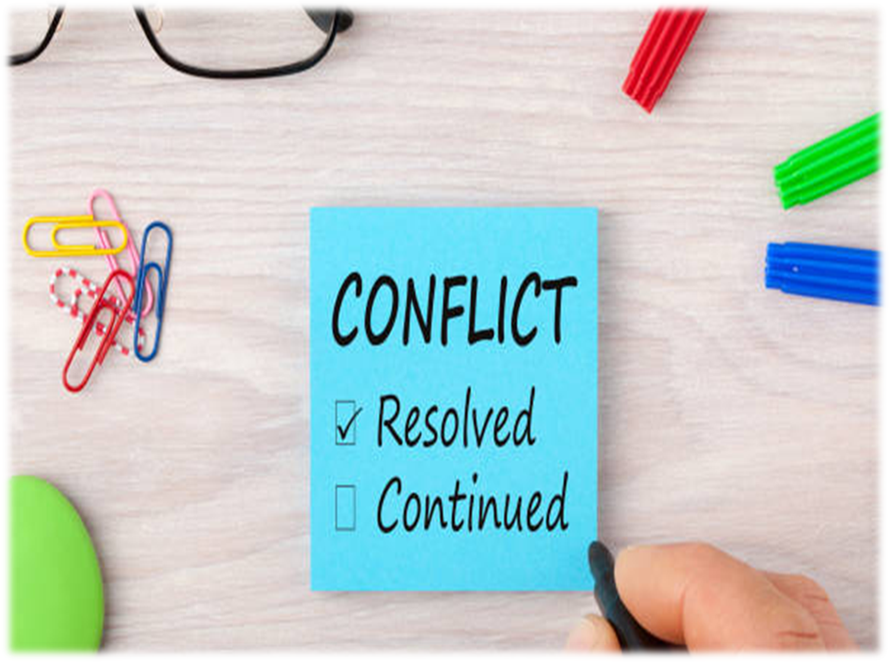

Conflict resolution
Part 1

Slide 2

Your relationship with your mother is sometimes like being on a big scary roller coaster

Slide 3
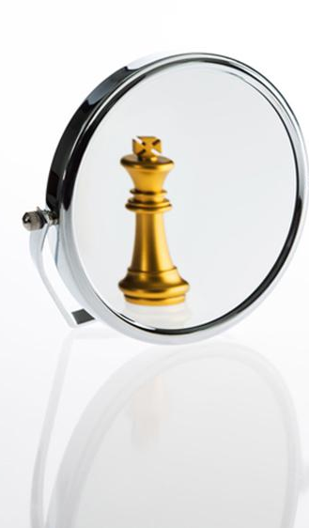
LET’S SELF- EVALUATE
&
BEGIN BY FILLING IN THIS SHORTQUIZ

Slide 4
The Prophet was asked about the great sins
He said, "They are:
(1 ) To join others in worship with Allah,
(2) To be undutiful to one's parents.
(3) To kill a person (which Allah has forbidden to kill)
(4) And to give a false witness.“
Bukhari

Slide 5
    وَبِالْوَالِدَيْنِ إِحْسَانًا
And with the parents do utmost good

Slide 6
    فَلاَ تَقُل لَّهُمَآ أُفٍّ
    Do not say “Ufff”

Slide 7
Ground rules
One person speaks at a time.
Be respectful
We will make a sincere commitment to listen to one another
We agree to try our hardest
We will not carry any grudges against anyone
We agree to attack the issues, not the people with whom we disagree
Notes:
One person speaks at a time.
Respectful
We will make a sincere commitment to listen to one another, to try to understand the other person's point of view before responding.
We agree to try our hardest and trust that others are doing the same within the group.
We will not carry any grudges against anyone when we leave this place.
We agree to attack the issues, not the people with whom we disagree

Slide 8
My Attitude
What are my boundaries in this situation?
How can I solve the problem?
Willingness to explore possible solutions?
Notes:
One person speaks at a time.
Respectful
We will make a sincere commitment to listen to one another, to try to understand the other person's point of view before responding.
We agree to try our hardest and trust that others are doing the same within the group.
We will not carry any grudges against anyone when we leave this place.
We agree to attack the issues, not the people with whom we disagree

Slide 9
Our Limitations
We cannot negotiate solutions to all of our problems in one session
We cant change others/ourselves overnight
The required change has to come from within
Notes:
One person speaks at a time.
Respectful
We will make a sincere commitment to listen to one another, to try to understand the other person's point of view before responding.
We agree to try our hardest and trust that others are doing the same within the group.
We will not carry any grudges against anyone when we leave this place.
We agree to attack the issues, not the people with whom we disagree

Slide 10
What are the needs that are most important to be negotiated at this time?

Slide 11

Let’s make a list of things that annoy you …
Notes:
Exercise
Parents and teen list and prioritize areas of conflict to be addressed
Each party explains the situation from their point of view

Slide 12
Top most annoying things in parents
1) They always compare me to others:
sometimes with a sibling or a cousin and sometimes with someone completely random!
Notes:
No magic wand

Slide 13
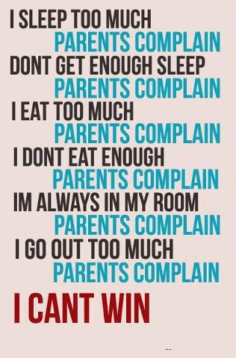
Top most annoying things in parents
2) Some parents have a never satisfied syndrome
Notes:
No magic wand

Slide 14
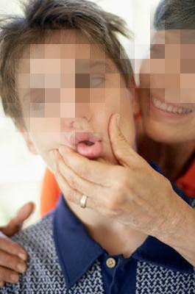
Top most annoying things in parents
3) They embarrass you at the wrong moments
Notes:
No magic wand

Slide 15

Top most annoying things in parents
4) They are too controlling
Notes:
No magic wand

Slide 16

Their weakness is not in your control!
Only your REACTION is!
Notes:
YOUR reaction to what they do
is what is in your can control

Slide 17

Unfortunately you don’t get a user’s manual for parenting
Notes:
when u become a parent…. on how to be an awesome parent
They didn’t , neither will u .
Therefore we all make mistakes.

Slide 18

Their intentions are not bad. They’re trying their best!
Notes:
Why do they do it ???
For some strange reason they feel that this will help u improve.

Slide 19

Notes:
but we are all of infinite worth.
badtameez
We r not talking abt distorted shapes and sizes
end

Slide 20

The communication gap between parents and teenagers

Slide 21
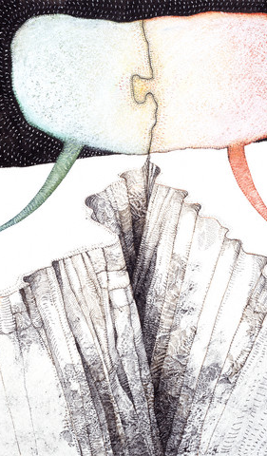
Do you and your parents speak different languages ?
Notes:
Do u ever feel that …..
Why is that ?
ever wondered?

Slide 22
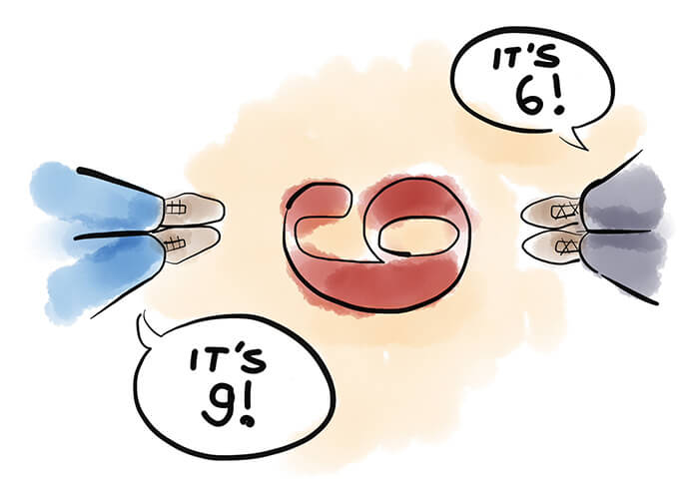
You and your parents see life through different glasses

Slide 23
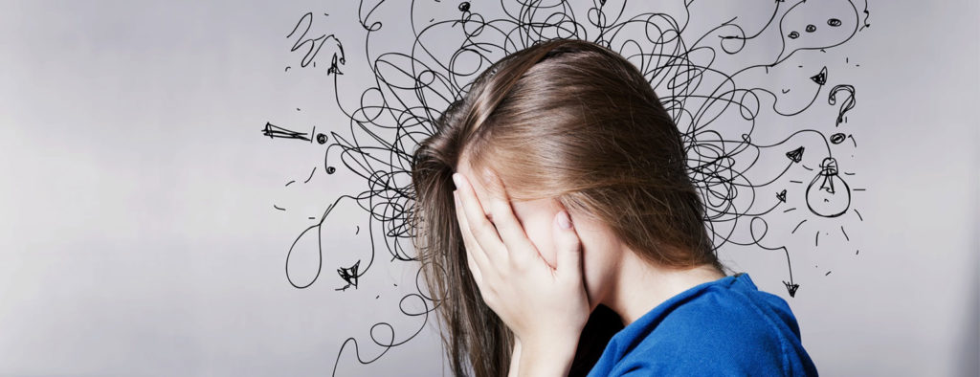
Different worries
Notes:
While u worry about what your friends are going to say
about your NEW HAIR STYLE

Slide 24
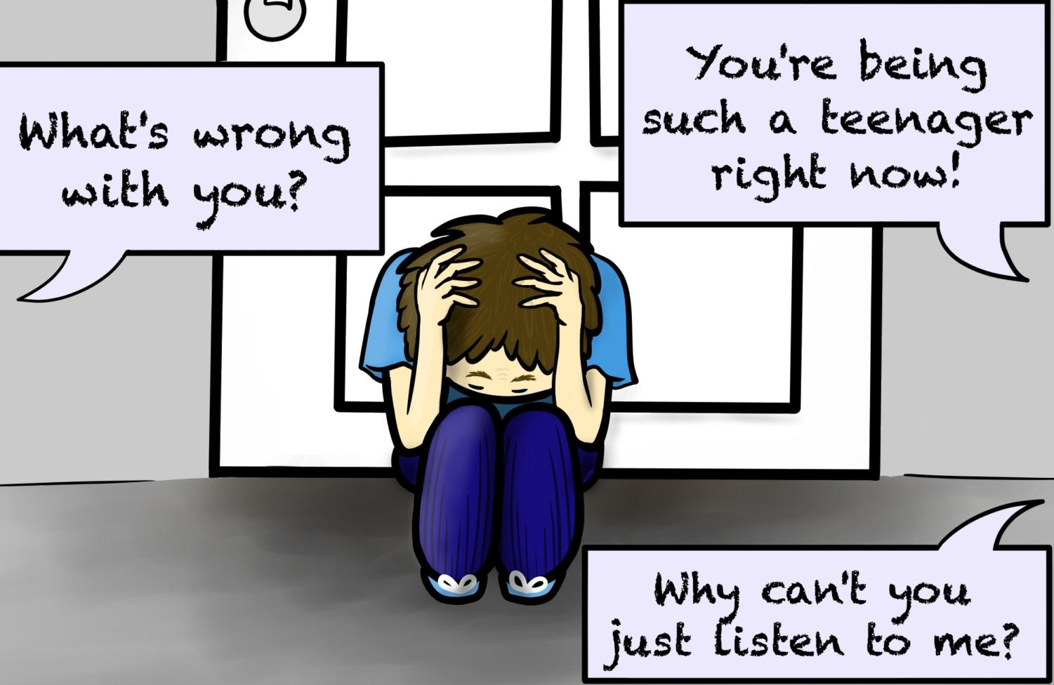

Slide 25

Focus on your reaction:
WHAT yOU SAY IS IN YOUR HANDS
Notes:
1.Don’t take it too seriously.
2.Promise yourself never to do it with your own kids.
3.No harm in letting them know that this hurts.

Slide 26
How bad is this communication gap?
WHAT YOU SAY versus WHAT THEY HEAR
I don’t want to talk about it right now VS I have time for my friends and tv but sorry not for you
You have no idea how to do this or that VS I know more than you
Notes:
WHAT THEY HEAR
I have time for my friends and tv but sorry not for you
I know more than u.

Slide 27
How bad is this communication gap?
WHAT THEY SAY versus WHAT YOU HEAR
When I was your age… VS I was so much better than you
Because I said so that’s why VS I have no good reason ,but you better do it or else…
Notes:
WHAT THEY HEAR
I have time for my friends and tv but sorry not for you
I know more than u.

Slide 28
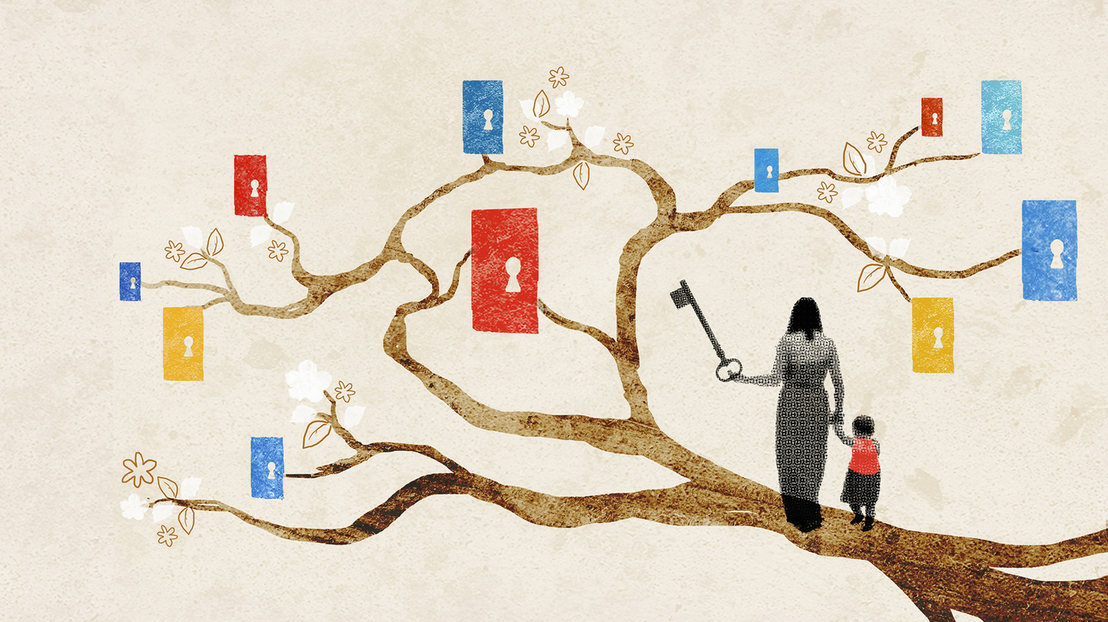
My parents years
of experience > Mine
Notes:
My parents
years of experience
>
Mine

Slide 29
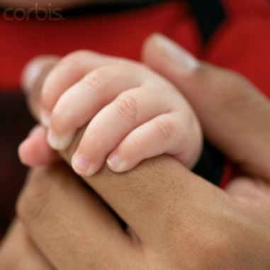
Why are they wiser?
My dad’s age 40 yrs
+ My mom’s age 35 yrs
= My parent’s combined age 75 yrs
- My age 15 yrs
= 60 yrs
more than ours
Notes:
In case u haven't noticed, they do have quite a bit more experience than u do
They r probably smarter than u think.

Slide 30

Both of u are right!
Notes:
When u communicate with your parents they see two faces and u see a vase And……
There r always two sides to the story and this is called communication gap.

Slide 31

FIND THE MIDDLE GROUND- Compromise!

Slide 32
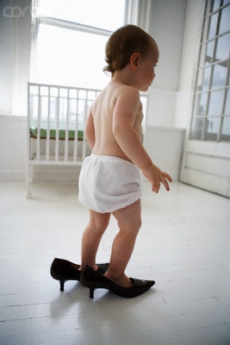
“Before you criticize someone,
You should walk a mile in their shoes.
Then, if you do, you’re a mile away…and
You’ve got their shoes.”
UNDERSTAND EACH OTHER
Notes:
So walk towards them
“ Before you criticize someone,
U should walk a mile in their shoes.
Then , if u do , you’re a mile away…and
You’ve got their shoes.”

Slide 33

Listen first then talk
Notes:
Our problem
We talk first and then pretend to listen !

Slide 34

Our natural response = ARGUING
The moment our parents say something we get angry and defensive
Notes:
Mothers plz rephrase that
Girls rephrase that response
So u think she is a bad influence on me.

Slide 35
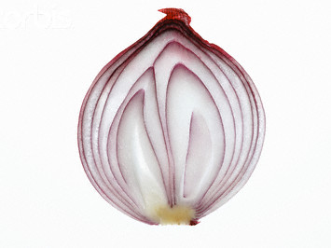
Listening is like peeling an onion
Notes:
…..U may have to peel few layers before uncovering the real issue

Slide 36
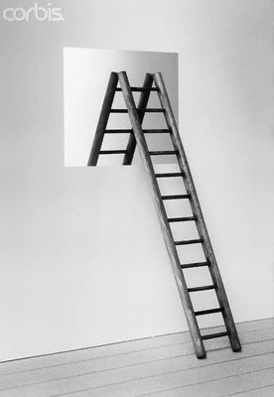
ACT LIKE A MIRROR
Notes:
So how do I listen?.........
A mirror reflect . It does not argue or fight
The goal is to understand them
Repeat in your own words what the other person is saying and feeling
Done till here

