Slide 1


Slide 2
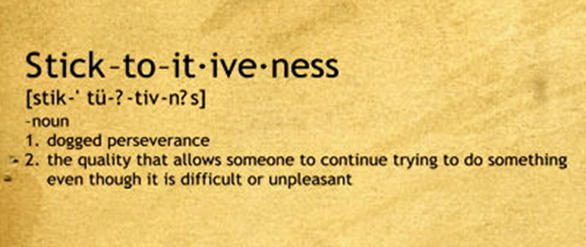
Cute word
You and I need this day in day out to achieve success

Slide 3

If they can do it, so can I!

Slide 4

Think of any habit you want to adopt

Slide 5
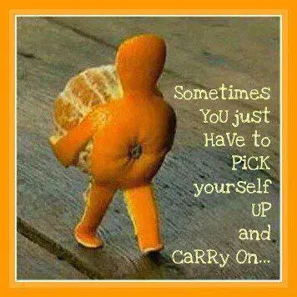
You will stumble,
get shoved, pushed,
BUT…

Slide 6



Sharpen focus, set goal

Slide 7



Build competence

Slide 8

Keep your passion burning

Slide 9

Stress and worries are real but don’t let them overpower you

Slide 10

Brooklyn Bridge

Slide 11

Carrying grudges and disappointments around is toxic for your spirit of perseverance
In your hatred towards your critics, you only harm yourself
Genuinely forgive such people for your own peace of mind

Slide 12
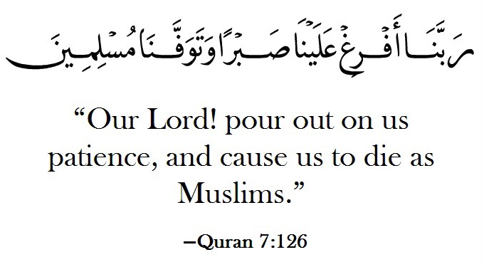
Dua for Patience, Steadfastness and Perseverance

Slide 13
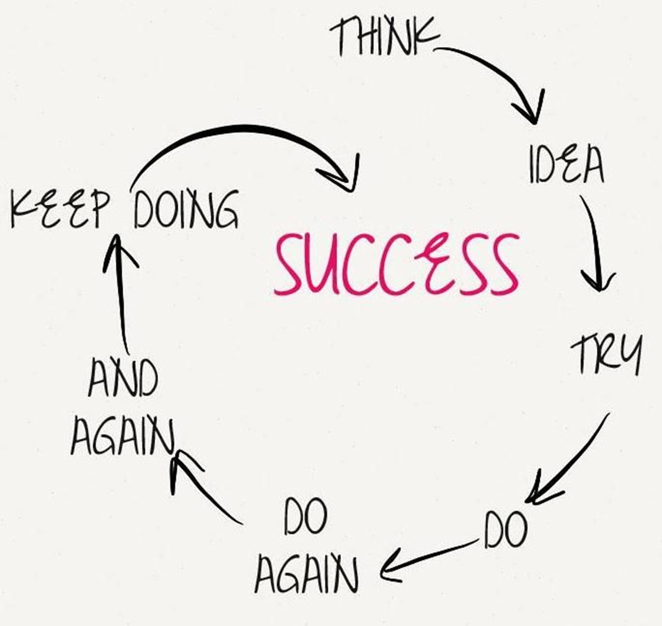
Never give up

Slide 14
RECAP
Sharpen Focus
Ignite Passion
Get Support
Do not Quit
Build Competence

Slide 15
