Slide 1


Slide 2
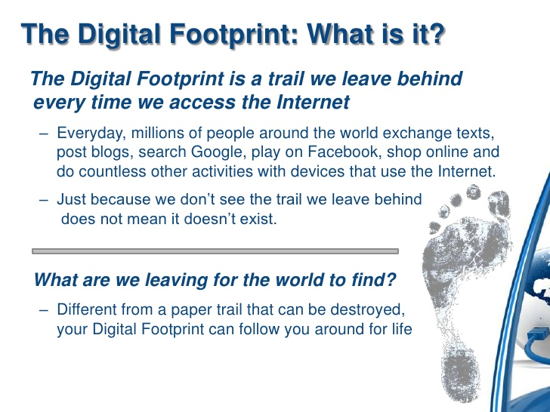

Slide 3
And We give life to the dead,
Activity

Slide 4

Pictures you post
Tweets
Sites you visit
Messages you send
Movies/shows
you watch
Likes
comments
Games you play
Snap chats

Slide 5
Why should I care?

Slide 6
How is it used??

Slide 7
How to manage your digital foot print?
Google yourself
Protect your personal data
Keep login info under lock and key
Think before you post
Nix the pics

Slide 8
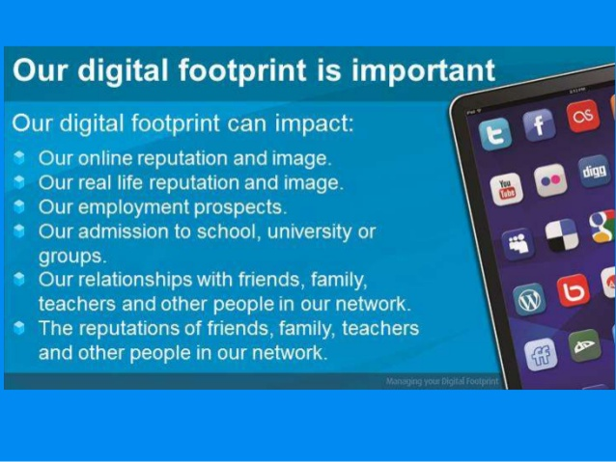
Our Aakhirah

Slide 9
And We give life to the dead,
And We record what they send forth before them, as well as their traces (that they leave behind in this world) – and We have preserved all that happens, in a manifest Book.
Surah Yasin – Verse 12

Slide 10
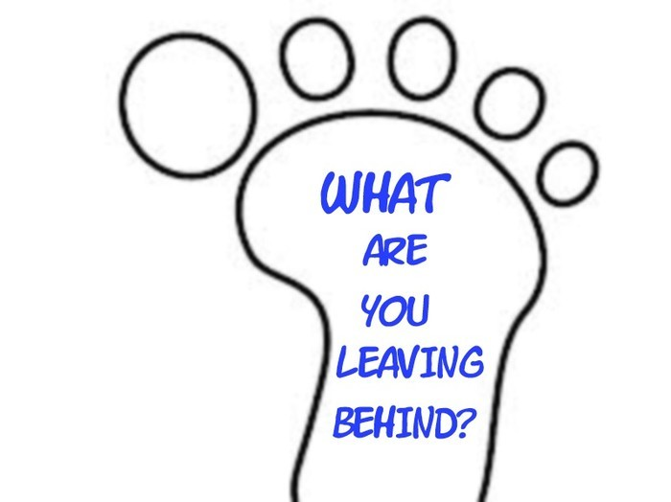

Slide 11
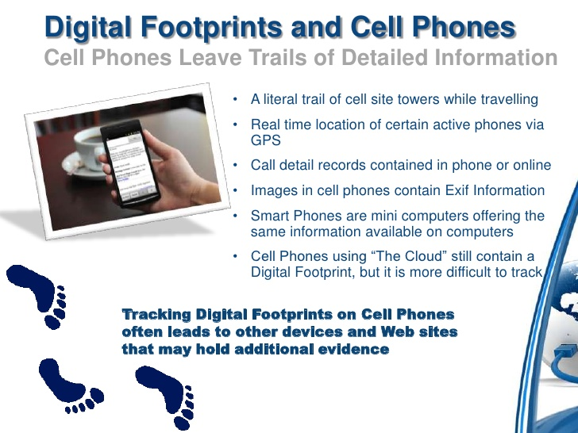

Slide 12
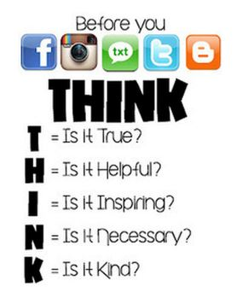
Does it reflect
That I am a Believer?

Slide 13
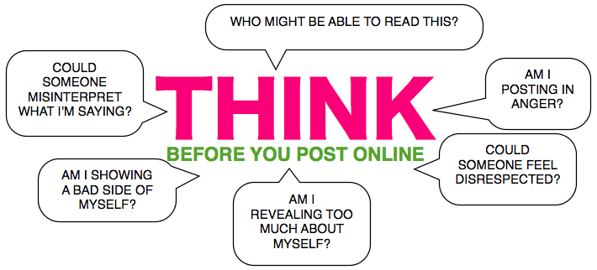
AM I BACKBITING?
AM I HURTING
SOMEONE’S FEELINGS?
AM I REVEALING SOMEONE’S SECRET

Slide 14
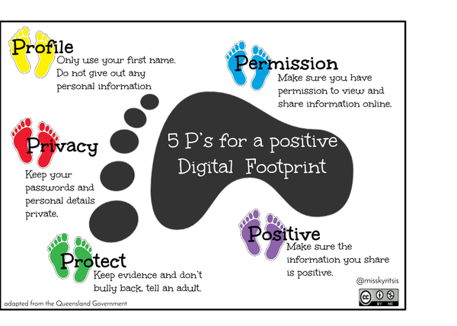
1. Allah (SWT)’s
2. Parents
Copyright
OK for
your age

Slide 15

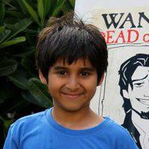

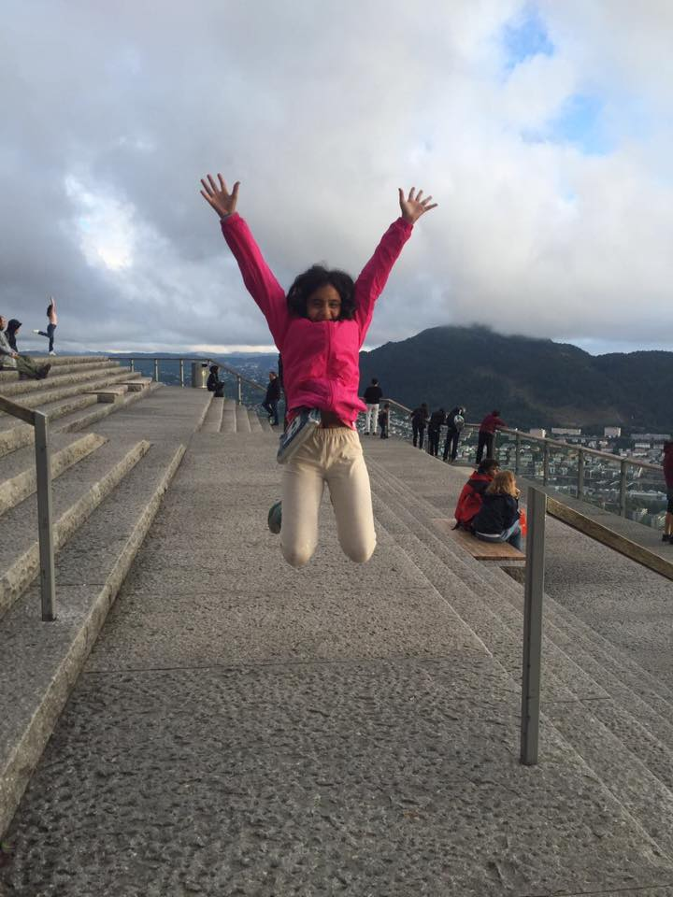

Hayaa Tabba
Rayyan
Lives
in Karachi
Likes
DOB
April 15

Slide 16
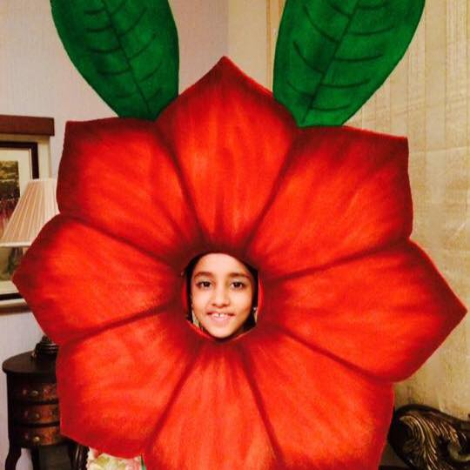
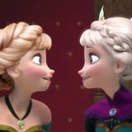
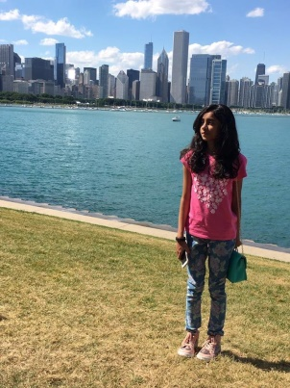

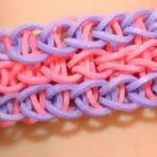
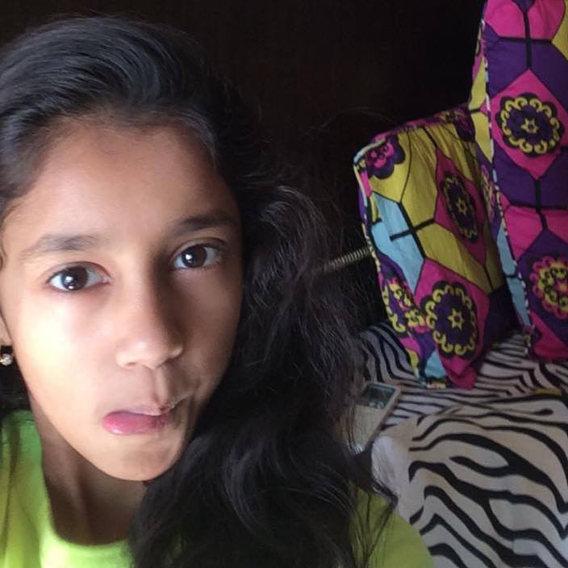
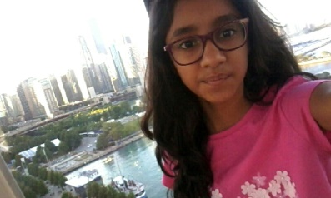
Hamnah Asim
Bay view High School
Likes

Slide 17
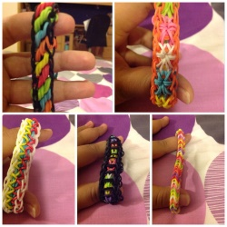
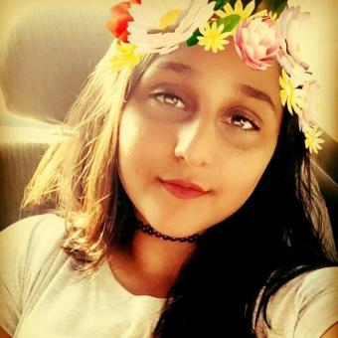
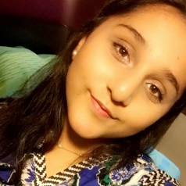
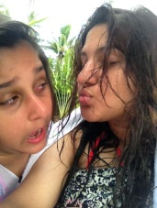
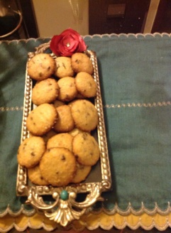
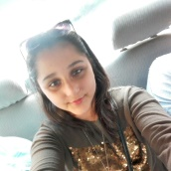

Maryam
Alizeh
Khawaja
Likes
Bay view academy
Following Mark
Zuckeburg and Sarah Sarfaraz
Espresso – shahbaz commercial check-in 25th May 1995
Lives
in Karachi
DOB

Slide 18


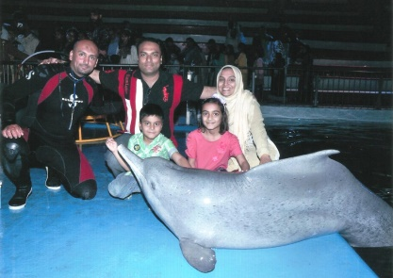
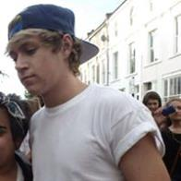
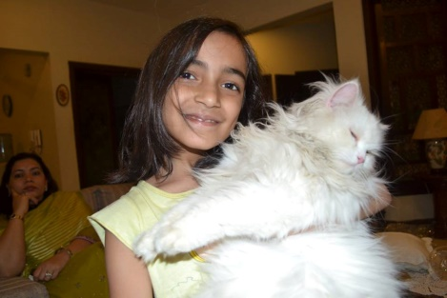
Ayma Mohsin
Dominoes pizza Ittehad on 1st March
11 family members on facebook
Likes
DOB
14 May

Slide 19
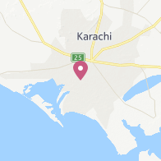
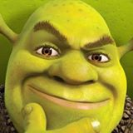
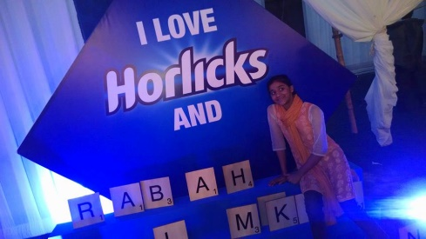

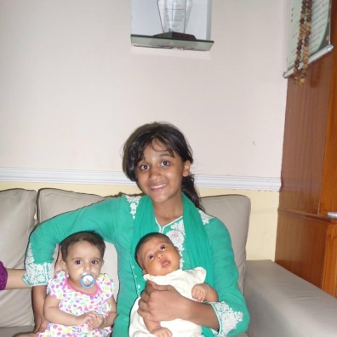
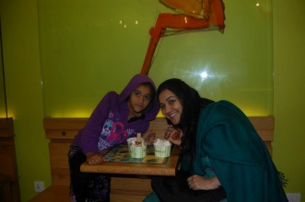
Rabaha Binte Obaid
Frere Hall
7 family members on facebook
Likes
DOB
26 June

Slide 20
