Slide 1

Slide 1
Why should we even bother?
Salah
Notes:
These can be changed to reflect your school’s specific rules.

Slide 2
Why do we have to do it?
Why so much?
What do I gain?

Slide 3

Slide 3
Significance of Salah
Salah 50 times a day
Reduced to
5 times a day

Slide 4
Slide 4
Fajr
Zuhr
Asr
Maghrib
Isha
Sleep
BE SAFE
Breakfast
Family time
School
Dinner
Lunch
Shopping
Nap
Hang out with friends
Swimming
Tuition
My day centered around Salah

Slide 5
Slide 5
Buraidah (RA) reported:
Messenger of Allah (ﷺ) said,
"That which differentiates us from the disbelievers and hypocrites is our performance of Salah. He who abandons it, becomes a disbeliever."
[At-Tirmidhi]
Notes:
*Change this verbiage to the language your school uses.

Slide 6
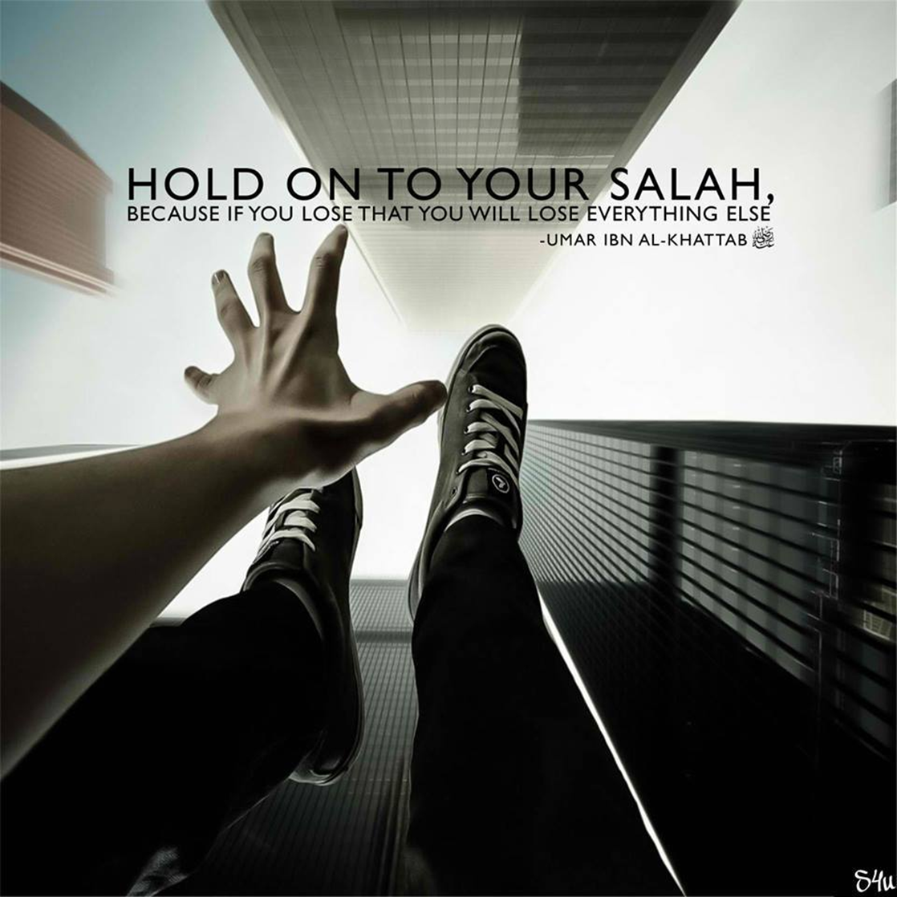
Slide 6
Don’t fall into Satan’s trap and repeat his mistake

Slide 7
Slide 7
مَا سَلَكَكُمْ فِي سَقَرَ
“What has brought you to Saqar (Hell)?”
قَالُوا لَمْ نَكُ مِنَ الْمُصَلِّينَ
They will say, “We were not among those who offered Salah,”
Surah Al Muddathir, verses 42-43

Slide 8
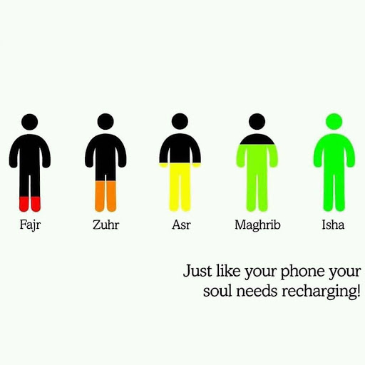
Slide 7
Just like your body needs food, your soul needs prayer; don’t starve yourself

Slide 9
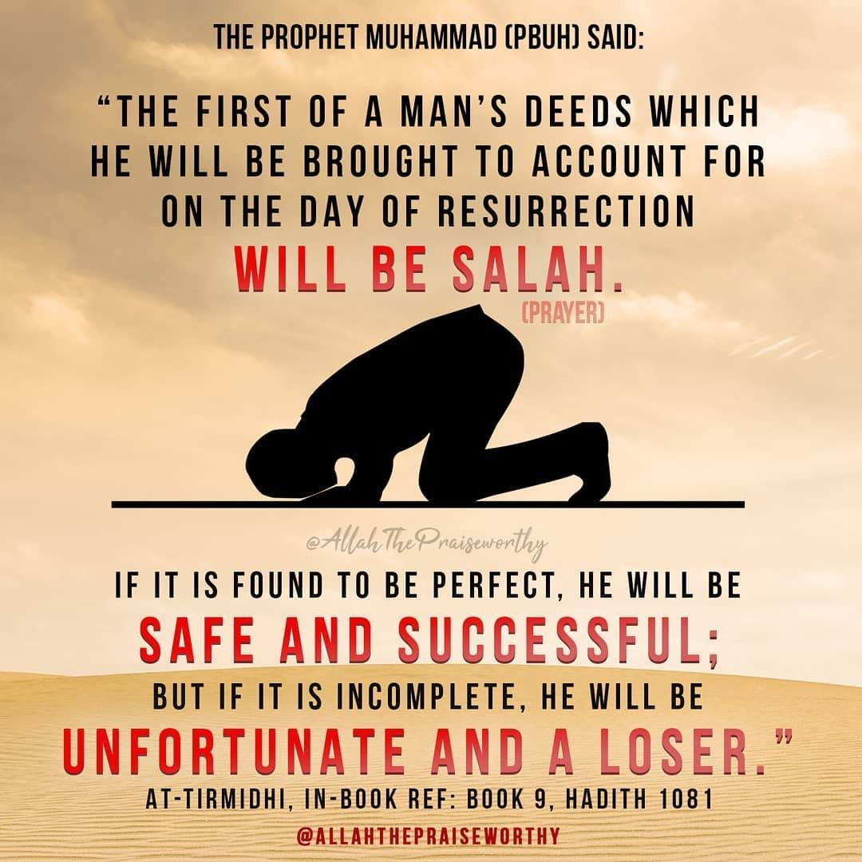
Slide 7

Slide 10
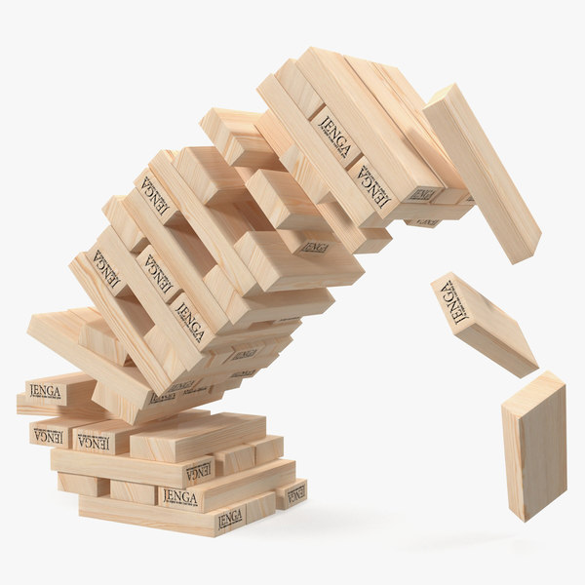
Weak foundation leads to toppling over of the entire structure

Slide 11
Slide 7
فَوَيْلٌ لِّلْمُصَلِّينَ
“So, Woe to those performers of Salah,
الَّذِينَ هُمْ عَن صَلَاتِهِمْ سَاهُونَ
who are neglectful of their Salah
Surah Al Maun, verses 4-5

Slide 12
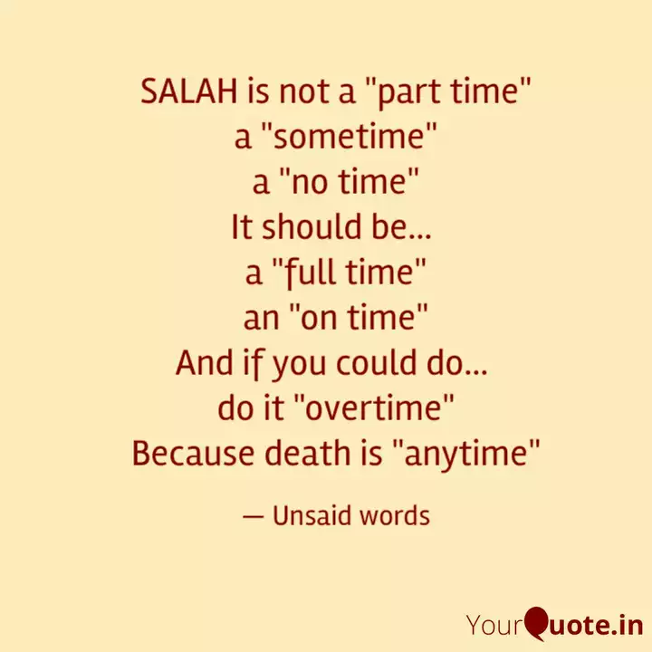
How is my Salah?
Skipping Salah
Not saying Salah at its correct time
Rushing through Salah
Half-heartedly performing Salah

Slide 13


Is Salah a mere obligation for you or something you're actually passionate about?

Slide 14
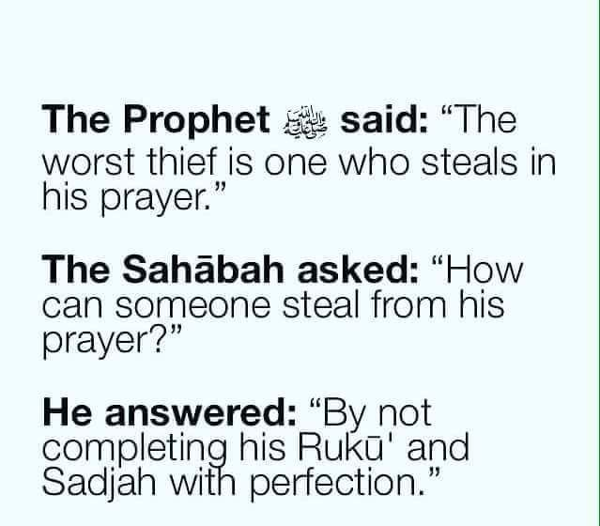

Slide 15
Mindful Salah
I am standing before Allah SWT! Shouldn’t I be mentally alert and present?
I could be performing my last Salah
Know and feel Allah SWT is watching you

Slide 16


Slide 17
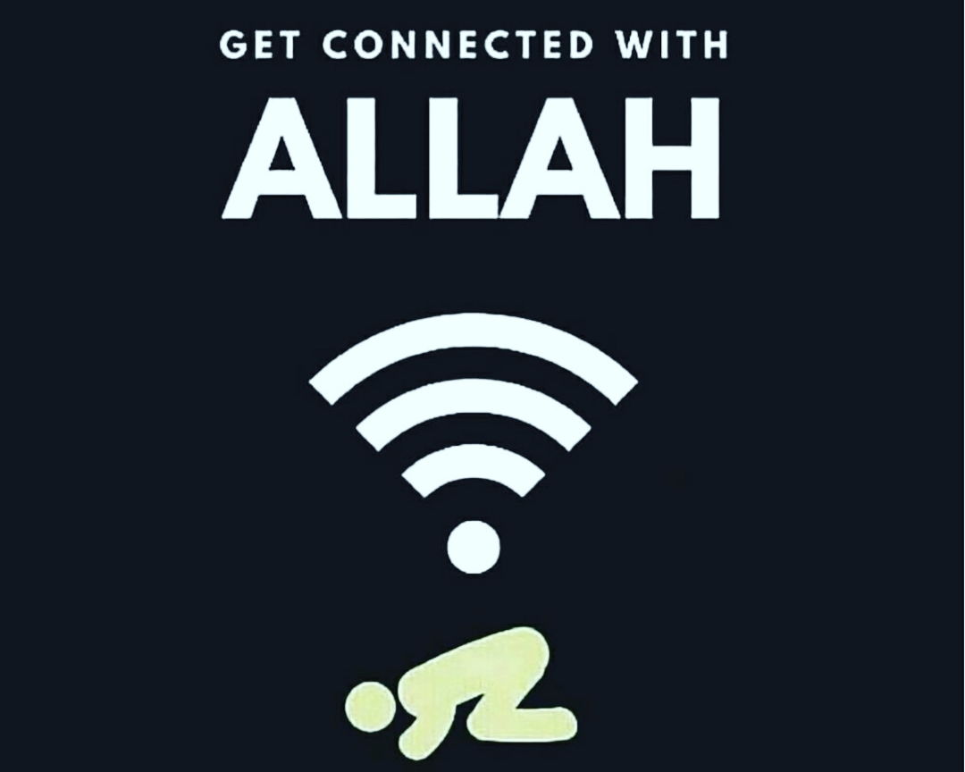
#Change your mindset

Slide 18
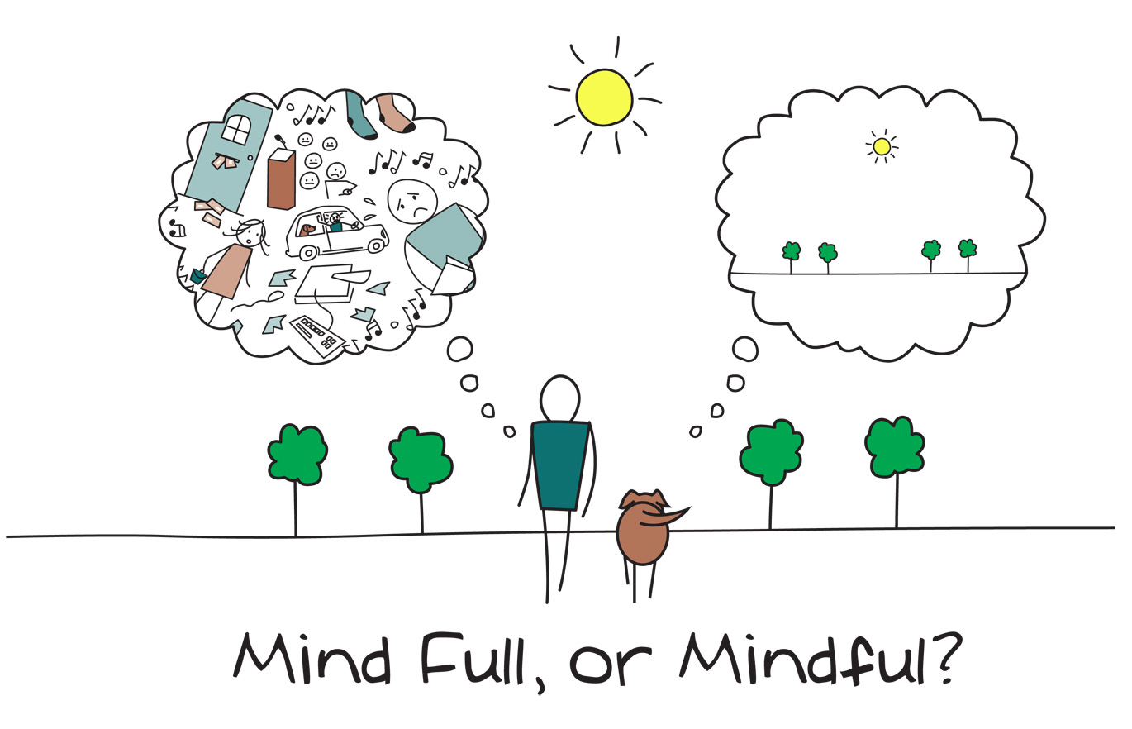
#Mindfulness

Slide 19
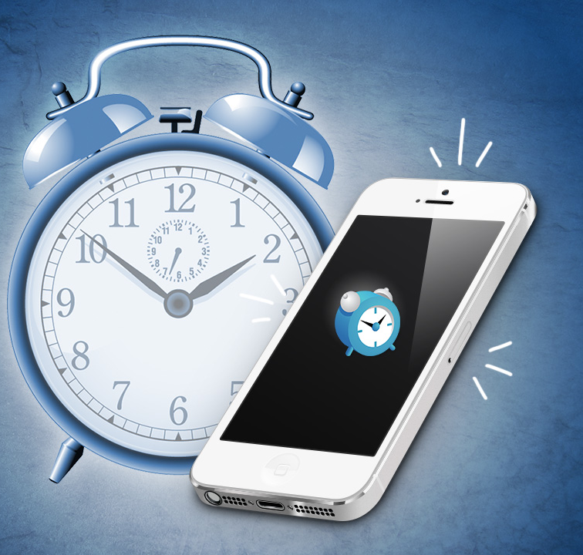
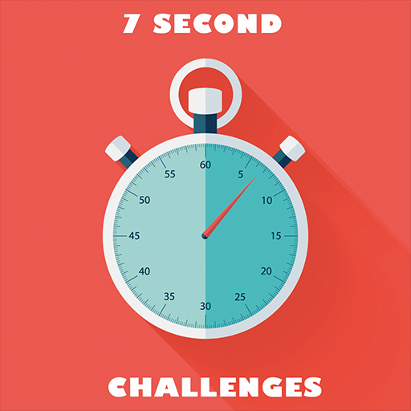
#Prioritize Salah

Slide 20

#Know the meaning of the words

Slide 21
