Slide 1
Framework Of Righteousness

Slide 2
Ayat Al Bir

Slide 3
Surah Al Baqarah 2: Verse 177
لَّيْسَ الْبِرَّ أَن تُوَلُّواْ وُجُوهَكُمْ قِبَلَ الْمَشْرِقِ وَالْمَغْرِبِ وَلَـكِنَّ الْبِرَّ مَنْ آمَنَ بِاللّهِ وَالْيَوْمِ الآخِرِ وَالْمَلآئِكَةِ وَالْكِتَابِ وَالنَّبِيِّينَ وَآتَى الْمَالَ عَلَى حُبِّهِ ذَوِي الْقُرْبَى وَالْيَتَامَى وَالْمَسَاكِينَ وَابْنَ السَّبِيلِ وَالسَّآئِلِينَ وَفِي الرِّقَابِ وَأَقَامَ الصَّلاةَ وَآتَى الزَّكَاةَ وَالْمُوفُونَ بِعَهْدِهِمْ إِذَا عَاهَدُواْ وَالصَّابِرِينَ فِي الْبَأْسَاء والضَّرَّاء وَحِينَ الْبَأْسِ أُولَـئِكَ الَّذِينَ صَدَقُوا وَأُولَـئِكَ هُمُ الْمُتَّقُونَ

Slide 4
Righteousness is not that you turn your faces to the east and west; but righteousness is that one believes in Allah and the Last Day and the angels and the book and the Prophets, and gives wealth, despite love for it, to relatives, and to orphans, the helpless, the wayfarer, and to those who ask, and (spends) in (freeing) slaves and establishes salah and pays zakah – and those who fulfill their covenants when they enter into a covenant, and those who are patient in hardship and suffering; and when in battle. Those are the ones who are truthful, and those are the God fearing

Slide 5
Righteousness is:
Firm Belief on:
Spending what you love on:
Establishing salah
Paying Zakah
Fulfilling contracts
Allah
The Last Day
Angels
The Book
Prophets
Close Relatives
Orphans
Needy
Travelers
Those who ask
Ransom of slaves
Being firm & patient in:
Pain & suffering
adversity
panic

Slide 6
لَّيْسَ الْبِرَّ
Righteousness is not
أَن تُوَلُّواْ وُجُوهَكُمْ قِبَلَ الْمَشْرِقِ وَالْمَغْرِبِ
that you turn your faces to the east and west;

Slide 7
الْبِر
Barr: land
stand firmly
Solace & calm to the inner consciousness
Bahr: ocean
man does not have firm standing on water
sense of unease, uprooted

Slide 8
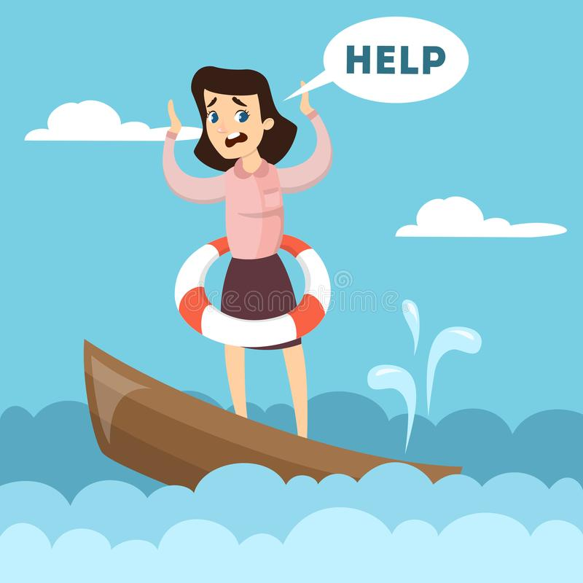
Bahr: ocean
We do not have firm standing on water
sense of unease, uprooted

Slide 9

Barr: land
stand firmly
Solace & calm to the inner self

Slide 10
وَلَـكِنَّ الْبِرَّ …
but righteousness is …

Slide 11
مَنْ آمَنَ بِاللّهِ وَالْيَوْمِ الآخِرِ وَالْمَلآئِكَةِ وَالْكِتَابِ وَالنَّبِيِّينَ
that one believes in Allah and the Last Day and the angels and the book and the Prophets,

Slide 12
مَنْ آمَنَ
1. have firm belief
Allah
The Last Day
Angels
The Book (Quran)
Prophets
بِاللّهِ
وَالْيَوْمِ الآخِرِ
وَالْمَلآئِكَةِ
وَالْكِتَابِ
وَالنَّبِيِّينَ

Slide 13
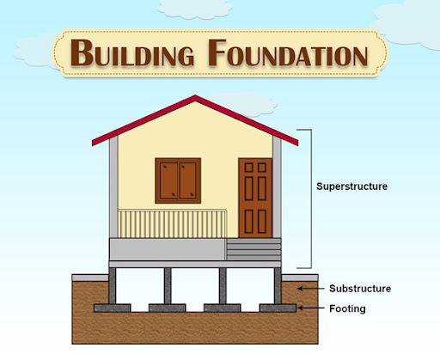
eeman

Slide 14
وَآتَى الْمَالَ عَلَى حُبِّهِ ذَوِي الْقُرْبَى وَالْيَتَامَى وَالْمَسَاكِينَ وَابْنَ السَّبِيلِ وَالسَّآئِلِينَ وَفِي الرِّقَاب
and gives wealth, despite love for it, to relatives, and to orphans, the helpless, the wayfarer, and to those who ask, and (spends) in (freeing) slaves

Slide 15
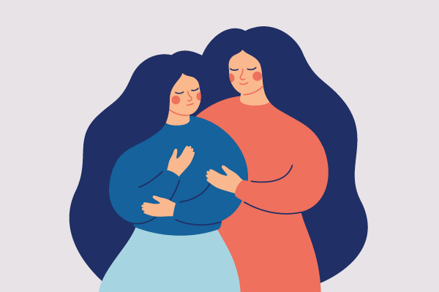
1st Manifestation of Righteousness
Empathy towards fellow human beings

Slide 16
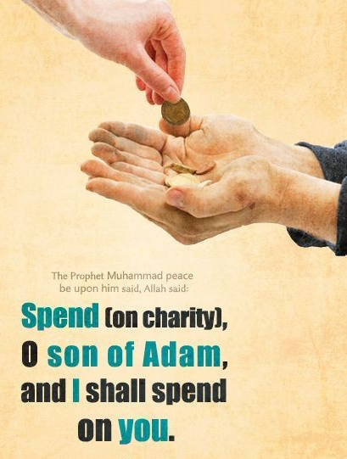
وَآتَى الْمَالَ عَلَى حُبِّهِ
2. Spending what you love
ذَوِي الْقُرْبَى
وَالْيَتَامَى
وَالْمَسَاكِينَ
وَابْنَ السَّبِيلِ
وَالسَّآئِلِينَ
وَفِي الرِّقَاب
Close relatives
Orphans
Needy
Travelers
Those who ask
Ransom of slaves

Slide 17
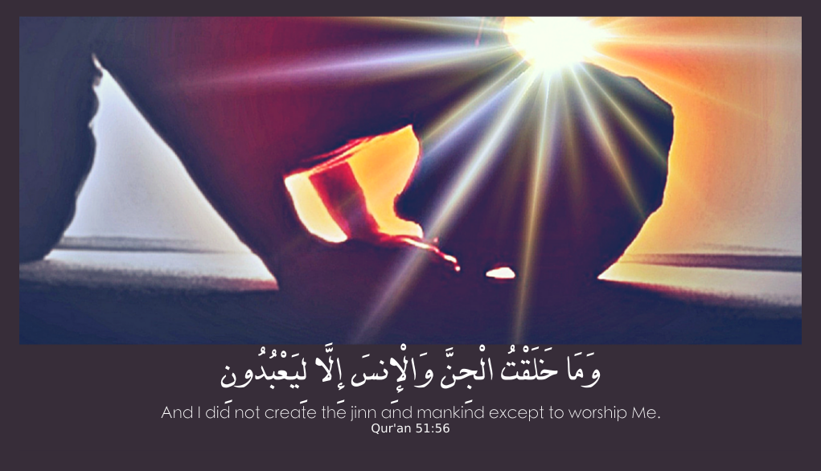
2nd Manifestation of Righteousness
Worship

Slide 18
وَأَقَامَ الصَّلاةَ
3. and establish prayer

Slide 19
وَآتَى الزَّكَاةَ
4. and pay zakah

Slide 20
وَالْمُوفُونَ بِعَهْدِهِمْ إِذَا عَاهَدُواْ
and those who fulfill their covenants when they enter into a covenant

Slide 21
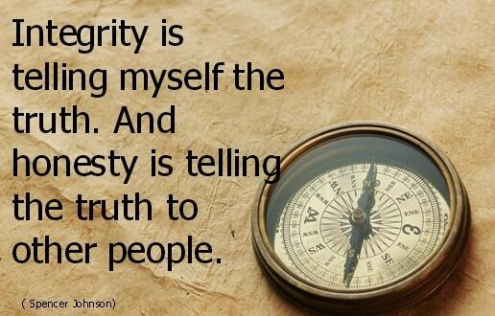
3rd Manifestation of Righteousness
Dealings with honesty
and
integrity

Slide 22
وَالْمُوفُونَ بِعَهْدِهِمْ إِذَا عَاهَدُوا
5. Fulfil promises
Types of promises:
With ourselves
With other human beings
With Allah (swt)

Slide 23
وَالصَّابِرِينَ فِي الْبَأْسَاء والضَّرَّاء وَحِينَ الْبَأْسِ
and those who are patient in hardship and suffering; and when in battle.

Slide 24
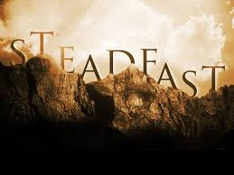
4th Manifestation of Righteousness
Being firm when faced with
right
& wrong

Slide 25
وَالصَّابِرِينَ فِي الْبَأْسَاء والضَّرَّاء وَحِينَ الْبَأْسِ
6. Be firm & patient
Pain & suffering
panic
adversity

Slide 26
Righteousness is:
Firm Belief on:
Spending what you love on:
Establishing salah
Paying Zakah
Fulfilling contracts
Allah
The Last Day
Angels
The Book
Prophets
Close Relatives
Orphans
Needy
Travelers
Those who ask
Ransom of slaves
Being firm & patient in:
Pain & suffering
adversity
panic

