Slide 1


LAZINESS
Notes:
Today Insha Allah we will look at a weakness in human beings .
It is called laziness.

Slide 2


"..one who does not like to work; one who finds activity or effort distasteful."

Slide 3

laziness is “lack of energy and enthusiasm of doing something that you should not lack energy/enthusiasm for”
Imam Al-Ragheb
Notes:
For example, you should not lack energy/enthusiasm to perform your prayers, or to go to work, or to study and improve yourself, but if you do then that’s laziness.

Slide 4

Lie
Aimlessly without any
Zeal in
Yourself.

Slide 5

Causes of Laziness

Slide 6

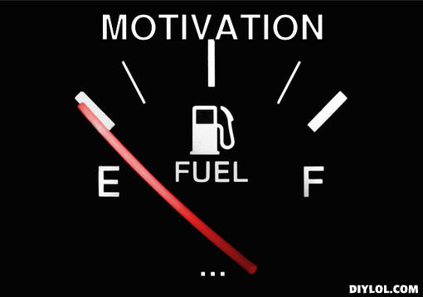

1. Lack of Motivation

Slide 7


2. No Specific Life goal
Productive Activity

Slide 8

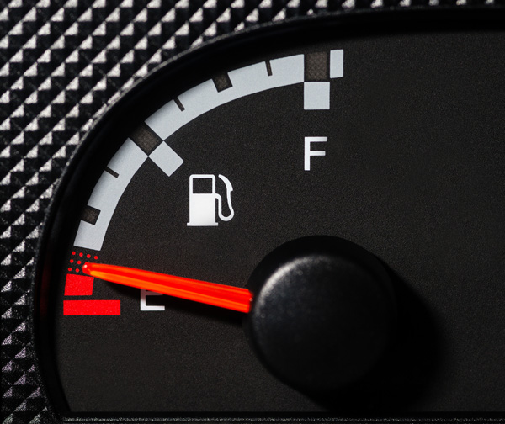
3. Poor Lifestyle Choices
Productive Activity

Slide 9



4. Lack of Will Power

Slide 10


5. Self Indulgence
Of ME

Slide 11



6. Being OK with mediocrity

Slide 12


7. Fear of Failure

Slide 13


8. Indecisiveness

Slide 14

Islamic Perspective
on
Laziness

Slide 15

Laziness is a disease of
the heart
Notes:
Laziness is actually a disease of the heart which we cannot see by our naked eye, but this disease has a very bad prognosis which can lead to other problems.
Laziness is truly a disease and we really need to make serious effort to fight in. It is the source of our weakness and defeat.

Slide 16
اللّهُمَّ إنِّي أعُوذُبِكَ مِن العَجزِ وَ الكَسلٍ
O Allah, I seek refuge in you from incapability/weakness and laziness
(Muslim, Ahmad, Tirmidhi)
Notes:
The Prophet (pbuh) frequently made the following supplication:
“Oh Allah, I seek your protection from, alajz” – which means the inability to do something. And when someone said, “I can’t do that,” The Prophet Sal Allahu alayhi wa sallam would seek protection from such negative speech by adding: “and I seek your protection (Oh Allah) from alkasl”- which is translated as laziness.

Slide 17
الكَسلٍ
To be lazy
To be idle
To be sluggish
To be negligent
To be inactive

Slide 18

Spiritual Consequences of Laziness

Slide 19


1. Hypocrisy

Slide 20
إِنَّ الْمُنَافِقِينَ يُخَادِعُونَ اللّهَ وَهُوَ خَادِعُهُمْ وَإِذَا قَامُواْ إِلَى الصَّلاَةِ قَامُواْ كُسَالَى يُرَآؤُونَ النَّاسَ وَلاَ يَذْكُرُونَ اللّهَ إِلاَّ قَلِيلاً
”Verily, the hypocrites seek to deceive Allah, but it is He Who deceives them. And when they stand up for As-Salat (the prayer), they stand with laziness and to be seen of men, and they do not remember Allah but little.
[Surah Al-Nisa: verse 142]
Notes:
The term laziness or “Kasal” in Arabic only appeared twice in the Qur’an, describing the hypocrites and their state of prayer:

Slide 21
وَمَا مَنَعَهُمْ أَن تُقْبَلَ مِنْهُمْ نَفَقَاتُهُمْ إِلاَّ أَنَّهُمْ كَفَرُواْ بِاللّهِ وَبِرَسُولِهِ وَلاَ يَأْتُونَ الصَّلاَةَ إِلاَّ وَهُمْ كُسَالَى وَلاَ يُنفِقُونَ إِلاَّ وَهُمْ كَارِهُونَ
”And nothing prevents their contributions from being accepted from them except that they disbelieved in Allah and in His Messenger and that they came not to As-Salat (the prayer) except in a lazy state, and that they offer not contributions but unwillingly.”
(Surah At Tauba: verse 54)
Notes:
And if you contemplate the above sources, you’d notice that laziness is associated with salah because salah is the most difficult of the daily obligations that a Muslim must complete since it has to be done every day, 5 times a day, without fail. An interesting point to make here is that whoever is lazy in their salah will be lazy in other acts of worship and whoever is NOT lazy in their salah, he/she won’t be lazy in other aspects of his/her life.

Slide 22


2. Shaytan’s Control over us
Notes:
Play video

Slide 23

3. Waste of Precious Time

Slide 24

4. Weakness in Eeman

Slide 25

5. Displeasure of Allah (SWT)

Slide 26

Even for a non-believer, consequences of laziness are terrible

Slide 27
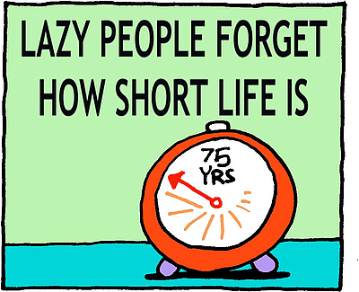
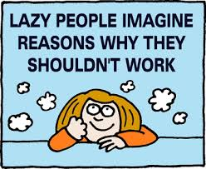

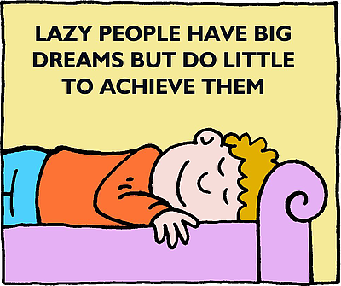
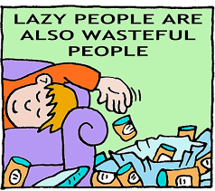
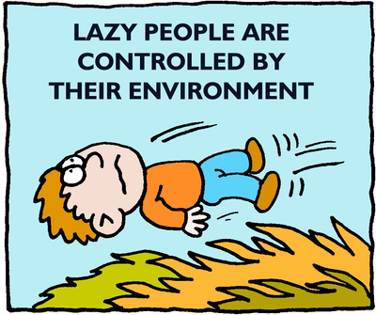

Slide 28

Can I bust this Laziness Habit?
“And those who shall strive for Our Sake, We shall surely guide them to Our ways”
(Surah Al-`Ankabut: Verse 69)

Slide 29


Tips to Bust Laziness

Slide 30



Be Honest
Notes:
First of all acknowledge that you have a problem
I am lazy – and that is not something to be proud of. I was not born lazy or I do not have a lazy gene lurking somewhere inside of me. No. The truth is I AM LAZY

Slide 31


Set Goals

Slide 32
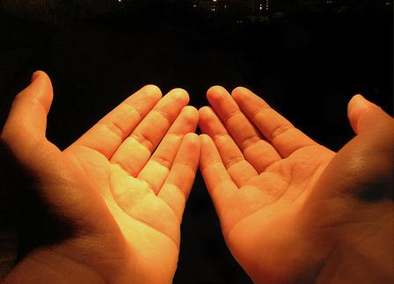

Remember Allah a Lot
اللّهُمَّ إنِّي أعُوذُبِكَ مِن العَجزِ وَ الكَسلٍ
(Muslim, Ahmad, Tirmidhi)
Notes:
Seek help from Allah – this particular duá is effective because Rasool Allah (saw) taught this. So sincerely pray to Allah, Ya Rabbi, please please please help me get rid of this disease. Save me from it. Give me energy and motivation.
Rasool Allah (saw) also taught us – tie your camel and then have trust in Allah
Meaning – we make dua to help with laziness, but we also do some action to get rid of it.

Slide 33


Fix Sleep Pattern
Notes:
A person once said that, " If you want to have a successful day, you need to sleep on time."
It is true. In this modern era, we have high-speed internet, smartphones and all those social networks like Facebook and Twitter that make us difficult to sleep on time. We are used to check our email, Facebook notifications, or watch something on Youtube before we go to the bed and thus make us staying up so late and reduce our sleeping time. Thus, when we wake up in the next morning, the quality of the whole day is not at the maximum level.
The amount of sleep you need on regular basis for optimal performance depends on various factors and one of them is age. For school-age children, they might need 10 to 11 hours of sleeping while adults might need 7 to 8 hours of sleeping. The quality of your sleep also plays an important role as much as your quantity of sleep. If your sleep is frequently interrupted or cut short, you're not getting quality sleep.
So now, try to adjust back your sleep habit. Make sure you go to the bed on time and lastly, avoid taking meals and caffeine close to your bedtime.

Slide 34


Move it …
Notes:
Be physically fit doesn't mean that you need to be athletes. It also doesn't mean that you need to have the gym membership. All you need is to be healthy to live an active lifestyle and beat laziness.
There are so many things that you can do to keep your body healthy and increase you physical and mental energy. Just simply jog for 30 minutes for three times a week. If you don't like jogging, you may try to go for swimming and other physical activities.
Make sure you do some household chores yourself.
Couch potatoing – bad idea.
ACTIVITY – on your feet. Up up up.

Slide 35


Eating Habits

Slide 36


Be with Energetic People

