Slide 1
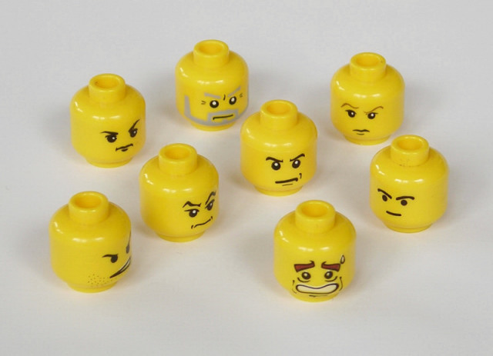
PEER PRESSURE

Slide 2

How to Avoid Peer Pressure

Slide 3


Slide 4

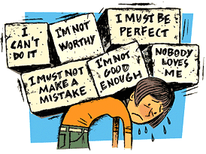
Build self-esteem

Slide 5
Check your motivation
Don’t JADE (Justify, Argue, Defend, Explain)
Have something ready to say
Lead an active and productive life

Slide 6
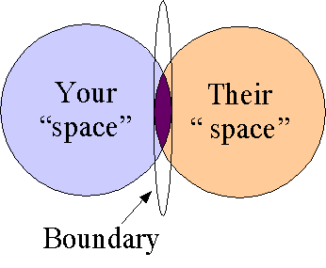
Respect your personal limits

Slide 7

Surround yourself with good friends

Slide 8
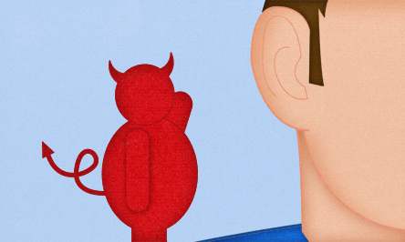
Avoid people that can tempt you to do things you will regret

Slide 9

Remind yourself of negative consequences
Putting my Aakhirah at stake
Distance from family
Dip in academics
Have no will power
Wrong Influence
Falling into bad habits
Losing REAL friends

Slide 10

Push against each other
activity

Slide 11

Practice standing your ground
Notes:
Show video: Cooler self

Slide 12
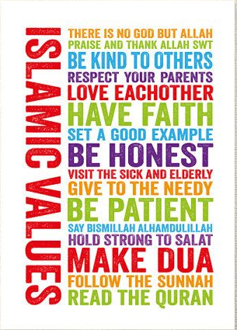
Acknowledge your values

Slide 13

Do not be ashamed of yourself

Slide 14

Talk about temptations with someone you trust

Slide 15
Thoughts and feelings can help you avoid peer pressure

Slide 16


Slide 17
FAST FACTS
True friends respect each other's wishes.
We can put pressure on ourselves too.
Caving in to what other people want won't get you respect.

