Slide 1
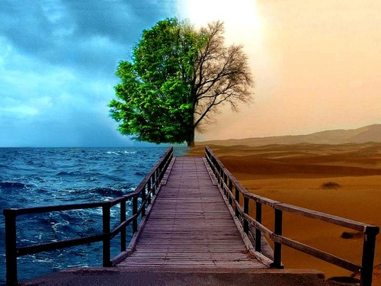

Perished Nations
Notes:
The Qur’an is the last book of Allah and His only unaltered revelation. This is why we are responsible for assuming it as our true guide along with the sunnah of prophet (pbuh). Therefore we need to explore very carefully and attentively what the qur’an related to and contemplate it. In Qur’an, Allah states the purpose of revealing Qur’an is to lead people to think:
“Here is a message for mankind; Let them take warning therefrom and let them know that He is one Allah; let men of understanding take heed” (surah Ibrahim 52)

Slide 2
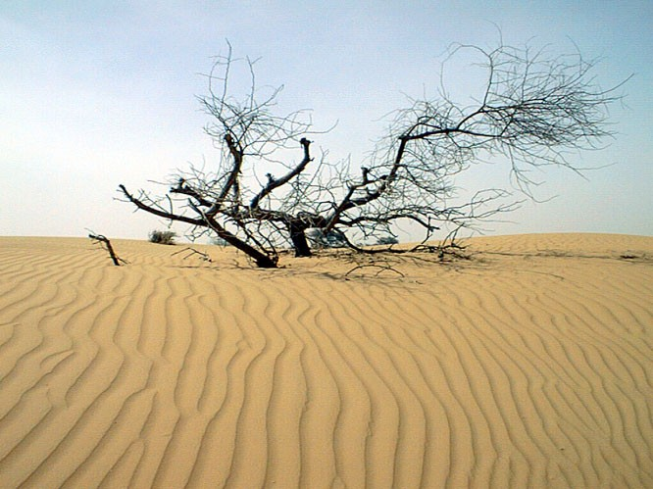
Why This History Lesson?
Contemplate
Draw lessons
Stay warned
Manifestation of Allah (swt)’s signs
Notes:
“So we made it an example to their own time and to their posterity and a lesson to those who fear Allah “ (surah al baqarah 66)
“example to their own time”, to set a warning
Nearly all the incidents of destruction in qur’an have become ‘observable’ and ‘identifiable’,thanks to the current studies and archaeological finds.
The purpose of these accounts is not to give us history lessons. They are told to set an “example” acc to the Qur’an
Allah is Ar Raheem but He is also Al Qahhar and Al Jabbar
We ridicule and criticise ulemas of deen without a second thought
Homosexuality, the sin of ppl of lut, is widespread today even amongst Muslims
Preaching requires courage and we learn lessons in courage from accounts of all these prophets who were ridiculed, threatened and forced to leave their homes

Slide 3
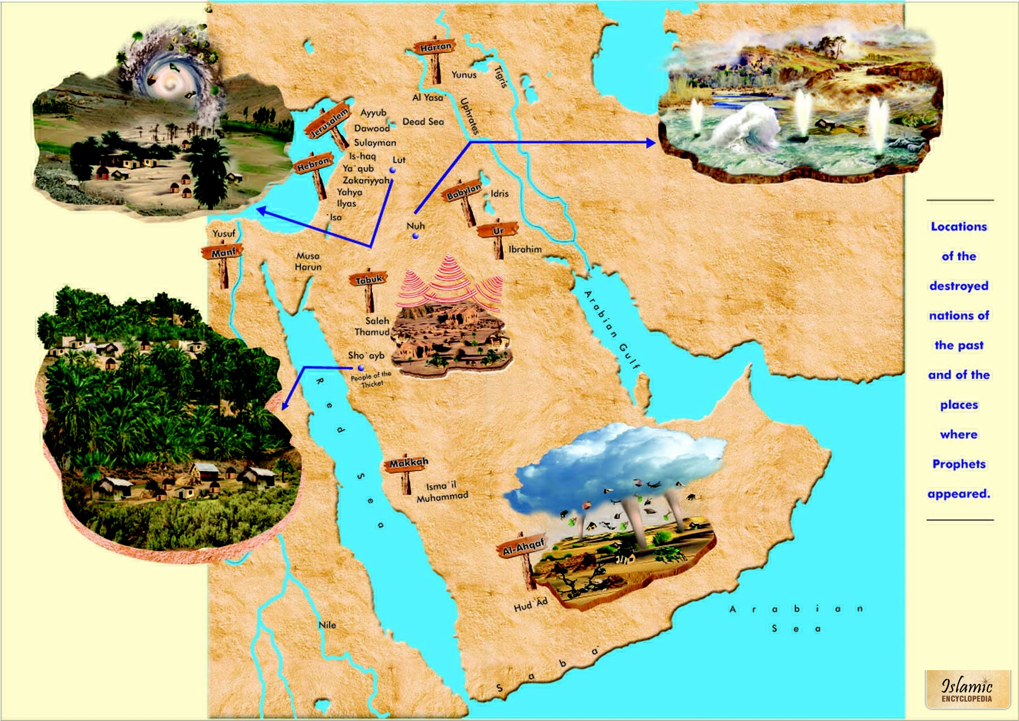

Slide 4
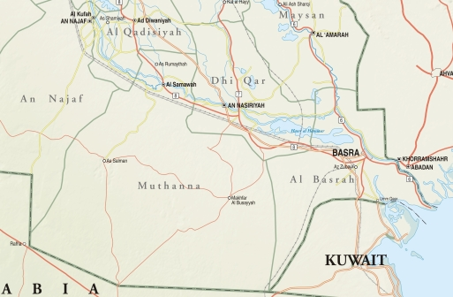
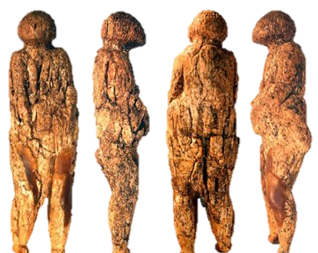
Nation of Nuh (AS)
Notes:
Present day southern Iraq – first nation to begin idol worship

Slide 5
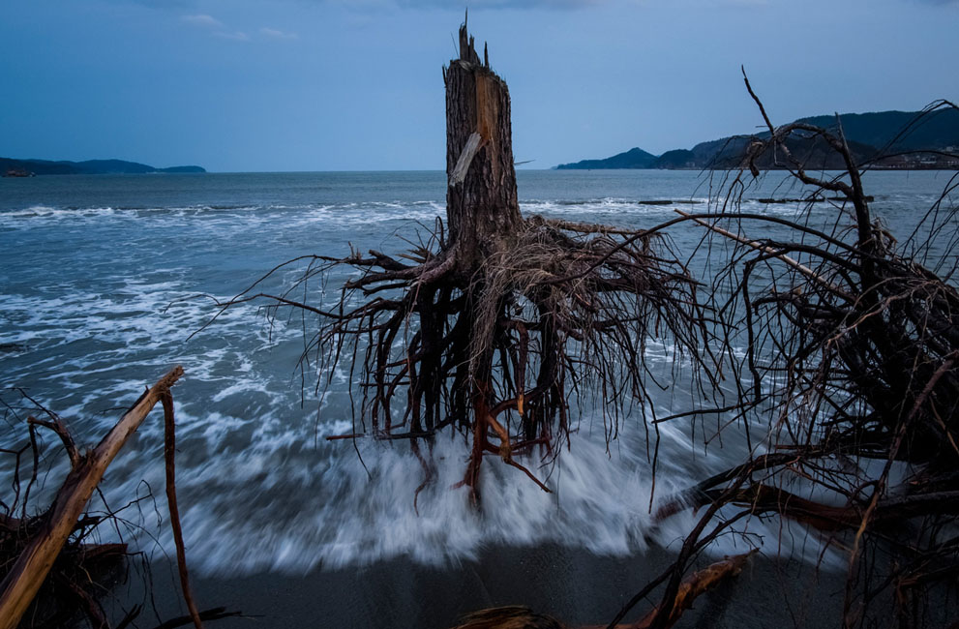
We (once) sent Nuh to his people, and he tarried among them a thousand years less fifty: but the Deluge overwhelmed them while they (persisted in) sin.
(Surah-al-Ankaboot: 14)

Slide 6
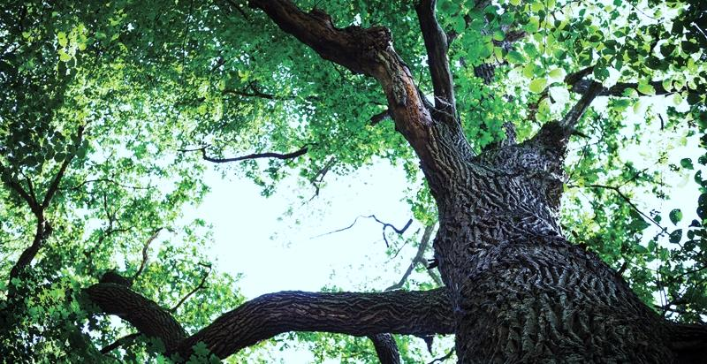
Points To Ponder
Perseverance
Allah (Swt) gives us plenty of time to repent
We will be asked about our effort not outcome

Slide 7
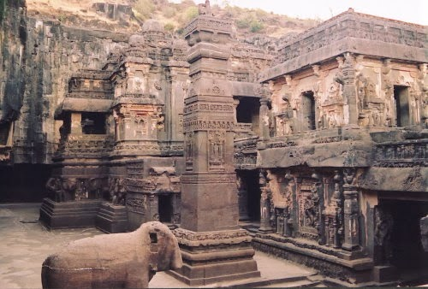
‘Ad Of Iram

Slide 8
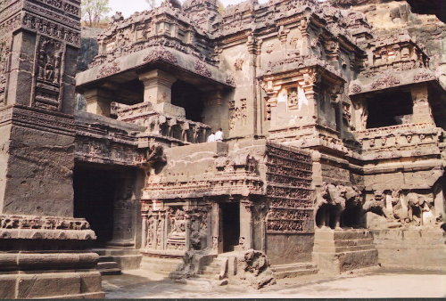
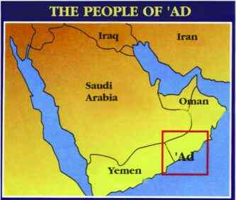
Have you not seen how your Rabb dealt with ‘Ad of Iram, (builders of) lofty pillars, the like of which were not created in the land.” Surah Al Fajr: Verses 6-8

Slide 9

And as for Ad, they were destroyed by a screaming, violent wind which Allah (swt) subjected them to for seven nights and eight days in succession so you would see the people therein fallen as if they were hollow trunks of palm trees
Surah al Haqqah, 69: Verses 6-7
Notes:
After a period of drought, hud (as)warned them to reform but they mocked him.Then, when they saw the (Penalty in the shape of) a cloud traversing the sky, coming to meet their valleys, they said, “This cloud will give us rain!”. Nay, it is the (Calamity) ye were asking to be hastened!- A wind wherein is a Grievous Penalty! (Surat al-Ahqaf : 24)
The burning dry heat changed to stinging cloud and a wind that shook everything increasing day by day. The winds did not stop until all the disbelievers were destryed. The believers were saved and migrated to an area known as Hadramawt where they established a community that worshipped Allah swt alone.

Slide 10
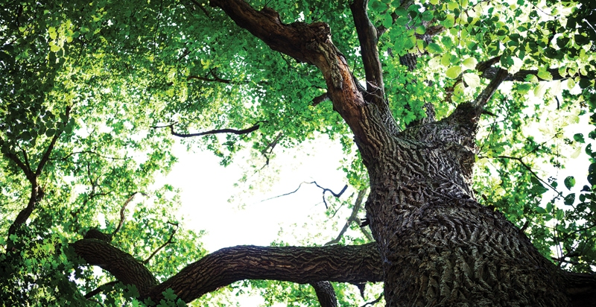
Points To Ponder
Do not be arrogant
Praise Allah (Swt) For All Your Blessings

Slide 11
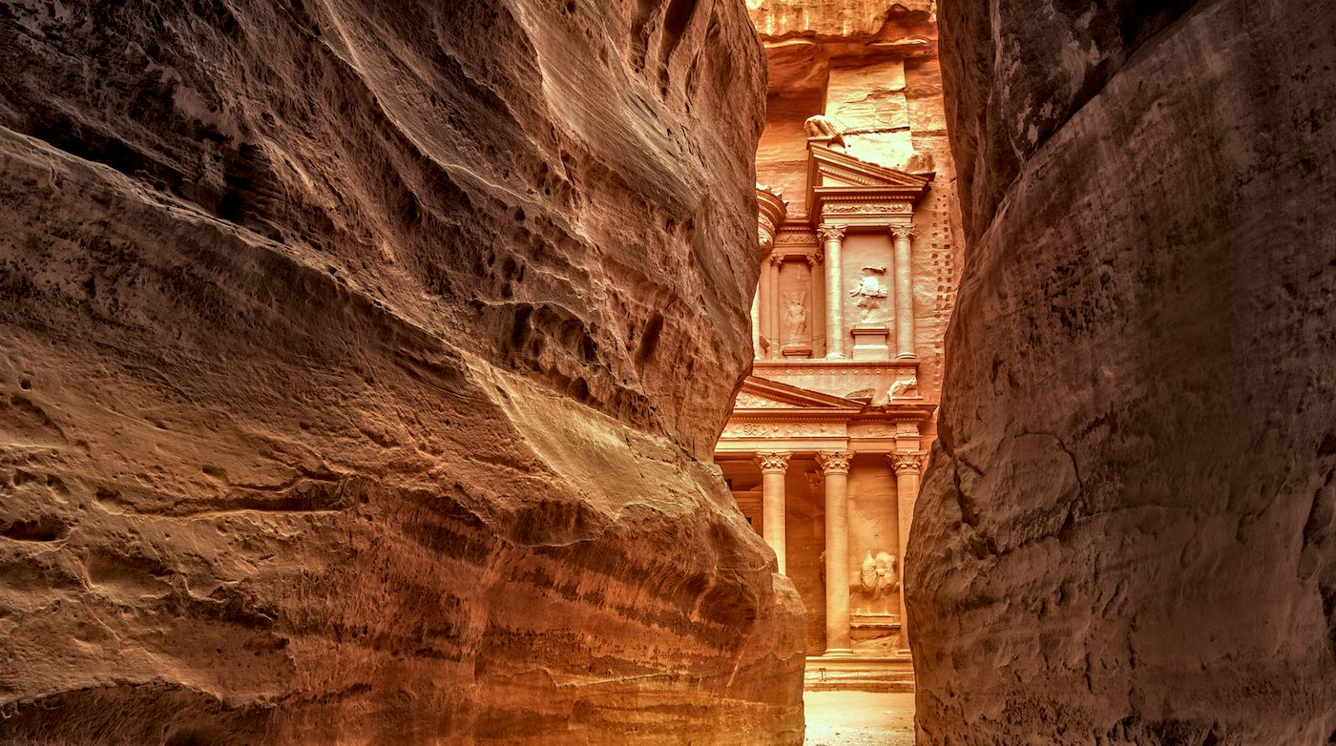
Nation of Thamud
Notes:
Saleh was the prophet sent to warn them but they rejected and scorned him.These people were also called Ashab ul Hijr as they used to built their hses in the mountains themselves.As their wealth increases so did theirdisobedience and arrogance, They pledged if Saleh (as) was able to show a miracle of having a ten months pregnant she camel out of the mountains they would surrender to Allah . Asked for a miracle so a she camel was sent and saleh as told them not to touch it but out of sheer arrogance they killed her.saleh as told them to live happily for three days in their homes until Allahs punishment came.
In Holy Quran Adand Thamud are always mentioned together.
Moreover, the verses advise Thamud to take warning from the destruction
of ‘Ad. This shows that Thamud had detailed information on ‘Ad.

Slide 12
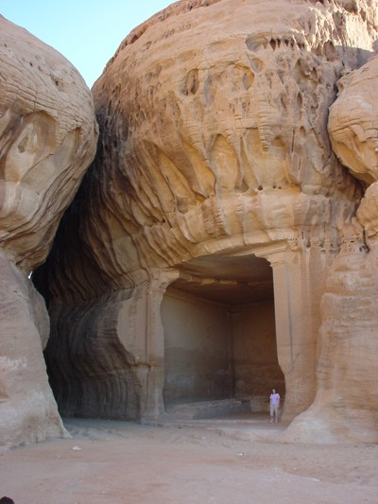
And remember how He made you inheritors after the 'Ad people and gave you habitations in the land: ye build for yourselves palaces and castles in (open) plains, and carve out homes in the mountains; so bring to remembrance the benefits (ye have received) from Allah, and refrain from evil and mischief on the earth.
Surah al-A‘raf: Verse 74

Slide 13
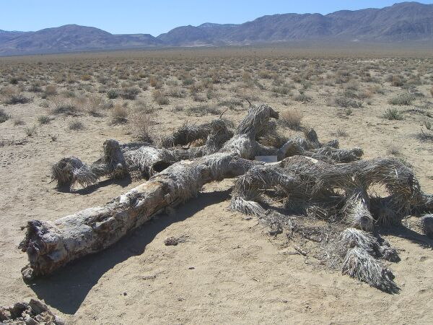
The (mighty) Blast overtook the wrong-doers, and they lay prostrate in their homes before the morning - As if they had never dwelt and flourished there. Ah! Behold! For the Thamud rejected their Lord and Cherisher! Ah! Behold! removed (from sight) were the Thamud!
Surah Hud : Verses 67-68

Slide 14
Points To Ponder
Never challenge Allah (SWT) or his signs
Be humble
Silent spectators of a crime will also be questioned

Slide 15
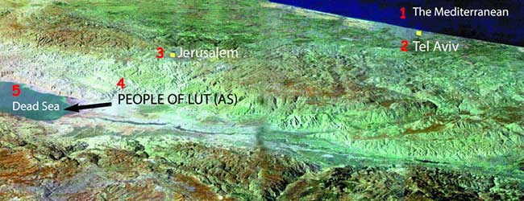
Nation of Lut (AS)
“ The people of Lut rejected (his) warning. We sent against them a violent tornado with showers of stones, (which destroyed them), except Lut's household: them We delivered by early Dawn,- As a Grace from Us: thus
do We reward those who give thanks. And (Lut) did warn them of Our Punishment, but they disputed about the Warning”. Surah al-Qamar: Verses 33-36
Notes:
Both lut and Ibrahim lived at the same time. Lut was sent as a messenger to one of ibrahims neighbouring communities.These people practiced a perversion unknown to the world till then which was called sodomy (pertaining to the area they lived in namely Sodom near Dead sea)
When lut warned them saying
Upon luts dua, Allah sent two angels in the form of men. These angels visited Ibrahim before coming to lut. The messengers first became anxious but then understood they were sent by Allah. Lut was worried and felt powerless to protect them.Meanwhile his people learnt that lut had handsome visitors and did not hesitate to approach them perversely. They circled the prophets house. Lut pleaded them not to disgrace his guests. His “visitors’ reminded him that they were messengers from Allah and said
“ O lut, We are Messengers from the Lord! By no means shall they reach you. Now travel with your family while a part of night remains and let not any of you look back but the wife (will remain behind). To her will happen what happens to the people. Morning is their time appointed , is not the morning near?” (surah Hud 81)
“Will you not fear Allah? I am to you a messenger worthy of all trust so fear Allah and obey me. No reward do I ask you of it, my reward is only from the lord of the Worlds.Of all the creatures of the world, will you approach males and leave those whom Allah has created for you to be your mates?Nay, you are a people transgressing (all limits)!!”

Slide 16
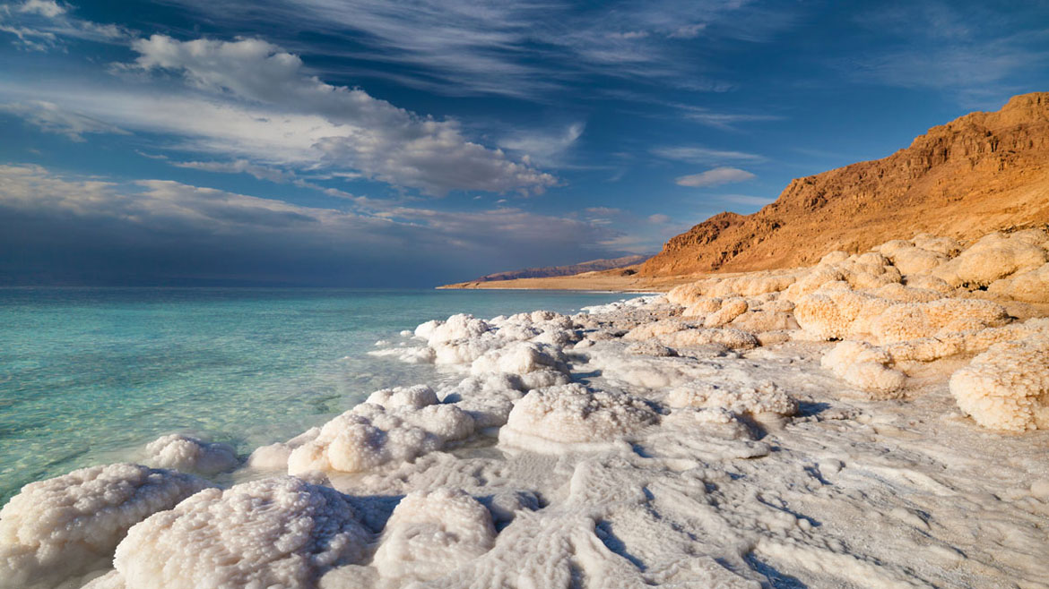
No Life In Or Around The Dead Sea
Notes:
Nothing grows on the banks of Dead sea, the terrain is inhospitable and it appears as if it is made from molten silica. Fish from river Jordan dies instantly on entering
Where exactly is dead sea??

Slide 17
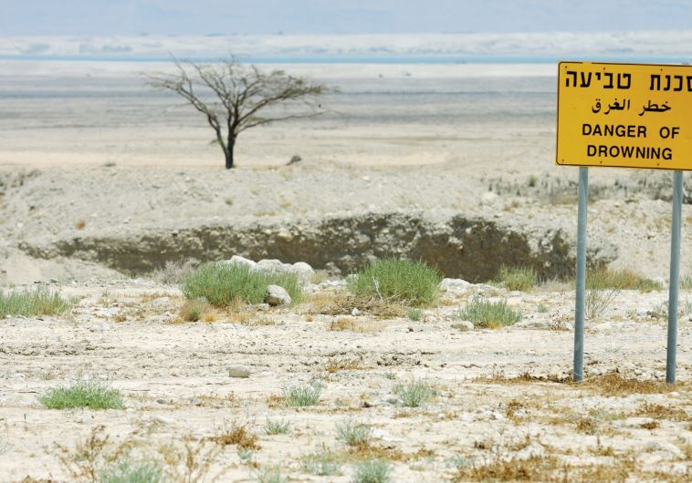

Slide 18
Points To Ponder
It is NOT OK to be gay
Be courteous to guests

Slide 19
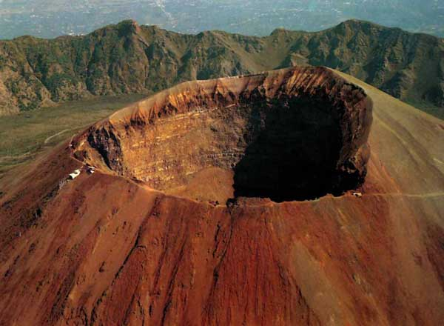
Pompeii
Notes:
POMPEII was destroyed two milleniums ago
Fate same as sodom and gomorrah
The destruction of Pompeii came by means of the eruption of the volcano Vesuvius.
The volcano Vesuvius is the symbol of Italy, primarily the city of Naples. Remaining silent for the last two millennia, Vesuvius is named the “Mountain of Warning”. It is not without cause that Vesuvius is known as such. The disaster that befell Sodom and Gomorrah is very similar to the disaster that destroyed Pompeii.
The lava and ash of a huge volcanic eruption, that happened two millennia ago, caught the inhabitants of that city. The disaster happened so suddenly that everything in the town was caught in the middle of its everyday life and remains today exactly as it was two millennia ago. It is as if the time had been frozen.
s.
Despite all these, things have not changed much where Pompeii once stood. The districts of Naples where debauchery prevails do not fall short of those licentious districts of Pompeii. The Island of Capri is a base where homosexuals and nudists reside. The Island of Capri is represented as a “Homosexual paradise” in tourist commercials. Not only on Capri and in Italy, but in nearly all the world, a similar moral degeneration is at work and people insist on not learning from the awful experiences of past peoples.

Slide 20
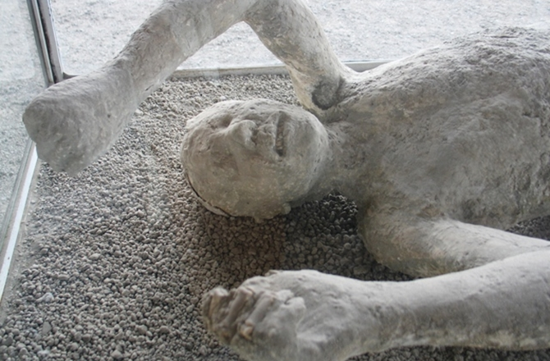
Frozen In Time

Slide 21
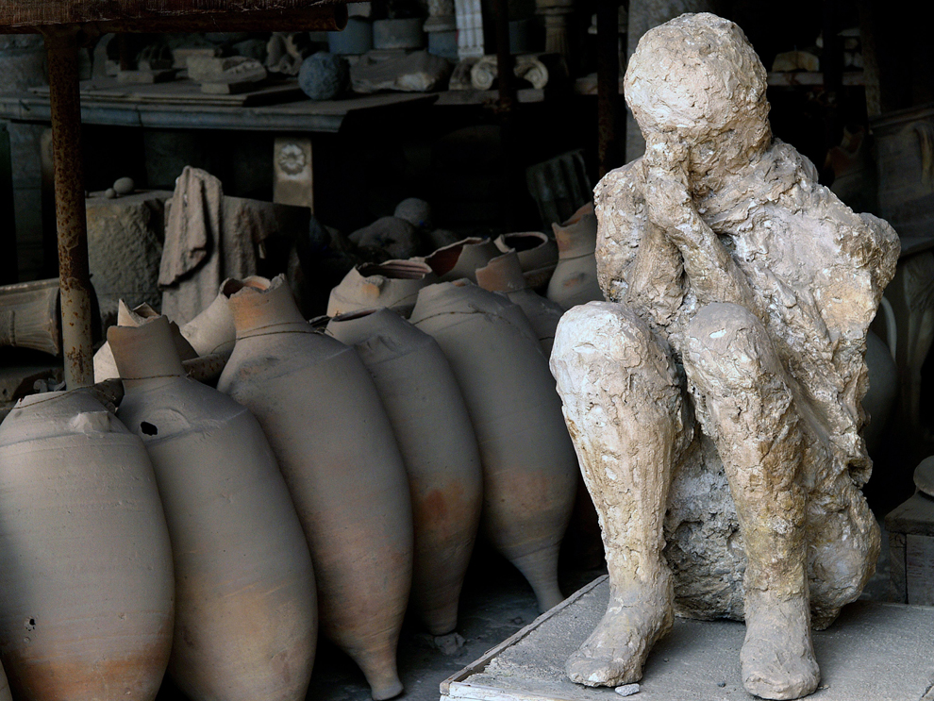
Pompeiians
Flash heated to Death

Slide 22
Points To Ponder
Transgressing limits set by Allah(SWT) lead to severe consequences
Modesty is the best policy

Slide 23
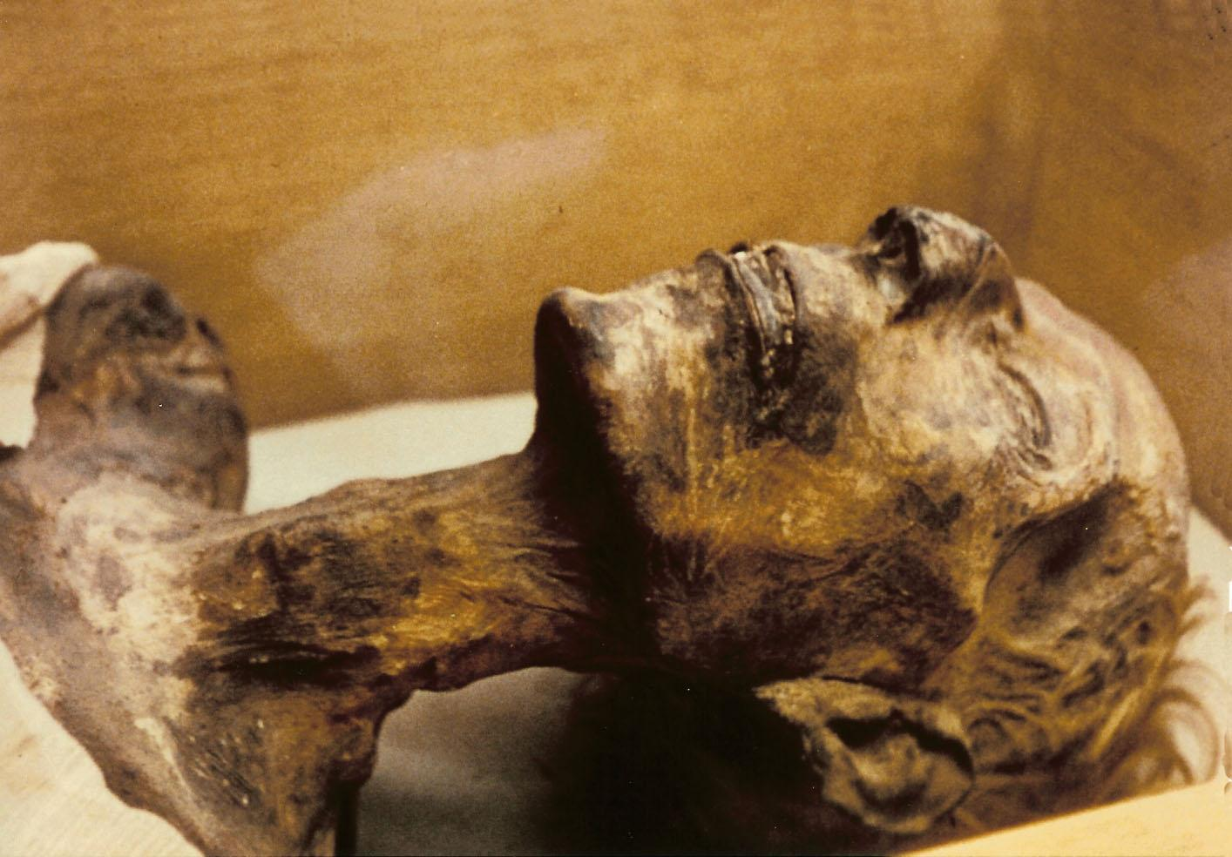
Pharaoh

Slide 24
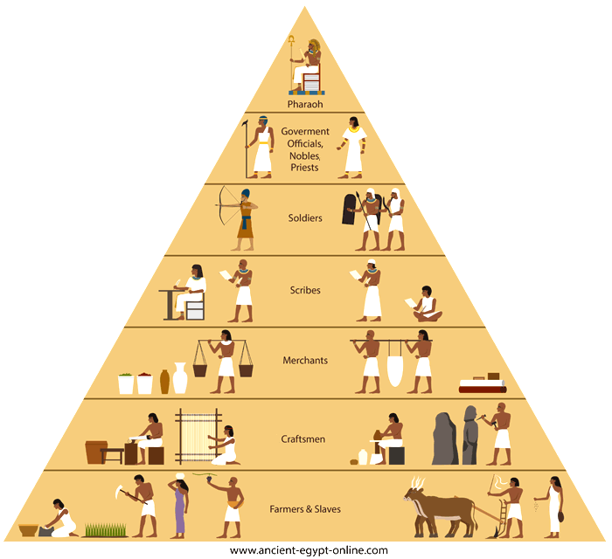
Organized and advanced society
Notes:
The absolutism in the regime had given the Pharaoh such power that he could have anything he wished for. It was not hard for the kings or pharaohs to reduce their people to submission. Pharaoh was looked upon as a holy being that held great power and met the needs of his people, who regarded himself as god.

Slide 25
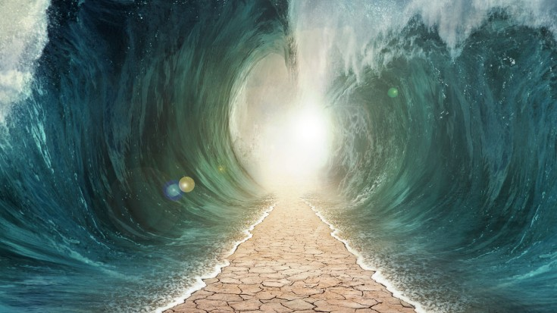
Strike the sea with your staff.’ So it was severed apart, and each part became like a big mountain.. Then we brought others close to that place. And we saved Musa (AS) and all those with him. Then we drowned the others. Surely, in this is a sign, but most of them are not believers.” Surah Ashuara 63-67

Slide 26
Points To Ponder
Never challenge Allah’s signs
Submit to Allah without a second thought
Be humble

